Slide 1

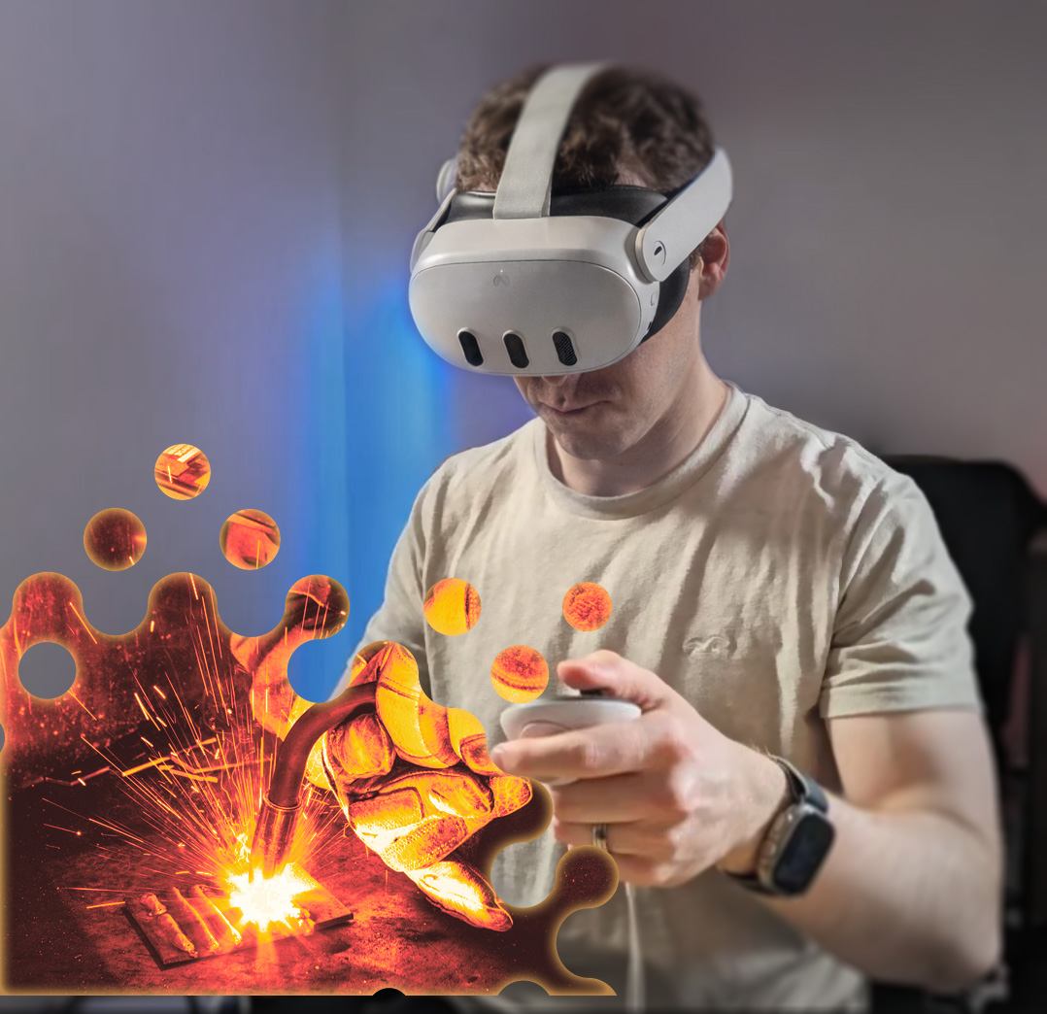

Welding Training
SIMULATOR
Virtual Reality Proof-of-Concept MIG Torch Welding Training Simulator
EDIT

Slide 2
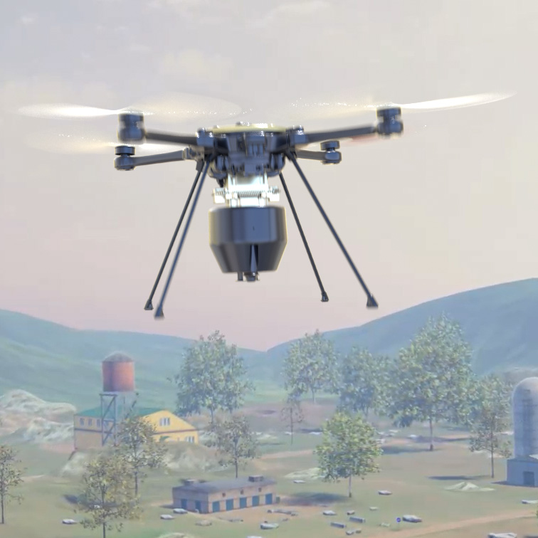
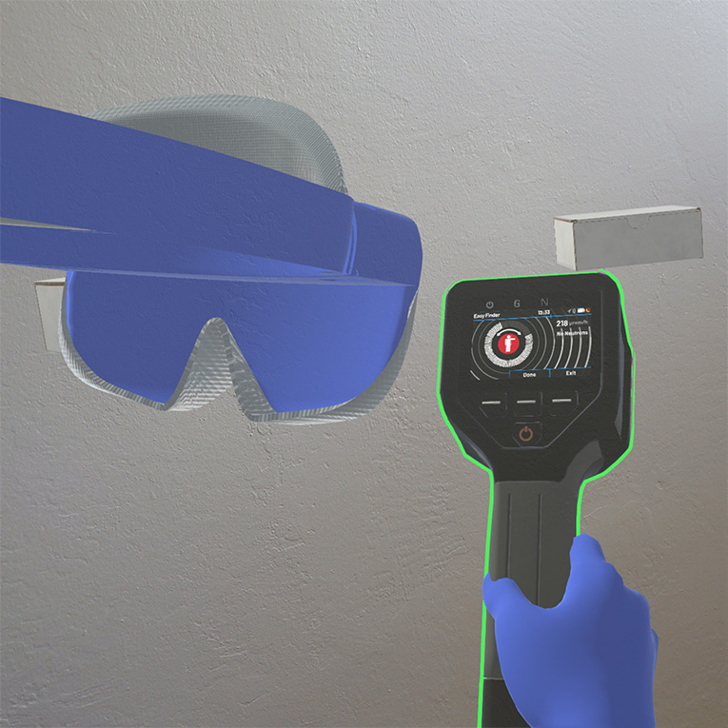
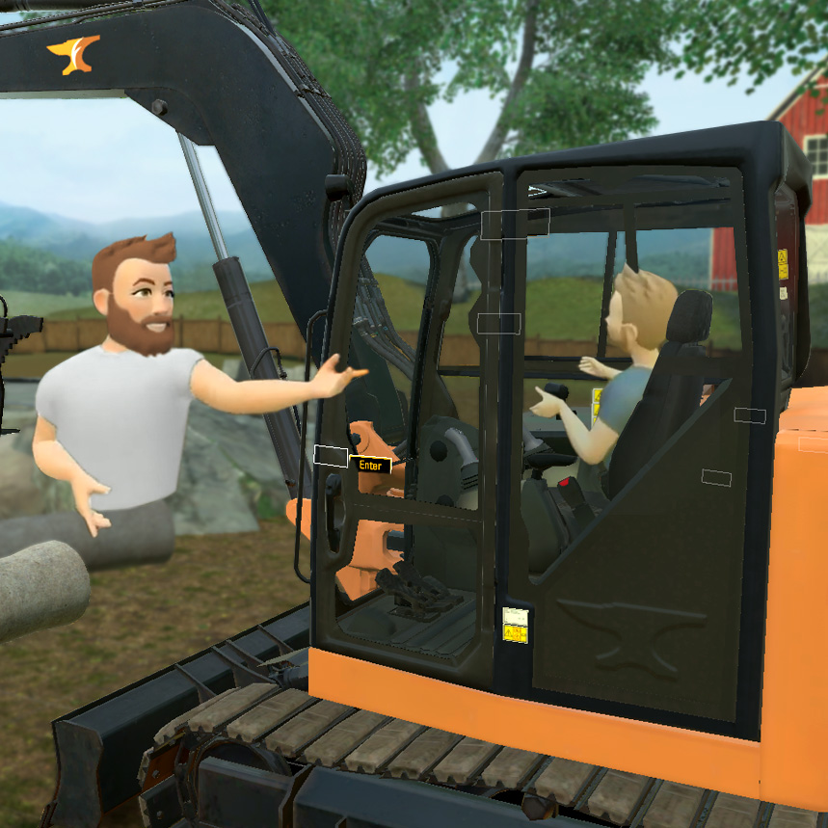
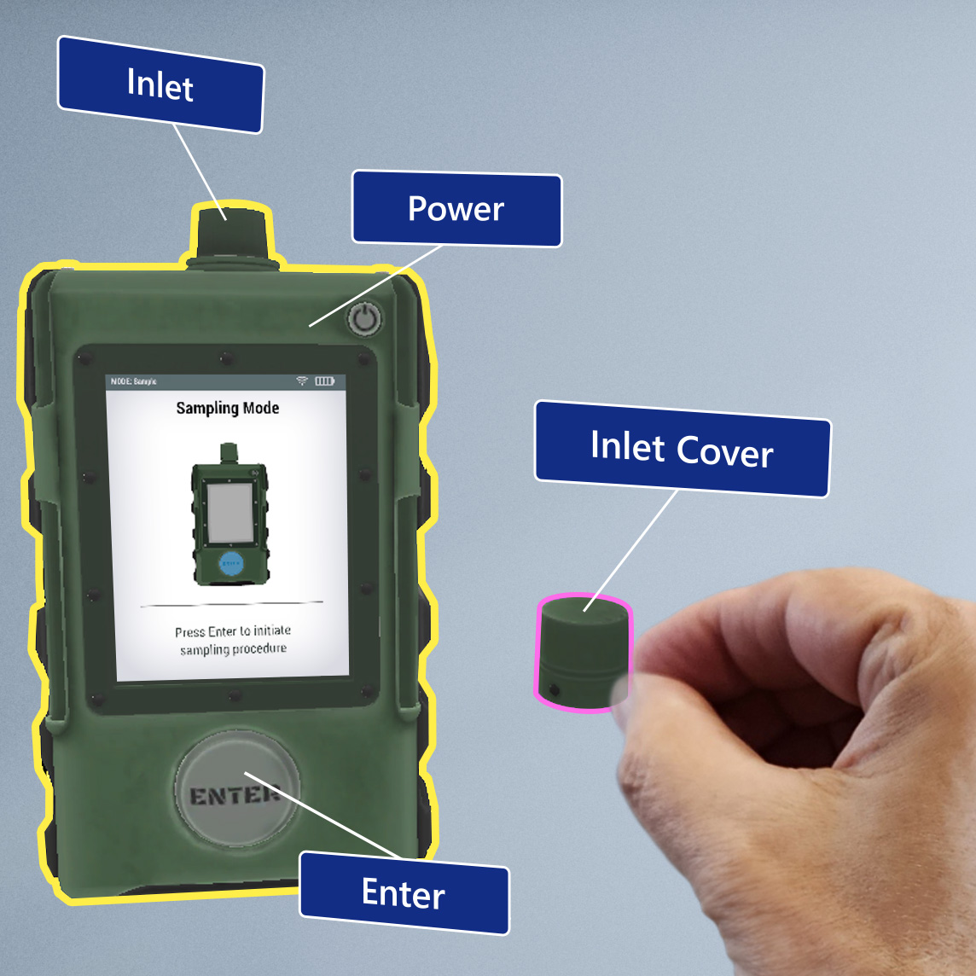
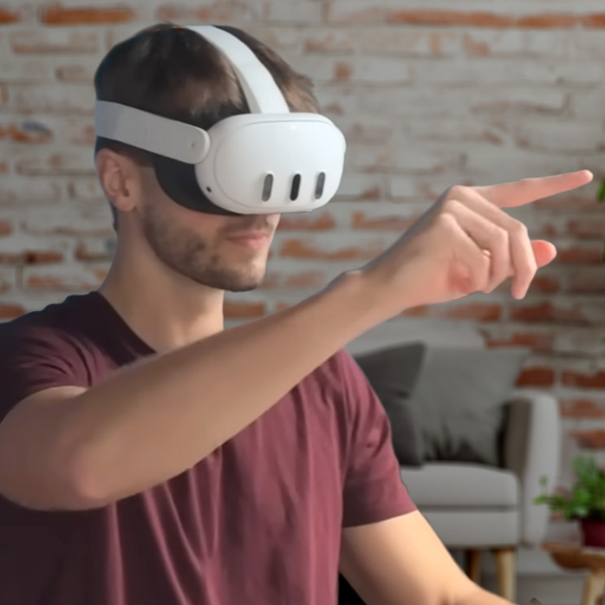
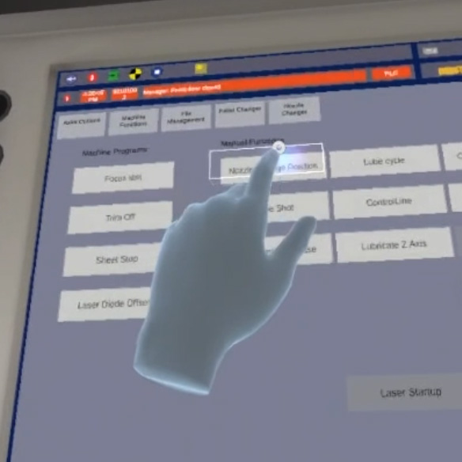
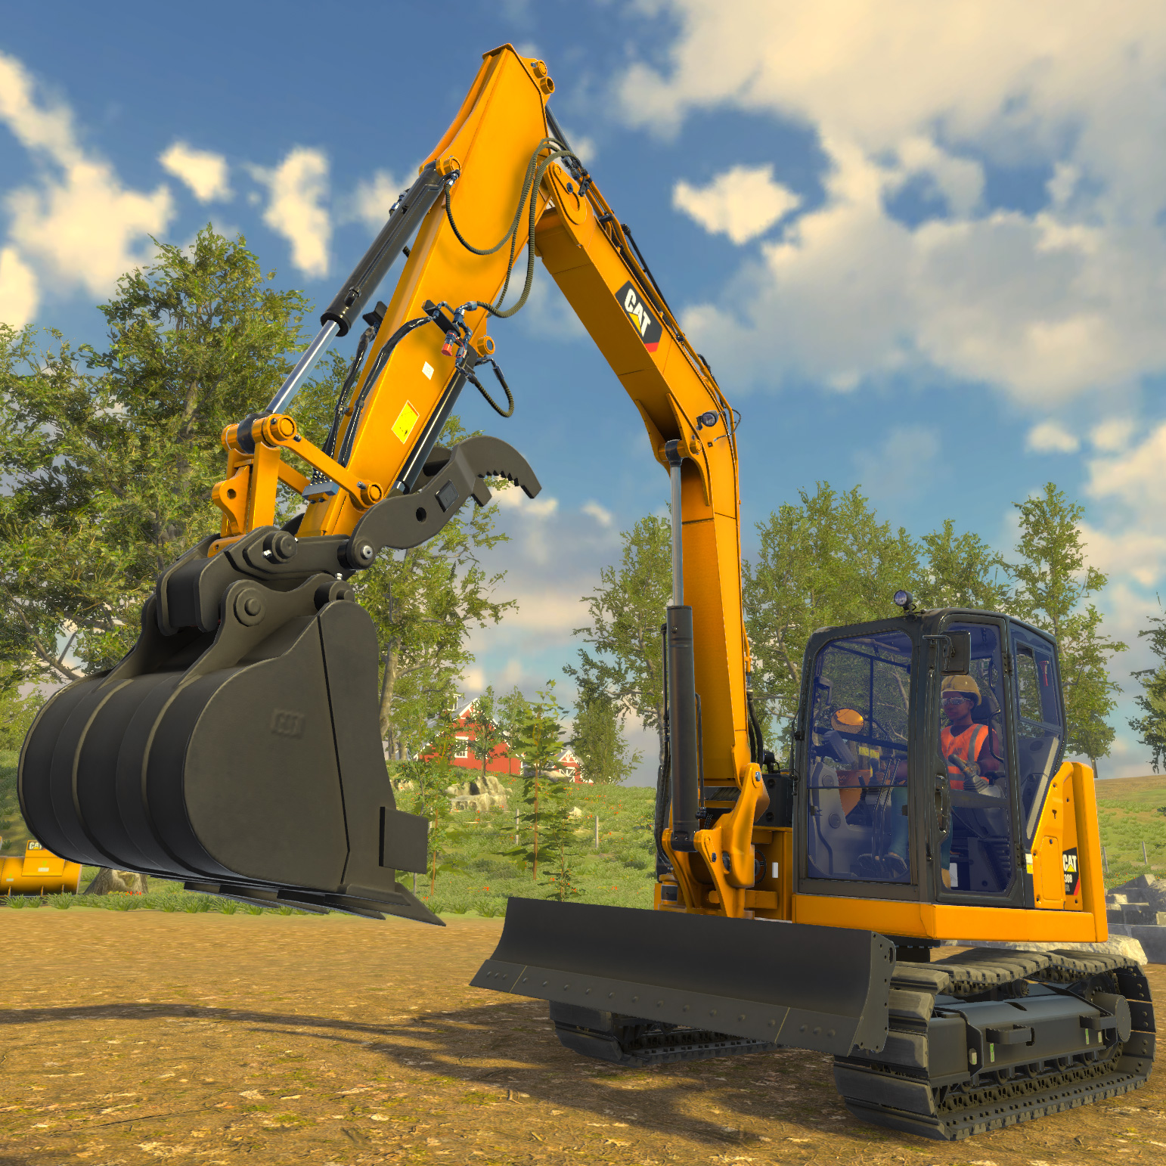
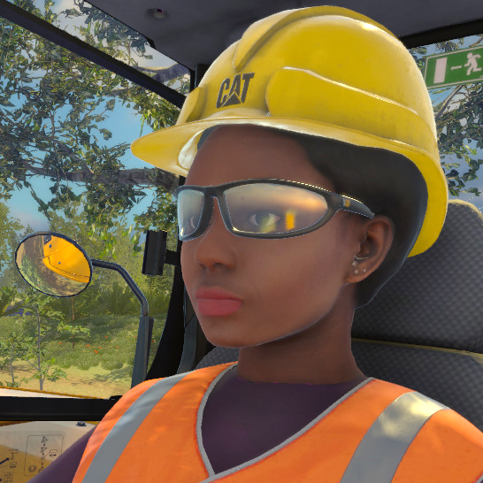
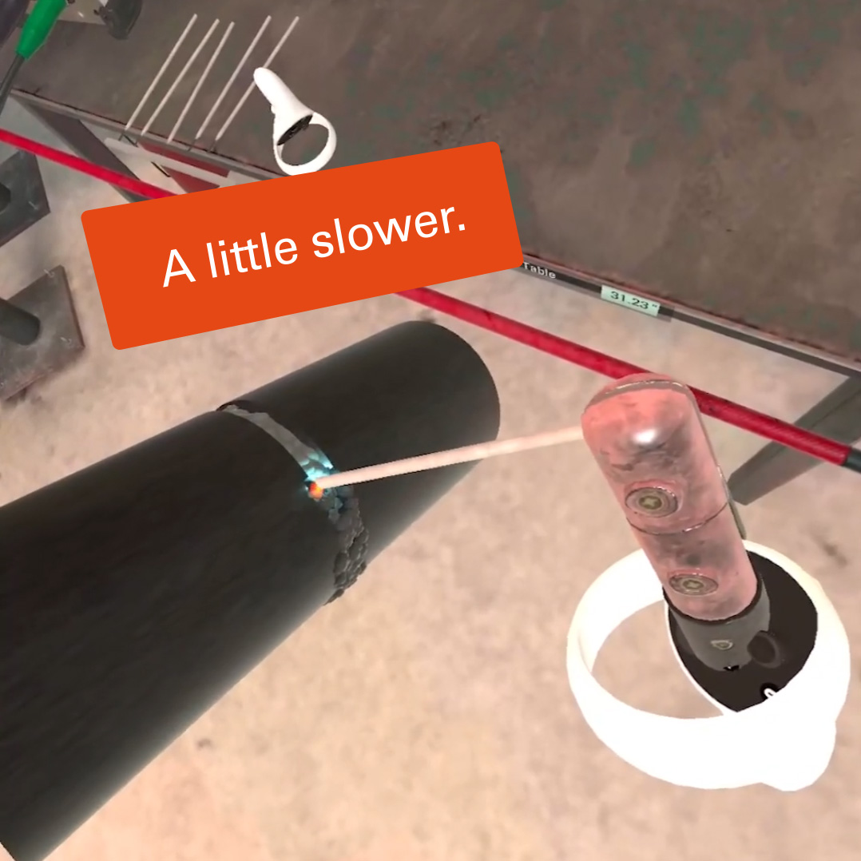
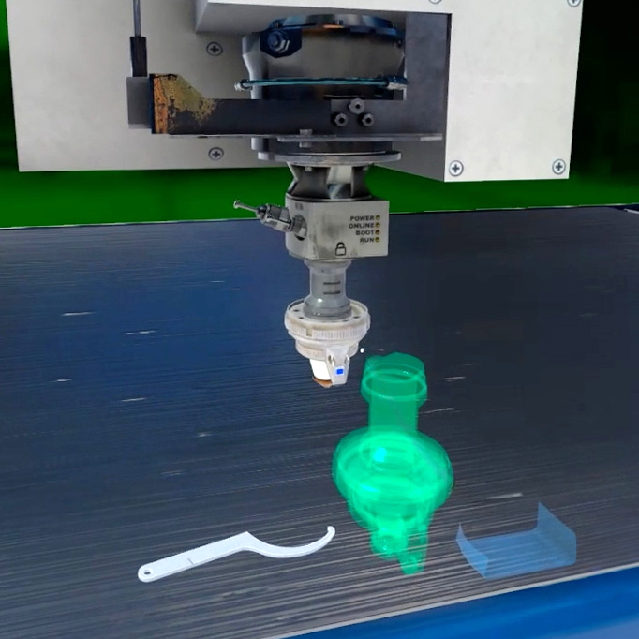
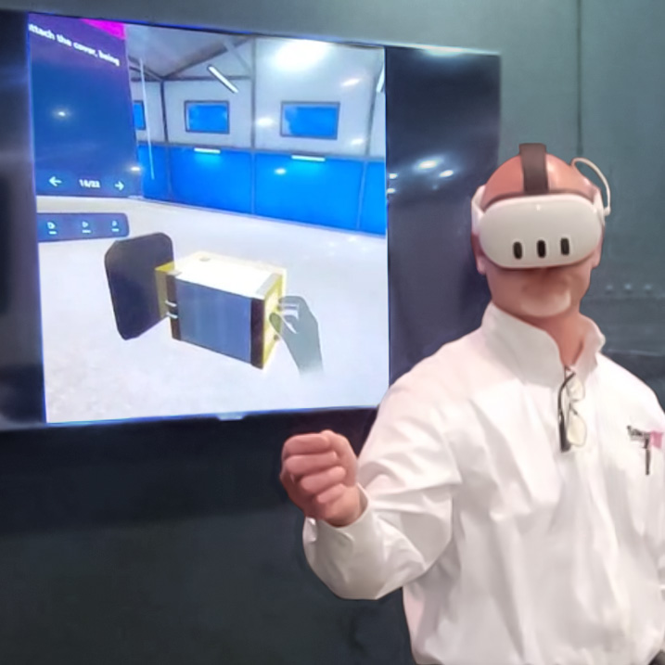
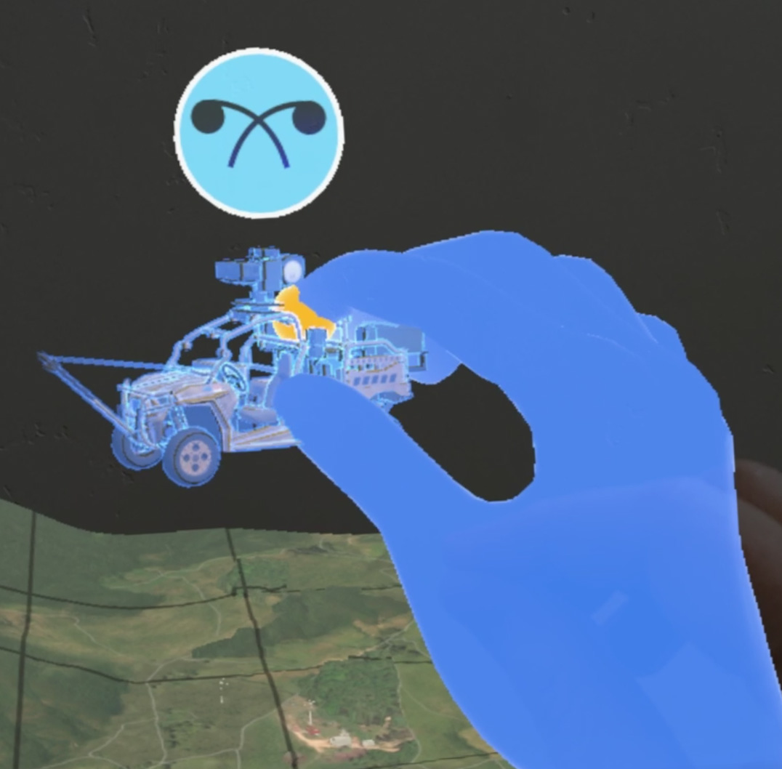
Contents
Project Overview
Why ForgeFX
Project Features
Lesson Content
Price Options
Development Process
In Conclusion
Appendix A: About ForgeFX
Appendix B: Recent Projects
3
5
7
27
30
34
44
46
52
EDIT

Slide 3
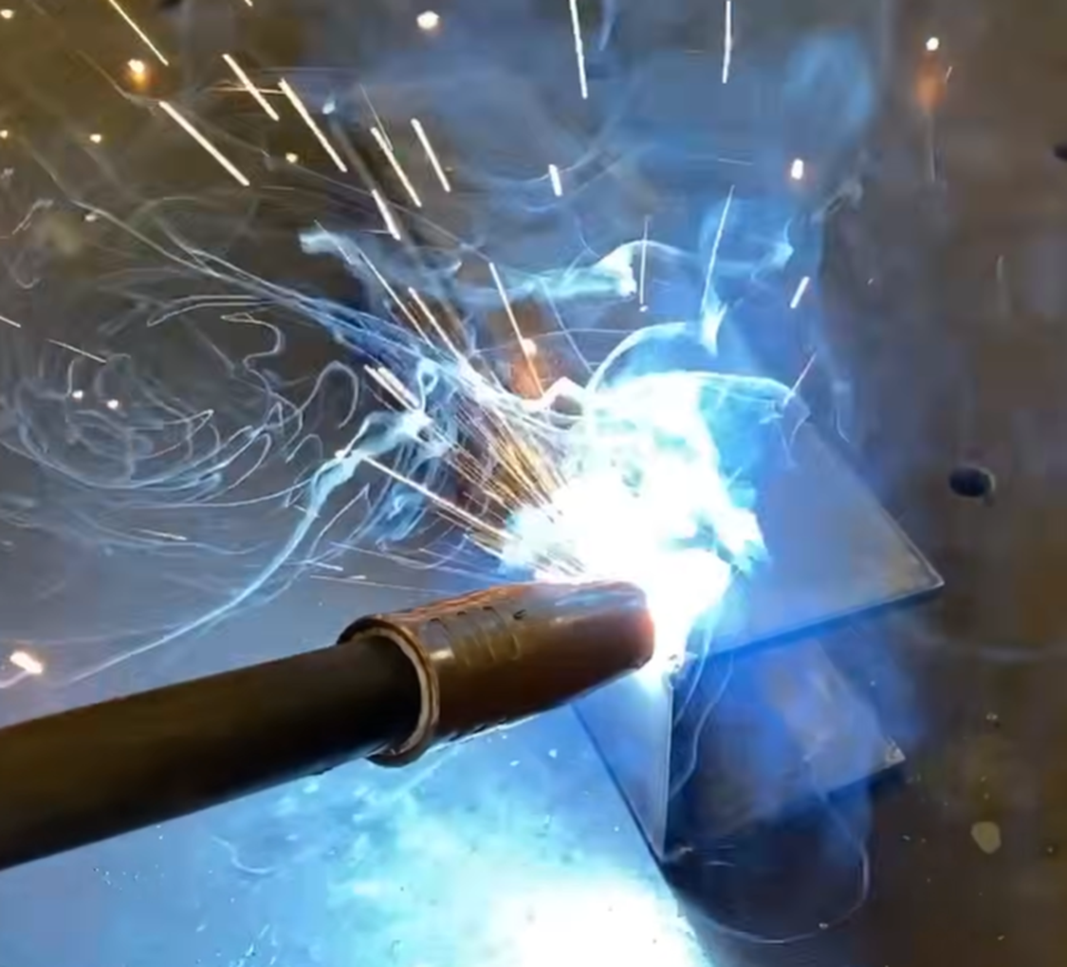
PROJECT OVERVIEW
Pearson is exploring the development of a virtual reality proof-of-concept training experience designed to introduce foundational MIG welding concepts and techniques. The experience is intended to support training programs delivered by Pearson for UK military learners, helping build spatial understanding and confidence before entering a physical welding lab..
Realistic
ForgeFX Simulations proposes the development of a Proof-of-Concept VR Welding Training Simulator designed to demonstrate the value of immersive learning by allowing learners to interact with MIG torch components, practice torch positioning, and observe how their technique influences weld outcomes within a safe virtual workspace

Slide 4

Project Overview
Expertise and attention
to detail
ForgeFX Simulations is excited to partner with Pearson to develop a custom Proof-of-Concept VR Welding Training Simulator designed to introduce foundational welding concepts through immersive, virtual, hands-on learning. This experience will demonstrate how interactive simulation can support welding education by allowing learners to explore welding equipment, practice technique fundamentals, and visually inspect and understand weld outcomes within a safe virtual environment.
Application Feature Highlights
Interactive Welding Equipment & Virtual Training Environment
Learners step into an immersive 3D welding workspace that recreates the look and feel of a real training station, providing spatial context and visual clarity around the tools and materials used in MIG welding. Within this environment, a detailed MIG torch and its key components are presented as interactive elements, allowing learners to explore the equipment and begin building familiarity with the tools they will encounter in the physical lab.
Structured, Custom Lesson-Based Training Program
Purpose-built simulation lessons guide learners through essential welding concepts, from identifying torch components and proper setup to practicing basic torch positioning and observing how technique influences weld outcomes. Guided instruction introduces each concept clearly, while practice mode allows learners to repeat activities and reinforce understanding.
Clear Interaction Design for Simulation-Based Learning
The simulator uses intuitive VR controls, clear visual prompts, and immediate feedback to keep learners focused on the task at hand. This streamlined interaction model allows the technology to stay out of the way while the learner concentrates on understanding welding concepts and observing how their actions influence the results.
Implementation and Results
ForgeFX will work closely with Pearson to ensure the simulator aligns with the intended instructional outcomes for this proof-of-concept initiative. Built on the proven ForgeSIM™ framework, the resulting experience will demonstrate how immersive VR can introduce welding concepts in a clear, engaging, and repeatable format, providing Pearson with a compelling foundation for evaluating simulation as a tool for technical training.

Slide 5

Why
ForgeFX
ForgeSIM™ Framework
Extensive Experience
Industry Reputation
Realistic

Slide 6
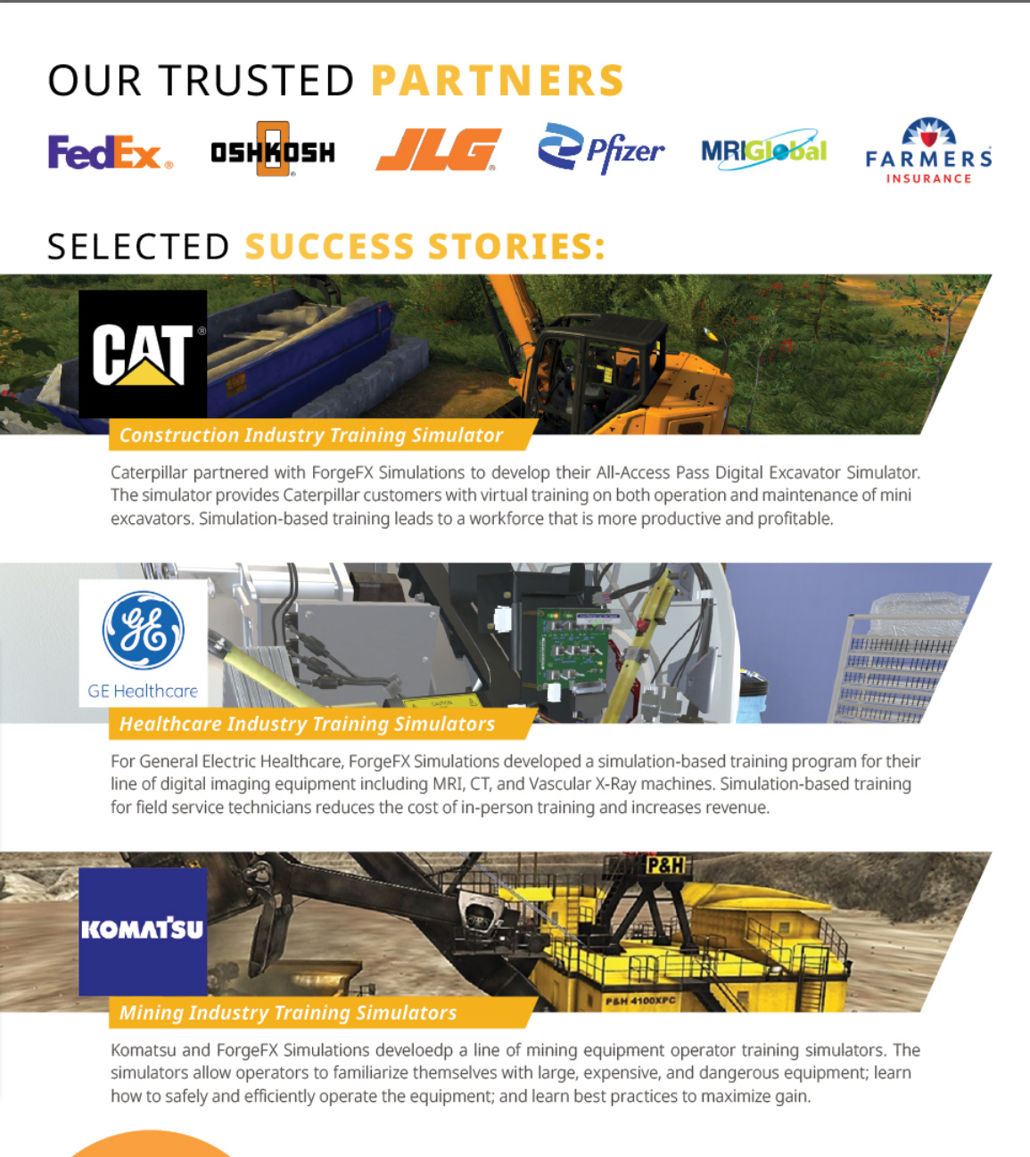
Why ForgeFX
A Legacy of Excellence
ForgeFX Simulations offers a uniquely qualified and strategically advantageous solution for simulation-based training development. Our proprietary technology, proven track record, and industry partnerships distinguish them from competitors and justify a sole-source procurement.
  ForgeSIM™ Framework – Proven, Proprietary Technology
  ForgeFX has developed a proprietary simulation framework, ForgeSIM™, over the past 20 years. Built atop the Unity game engine, this robust code library enables rapid development of high-quality, custom simulation applications that offer clients a lower-risk, cost-effective solution with shorter development timelines and greater technical stability.
  Unity Game Engine Experts
  ForgeFX’s development team brings deep technical expertise in Unity, the most widely adopted engine for immersive content development. Our mastery ensures optimal performance, seamless hardware integration, and compelling user experiences across VR, AR, and MR platforms.
  Meta Technology Partner
  As an official Meta Technology Partner, ForgeFX is uniquely positioned to access early platform innovations, tools, and support from Meta. This relationship ensures ForgeFX delivers cutting-edge solutions that are future-ready and aligned with the evolving capabilities of mixed reality hardware.
  Trusted by Industry Leaders
  ForgeFX has delivered successful training simulations for many Fortune 500 companies, including FedEx, Caterpillar, GE Healthcare, and the US Department of Defense, to address critical workforce challenges across logistics, heavy equipment, and medical industries. Our work is validated by repeat business, cross-industry referrals, and sustained client relationships, including the development of the advanced VR welding training platform, the OcuWeld™ simulator used by StrataTech Education Group’s Tulsa Welding School.
  Pioneers in Virtual Reality Training
  With roots in traditional desktop-based simulation, ForgeFX was an early adopter of VR and has been delivering immersive training solutions since the inception of modern VR hardware. Our experience spans the full evolution of XR technologies, giving them unmatched insight into best practices for effective learning in virtual environments.
  ForgeFX is well-equipped to develop the [PROJECT]. Our experience, methodology, framework, and commitment to client success make us the ideal partner for this project. We look forward to the opportunity of partnering with [COMPANY] to create the envisioned training platform.

Slide 7
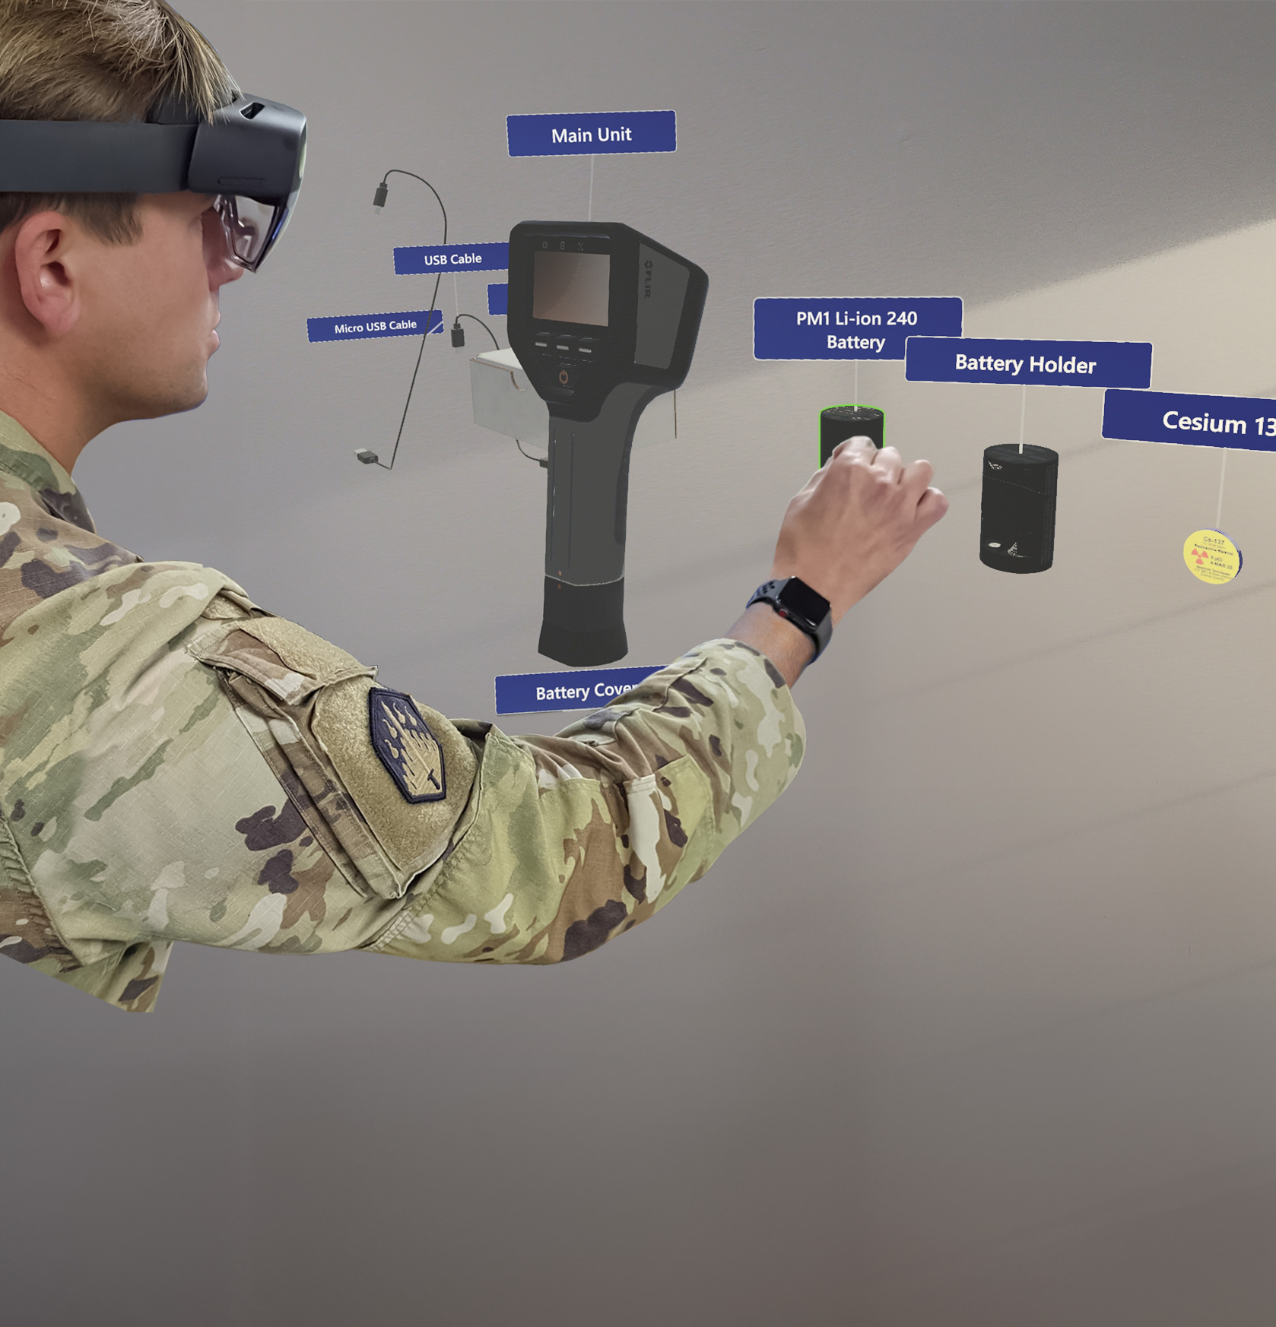

Project Features
EDIt
The following pages detail the many aspects of the training simulator that ForgeFX will develop to meet your trainees’ needs.
edit

Slide 8


SIMULATOR Foundation
Pearson POC MIG torch training simulator
EDIT
These components are integral to a robust, compelling simulator. The following pages describe in more detail how these features work to achieve a rewarding educational experience.
Mixed Reality Training
Pass-through video capability augmented with multimedia information.
ForgeSIM™ Framework
A solid, tested code library ensures that the simulator is built efficiently and will support future expansion.
VIRTUAL EQUIPMENT
Full-scale 3D digital replicas of your equipment closely reproduce the experience of real-world training.
VIRTUAL ENVIRONMENT
Interior and exterior features provide context and boost the immersive experience.
Hand Tracking
Controller-free technology allows for more natural, hands-on learning.
User Interface
Utilizing modern best practices in user interaction design ensures an easy and intuitive application.
Audio Narration
Spoken instructions provide non-visual cues and audio learner support.
Instruction Modes
Two levels of guidance allow trainees to learn, practice, achieve mastery, and be tested on their knowledge.
PERFORMANCE TRACKING
The trainees’ actions in each session will be tracked, and the results will be displayed in a performance report screen.

Slide 9
FORGESIM™ FRAMEWORK
Rapid Development
Real-World Integration
Performance Tracking
Realistic

Slide 10
ForgeSIM™ Framework
Essential
Building Blocks
of the Training Simulator
ForgeFX's commitment to innovation and quality is embedded in every layer of our ForgeSIM™ suite. It embodies the best practices and technological advancements we've acquired over numerous successful deployments. Each component is designed to integrate seamlessly, providing clients with a cohesive development experience from concept to execution.
Here are the elements of the framework:
ForgeSIM™ CORE: Our core re-useable application framework enabling rapid development of fundamental application flows, based on a rock-solid foundation.
ForgeSIM™ CONNECT: Proprietary process and approach to bridge the gap between static machine and equipment CAD files to their interactive counterparts, matching real-world behaviors.
ForgeSIM™ CONTROL: Pre-built system to connect real-world equipment controls to ForgeSIM-based applications. Protocol support includes both custom and standard CAN-BUS systems.
ForgeSIM™ TRACK: Sophisticated system which granularly tracks both raw user actions as well as client-specified higher-level performance assessment and reporting criteria.
ForgeSIM™ GATHER: Time-tested multiplayer framework designed specifically for the team-based practice and instructor/student modalities required for simulation-based training.

Slide 11
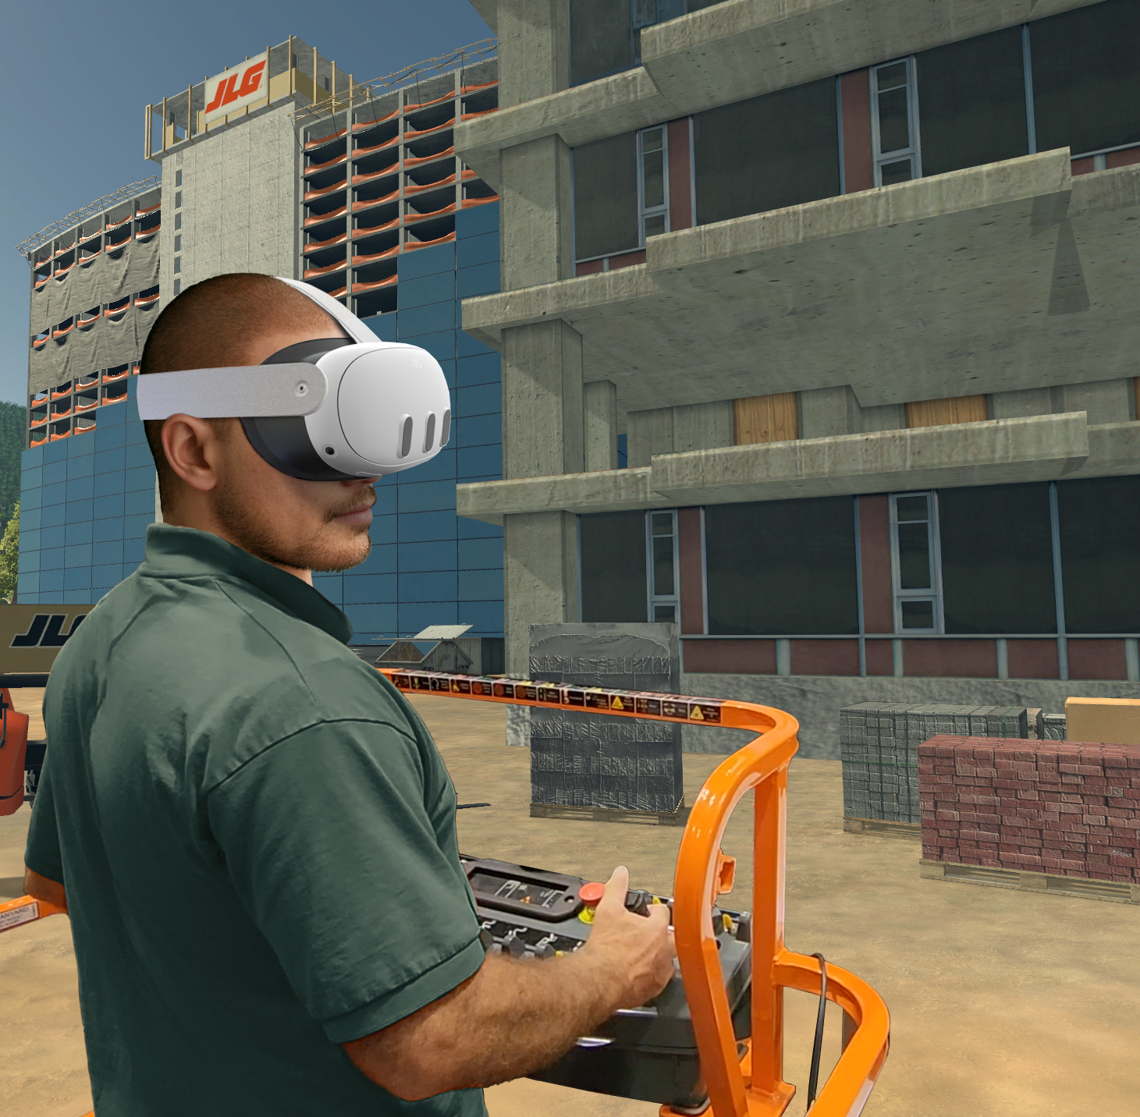
Virtual Reality Training
Change to holotrainer
Safe
Engaging
Economical
Realistic

Slide 12
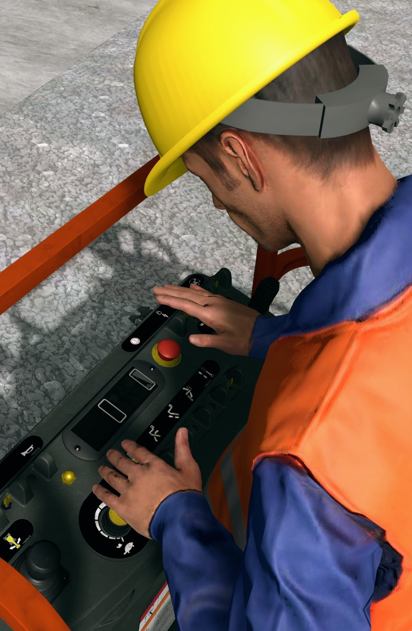
Virtual Reality Training
Risk-Free Skill Building for Real World Mastery.
Virtual Reality (VR) is a revolutionary technology that has transformed operator training. VR offers an immersive experience that makes it an excellent choice for training across a wide range of industries. Here are some of many compelling reasons why:
Realistic Simulation: VR creates highly realistic and immersive environments that replicate real-world scenarios. This allows trainees to experience situations as if they were physically present, enhancing the effectiveness of the training.
Safe Environment: Virtual reality provides a safe space for trainees to make mistakes and learn from them without real-world consequences. This benefit is particularly valuable in high-risk industries.
Cost-Effective: While traditional training methods often involve expensive equipment, materials, and facilities, VR training eliminates the need for physical props and allows for the reuse of virtual assets.
Accessibility: VR training can be conducted remotely, making it accessible to a wider audience. Trainees can participate from different locations, reducing the need for travel and associated expenses.
Engagement: The immersive nature of VR captivates trainees, increasing their engagement and motivation to learn. Leveraging positional tracking allows users to feel a greater sense of presence in the simulated environment, which leads to better retention of information and skills.
Repeatability: VR simulations can be repeated as many times as needed without wear and tear on physical equipment. Trainees can practice until they achieve proficiency.
Risk-Free
Skill Building
for Real World Mastery

Slide 13
Virtual Environment
Structures
Objects
Terrain
Realistic

Slide 14
Virtual Environment
The Welding Station
The simulator will place learners inside a purpose-built VR welding training station modeled after the layout of a real instructional welding station. This immersive environment establishes the visual and spatial context for training, allowing students to clearly understand how welding tools, materials, and work surfaces are arranged during MIG welding practice.
  VR Welding Training Station: A digitally constructed welding station modeled after a typical instructional station, including the workbench, weld plates, and surrounding shop equipment students expect to see during MIG training.
  Focused Weld Work Area: The simulator environment is designed to visually frame the weld plate and torch work area, allowing learners to clearly observe torch position, weld progression, and bead formation during exercises.
  Immersive First-Person Perspective
  Learners will stand inside the virtual welding station in natural first-person view, creating the spatial awareness of work distance, tool positioning, and plate orientation that is fundamental to welding instruction.
Case Study: OcuWeld
ForgeFX developed the OcuWeld VR Welding Training Simulator for the StratTech, creating an immersive welding workshop that supports hands-on skill development. The simulator replicates the layout and spatial context of a real instructional welding lab, allowing learners to practice foundational welding procedures in a realistic training environment and prepare for physical workshop instruction.

Slide 15

Virtual Equipment
Detailed
Interactive
Dynamic
Realistic

Slide 16

Virtual Equipment
Virtual
MiG Torch
The centerpiece of the proposed simulator will be a detailed virtual MIG welding torch developed to reflect the scale, structure, and visual character of the real equipment used in introductory welding instruction. Modeled as an interactive 3D training asset, this digital replica will establish a strong sense of realism while clearly presenting the major components and physical configuration of the tool.
True-to-Form MIG Torch Model
The virtual torch will accurately represent the overall form and component layout of a standard MIG welding gun, including the gun body, trigger, nozzle, contact tip, gas diffuser, and cable assembly.
Detailed Visual Fidelity
The equipment model will be developed with careful attention to proportion, surface detail, and material definition so the torch feels recognizable, believable, and appropriate for technical training in VR.
Interactive Component Representation
Key torch elements will be configured as interactive 3D components, allowing the equipment to support inspection, assembly demonstration, and basic positioning within the simulation.
Networked Training for Collaborative Learning
EDIT
CASE STUDY: OcuWeld
Within the OcuWeld simulator, ForgeFX developed detailed interactive welding equipment to support technical training objectives. The virtual welding torch and surrounding tools are modeled as interactive 3D assets, enabling learners to examine components, understand equipment configuration, and practice positioning within the simulated workspace.
REVIEW

Slide 17
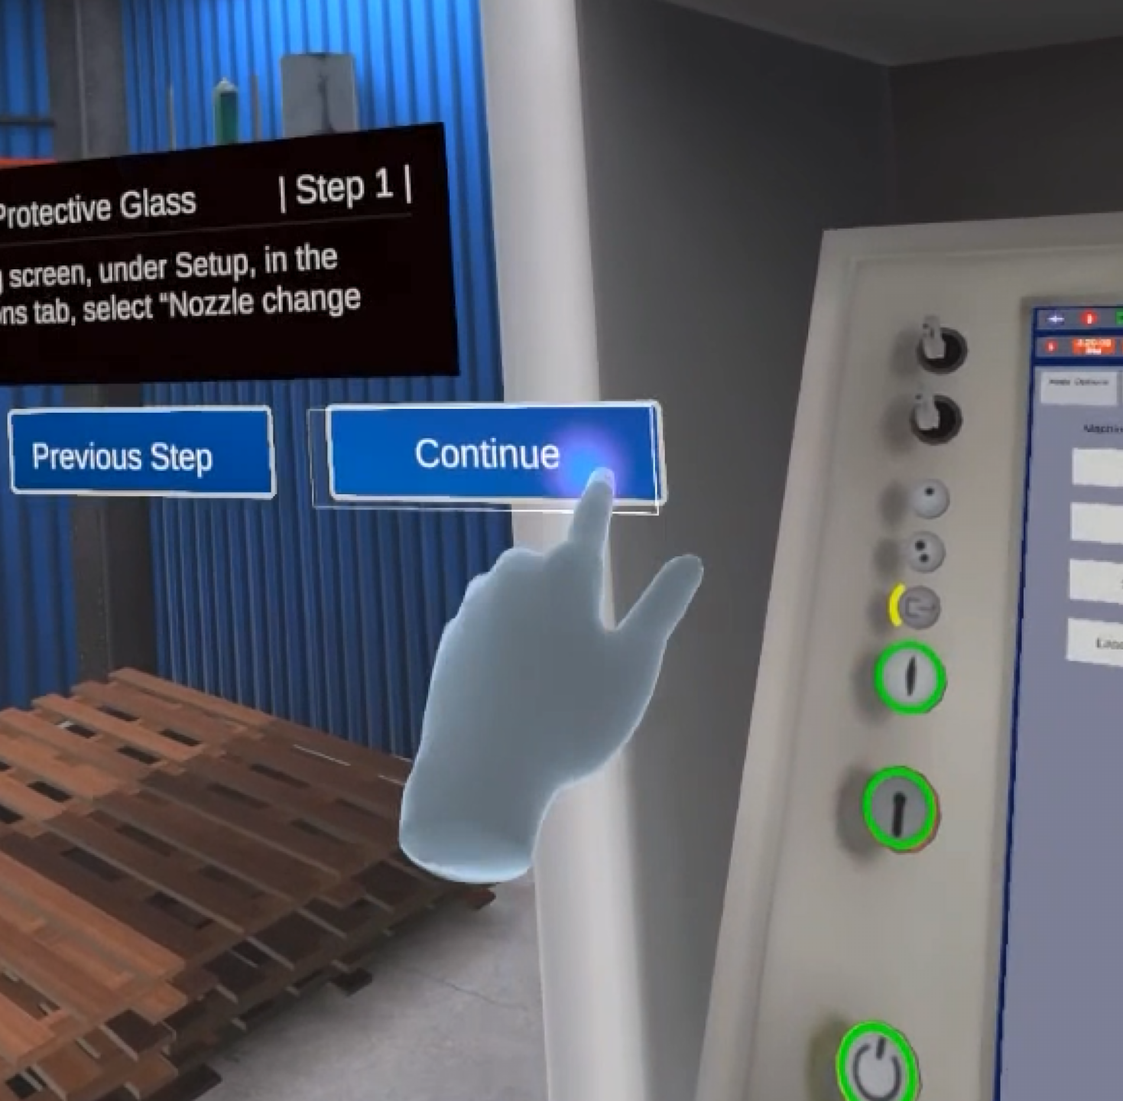
User Interface
Intuitive
Relevant
Accessible
Realistic

Slide 18
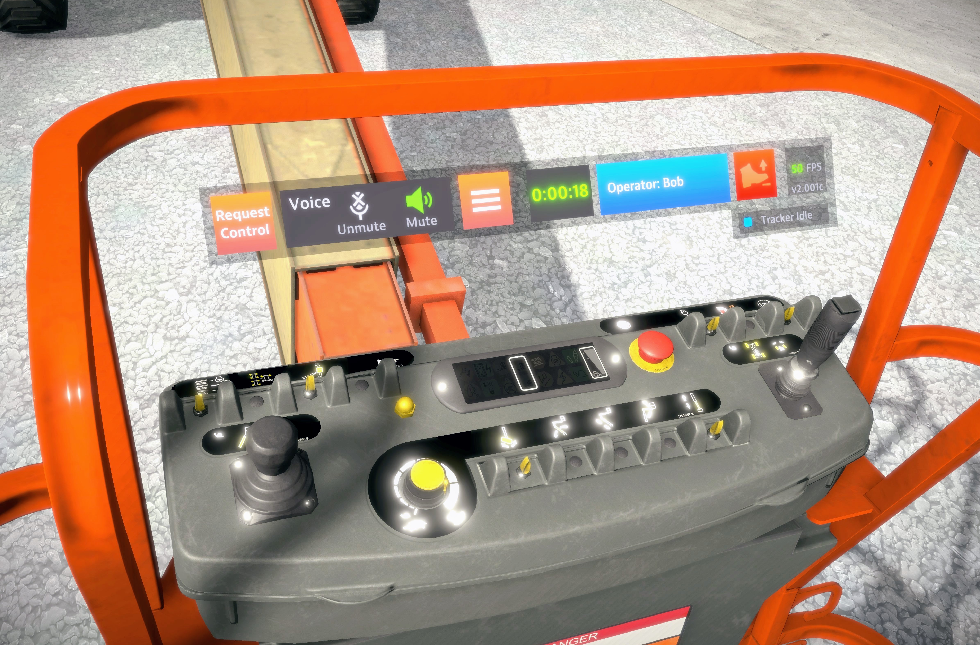
User Interface
Enhancing Engagement
The ways in which people interact with various computing devices have evolved a great deal, and ForgeFX stays current with the best practices of user experience (UX) design. Our goal is to craft intuitive interfaces that allow users to focus on the content of simulator lessons. Venturing into UX for a MR environment is a pioneering endeavor, one which ForgeFX has consistently been at the forefront to driving innovation as we advance the use of mixed reality training simulators.
An intuitive interface and experience not only boosts engagement but ensures that learners stay motivated, navigating seamlessly through the virtual curriculum. The user interface is crucial in MR training as it dictates how trainees interact with lessons. Ultimately, an exceptional interface fosters a rewarding user experience, enhancing learners‘ enjoyment and information retention.
edit
Case Study: JLG
In the several training simulators developed for JLG Industries, the virtual controls were conveniently placed in an otherwise unused space, scaled to be easily reached in MR, and designed to coordinate with the machines‘ real controls.

Slide 19

Hand Tracking
Easy
Natural
Effective
Realistic

Slide 20
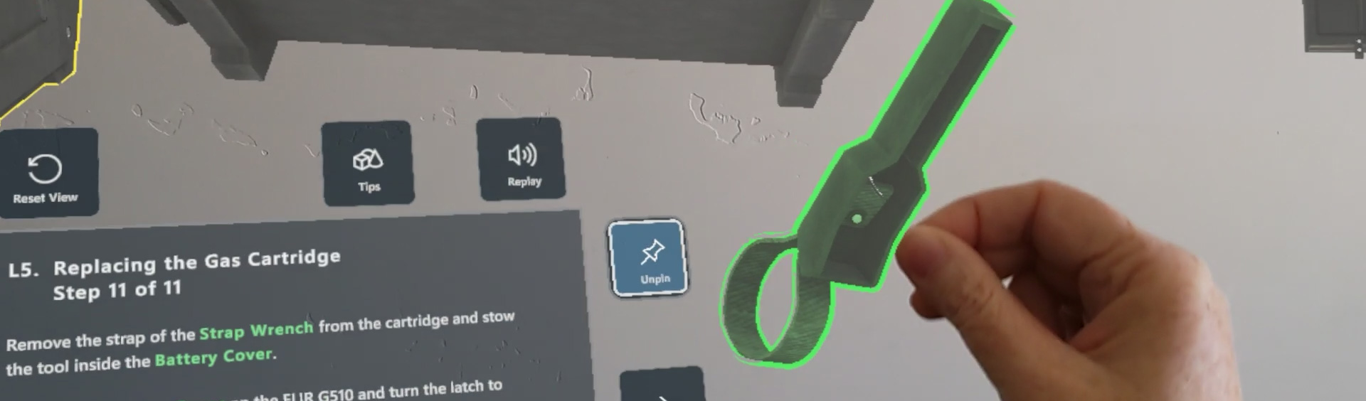
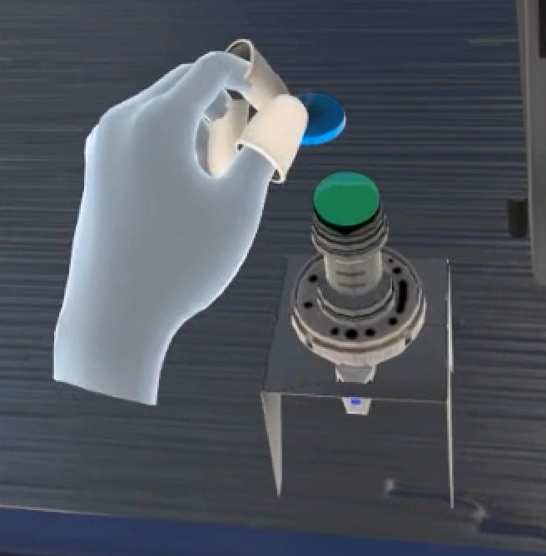
Hand Tracking
Engagement Redefined:
Hands-On Experience
Hand tracking is the detection of user hand movements in the virtual reality (VR) environment. Included with all modern mixed reality devices, this technology allows for direct and natural manipulation of virtual objects, as opposed to clicking on them with a controller device, thereby providing an immersive and realistic training experience.
In the proposed simulator, hand tracking will play a pivotal role in enhancing trainee engagement and knowledge retention. The following are key benefits of this feature:
Natural Interaction: The ability for trainees to use their hands to move and manipulate virtual objects just as they would in real life enhances immersion, stimulates muscle memory, and makes the training more intuitive.
Realistic Environment: By enabling trainees to interact directly with virtual products, hand tracking creates a training environment that closely mirrors real-world scenarios.
Enhanced Engagement: The ability to interact naturally with the VR environment increases trainee engagement, giving them a great sense of presence and agency in the virtual world.
Finally, hand tracking technology also unlocks unique options for performance analysis. For example, to track fine-grained trainee interactions during the session, providing valuable insights into their understanding and proficiency.
Case Study:
TRUMPF TruLaser 2030
In the training simulator ForgeFX developed for the TRUMPF Group, hand tracking plays a crucial role by allowing the trainee to employ precise hand movements to manipulate small machine components.

Slide 21

Audio Narration
Enhances
Realism
Accommodates Learners
Focused Instruction
Realistic

Slide 22
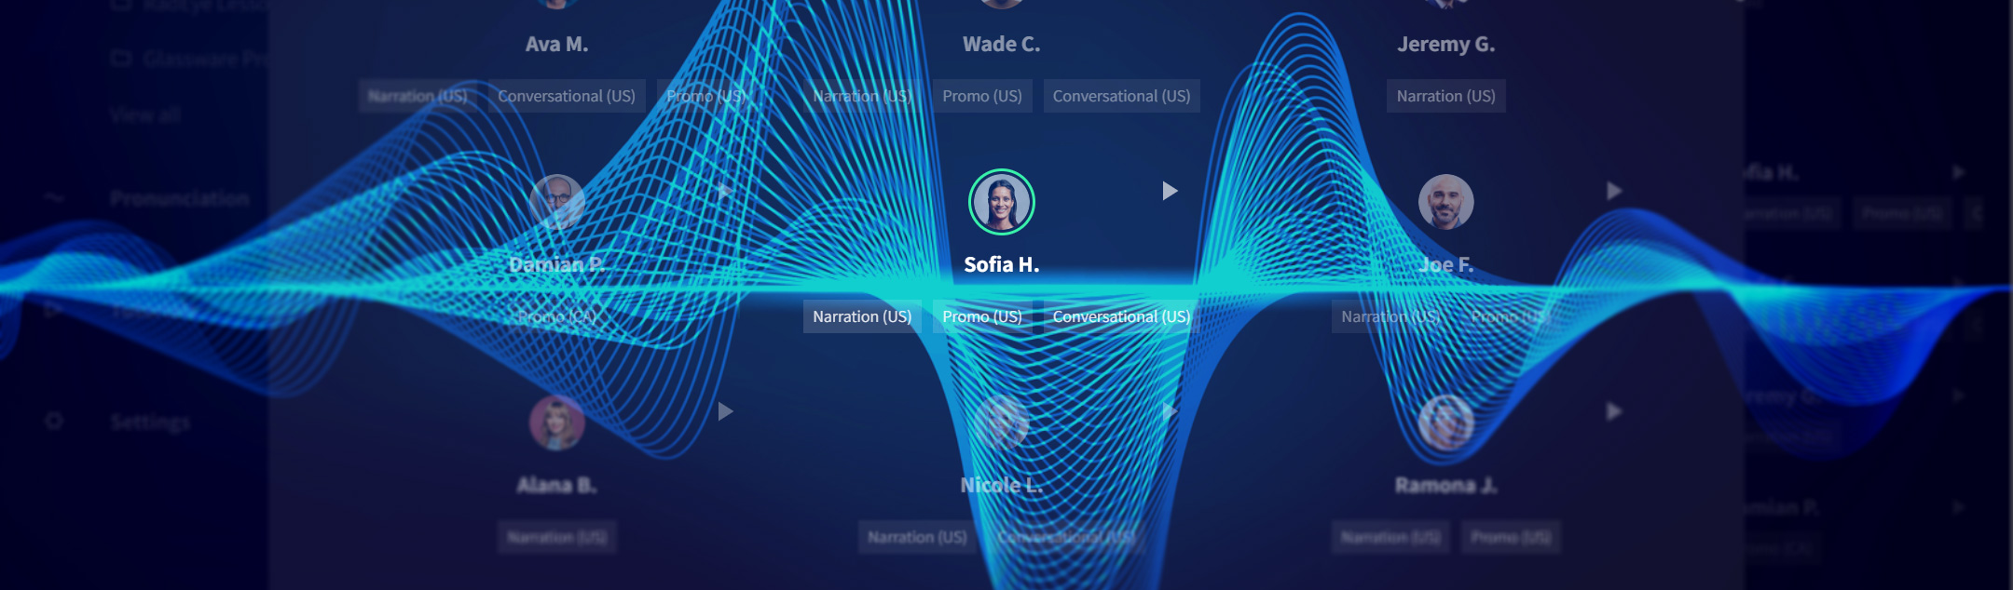
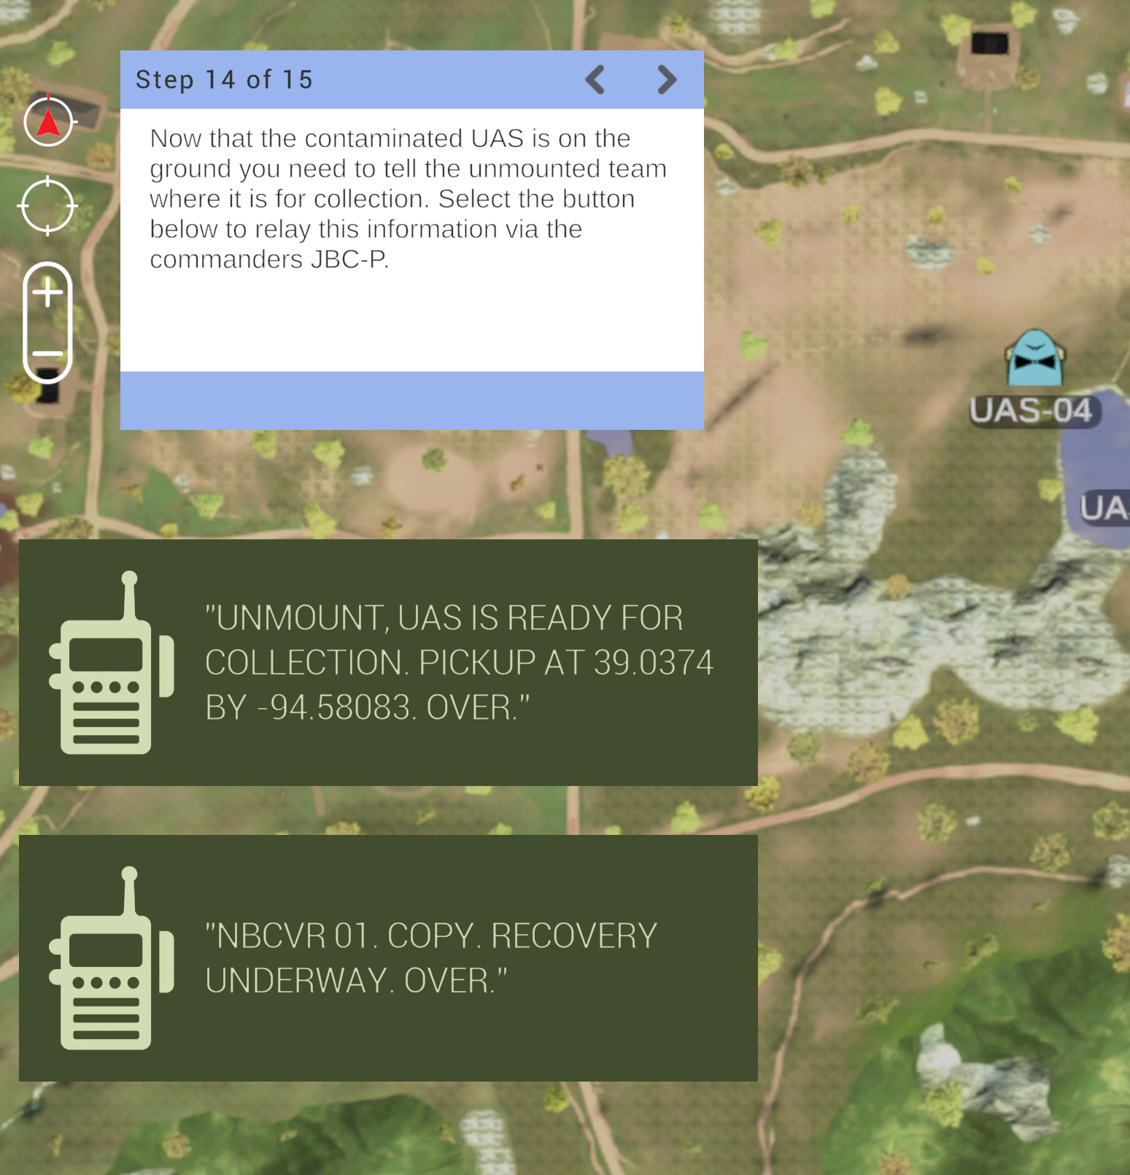
Audio Narration
Boosting
the Gain of Training
Recent advances in realistic AI-generated voices have made audio narration of lesson content affordable and easy to produce. ForgeFX frequently turns to the services of WellSaidLabs to create custom narration of our clients’ lessons. Clients can choose from a range of genders, ages, and narrative styles for spoken content. When a script is uploaded, the audio narration is generated within seconds, which makes it easy to revise and update lesson content.
Providing optional audio narration to trainees can greatly boost engagement and knowledge retention. Many people can find learning challenging when content is delivered via written text but have no problem understanding it in audio form. In addition, audio reinforcement can overcome reading difficulties such as dyslexia or language unfamiliarity.
Another use of audio feedback is to provide over-the-shoulder coaching to the trainee while they’re engaged in a task. Prompts such as “that’s too fast” lets them focus on what they’re doing without having to look away to read text.
When delivering critical information that can affect expensive equipment or even lives, it’s important to accommodate different learning styles and provide several types of information to teach as effectively as possible.
Case Study:
Tele-Op Simulator
In this UAS training simulator for the JPEO, ForgeFX not only provided a choice of male or female narration options, but also emulated real-world radio communications between squad members to provide context and verisimilitude for the lesson.

Slide 23
Instruction Modes
Guided
Unguided
Realistic

Slide 24
Instruction Modes
Guided and Unguided
Training
Modalities
The simulator will feature two distinct instructional modes: “Guided” and “Unguided.” These modes are designed to provide a comprehensive learning experience, catering to different stages of the training process.
Guided Mode
This mode is intended for initial learning phases, where trainees are still familiarizing themselves with basic operations. In this mode, students will be provided with step-by-step instructions and hints to help them navigate through various tasks. The guided mode will:
  Provide real-time feedback and support to ensure correct understanding and application of procedures.
  Enable trainees to practice in a low-pressure environment while they gain confidence.
Unguided Mode
Once trainees have gained sufficient knowledge and confidence from the guided mode, they can transition to the unguided mode. This mode serves as an assessment tool where students apply their learned skills without any assistance. This mode will:
  Challenge trainees to perform tasks independently, reinforcing their understanding of operations.
  Generate after-session performance reports that highlight areas of strength and those requiring improvement.
Incorporating both modes into the simulator ensures a comprehensive training approach that caters to varying levels of expertise among operators. It allows beginners to learn at their own pace in a supportive environment, while more experienced operators can test their skills and knowledge in realistic scenarios.

Slide 25
Performance Tracking
Individualize Learning
Monitor
Progress
Customize
Goals
Realistic

Slide 26

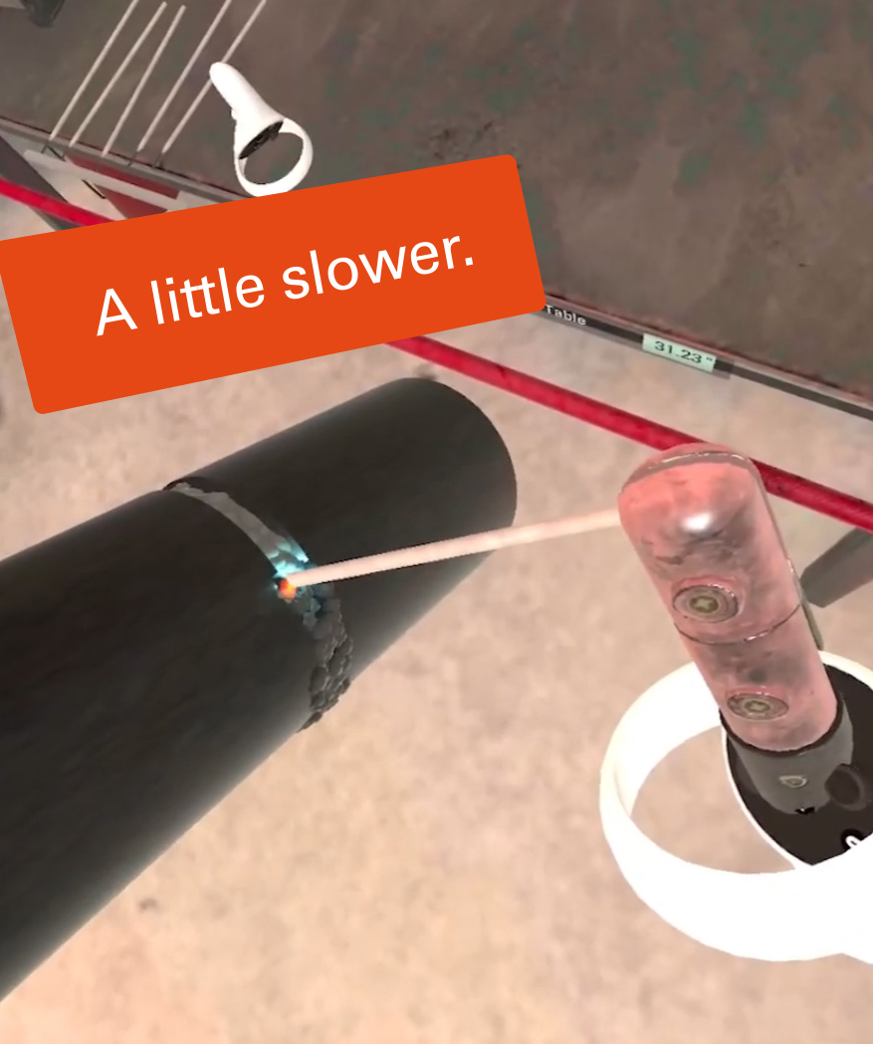
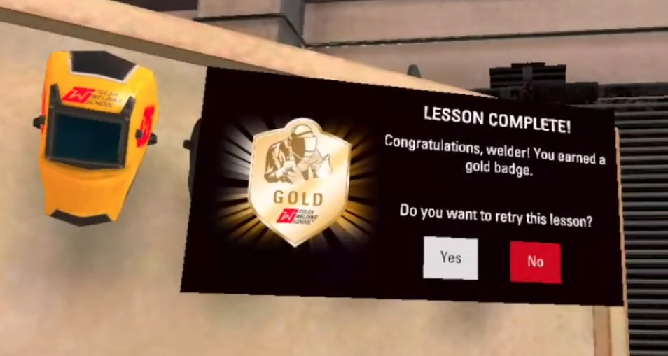
Performance Tracking
Monitoring
Trainee
Proficiency
The proposed simulator will incorporate a robust system for tracking trainee performance. This feature is designed to provide valuable insights into the progress of each trainee, enabling trainers to identify areas of strength and improvement.
  Performance Tracking: The simulator will track actions taken by the trainees during their training sessions, time spent on each task, and correct and incorrect actions taken.
  Data Analysis: The collected data will be analyzed in real-time to provide immediate feedback to the trainees. This instant feedback mechanism is designed to reinforce correct actions and rectify mistakes promptly, enhancing the learning process.
  Reporting: At the end of each training session, a performance analysis report will be generated. Available as a downloadable text document, this report could potentially integrate with an existing Learning Management System (LMS) for tracking and analysis across multiple training modules.
Trainers will be enabled to monitor trainee progress, provide timely feedback, and make data-driven decisions to enhance the effectiveness of their training programs overall.
edit
Case Study: OCUWELD
ForgeFX displayed trainees’ performance data in a graphic, gamified style to increase readability and engagement.

Slide 27

LESSON CONTENT
EDIt
This section describes in more detail the structure and type of lessons that will be included in the proposed simulator.

Slide 28
Lesson Definition
Risk-Free Skill Building for Real World Mastery.
The simulator training lessons are tailored to meet your initiative’s training requirements. The lesson framework supports selecting and including content based on specific training needs and offers the flexibility to expand and integrate additional lessons as the program progresses.
Objective, Overview, and Learning Outcomes: The simulator lesson will outline what the learner will achieve by the end of the lesson, summarizing the key content, skills, and knowledge areas covered. It will provide a clear statement of the intended learning goals and the specific, measurable outcomes that will indicate the learner’s competence.
Immersive Instructional Content and Lesson Flow: A typical lesson comprises 10-15 steps, and learners will be guided through these steps using virtual prompts, ensuring a smooth and coherent flow throughout the lesson. The instructional content includes interactive exercises and real-time feedback, all within the simulated environment.
Assessment and Feedback: In the virtual training lesson, assessment and feedback are seamlessly integrated throughout the experience. As learners progress through each step, the simulation automatically provides real-time assessment, offering feedback on their performance where required. At the end of the lesson, a performance summary report will provide a comprehensive overview of the learner's progress.
The proposed work represents a proof-of-concept prototype designed to demonstrate selected training concepts and interactions. The scope does not include the development of a complete enterprise training system, and elements of the experience may be simplified to support rapid evaluation and feedback.
Defining
Simulator-based lessons

Slide 29

LESSON LIST
the Content with immersive quality
The VR MIG welding training experience will be organized into a series of focused lessons designed to introduce welding equipment, foundational concepts, and essential techniques. Based on the objectives outlined by Pearson, the proposed Proof-of-Concept will include the following introductory lessons.
Know Your Torch: This lesson introduces the primary components of a MIG welding torch, allowing learners to identify and become familiar with the parts required for proper welding setup. Interactive 3D highlighting and confirmation interactions guide the learner through each component before advancing.
Learning Steps
Identify the gun body and trigger.
Identify the nozzle, contact tip, and gas diffuser.
Identify the cable assembly, including power, gas, and wire feed.
  Prepare the Torch: In this lesson, learners practice the correct setup of the MIG torch prior to welding. The experience reinforces how core components are assembled and positioned before beginning a weld. Guided interactions support the assembly process and reinforce the correct sequence of setup steps.
Learning Steps
Install the contact tip (handtight).
Install the nozzle over the contact tip.
Confirm the gas connection.
Confirm the wire path through a simplified internal visualization.
First Virtual Bead: This lesson introduces basic torch positioning and movement concepts while allowing learners to observe how welding technique affects the formation of a weld bead. The system provides visual feedback highlighting bead width consistency, spatter presence, travel speed issues, and an overall bead quality rating of Good, Acceptable, or Poor.
Learning Steps
Position the torch at the correct angle and standoff distance.
Pull the trigger and maintain a weld bead for 3–5 seconds.
Inspect the completed virtual bead.

Slide 30

PRICE & Scope
Our proposal presents the defined project scope, pricing structure, and product ownership model, with a clear focus on delivering a compelling return on investment.
BOILER
PLATE

Slide 31


Product Ownership
One cost,
infinite
potential
Our clients own all the assets that we create for their projects. ForgeFX Simulations develops all assets in non-proprietary development tools, which ensures that you are not locked into any specific platform and have the freedom to modify, update, or expand your projects as needed.
One-time development cost: We believe in straightforward financial transactions without hidden fees. This means that when you commission a project with us, you're charged only once for the development of your assets.
No licensing: With ForgeFX, you don't have to worry about ongoing licensing fees for the assets we develop for you. Once the project is completed, the assets are yours to use as you wish, free from any additional licensing costs that can often accumulate over time.
No per-seat costs: Whether your team is large or small, our development approach does not include per-seat costs. This ensures that your entire team can utilize the assets without incurring additional charges based on the number of users or seats, facilitating a more collaborative and inclusive environment.
ForgeFX takes pride in fostering long-term relationships that span many years with our clients. Our comprehensive range of services includes initial consultation to understand your vision, bespoke design and development tailored to your unique requirements, as well as ongoing maintenance and support to ensure longevity and success for your projects.

Slide 32
Simulator ROI
Pearson POC MIG torch training simulator
When considering any project, it’s important to determine the return on investment so that stake holders know where the money is going and what they can expect to receive in return. Simulators are no different, and the ROI can be significant. Listed below are the leading benefits of utilizing simulation-based training and the associated returns.
Reduced Wear and Tear on Physical Equipment
By conducting portions of training on simulated equipment, there is less wear and tear on real-world equipment and a reduced incidence of accidents and their associated repairs.
Reduced Use of Consumables
Simulators require zero fuel, oil, or other materials to be used in training. Conducting training without the expense of consumables greatly decreases the cost of training.
Increased Operator Familiarity
Training with physical equipment will always be necessary; however much of the basic training can be conducted within the simulator so operators are familiar with the equipment before real-world training begins. They can practice a procedure or task over and over until they’ve mastered it, acquiring mastery without incurring expenses or risking injury.
Reduce Training Time & Expenses
Getting access to real-world equipment can be challenging, costly and time consuming. Removing the need to travel to get operators on the equipment can quickly have a positive effect on a company’s bottom line.
Increased Throughput
Regardless of industry or type of equipment, all companies struggle with throughput of trainees. There are only so many trainers, equipment available for training, and hours where conditions are correct for training. Simulators remove these barriers and allow trainees to train regardless of trainer or equipment availability; and remove any environmental or geographical limitations that are out of an organization’s control.
Sales and Marketing Opportunities
While simulators are typically built for training departments, sales and marketing departments love them because they provide excellent opportunities to put people behind the controls of a virtual machine in a setting where that is not possible with real-world machines. People want to try before they buy, and simulators give customers that ability.

Slide 33
Proof of Concept scope & Cost
Pearson Education Training Simulator
To closely match Pearson’s requirements, here is the scope and cost for the POC Virtual Reality Welding Simulator. Please feel free to suggest an option we haven’t proposed, and we will update our proposal and quote to match your requirements.
# | FEATURE | OPTIONS
 |  | POC
1 | Simulation Framework Core architecture for the trainer. ForgeSIM™ Framework Requirements Verification User Interface Audio Effects & Voiceover Narration Performance Tracking | ✓
2 | Virtual Equipment MIG Torch, and related components. | ✓
3 | Virtual Environment This is the custom virtual Welding station in which the user will train. This environment will be tailored to your specifications. | ✓
4 | Extended Reality (XR) Includes support for the virtual equipment and environment to be interacted with in a Stereoscopic virtual reality 3D experience for the Meta Quest. | ✓
5 | Instruction Modes: Guided Support for a structured step-by-step guided mode that allows users to advance through the training without assistance. | ✓
6 | Training Lessons Step-by-step interactive training MIG Welding curriculum & content. | 3
Development Time (Months) |  | 3
Total Cost |  | $178k

Slide 34
Proof of Concept scope & Cost
Pearson Education Training Simulator
This revised scope reflects the feedback from our initial discussions, narrowing the feature set to what matters most for a successful proof of concept. The features below represent the essential components needed to deliver a compelling VR welding training experience within a 6 week development timeline.
# | FEATURE | OPTIONS
 |  | POC
1 | Core Welding Mechanic | Basic torch-to-workpiece interaction. Feedback indicators for common technique errors (speed, angle, distance). Fidelity subject to scope constraints.
2 | Weld Bead Simulation | Simple visual representation of a weld bead forming. Basic particle or visual effect. Not a physics simulation.
3 | Guided Lesson Flow | Step-by-step instruction sequence for one lesson (Lesson 3). Narrated guidance. Scope limited to a single guided pass — no branching or adaptive logic.
4 | Ghost-Hands Overlay | Basic reference visualization showing approximate correct hand/torch position. Indicative only.
5 | Pearson-Branded UI | Simple menu, basic in-lesson UI, and end-screen. Styling based on client-provided brand guide (assumed available). Design is functional, not polished.
6 | Haptic Feedback | Basic controller haptic response during welding interaction. Limited to on/off or simple intensity — not nuanced force feedback.
7 | In-Headset Performance Score | Basic pass/fail or simple graded result shown at lesson end. No data saved, no LMS, no reporting.
8 | Meta Quest APK Delivery | Functional build delivered as a sideloaded APK for Meta Quest. Basic QA pass. Not a production-ready release.
9 | Virtual Training Environment | A compact indoor virtual environment designed for stationary training. All training activities take place in a single location, with every tool and resource positioned within arm’s reach of the trainee.
Development Time |  | 6 weeks
Total Cost |  | $50,000

Slide 35


Development Process
  In over two decades of working with clients, we’ve found that an agile, iterative, and transparent development process works best. We provide our clients visibility into every step of the development process, including features as they are being developed. This allows for quick course-corrections and ensures that development stays headed in the right direction.
BOILER
PLATE

Slide 36
Development Milestones
[Pearson POC MIG torch training simulator
This chart illustrates the several stages of development that the project will pass through on its way to completion and delivery.
Team introductions and project initiation
KICK-OFF
PRE-ALPHA
25% feature-complete application
50% feature-complete application
ALPHA
BETA
75% feature-complete application
99% feature-complete application
RELEASE CANDIDATE
GOLD MASTER (GM)
100% feature-complete application

Slide 37
Production Schedule
[Pearson POC MIG torch training simulator
This chart illustrates the team members who develop our simulators, and the amount of effort they take to produce a quality training product.
Development Team | Production Phases in Milestones
 | Requirements Gathering, Design |  | Modeling, Coding, Writing, Production
 | Pre-Alpha | Alpha | Beta | Release Candidate | Gold Master
Producers & Team Leads (2)
Developers (3)
Artists (2)
Audio Engineer (1)
User Interface Designer (1)
Production & QA (1)
Client Communication & Coordination
Team Org.
Team Coordination
Project Strategy
Project Structure
Hardware Logic
Lesson Logic
Software Logic
User Interface
Environment Modeling
Equipment Modeling
Audio Capture
Audio Design
UI Design
Asset Production
Production Tasks
Iterative Testing

Slide 38
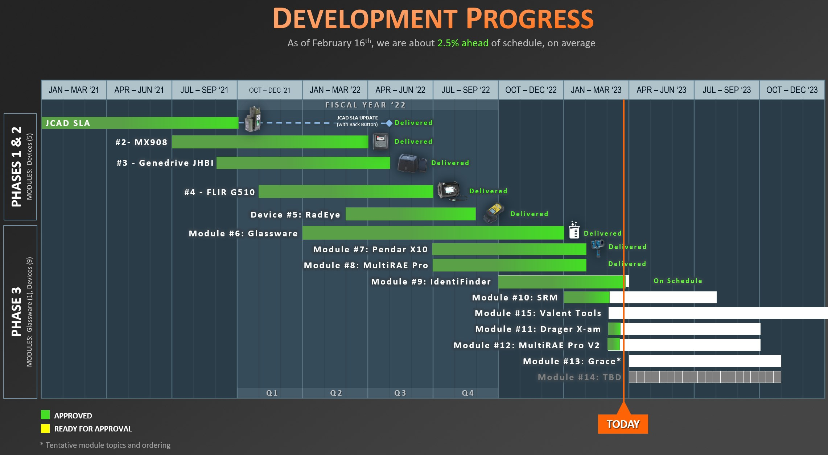
Project Example: Schedule Management
[Pearson POC MIG torch training simulator
HoloTrainer Schedule Management
One of the most critical factors in the development of custom software is the ability to deliver the final product on time. ForgeFX project managers have extensive experience in the systematic planning, monitoring, and control of project activities to ensure timely completion. ForgeFX anticipates the development of your simulator to be a multi-phased effort, requiring optimized resource allocation over an extended period.
Leveraging both Gantt and milestone charts, ForgeFX provides Stakeholders with a project timeline at project kickoff. As the project progresses, actual performance is continually measured against the planned schedule. The ForgeFX project manager will address any variances, ensuring that potential delays or accelerations are appropriately communicated to Stakeholders.
An example of ForgeFX’s successful management of a multi-phased software development project is the HoloTrainer XR Training Simulator for the Department of Defense. This program required the development of full training simulators for fifteen different devices, each built by a different manufacturer. The overall program was divided into three development phases, with the total period of performance of 3 years. The Gantt chart below provides an example of how the ForgeFX team monitors the real-time status of the overall project time for this multi-phased project consisting of nearly 3000 individual and interactive training steps.

Slide 39
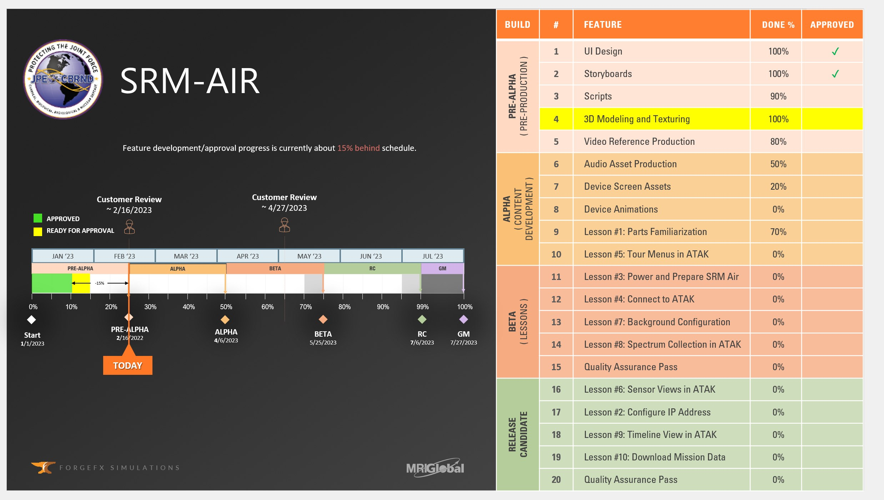
Project Example: Milestone Tracking
[Pearson POC MIG torch training simulator
HoloTrainer Milestone Tracking
In addition to expertise in overall schedule management, ForgeFX has demonstrated the ability to track progress at the milestone and application feature level.
Shown below is an actual milestone status chart used during a bi-weekly HoloTrainer client meeting. For this specific training module, the chart tracks the development status from kick-off through each milestone deliverable (Alpha, Beta, etc.). It also identifies whether the team is ahead or behind schedule and provides a metric to quantify this schedule status.
Moreover, ForgeFX Simulations also maintains detailed records of requirements and progress on a feature-by-feature basis within each module, as identified in the table. Each feature’s percent progress is monitored, as well as the client-approval status for each specific feature.
This granular approach allows for precise monitoring and control over every aspect of development and provides additional benefits including early identification and resolution of potential issues and facilitates accurate forecasting and planning.
ForgeFX’s approach to schedule management, with its focus on low-level per module tracking, ensures that every aspect of your simulator’s development process will be carefully monitored and controlled to guarantee on-time delivery of a high-quality training solution.

Slide 40

Agile Methodology
A Culture of Continuous Improvement
We follow an agile development process: a practice of delivering fully functioning application builds every two weeks for review. At each review we meet virtually via conference call and shared desktop to assess the progress made over the preceding month, discuss the current prioritized feature list, and determine requirement details for the features to be developed over the course of the next two weeks.
The Sprint Cycle: One Month of Development
Sprint Planning: Review the prioritized feature list, possibly reprioritizing features, and/or adding removing features based on what we learn as development progresses and clients give their feedback.
Sprint: The development team works for 2 weeks developing the discussed features.
Sprint Delivery: At the end of each 2-week period, we upload the latest build for download and review.
Sprint Review Meeting: Review of progress from the prior 2 weeks and feedback collection. Revisions based on this feedback will be candidates for completion in the following sprint.
Sprint Planning
Sprint
(2 weeks)
Sprint
Delivery
Sprint Review Meeting

Slide 41
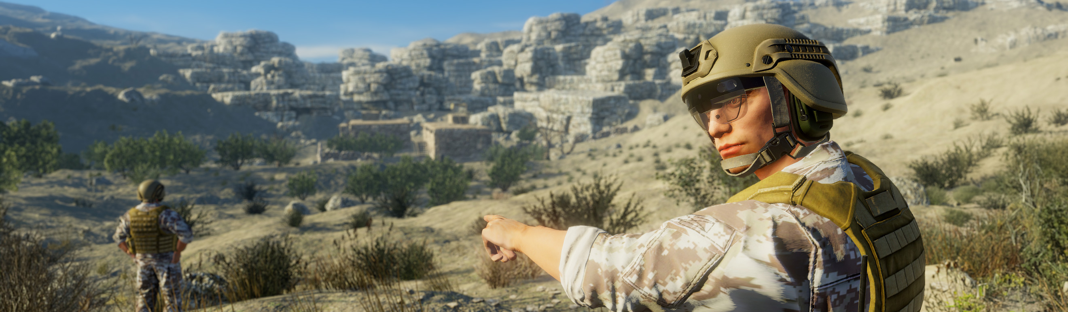
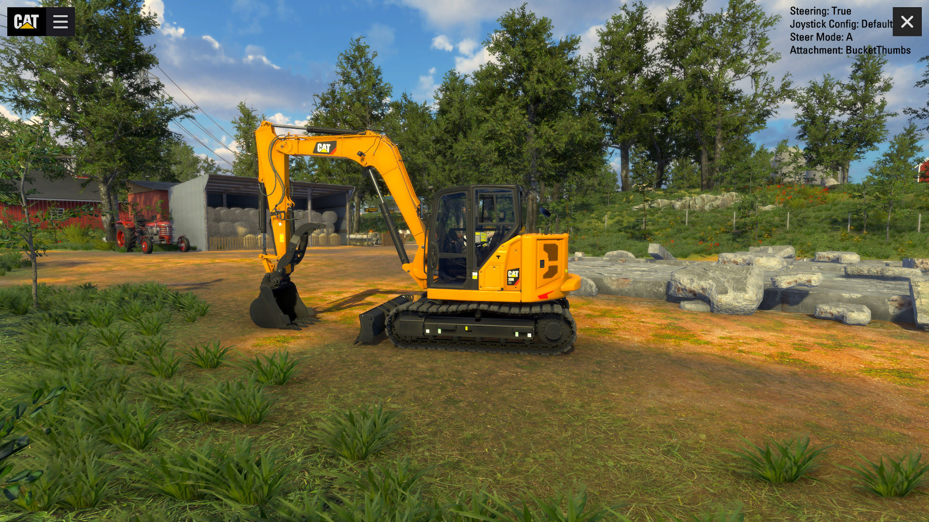
Game Engine Technology
Leveraging
a Winning
Strategy
The game engine is a software framework designed for the creation and development of video games. Video game developers use them to create games for video game consoles, mobile devices and personal computers. Simulations have many vital elements in common with games and their development processes:
  Interactive 3D Environments
  Task-Based Scenarios
  Scoring Mechanisms
  User Performance Monitoring
  Distribution Methods
For this reason, ForgeFX uses Unity, the dominant global game development software. More games are made with Unity than with any other game technology. We use game engine technology to produce our 3D simulations and visualizations because they are an incredibly efficient development environment with which to produce high-quality, enterprise-grade interactive 3D applications.
A Culture of Continuous Improvement
We follow an agile development process: this is built around a process of delivering fully functioning application builds every 2 weeks for review. At that point, we will meet virtually via conference call and shared desktop to review the progress made over the preceding month, review the current prioritized feature list, and discuss requirement details for the features to be developed over the course of the next 2 weeks. In the agile process each one-month block of development, called a sprint, looks like this:
Case Study: Caterpillar
ForgeFX developers enjoy injecting a simulated environment with all the little details that bring it to life and increase the feeling of immersion. Subtle effects such as trees swaying, birds flitting overhead, and cows mooing help the user feel as if they are in a real-world situation.

Slide 42

Quality Assurance Testing
Key to
a Superior
User Experience
To develop a robust application which is both reliable and supportable we follow a series of best practices that we have developed over the years.
The first piece of this puzzle, which occurs during development of the application, is automated unit testing. With each incremental change that is made to the application, we automatically run a suite of comprehensive tests which ensure that new features have not negatively impacted existing features.
The second piece that facilitates application support, after deployment to users, is our automated error reporting. The application, with end-user permission, sends us performance and issue telemetry which allows for detection and correction of issues in the deployed application.
Finally, we include the capability for both trainers and trainees to manually submit feedback from within the application, including a screenshot of the relevant item. This closes the loop for end-to-end reliability and support systems.
Usability testing is a type of testing we perform to evaluate our products, essentially testing how usable the application by users. Throughout the course of the development of the product, we will have people who have never seen the application use the software, to determine how user-friendly the program is. This type of testing gives us direct input on how users will be able to navigate and use the system.
These testing protocols are paramount to the to the success of our simulators, as we often uncover simple course corrections that we can perform to make the application more useable, and thus more successful.

Slide 43

On Target?
Once our understanding is clear in terms of project goals, features, and budget requirements, we’ll be in position to move forward with next steps towards kicking off the development of your project.
Goals
Features
Cost
Realistic

Slide 44



Let’s Get Started!
Mary Pierce
Executive Director of
Enterprise Partnerships
Mary consults with our clients, studies their business, and generates creative solutions for their training needs.
ForgeFX Simulations looks forward to working with you to design and develop your training simulator. If our proposal is in line with your requirements and you would like to hire us, please contact Mary Pierce to discuss development options and she will send you a project agreement for this proposal to review.
(415) 788-5725, ext. 703
Mary.pierce@forgefx.com
ForgeFX Simulations
1160 Battery Street East, Suite 100
San Francisco, CA 94111
(415) 788-5725 www.forgefx.com
BOILER
PLATE

Slide 45
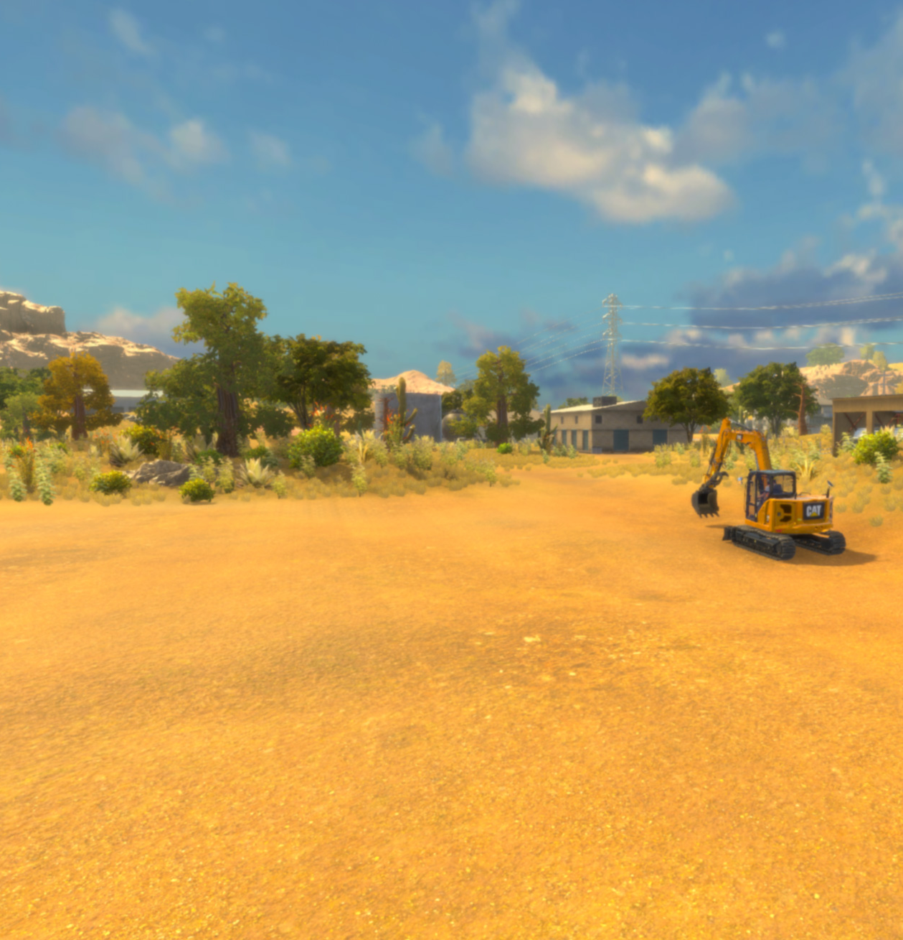

IN CONCLUSION
Some final thoughts about this project and our hope for a successful cooperative venture with your organization.
BOILER
PLATE

Slide 46

Looking Forward
A future
Beneficial Partnership
We hope that this document has demonstrated our commitment to providing the very best quality training for trainees across various industries who often face hazardous situations. We strongly feel that virtual reality simulators such as the ones we develop are a highly effective method for conducting comprehensive and impactful training. This immersive technology is key in enhancing safety protocols and reducing the incidence of expensive mishaps.
ForgeFX has a long track record of developing and delivering high-quality training simulations for our clients. We follow an agile development process which allows for both flexibility and predictability. Through maximizing efficiency and minimizing development costs which do not directly contribute to the quality of the end-product, we are able to deliver a remarkable level of affordability. We leverage and build upon the constant advances in video game development tools technology for the benefit of our clients. Our leadership team is tight-knit, passionate, and works directly with each of our clients.
All of this taken together makes ForgeFX uniquely qualified to develop simulation-based training for your organization, and we look forward to your response to our proposal and hopefully to working with you to produce your simulator.
Thank you for your interest in our development services, and please contact Greg Meyers if you have any questions and to discuss next steps.

Slide 47

Appendix A: About ForgeFX
From the time Greg, Adam, and David founded ForgeFX in 2002, the company has produced innovative educational and job-training simulations. The three founders actively oversee every project that ForgeFX develops, leading dozens of projects from concept to completion and delivery.

Slide 48
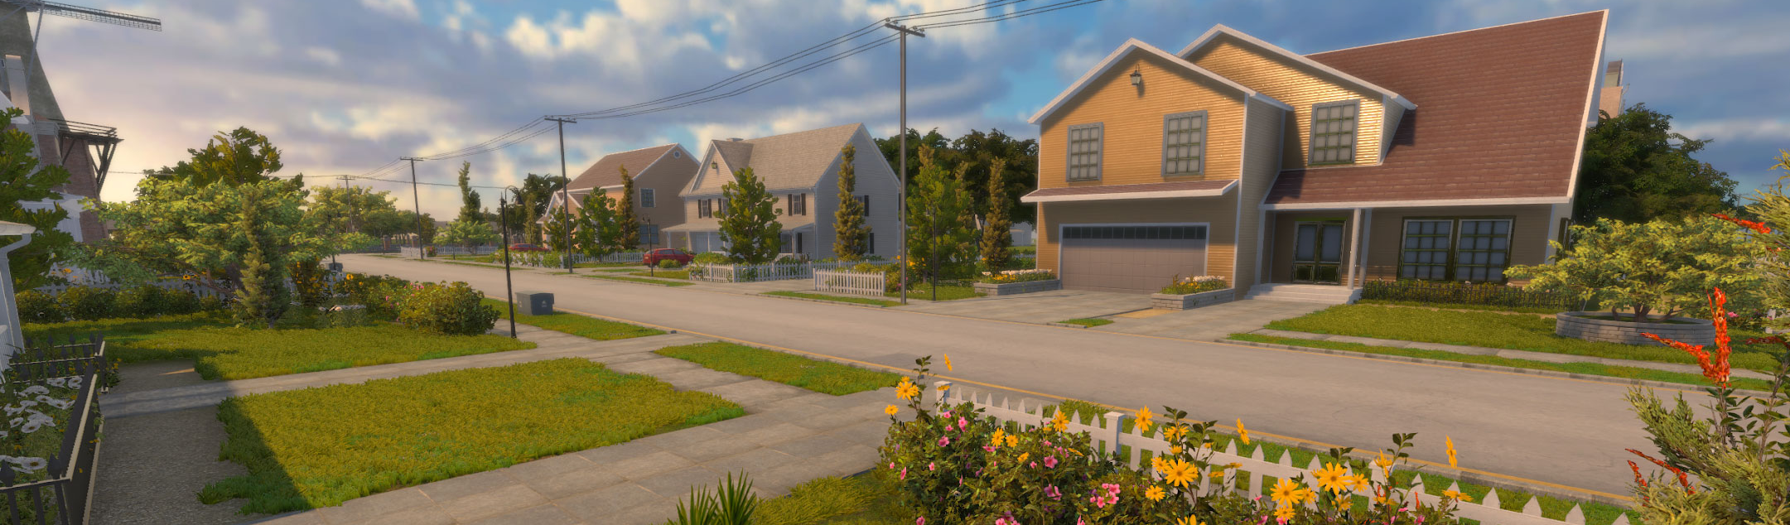
Company Structure
Core Values of Efficiency and Enthusiasm
We hope that this proposal has demonstrated our commitment to providing the very best quality training for the individuals who will put their lives on the line in service to the safety of others. We strongly feel that virtual reality simulators such as the ones we develop are a highly effective solution for training first responders thoroughly and meaningfully while preserving their own safety and avoiding costly accidents.
ForgeFX has a long track record of developing and delivering high-quality training simulations for our clients. We follow an agile development process which allows for both flexibility and predictability. Through maximizing efficiency and minimizing development costs which do not directly contribute to the quality of the end-product, we are able to deliver a remarkable level of affordability. We leverage and build upon the constant advances in video game development tools technology for the benefit of our clients. Our leadership team is tight-knit, passionate, and works directly with each of our clients.
All of this taken together makes ForgeFX uniquely qualified to develop simulation-based training for your organization, and we look forward to your response to our proposal and hopefully to working with you to produce your simulator.
Thank you for your interest in our development services, and please contact Greg Meyers if you have any questions and to discuss next steps.

Slide 49



Company Leadership
Executive Team
GREG MEYERS | CEO & Co-Founder
As Executive Producer for projects, Greg establishes and manages client relationships and develops and negotiates project scope and contracts. Prior to founding ForgeFX, Greg was a front-line participant in the landmark dot-com era, working at digital content development agencies; these included Sapient’s Rich Media Group and the ad agency Red Sky Interactive––one of the world’s most-awarded agencies at the time.
ADAM KANE | CTO & Co-Founder
As the CTO and a Co-Founder of ForgeFX, Adam brings to the table a unique blend of technical expertise and strategic insight that serves both ForgeFX and our clients. Continually scanning the horizon for key trends, he shapes the technology roadmap for us and our clients. His commitment to pioneering immersive experiences has steered both ForgeFX and our clients from the realm of VR, through the landscape of AR, and now into the transformative world of AI.
DAVID VAILLANCOURT | COO & Co-Founder
David manages the art production staff which includes user interface designers and 3D modeling and texturing artists. Prior to founding ForgeFX, David worked with both Greg and Adam in Sapient’s Rich Media Group. Before that, he was at the video game company Presage, working on cutting-edge real-time interactive 3D web graphics, as this was first becoming possible in the late 1990s.

Slide 50



Project Team Leads
ForgeFX Development Team Leaders
SCOTT LAFORGE | Chief Product Officer
Scott provides architectural solutions and designs, assessments, strategies, and road maps. He defines product ideas, iterates on those product ideas, and formulates a vision. He defines functional requirements for software products to fulfill the envisioned ideas and interacts with other cross-functional teams to architect, design, develop, test, and release features and final products.
Mary Pierce | Executive Director of Enterprise Partnerships
Mary spearheads strategic collaborations with organizations across a wide range of industries. Her primary objective is to address critical training, operational, and educational requirements within these industries by leveraging ForgeFX's expertise in developing custom, immersive, and interactive simulators. Mary has nearly 20 years of experience managing complex portfolios, leading cross-functional teams, and establishing and maintaining customer partnerships to meet strategic business objectives.
GENEVIEVE MOORE | Chief Creative Officer
Genevieve is an award-winning interactive designer who oversees the user interface design of our products. Bringing over 20 years’ worth of design experience for multiple platforms, she ensures that our simulators reflect the branding and positioning of our clients, while keeping them intuitive and easy for their customers as well.

Slide 51



Project Team Leads
ForgeFX Development Team Leaders
RIVER COX | Technical Program Manager
As the technical program manager at ForgeFX, River orchestrates the implementation of products across multiple disciplines. River is responsible for ensuring the timely and stable execution of product requirements and deliverables. He works closely with individual contributors to ensure the team is well prepared, trained, and coordinated to meet the unique requirements and challenges of each delivery.
DEVIN WEIDINGER | Senior Software Architect
A virtual reality enthusiast and passionate developer for Mobile VR, Devin enjoys rapid prototyping and proving theories one demo at a time. When he’s not working, he’s still working—breaking new ground for the future of virtual reality. His interests are new technologies, drawing, programming, virtual reality, software development and competitive gaming.
RACHEL CALGARO | QA Manager
Rachel oversees the quality assurance process at ForgeFX. As QA manager, Rachel and the QA team works closely with the development team throughout the production of each simulator we create, testing the application as it gets built to ensure a bug-free delivery. Rachel’s attention to detail and methodical testing and reporting methods guarantee that upon release, your software will work as expected, without issue.

Slide 52







Project Specialists
Development Team
ForgeFX has taken the care to develop a team of professionals across a wide set of talents, who collectively follow the creative thought process of interactive 3D simulation and visualization development from inception all the way through to deployment.
3D Graphics Specialists
Our modelers excel at re-creating practically anything under the sun, from sweeping landscapes to the smallest internal parts of medical imaging equipment. The backbone of our realistic simulators is the verisimilitude that our modelers deliver, scrupulously replicating both the physical features and the kinetic properties of our clients’ products.
Game Engine Specialists
To bring our 3D models to life, we rely on our code developers to duplicate the physical functions and interactive details in response to the users’ actions. They program the responsiveness of hydraulics to the actions of the joystick; the particle physics of fluids, gases, soil, and metal; create the soundscape generated by engines and environments; and clone the interface functionality of clients’ software.
Development Tools Experts
Behind the scenes but essential to our development process are the specialists who maintain the superstructure that interconnects the various departments. Our experts maintain our schedules, administrate our Kanban task boards, perform quality assurance testing, and expand our internal ForgeSIM™ Framework capabilities.

Slide 53
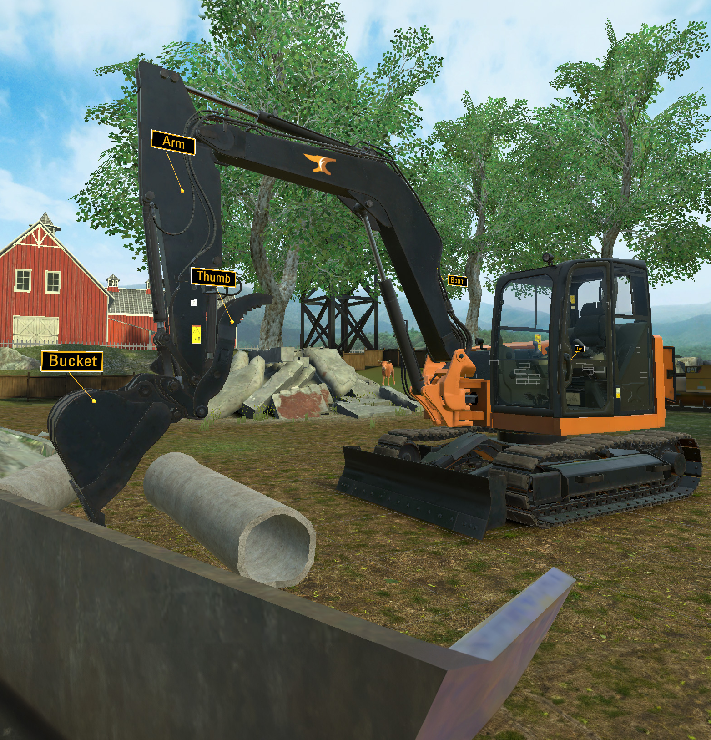
Appendix B: Recent Projects
Since 2002, ForgeFX Simulations has focused on the development of highly interactive 3D training simulations for clients across a wide spectrum of industries. The simulation-based training that ForgeFX has developed for our clients has set them apart as innovators in their industries. This section includes a collection of some of ForgeFX’s latest development efforts for our clients.

Slide 54









Selected Clients
A collection of our our clients and the work we’ve done for them.
Commercial training simulator for the 308 Mini Hydraulic Excavator.
AR, VR, PC, tablet & real-world operator training simulators for access equipment.
OcuWeld welding instruction simulator for the Meta Quest 2 platform.
Horizontal Directional Drill training simulator for both VR and flat-screen modes.
Virtual reality aircraft de-icing operator training simulators for PC and real-world controls.
Unmanned vehicle tele-operation training simulator.
Simulation-based training application for employee safety training.
Simulation and AR-based training applications for MR,
CT and XV machines.
Underground and surface mining equipment operator training simulators.

Slide 55
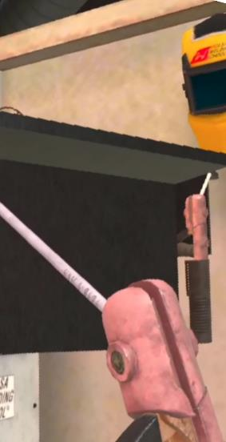

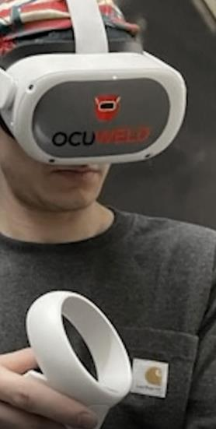
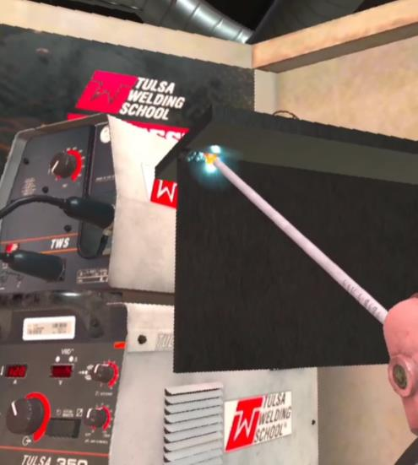


StrataTech Education Group
CASE STUDY: STRATATECH EDUCATION GROUP
OcuWeld Welding Trainer for Meta Quest
ForgeFX recently worked with Tulsa Welding School and The Refrigeration School, Inc, to develop OcuWeld™, a virtual reality welding education simulator that teaches students how to prep, grind and join materials in a virtual environment that removes the safety and cost concerns.
Students are assigned a Meta Quest set on which OcuWeld is installed. Via OcuWeld, they log in to their Canvas learning management system accounts. ForgeFX worked closely with StrataTech to accurately reproduce the effects of welding with various types of torches and materials, mimicking as closely as possible the hands-on feel and physical effects of real-world tools.
Read more

Slide 56
Somero Enterprises
CASE STUDY: SOMERO S-22EZ LASER SCREED
Concrete Screeding Trainer for Meta Quest
ForgeFX is excited to announce our recent development of the Meta Quest-based S-22EZ Laser Screed Simulator for Somero Enterprises, Inc. The simulator provides a detailed and accurate digital replica of the S-22EZ Laser Screed cockpit with simulated physical controls, buttons, and mechanical and visual feedback solutions. The Meta Quest’s superior hand-tracking capabilities allows for a fully immersive experience without the need for physical hardware controls. The simulator incorporates a robust system for tracking trainee performance and presents them with a score card at the end of their session. This feature provides valuable insights into the progress of each trainee, enabling trainers to identify areas of strength and improvement.
EDIT
Read more

Slide 57
StrataTech Education Group
CASE STUDY: TRUMPF TRULASER 2030
EDIT
Meta Quest-Powered Training
ForgeFX recently joined with Trumpf to develop TruLaser 2030, a VR simulator that educates students in how to replace the protective glass of the TruLaser 2030 fiber machine.
ForgeFX chose the Meta Quest headset because it meets important criteria such as a comfortable design for long use, a wide field of view, adjustable PPD, good battery life, modest cost, comfortable fit, and ease of use. Specific features that the application includes are the ability for a group to observe what’s going on in the headset, by wirelessly casting a live feed to any external display; and the ability to record, save, and share training session .mp4 videos.
Read more

Slide 58
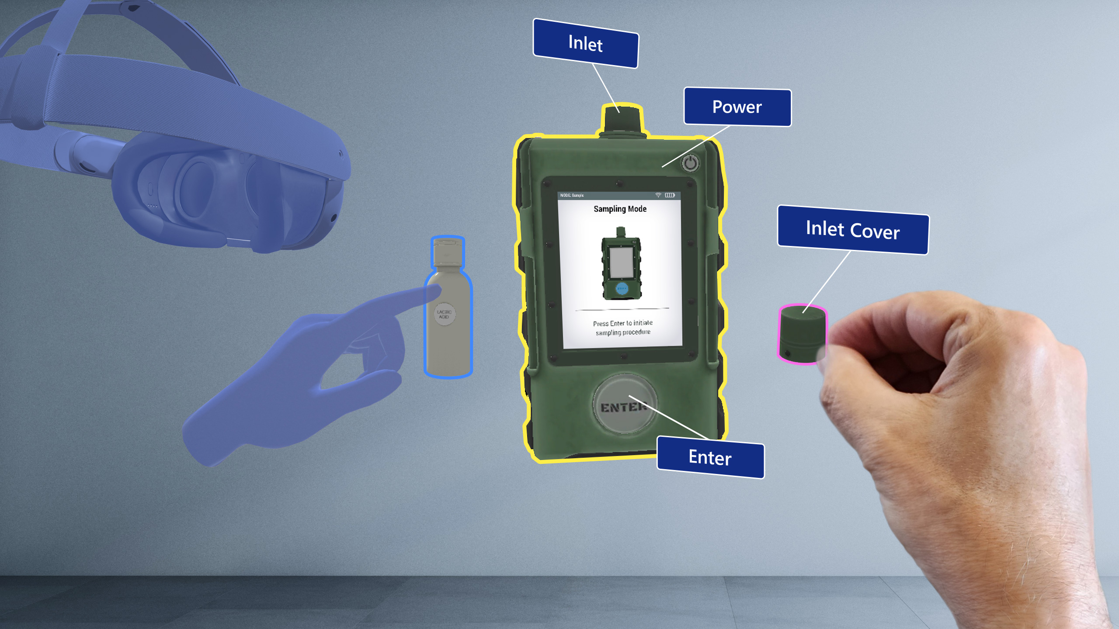
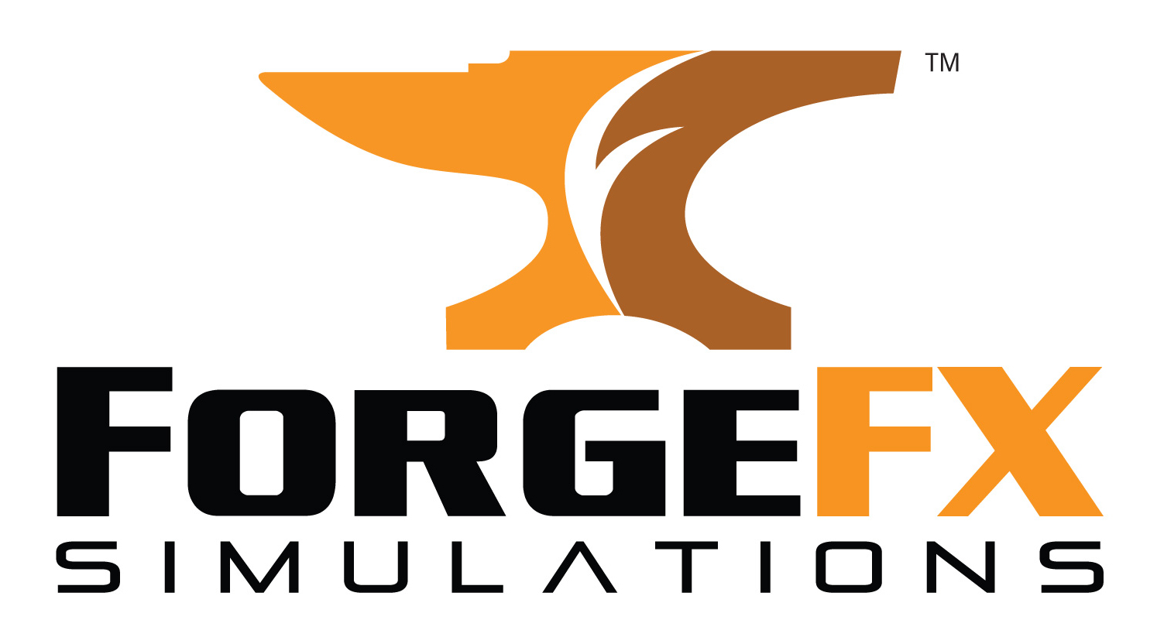
Mixed Reality Trainer
CASE STUDY: MIXED REALITY TRAINER
Demonstrating AR Expertise
This application is a demonstration of a typical familiarization tutorial in an Augmented Reality training simulation. Wearing a Meta Quest, users can follow tutorial steps that teach the components and use of a material sampling and analysis device. Similar to the ForgeFX Showcase, the Mixed Reality Trainer is a multi-user virtual environment in which participants can speak to and interact with each other and with the virtual objects. This is another example in which ForgeFX both demonstrates our proficiency with various Mixed Reality platforms and exemplifies the advantages of collaborative training.
Read more

Slide 59
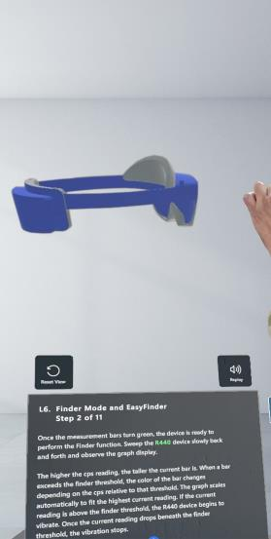
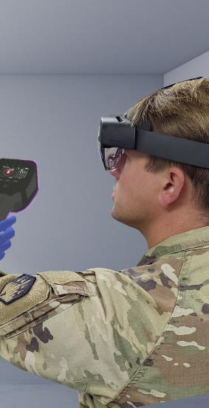
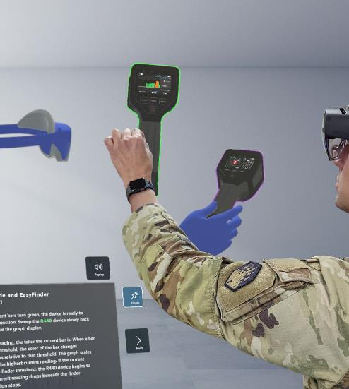
JPEO-CBRND: HoloTrainer
EDIt
CASE STUDY: JPEO-CBRND
CBRND HoloTrainer
ForgeFX collaborated with MRIGlobal to develop the CBRND HoloTrainer, an augmented reality device training simulator built for the Microsoft HoloLens 2. The CBRND HoloTrainer instructs trainees in the familiarization, operation, and maintenance of chemical, biological, radiological, and nuclear detection devices by providing holographically-projected interactive 3D virtual versions of the equipment they need to learn to use. Trainees follow interactive narrated tutorial steps that teach the components and use of the devices and can learn collaboratively in a shared multi-user environment.
Read more

Slide 60
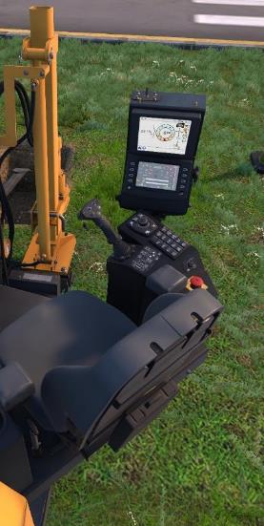
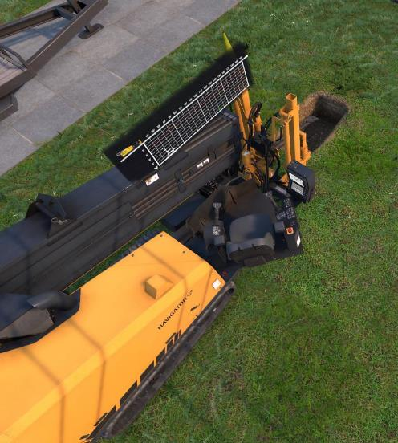
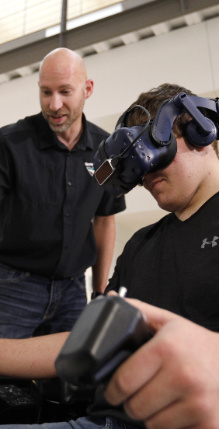
Vermeer Corporation
CASE STUDY: VERMEER CORPORATION
HDD Fundamentals
With infrastructure development and underground utility installations rising around the world, the need for skilled horizontal directional drill (HDD) operators is skyrocketing. To meet this growing demand, market leader Vermeer Corporation partnered with ForgeFX Simulations to develop the HDD Fundamentals training tool for real-world simulators combined with virtual reality via the HTC Vive platform.
The simulator features tutorials in many aspects of drill preparation including checking underground utilities, lessons in soil types and bits, and operation of the mixing machine; and substantive interactive walk-throughs of bore planning, pipe feeding, and drill operation.
Read more

Slide 61
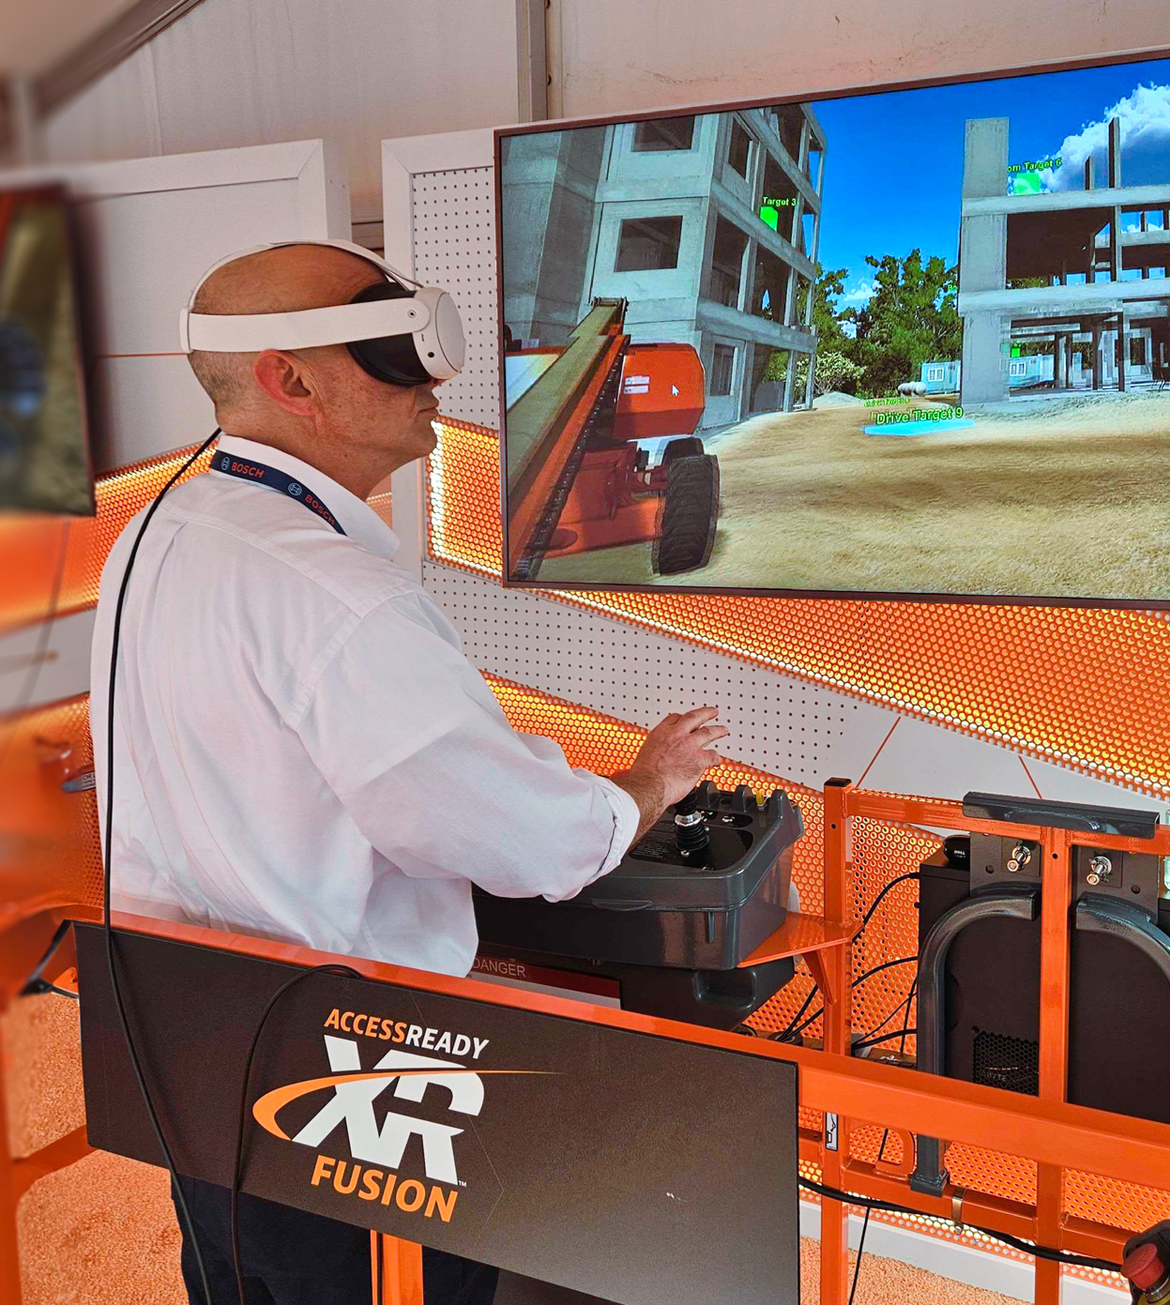
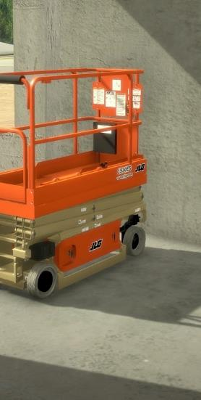

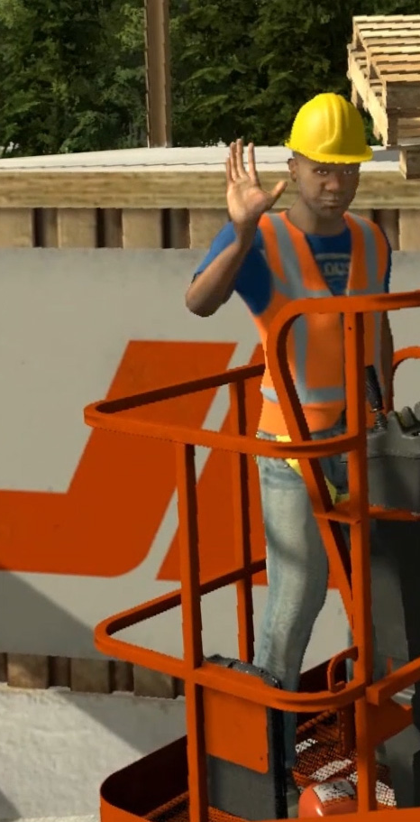
JLG Industries
CASE STUDY: JLG INDUSTRIES
A Long-Standing Partnership
Since 2014, ForgeFX has developed several simulator solutions for JLG Industries, the world’s leading manufacturer of aerial work platforms, telehandlers, and other access equipment. Not only has ForgeFX developed simulators that provide training on various types of equipment; we also designed a Scenario Builder for JLG in which trainers can create and edit their own custom training scenarios.
JLG training simulators run on multiple platforms including iPad, laptop, and VR-enabled real-world simulators. Recently ForgeFX upgraded the VR simulators from the HTC Vive to the Meta Quest platform, which provided enormous benefits in the form of non-tethered hand tracking and improved responsiveness between the operator and the equipment.
EDIt
10 Year
Partnership
Read more

Slide 62
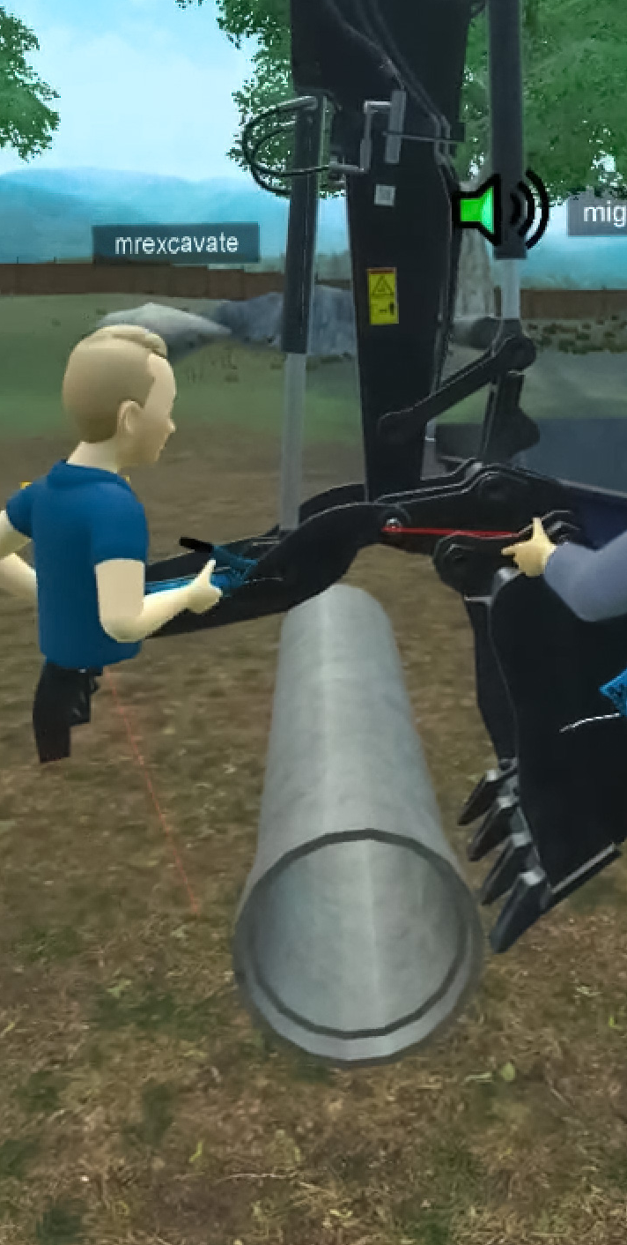
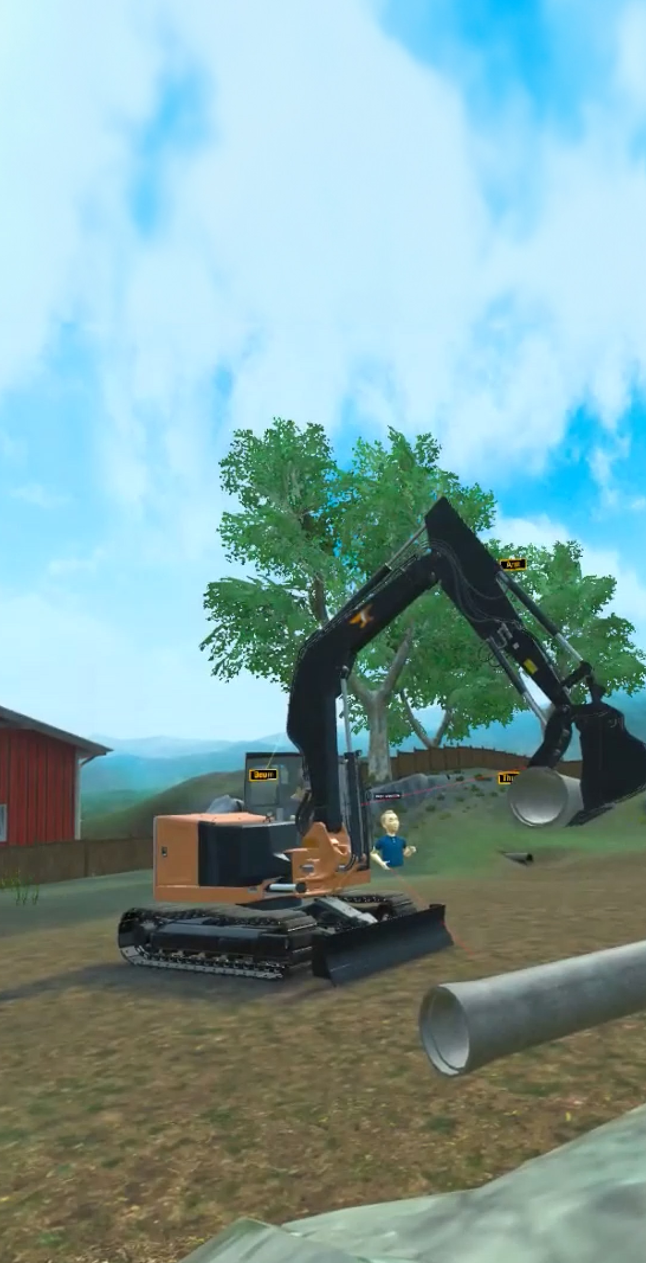
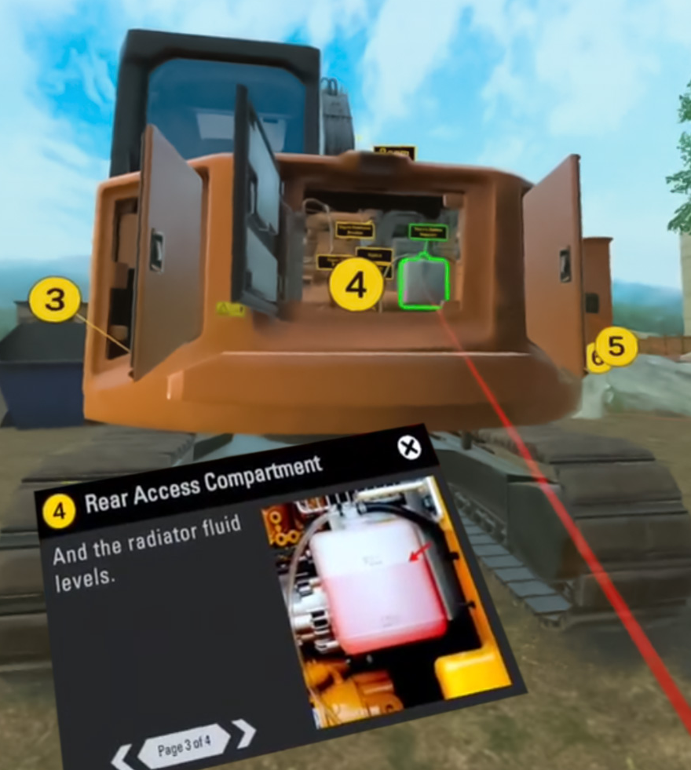
ForgeFX Showcase
CASE STUDY: FORGEFX SHOWCASE
Leveraging Meta Quest Development Tools
ForgeFX made ample use of the Meta Quest Developer Hub and other support offered by Meta to create this VR showcase application. Because the demonstration is most effective as a multi-user experience, ForgeFX used the Meta Avatars SDK to allow users to easily project their presence into the simulation.
This application melds technology and education to deliver an immersive experience that transcends conventional sales methods. Inside the application, users take command of an excavator and perform pre-inspection steps and place pipes into a dumpster. This multi-user VR environment provides a real-time virtual meeting space where ForgeFX not only shows off our expertise but also demonstrates the benefits of multi-user training for both education and sales opportunities.
Read more

Slide 63





Pierce Manufacturing
CASE STUDY: PIERCE MANUFACTURING
Heavy-Duty Sales Tool
ForgeFX Simulations is honored to be a simulation development partner for Pierce Manufacturing, one of the largest fire apparatus producers in the world. ForgeFX worked with Pierce to develop the Pierce Ascendant® 100 Heavy Duty Aerial Tower Fire Truck Simulator for real-world simulators combined with virtual reality via the HTC Vive platform. Pierce is an Appleton, Wisconsin-based manufacturer of custom fire and rescue apparatus and a wholly owned subsidiary of Oshkosh Corporation. ForgeFX is proud to be a simulation development partner with Oshkosh for more than five years, currently supporting their Pierce Manufacturing and JLG Industry brands, by providing simulation development services for a wide array of equipment and trucks across industry sectors.
Read more

Slide 64




FedEx
CASE STUDY: FEDEX
Airport Ramp Safety Training
For FedEx, ForgeFX developed a productivity- and safety-focused simulator geared towards training freight handlers. There are various scenarios in which the trainee must indicate the safest procedure in a particular situation. After the trainee has made their choice, they watch an animated cut scene which illustrates the results. Proper choices result in efficient, effective, safe, and successful completion of the operation. A visceral demonstration of unsafe practices is the result of incorrect choices.
DESIGN
Read more

Slide 65



Caterpillar
CASE STUDY: CATERPILLAR
Excavator Operation and Maintenance Training
The CAT All Access Pass Experience simulator is a robust training and sales tool for the 308 model Mini Excavator. It is intended to be used by both showroom sales teams and the end consumer who wants to practice operation of the machine. Inside either American or Mexican environments, the user can choose from a wide menu of activities including control familiarization, hammer and basket tutorials, and even a game of skill in the arena.
More importantly, the simulator includes both machine inspection and maintenance walk-throughs. The user is guided step-by-step through these crucial and complicated tasks on a highly detailed virtual model of the excavator to ensure comprehension of the many elements required.
DESIGN
Read more

Slide 66




JPEO-CBRND: RENDR Tele-Op
CASE STUDY: JPEO-CBRND
RENDR Tele-Op Simulator
This unmanned vehicle teleoperation training simulator was developed by ForgeFX Simulations and MRIGlobal for the Joint Program Executive Office for Chemical, Biological, Radiological and Nuclear Defense (JPEO-CBRND). The JPEO-CBRND is responsible for the development, acquisition, fielding and life-cycle support of chemical, biological, radiological and nuclear defense equipment and medical countermeasures. The training simulator allows soldiers to learn how to operate the unmanned vehicle, along with the suite of sensors it contains.
Read more

Slide 67





GE Healthcare
CASE STUDY: GE HEALTHCARE
AR-Based Training
ForgeFX developed several virtual training simulators products for GE HealthCare, including applications for MR, CT and Vascular services field engineers. These training simulators allow GE Healthcare technicians to train for the technical maintenance of diagnostic imaging apparatus on a standard computer, without the need for access to the real-world equipment. Trainees use the simulator to learn how to conduct the corrective and planned maintenance procedures and practice these tasks associated with each piece of equipment.
DESIGN
Read more

Slide 68





Global Ground Support
CASE STUDY: GLOBAL GROUND SUPPORT
VR-Based Training
Recently upgraded from the Oculus Rift to the Meta Quest platform, Global Ground Support’s VR Deicer Simulator is available to customers worldwide. This networked multiplayer VR training simulator allows for safe, effective and cost-cutting training. Trainers have the ability to generate more than a million different situations for their trainees, choosing aircraft model and detailed environmental conditions: temperature, wind speed and direction, precipitation level and type. The simulation teaches equipment operators year-round to use GGS deicers quickly, with more flexibility and at a lower cost than traditional training. No real-world equipment is taken off the line and no expensive consumables, such as fuel, oil and deicing fluids, are required.
DESIGN
Read more

Slide 69



Komatsu
CASE STUDY: KOMATSU
Mining Equipment Simulations
ForgeFX is a proud partner of P&H Mining Equipment, a subsidiary of Komatsu. P&H Mining builds and supports a line of drilling and material-handling machinery for surface mining operations worldwide.
By providing a range of training simulators for underground longwall systems, surface mining equipment, and heavy earth movers, ForgeFX has established expertise in the creation of virtual training environments for complex machinery. Each of these custom simulators run on both desktop computers and real-world physical control stations.
Read more

Slide 70
END

Slide 71
END

Slide 72
EXTRAS
EXTRAS
SPACER
SLIDE

Slide 73



Appendix A: Development Agreement
22
Appendix A:
Appendix C: Development Agreement
CONCLUSION
Some final thoughts about this project and ForgeFX’s hope for a successful cooperative venture with John Deere.
LEARN MORE
EDIT

Slide 74
Development Agreement
  This Independent Contractor Agreement is entered into as of Month Day, Year, between Company Name located at Company Address and ForgeFX, LLC located at 1160 Battery Street East, Suite 100, San Francisco, CA 94111.
Independent Contractor.
  Subject to the terms and conditions of this Agreement, Company Name (“Nickname”) hereby engages ForgeFX LLC (“ForgeFX”) to perform the services set forth herein and defined as the “The Product” and titled “Project Title,” and ForgeFX hereby accepts such engagement.
Duties, Term, and Compensation.
  ForgeFX’s duties, term of engagement, compensation and provisions for payment thereof shall be as set forth in the Budget and Schedule sections of this document, which may be amended in writing from time to time or supplemented with subsequent estimates for additional services to be rendered by ForgeFX and agreed upon by Company Name, and which collectively are hereby incorporated by reference.
Scope of Performance.
  Company Name will provide ForgeFX with reasonable access to resources and information to allow them to develop The Product. This material will be considered Confidential Information and provided on an as necessary basis to perform the work under this Agreement, and ForgeFX accepts such limited access and acknowledges that access to the Company Name Property is provided only for performing the work under this Agreement.
Written Reports.
  Company Name may request that project plans, schedules, progress reports, and a final results report be provided by ForgeFX via their online collaborative system which documents all aspects of The Project. Upon request, ForgeFX shall provide such reports in an alternative format acceptable to Company Name.
Conflicts of Interest.
  ForgeFX represents that they are free to enter into this Agreement and that this engagement does not violate the terms of any agreement between ForgeFX and any third party. During the term of this agreement, ForgeFX shall devote as much of ForgeFX’s productive time, energy and abilities to the performance of ForgeFX’s duties hereunder as is necessary to perform the required duties in a timely and productive manner. ForgeFX is expressly free to perform services for other parties while performing services for Company Name.
Merger.
  The merger or consolidation of Company Name or ForgeFX into or with any other entity shall not terminate this Agreement.

Slide 75
Development Agreement
Termination.
  Company Name may terminate this Agreement at any time by providing 14 working days written notice to ForgeFX. In addition, if ForgeFX fails or refuses to comply with the reasonable directive of Company Name, engages in misconduct in connection with performance hereunder, or breaches any provision of this Agreement, Company Name at any time may terminate the engagement of ForgeFX immediately and without prior written notice to ForgeFX.
Duties upon Termination.
  Upon termination of this Agreement for any reason, ForgeFX must return to Company Name all equipment, access, Confidential Information, and/or Company Name Property whether in tangible or electronic form, that ForgeFX was provided to perform the duties under this Agreement.
Independent Contractor.
  This Agreement shall not render ForgeFX an employee, partner, agent of, or joint venture with Company Name for any purpose. ForgeFX is and will remain an Independent Contractor in ForgeFX’s relationship to Company Name. Company Name shall not be responsible for withholding taxes with respect to ForgeFX’s compensation hereunder. ForgeFX shall have no claim against Company Name hereunder or otherwise for vacation pay, sick leave, retirement benefits, social security, worker’s compensation, health or disability benefits, unemployment insurance benefits, or employee benefits of any kind. Unless otherwise specified, ForgeFX shall be solely responsible for, and shall pay, all expenses incurred by ForgeFX in performing its duties under this Agreement. ForgeFX shall be solely responsible for, and shall pay its own workers’ compensation and general liability insurance and waives any claim to eligibility under any Company Name health, welfare, defined benefit or defined contribution retirement plan, or any other benefit provided by Company Name to its respective employees; and ForgeFX shall be solely responsible for all employment, income and other taxes with respect to the ForgeFX commissions paid to ForgeFX pursuant to this Agreement. ForgeFX shall defend, indemnify and hold harmless Company Name from and against any liability arising out of a breach of this Section or ForgeFX’s failure to comply with all tax laws applicable to its receipt of service provider commissions. Unless otherwise provided herein, ForgeFX shall not, and shall have no authority to, enter into any contract or commitment or incur any other obligation in the name or on behalf of Company Name. ForgeFX shall determine the best manner in which to perform ForgeFX’s duties once assigned by Company Name.
Liability.
  The work to be performed under this Agreement will be performed entirely at ForgeFX’s risk. ForgeFX assumes all responsibility for the condition of tools, equipment, software and other items used in the performance of this Agreement. Up to, but not exceeding, the total Contractor compensation, ForgeFX agrees to indemnify, defend and hold Company Name harmless from any and all claims, judgments, damages, liabilities and costs (including – but not limited to – attorneys’ fees and expert costs) caused by, arising out of, or in connection with The Products failure to provide the services rendered under this Agreement, including – but not limited to – any and all claims for infringement of patent(s) or other intellectual property in providing the Product or other services to Company Name.

Slide 76
Development Agreement
Warranty.
  ForgeFX warrants to Company Name that for a period of ninety (90) days from the Final Delivery Date (the “Warranty Period”), the software shall operate in substantial conformity with the provided documentation. ForgeFX’s sole liability for any breach of this warranty shall be to use commercially reasonable efforts to provide Company Name with an error-correction or work-around that corrects the reported non-conformity, to replace the non-conforming software with conforming software.
Choice of Law.
  The laws of the state of California, without regard to its conflicts of laws provisions, shall govern the validity of this Agreement, the construction of its terms and the interpretation of the rights and duties of the parties hereto. Disputes will be settled through arbitration in a neutral location, according to the rules of the American Arbitration Association.
Confidentiality.
  It is likely that ForgeFX will learn of information that Company Name regards as confidential or sensitive. ForgeFX agrees to keep confidential this information and any other information that ForgeFX may acquire with respect to Company Name’s business, including, but not limited to information relating to Company Name’s products, customers, suppliers, pricing, costs, know-how, strategies, programs, processes, and practices (“Confidential Information”). This pledge to protect Confidential Information from disclosure will continue even after the termination of this Agreement. For purposes of this Agreement, the Product and its development, source code, and any and all related notes, documents, work papers, and analyses shall constitute Confidential Information. ForgeFX shall not, at any time, directly or indirectly disclose any Confidential Information to any Competitive Business, including – but not limited to – utilizing any Confidential Information to assist in any way in the provision of goods or services by ForgeFX to a Competitive Business. The terms set forth in this Section 13 shall be superseded by the terms of any non-disclosure or confidentiality agreement which the parties have executed or may execute in the future relating to the subject matter hereof.
Ownership Rights.
  All writings and other works, excepting the ForgeSIM™ Simulation Engine as defined in the following section, but including and not limited to Company Name’s designs, trade dress, logos, products, pricing, costs, know-how, marketing and business strategies, as well as any and all programs, processes, and practices and all those relating to Company Name’s products, customers, computer programs, software, syllabuses, business plans, and all such similar creations, whether complete or incomplete, created by ForgeFX, either relating to the business of Company Name or relating to ForgeFX’s work for Company Name, during the course of employment shall be the exclusive property of Company Name, except that ForgeFX may take shared developer credit for the development of the Product so they can provide a reference to the work in order to provide limited examples of previous work in an online portfolio or featured case study, or to submit such work to industry competitions with the prior written consent of Company Name. To this end, all such works shall be considered “works for hire” which are owned by Company Name, including computer source code, within the meaning of 17 U.S.C. §101.

Slide 77
Development Agreement
To the extent that such works do not meet the definition of a “work for hire” pursuant to 17 U.S.C. §101, ForgeFX hereby assigns such works to Company Name and appoints Company Name with power of attorney to execute written assignments of copyright to place legal title in such works in the name of Company Name. ForgeFX hereby assigns to Company Name and/or the MANUFACTURER all of its right, title and interest in and to all Inventions. During the term of ForgeFX’s engagement by Company Name and at all times thereafter, upon request by Company Name, ForgeFX shall do any reasonable act and thing to assist Company Name in any way to vest in Company Name all of ForgeFX’s right, title and interest in and to the Product and any related inventions and to obtain, defend and enforce Company Name’s rights with respect to those.
Simulation Engine Ownership.
  ForgeFX retains the rights to their core simulation engine (ForgeSIM™ Simulation Engine) proprietary software, while granting a perpetual non-exclusive license to Company Name. This code library includes the core training simulation framework and foundation which is a prior work of ForgeFX and is not specific to Company Name.
Waiver.
  Waiver by one party hereto of breach of any provision of this Agreement by the other shall not operate or be construed as a continuing waiver of the same or any other provision. All waivers must be in writing and signed by the waiving party.
Assignment.
  ForgeFX shall not assign any of ForgeFX’s rights or obligations under this Agreement without the prior written consent of Company Name but is permitted to delegate the performance of any of ForgeFX’s duties hereunder, provided that ForgeFX shall remain solely liable for the work performed by such delegate(s).
Notices.
  Any and all notices, demands, or other communications required or desired to be given hereunder by any party shall be in writing to the persons executing this Agreement on behalf of each of the respective parties. Notices shall be sent to the addresses of the parties set forth above by certified mail, return receipts requested.
Modification or Amendment.
  No amendment, change or modification of this Agreement shall be valid unless in writing signed by the parties hereto.
Entire Understanding.
  This document and any schedules attached constitute the entire understanding and agreement of the parties, and any and all prior agreements, understandings, and representations are hereby terminated and canceled in their entirety and are of no further force and effect.
Unenforceability of Provisions.
  If any provision of this Agreement, or any portion thereof, is held to be invalid and unenforceable, then the remainder of this Agreement shall nevertheless remain in full force and effect.

Slide 78
Development Agreement
Compliance with Laws.
  ForgeFX shall, in the performance of services hereunder, fully comply with all applicable provisions of laws, regulations, or ordinances, including but not limited to the laws of the United States. Without limiting the foregoing, ForgeFX specifically certifies that neither it nor any of its employees or agents (i) is an official, agent or employee of any government or governmental agency or political party or a candidate for any political office, (ii) will use any funds for unlawful contributions, gifts, entertainment or other unlawful expenses related to political activity, (iii) will make any unlawful payment or offer anything of value to government officials or employees or to political parties or campaigns or will make any unlawful payment to any other person in any country in which ForgeFX provides services under this Agreement, (iv) will make any other unlawful payment, or (v) will violate any applicable export control, money laundering or antiterrorism law or regulation, nor will any of them otherwise take any action which would cause ForgeFX to be in violation of any laws, codes or national conventions or any related international conventions relating to bribery of foreign or domestic officials.
Unauthorized Disclosure or Use.
  While ForgeFX is engaged by Company Name and for a period of one (1) year after the last day of ForgeFX’s engagement by Company Name (regardless of the reason that such engagement ceases), ForgeFX shall not, in connection with or to benefit any Competitive Business of Company Name, (i) use any Confidential Information for any purpose, (ii) disclose any Confidential Information to any person or entity, (iii) keep or make copies of any documents, records or property of any nature whatsoever containing any Confidential Information or (iv) assist any third party in engaging in any of the foregoing, except to the extent reasonably necessary or appropriate to perform ForgeFX’s duties under this Agreement and except as is expressly authorized by Company Name. Nothing in this Agreement reduces ForgeFX’s obligation to comply with applicable laws relating to trade secrets, confidential information and unfair competition. Accordingly, notwithstanding the foregoing, ForgeFX’s obligations under this Section with respect to Confidential Information that constitutes a trade secret under applicable law shall continue until such Confidential Information no longer constitutes a trade secret.
Scope of Work.
  The scope of work for this project is based on Option A (“Core”) as defined in the Scope Options & Pricing page in this document. If Company Name decides to proceed with one of the other proposed options, ForgeFX will submit a revised Development Agreement.
Change Orders.
  As the project proceeds, certain desired features may surface that were not included in the initial scope of the project. If the scope of the feature is substantial, ForgeFX will communicate this and put together a bid for the time and budget that would be required to implement the out-of-scope feature.

Slide 79
Development Agreement
Cost Breakdown.
  The following table breaks down the project cost by development activity.
# | Feature | Hours | Total %
1 | Project Management | 42.75 | 5
2 | 3D Model Development | 128.25 | 15
3 | 2D User Interface Development | 42.75 | 5
4 | Application Programming | 427.5 | 50
5 | Requirements Gathering | 428 | 10
6 | Documentation | 42.75 | 5
7 | Reviews | 42.75 | 5
8 | Quality Assurance | 42.75 | 5
Total |  | 855.00 | 100%
Post Launch Support
  Post launch support will be available on an as needed basis at an hourly rate of $125 for a period of 6 months. At which point Company Name may arrange a support extension with ForgeFX.
Timeline and Invoicing Schedule.
  The product will be developed over the course of 3 months. Invoices will be submitted to Company Name at the end of each month. Payments due net 30 upon receipt of any undisputed invoice.
Month | Description | Hours | Cost
0 | Kickoff and Initial Development |  | $10,000
1 | Alpha Development | 285 | $13,000
2 | Beta Development | 285 | $13,000
3 | Release Candidate (RC) & Golden Master (GM) Development | 285 | $14,000
 | Totals | 855 | $50,000

Slide 80
Development Agreement
Development Agreement
IN WITNESS WHEREOF the undersigned have executed this Agreement as of the day and year first written above.
Company Name
Street Address
City, State, Zip
By: ______________________________
Name: ___________________________
Title: ____________________________
Date: ____________________________
ForgeFX, LLC
1160 Battery Street East, Suite 100
San Francisco, CA 94111
By: ______________________________
Name: Greg Meyers
Title: CEO
Date: 9/20/2023
Tax ID: 20-2500458

Slide 81
Development Agreement
  This Independent Contractor Agreement is entered into as of ________________, between ___________________ ______________________ located at _______________________________________________________________ and ForgeFX, LLC located at 1160 Battery Street East, Suite 100, San Francisco, CA 94111.
Independent Contractor.
  Subject to the terms and conditions of this Agreement, Company Name (“Nickname”) hereby engages ForgeFX LLC (“ForgeFX”) to perform the services set forth herein and defined as the “The Product” and titled “Project Title,” and ForgeFX hereby accepts such engagement.
Duties, Term, and Compensation.
  ForgeFX’s duties, term of engagement, compensation and provisions for payment thereof shall be as set forth in the Budget and Schedule sections of this document, which may be amended in writing from time to time or supplemented with subsequent estimates for additional services to be rendered by ForgeFX and agreed upon by Company Name, and which collectively are hereby incorporated by reference.
Scope of Performance.
  Company Name will provide ForgeFX with reasonable access to resources and information to allow them to develop The Product. This material will be considered Confidential Information and provided on an as necessary basis to perform the work under this Agreement, and ForgeFX accepts such limited access and acknowledges that access to the Company Name Property is provided only for performing the work under this Agreement.
Written Reports.
  Company Name may request that project plans, schedules, progress reports, and a final results report be provided by ForgeFX via their online collaborative system which documents all aspects of The Project. Upon request, ForgeFX shall provide such reports in an alternative format acceptable to Company Name.
Conflicts of Interest.
  ForgeFX represents that they are free to enter into this Agreement and that this engagement does not violate the terms of any agreement between ForgeFX and any third party. During the term of this agreement, ForgeFX shall devote as much of ForgeFX’s productive time, energy and abilities to the performance of ForgeFX’s duties hereunder as is necessary to perform the required duties in a timely and productive manner. ForgeFX is expressly free to perform services for other parties while performing services for Company Name.
Merger.
  The merger or consolidation of Company Name or ForgeFX into or with any other entity shall not terminate this Agreement.

Slide 82
Proof-of-Concept Development Agreement
  This Independent Contractor Agreement is entered into as of ______________________, between Road Safety Services, LLC located at _________________________________________________ and ForgeFX, LLC located at 1160 Battery Street East, Suite 100, San Francisco, CA 94111.
Independent Contractor.
  Subject to the terms and conditions of this Agreement, Road Safety Services, LLC (“RSS”) hereby engages ForgeFX LLC (“ForgeFX”) to perform the services set forth herein and defined as the “The Product” and titled “Pavement Marking Operations VR Training System,” and ForgeFX hereby accepts such engagement.
Duties, Term, and Compensation.
  ForgeFX’s duties, term of engagement, compensation and provisions for payment thereof shall be as set forth in the Budget and Schedule sections of this document, which may be amended in writing from time to time or supplemented with subsequent estimates for additional services to be rendered by ForgeFX and agreed upon by, Road Safety Services, and which collectively are hereby incorporated by reference.
Scope of Performance.
  Road Safety Services will provide ForgeFX with reasonable access to resources and information to allow them to develop The Product. This material will be considered Confidential Information and provided on an as necessary basis to perform the work under this Agreement, and ForgeFX accepts such limited access and acknowledges that access to the Road Safety Services Property is provided only for performing the work under this Agreement.
Written Reports.
  Road Safety Services may request that project plans, schedules, progress reports, and a final results report be provided by ForgeFX via their online collaborative system which documents all aspects of The Project. Upon request, ForgeFX shall provide such reports in an alternative format acceptable to Road Safety Services.
Conflicts of Interest.
  ForgeFX represents that they are free to enter into this Agreement and that this engagement does not violate the terms of any agreement between ForgeFX and any third party. During the term of this agreement, ForgeFX shall devote as much of ForgeFX’s productive time, energy and abilities to the performance of ForgeFX’s duties hereunder as is necessary to perform the required duties in a timely and productive manner. ForgeFX is expressly free to perform services for other parties while performing services for Road Safety Services.
Merger.
  The merger or consolidation of Road Safety Services or ForgeFX into or with any other entity shall not terminate this Agreement.

Slide 83
Development Agreement
Development Agreement
IN WITNESS WHEREOF the undersigned have executed this Agreement as of the day and year first written above.
Company name:
Street address:
Signature:
Name:
Title:
Date:
ForgeFX, LLC
1160 Battery Street East, Suite 100
San Francisco, CA 94111
Signature:
Greg Meyers
CEO
Date:
Tax ID: 20-2500458

Slide 84

(xxxxxx)
DEVELOPMENT Roadmap
TECHNOLOGY
ROADMAP
This roadmap outlines a strategic two-phase approach to delivering an exceptional xxxxxx, including ideas for future expansion. The first phase, with its foundational model visualization, is designed to generate immediate visitor excitement and engagement. By building anticipation and laying the groundwork, we pave the way for a fully immersive AR experience in the second phase, showcasing xxxxxxx's innovation with maximum impact.
3
Future Expansion
With the (xxxxxxxxxxx) fully developed, xxxxxx can enhance the application by adding new features that continue to deliver value. Remote stakeholders could join the tour virtually, sharing the AR experience in real time for collaborative discussions. A timeline feature might showcase the evolution of the xxxxx, and customizable tours could allow users to focus on specific equipment or areas of interest, tailoring the experience to their needs.
2
Immersive xxx Experience
Building on the Model Viewer foundation, Phase 2 will develop a fully immersive xxxxxxx Experience. This phase will incorporate spatial mapping, enabling the headset to trigger interactions as participants move through the facility intelligently. By transitioning from the Model Viewer to the Unity game engine, this phase will introduce enhanced interactivity, real-time data visualizations, and future projections, delivering a more engaging and comprehensive experience that highlights the innovation and potential of xxxxxx facility.
1
Model Viewer
Setting the stage for an exceptional xxxx, the first phase will begin with the Model Viewer. This phase will introduce the xxxxx, where visitors will explore and interact with 3D models of future equipment, that can be selected and viewed as if they were present in the real-world environment.

Slide 85
Technology Roadmap
TECHNOLOGY
ROADMAP
PHASE 4
Autonomy
4B
Subdermal Scanning
Incorporates subdermal scanning technology for depth analysis and accurate facial anatomy replication in simulations and live overlays.
4A
Dynamic Number of Injections
Introduces variable injection numbers in training scenarios, catering to different treatments and techniques.
PHASE 3
Full-Scale Expansion
3B
Dynamic Injection Point Targeting
Provides realistic training by adjusting injection points, angles, and depths based on chosen facial models, with augmented reality overlays for guidance.
3A
MD Codes
Allows users to practice HA filler injections on virtual facial subunits using MD Codes™, with guidance on injection depth, tool selection, and techniques.
PHASE 2
Validation &
Teleoperation
2B
Spectator Mode
Spectator Mode allows live viewing of the simulation on a large display, showing what the headset wearer sees, to facilitate group learning and interaction.
2A
Injection Playback
Feature for playback of sessions, enabling technique review and practice against professional standards. Playback includes voice.
PHASE 1
Foundation Setup
1A
Training
Refinement and evolution of training hardware. Miniaturization. Ergonomics.

Slide 86







HANDS

