Slide 1

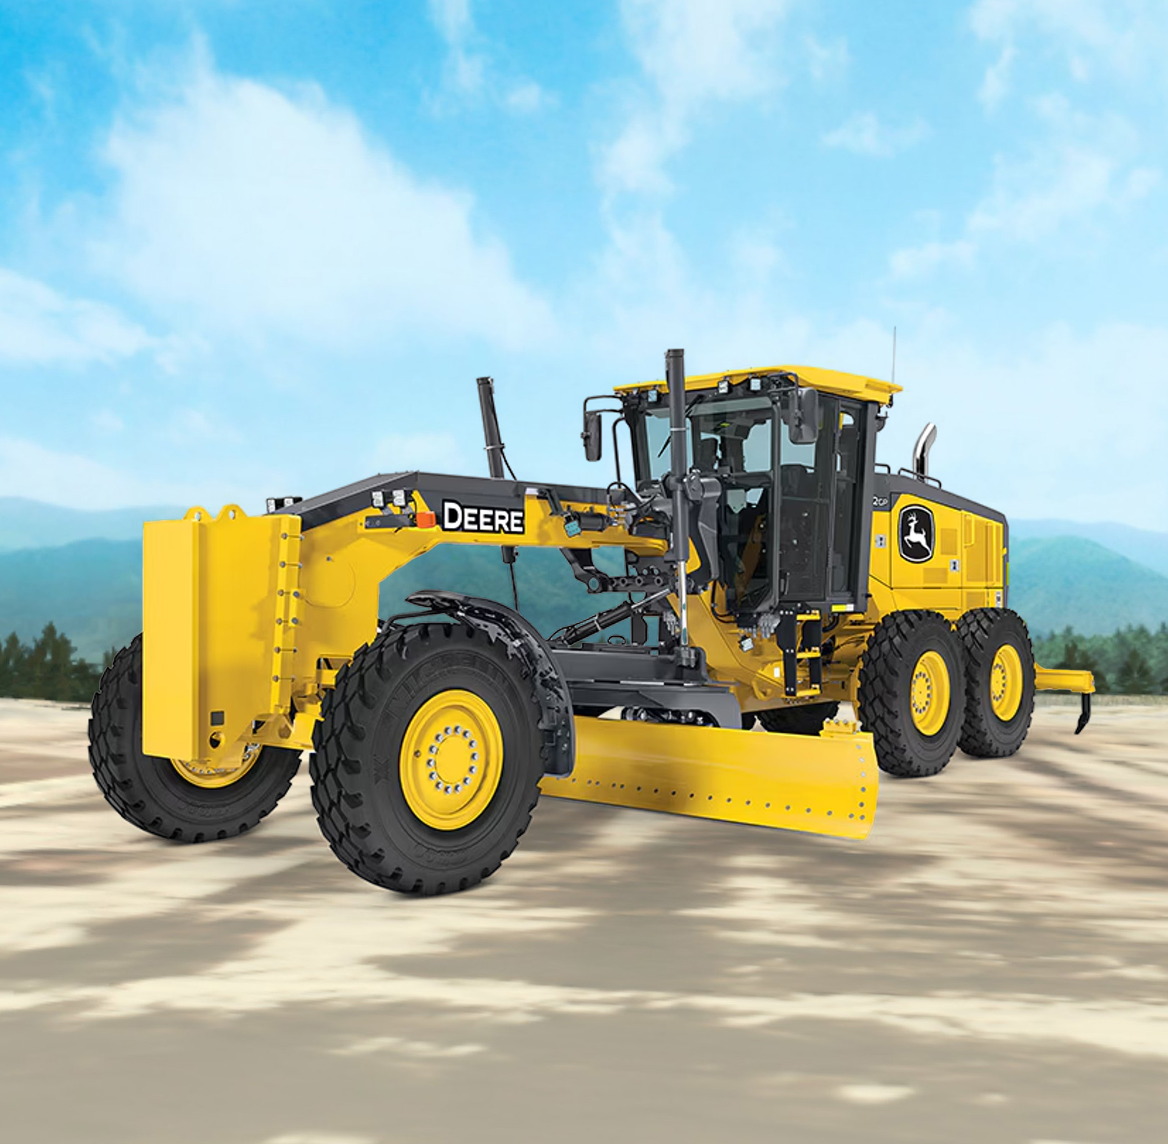

Extended Reality Training System
Support and maintenance
EDIT

Slide 2
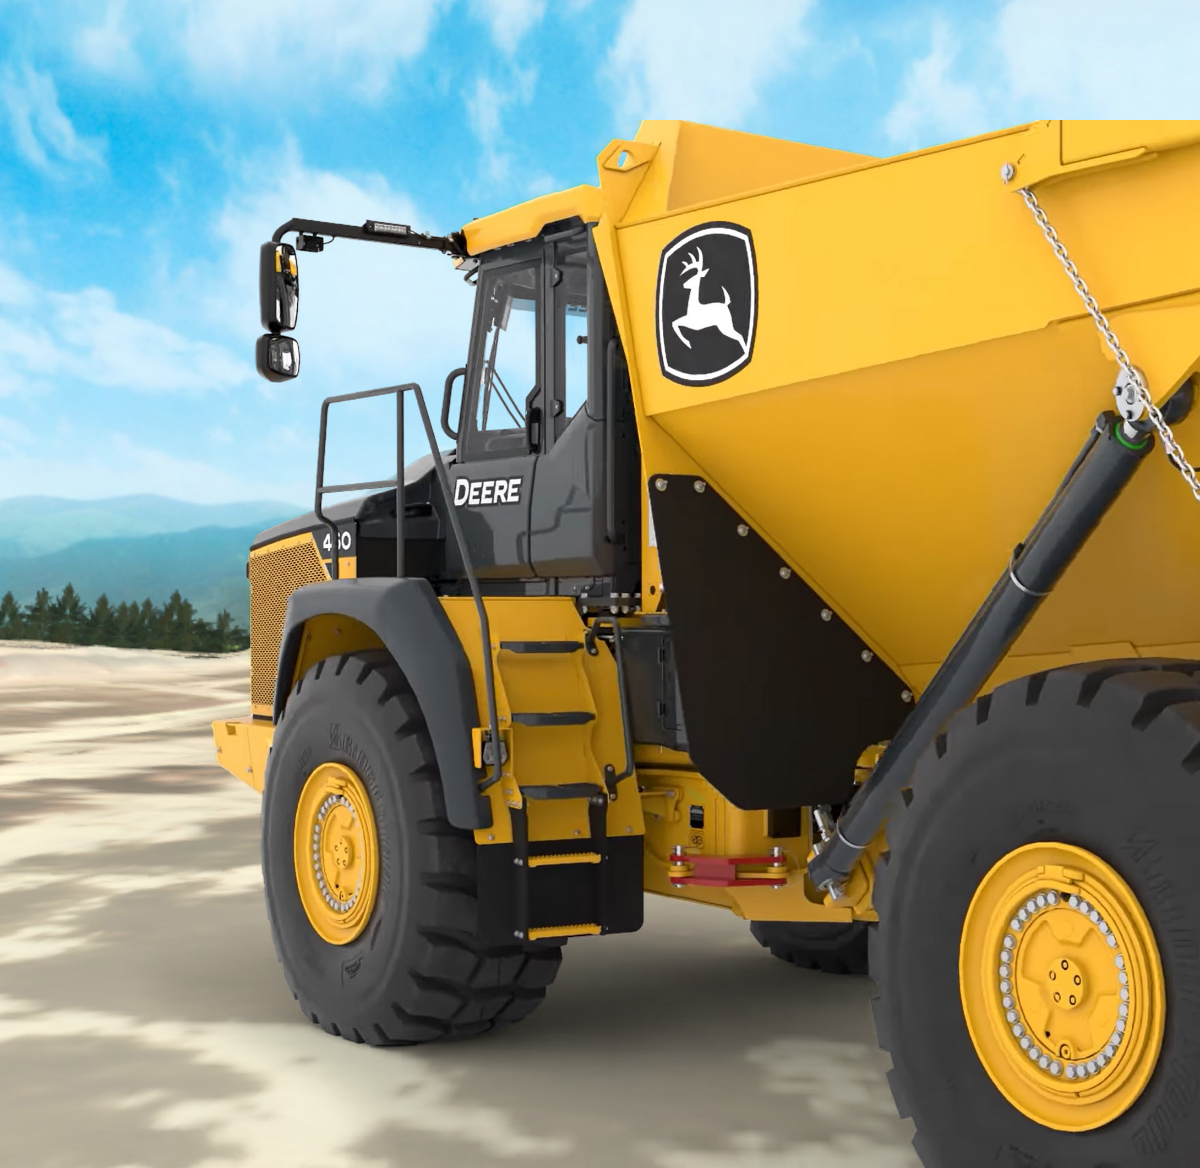
Support
& Maintenance
This proposal outlines twelve months of dedicated support and maintenance for the John Deere Extended Reality Training System, ensuring long term platform stability while supporting John Deere’s licensing and distribution. The program includes a baseline of 40 hours per month (480 hours annually) of expert services at $185 per hour, invoiced monthly. To provide transparency, ForgeFX will deliver monthly usage reports showing hours consumed, hours remaining, and any rollover balance (up to 100 hours).
This support contract provides the foundation for sustaining the John Deere Immersive Training Platform, the comprehensive immersive simulation environment, and licensing and distribution frameworks to deliver smooth operations across John Deere’s XR training domains. The program’s long-term stability, responsiveness, and field alignment rely on the structured support outlined in this agreement.

Slide 3
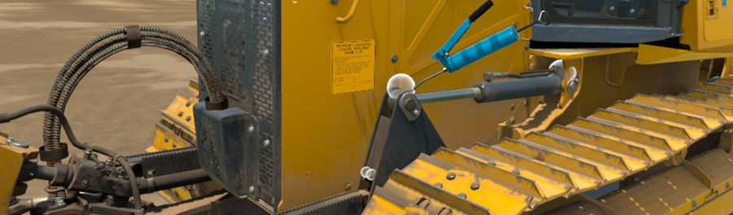
Scope of Work
ForgeFX will provide twelve (12) months of support and maintenance services for the John Deere Extended Reality Training System. These services will be dedicated to ensuring stability, modernization, and responsiveness to client needs. Support includes both proactive maintenance activities initiated by ForgeFX and reactive issue resolution following Tier 1 validation and escalation by John Deere. Under this agreement, ForgeFX will:
Allocate up to forty (40) hours of professional services per month, equating to four hundred eighty (480) hours annually.
Focus efforts on maintaining and strengthening the Training Simulator Program’s existing systems and licensing tool, addressing technical issues, and implementing updates that enhance performance and reliability. Support will also be allocated as needed for John Deere’s distribution program.
These services are designed to sustain the simulator as a commercially deployable training product and are not solely dependent on customer-reported issues.
This agreement is limited to maintenance and support activities. Development of new features or major functionality enhancements may be added upon mutual agreement under a separate statement of work.

Slide 4
Scope of Work
Core Maintenance Support
Collaborate with John Deere stakeholders to validate reported issues, identify and address root causes, prioritize fixes based on operational impact and commercial risk, and confirm resolution.
Perform quality assurance and regression testing on updates to validate fixes in deployment environments and confirm issue resolution through testing and verification to maintain simulator and licensing tool health.
Implement targeted simulator and licensing tool maintenance updates that enhance system compatibility, reduce risk, address edge cases encountered in the field, to support and improve long-term reliability of the training program.
Contribute to the continuity and credibility of the training program by ensuring consistent performance, timely issue resolution, and structured maintenance support.
Provide ongoing communication with John Deere stakeholders regarding issue status, prioritization, and resolution progress.
Remain available to reprioritize or expedite efforts in response to urgent issues or other critical needs identified by John Deere.
Provide ongoing engineering oversight to ensure continuity and long-term reliability of the simulator platform and licensing tool, including stewardship of the simulator codebase to maintain long-term maintainability, stability, and scalability.

Slide 5

Scope of Work
XR Distribution Framework
Liaise with XR platform providers (e.g., device manufacturers, MDM solutions, and content distribution frameworks) to ensure compatibility, performance alignment, and timely issue resolution.
Provide technical advisory support related to the configuration and deployment of XR training solutions, including guidance on integration with enterprise device management platforms (MDMs) and alignment with John Deere’s IT and distribution environments.
Support John Deere’s XR program by advising on industry best practices, headset procurement pathways, reseller coordination, and deployment logistics.
Assist with enabling operational features in the MDM environment such as device home environment configuration, content casting, remote updates, standardized setup, and device health optimization across global teams.
Assist with high-level escalations related to enterprise deployment and accessibility in coordination with John Deere stakeholders and third-party service providers as needed.
Provide advisory support on simulator behavior within managed device environments, including coordination with John Deere stakeholders and provisioning partners.
Provide strategic guidance on XR program scalability, long-term platform alignment, and best practices for enterprise training deployments.
ForgeFX will provide advisory and escalation-based support related to XR distribution only to the extent such support affects simulator compatibility, performance, and operation within managed enterprise environments. ForgeFX’s role does not include direct MDM administration, device provisioning, fulfillment, hardware setup, logistics, or other operational deployment tasks, which are the responsibility of John Deere and its designated MDM, provisioning, and distribution partners.

Slide 6
Cost And Billing
Billing
ForgeFX will invoice a fixed monthly fee of $7,400, representing up to forty (40) hours of support services at a rate of $185 per hour. The total annual contract value for a 12-month period is $88,800.
Monthly Usage and Rollover
Support hours are tracked monthly against the 40-hour allocation.
If fewer than 40 hours are used in a given month, the unused hours will roll forward into a cumulative bank.
The rollover bank is capped at a maximum of 100 hours. Any hours exceeding this cap will expire and will not be carried forward.
Application of Hours
In months where support usage exceeds 40 hours:
Available rollover hours will be applied first to cover the overage.
Once rollover hours are exhausted, any additional work will require prior approval under the Additional Hours provision below.
End of Term
Any unused rollover hours remaining at the end of the twelve-month term will expire and will not be refunded or carried into a subsequent agreement unless otherwise agreed in writing.
Reporting
ForgeFX will provide a monthly report detailing: Hours consumed during the month, cumulative hours used to date, remaining base allocation, and available rollover balance (up to 100 hours)

Slide 7
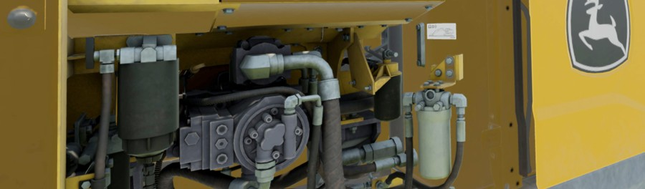



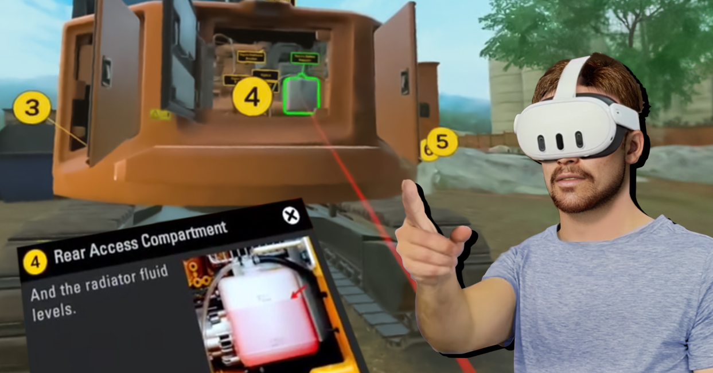
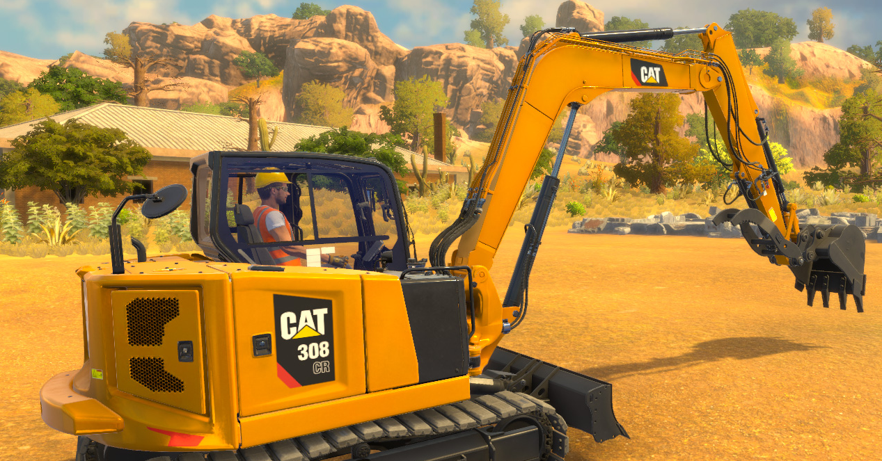
Support Tier: Definition
Under this proposal ForgeFX offers to provide John Deere with Tier 2 support for specialized activities relating to the smooth operation of the simulator, licensing tool, and overarching distribution program.
For the purposes of this proposal, support services for the John Deere Extended Reality Training System are organized into the following tiers to clearly define roles and responsibilities across all participating parties.
Tier 1 Support
Tier 1 support is owned by John Deere and its designated partners, including VR Expert, and serves as the initial point of contact for customers. Tier 1 support includes customer and end user inquiries, device provisioning and fulfillment, hardware setup, basic simulator access and usage guidance, and initial issue validation. ForgeFX does not provide direct Tier 1 end user or dealer helpdesk support.
Tier 2 Support
Tier 2 support is provided by ForgeFX and includes application-level support for the XR Training Simulator. Tier 2 activities include investigation and resolution of operational defects, simulator configuration issues, performance optimization, proactive platform maintenance, compatibility updates, and corrective software fixes for issues escalated by John Deere following Tier 1 validation. Tier 2 support includes program level support and maintenance for John Deere’s distribution program. Non-critical and operational distribution activities, including provisioning, device management, and fulfillment, are performed by John Deere and its third-party MDM and provisioning partners, with ForgeFX providing escalation support as needed.
Exclusions
The following are not included under this agreement:
Tier 1 support or ticket intake
Direct end-user or dealer helpdesk support
Device provisioning, hardware setup, logistics, or warranty support
Customer account management
Development of new features or major enhancements (covered under separate SOW)
  ForgeFX is well-equipped to develop the [PROJECT]. Our experience, methodology, framework, and commitment to client success make us the ideal partner for this project. We look forward to the opportunity of partnering with [COMPANY] to create the envisioned training platform.

Slide 8

On Target?
Once our understanding is clear in terms of project goals, features, and budget requirements, we’ll be in position to move forward with next steps towards kicking off the development of your project.
Goals
Features
Cost
Realistic

Slide 9



Thank you!
Mary Pierce
Executive Director of
Enterprise Partnerships
Mary consults with our clients, studies their business, and generates creative solutions for their training needs.
Thank you for exploring this addition to the Halliburton Immersive Training Platform. As an approved vendor, we value the opportunity to continue supporting Halliburton’s commitment to innovative and effective training solutions.
We appreciate the collaboration that has brought us to this stage and look forward to building on the strong foundation we’ve already established. Our goal is to enhance and expand the Cementing Services Division's training capabilities with solutions that align seamlessly with Halliburton’s operational needs.
(415) 788-5725, ext. 703
Mary.pierce@forgefx.com
ForgeFX Simulations
1160 Battery Street East, Suite 100
San Francisco, CA 94111
(415) 788-5725 www.forgefx.com
BOILER
PLATE

