Slide 1


Cargojet deicing
SIMULATOR
A Virtual Reality Deicing Training Platform
EDIT

Slide 2

Project
Overview
Cargojet's objective is to provide operators with a realistic, repeatable training environment where they can safely develop and refine aircraft deicing skills before performing live operations. By replicating real-world equipment, aircraft, and environmental conditions, the simulator enables operators to build confidence, improve spray technique, and practice operational decision-making without consuming deicing fluid or impacting daily operations.
The proposed solution is a scalable Virtual Reality Aircraft Deicing Training Platform centered on the TEMPEST I deicing truck and Cargojet's operational procedures. Operators interact with Cargojet-furnished Tempest I controls while practicing Type I and Type IV deicing procedures on representative aircraft in a realistic virtual environment. Environmental conditions such as contamination, visibility, lighting, and wind replicate the operational challenges encountered during day-to-day deicing activities, while integrated performance metrics provide objective feedback on spray coverage, material usage, and completion time.
To support Cargojet's implementation schedule and budget objectives, ForgeFX has organized the proposed solution into a series of scalable implementation options that expand training capability while leveraging a common software and simulation foundation. The following pages summarize our recommended implementation paths, with a detailed feature comparison matrix provided in Appendix A.

Slide 3
Implementation: At a Glance
[PROJECT]
Based on our proposal review discussion, ForgeFX refined the implementation strategy to prioritize the capabilities that Cargojet identified as having the greatest operational value. The options below represent progressive implementation paths that balance schedule, budget, and training capability while preserving a scalable foundation for future expansion.
Why ForgeFX Recommends Option 2
Following our proposal review discussion, ForgeFX believes Option 2 provides the best balance of implementation schedule, capability, and operational value. This option prioritizes the training capabilities Cargojet identified as most critical—including Boeing 767 operations, Type I and Type IV spray simulation, free-form practice, representative weather conditions, and objective performance feedback on coverage, time, and material usage—while establishing a scalable software foundation for future expansion.
A detailed feature comparison matrix is provided in Appendix A.
Option | Implementation | Primary Purpose | Duration | Investment
Option 1 | Spray Skills Trainer | Foundational operator familiarization with TEMPEST I controls and Type I spray techniques. | 5 Months | $585,000
Option 2 Best fit for realistic operational training. | Spray Performance Trainer | Develop operational spray proficiency using Cargojet's primary aircraft, spray types, weather conditions, and performance scorecard. | 5 Months | $780,000
Option 3 | Core Deicing Simulator | Train complete single-truck Type I deicing procedures within a structured training environment. | 9 Months | $1,200,000
Option 4 | Operational Deicing Simulator | Expand training to advanced operational procedures, additional workflows, and instructor-led qualification. | 11 Months | $1,770,000
Option 5 | Enterprise Deicing Training Platform | Deliver a comprehensive enterprise training platform supporting multiple aircraft, enterprise administration, and future expansion. | 14 Months | $2,250,000
Implementation Note: Each implementation option includes the capabilities of all preceding options unless otherwise noted. The options are presented as standalone implementation paths, and their pricing is not additive. Should Cargojet elect to expand the simulator in the future, previously developed software, digital assets, integrations, and training content may be leveraged to reduce redevelopment effort and preserve prior investment.

Slide 4

Foundational Training: Options 1–2
[PROJECT]
The foundational implementation options are designed to rapidly improve operator proficiency with Cargojet's aircraft deicing equipment and spray techniques before introducing more advanced operational workflows. These options focus on building confidence through realistic spray practice, objective performance feedback, and representative operating conditions while minimizing implementation time and cost.
OPTION 1
Spray Skills Trainer
$585,000 · 5 months
OPTION 2
Spray Performance Trainer
$780,000 · 5 months
Best fit for realistic operational training
Recommended Choice
Best suited for: Foundational operator familiarization with TEMPEST i controls and Type I spray techniques
INCLUDES
✓ TEMPEST i deicing truck VR simulation
✓ Boeing 767 exterior aircraft model
✓ Type I spray simulation
✓ Cargojet-furnished Tempest I physical control integration
✓ One guided module
✓ One qualification assessment
✓ Basic pass/fail reporting
DOES NOT INCLUDE
✕ Sandbox practice
✕ Type IV Spray
✕ Instructor management tools
✕ LMS integration
✕ Multi-user training
✕ Configurable weather
Best suited for: Operators who require realistic spray practice on Cargojet's highest-priority aircraft and under operational conditions.
INCLUDES
✓ TEMPEST i deicing truck VR simulation
✓ Boeing 767 exterior aircraft model
✓ Type I & Type IV spray simulation
✓ Cargojet-furnished Tempest I physical control integration
✓ Free-form sandbox training for independent practice
✓ Weather system including frost, light/medium/heavy snow contamination, day/night lighting, low-visibility conditions, wind speed, and wind direction
✓ AI-assisted vehicle movement
✓ Performance scorecard measuring Type I & IV material usage, spray coverage by aircraft section, and total deicing completion time.
DOES NOT INCLUDE
✕ Guided instructional Lessons
✕ Instructor management tools
✕ LMS integration
✕ Multi-user training
Cargojet will furnish the TEMPEST i controls for integration. Development will require 2 sets of controls, of which 1 will be returned as part of the project deliverables. The second set will be retained by ForgeFX for troubleshooting and support.

Slide 5
Operational Training: Options 3–5
[PROJECT]
The operational implementation options expand beyond individual spray proficiency to replicate complete aircraft deicing operations within a realistic training environment. These solutions introduce operational workflows, instructor-led training, enterprise management capabilities, and expanded aircraft support, providing Cargojet with a scalable platform that can evolve alongside future operational requirements.
OPTION 3
Core Deicing Simulator
$1,200,000
9 months
OPTION 4
Operational Deicing Simulator
$1,770,000
11 months
OPTION 5
Enterprise Deicing Platform
$2,250,000
14 months
Best suited for: Complete single-truck Type I deicing training
INCLUDES
Everything included in Option 2, plus:
✓ Four guided learning modules covering complete Type I deicing procedures
✓ Structured learning progression from equipment familiarization through complete operational workflow
✓ One comprehensive qualification assessment validating complete Type I operational proficiency.
✓ Expanded performance reporting including spray coverage, contamination removal effectiveness, procedural compliance, completion time, and pass/fail status
✓ Basic instructor management tools for launching training sessions, monitoring trainee progress, and reviewing assessment results
DOES NOT INCLUDE
✕ Additional aircraft beyond the Boeing 767
✕ Advanced operational workflows (e.g., fluid injection, specialized procedures)
✕ Enterprise reporting and historical analytics
✕ Learning Management System (LMS) integration
✕ Multi-user collaborative training
Best suited for: Advanced operational training across Cargojet's aircraft fleet
INCLUDES
Everything included in Option 3, plus:
✓ Boeing 757, Boeing 767-200, and Boeing 767-300 training aircraft
✓ 6 guided learning modules covering advanced operational procedures and fleet-specific operations
✓ Three comprehensive qualification assessments supporting advanced operational scenarios
✓ Type I and Type IV operational workflows, including fluid injection procedures
✓ Advanced AI-assisted vehicle positioning supporting Cargojet-approved operational drive paths
✓ Enhanced instructor management with expanded scenario control and trainee management
✓ Expanded performance reporting including operational compliance, material usage, procedural scoring, and scenario-specific analytics
DOES NOT INCLUDE
✕ Enterprise performance dashboards
✕ Learning Management System (LMS) integration
✕ Multi-user collaborative training
✕ Customer-specific workflow
authoring
Best suited for: Enterprise-wide standardized training and long-term program management
INCLUDES
Everything included in Option 4, plus:
✓ 10 guided learning modules supporting enterprise training and recurrent qualification
✓ Five comprehensive qualification assessments covering enterprise training objectives
✓ Full enterprise instructor management console with advanced scenario authoring
✓ Single- and two-truck operations, engine-running procedures, and fluid injection
✓ Enterprise performance dashboards with historical reporting, trend analysis, and trainee performance tracking
✓ Learning Management System (LMS) integration
✓ Multi-user collaborative training
✓ Cargojet-specific operational procedures, enterprise workflows, and future training content framework.
Notes:
Update to sideline text

Slide 6
Recommended
Simulator Configuration
[PROJECT]
Standard Simulator Deployment
The proposed implementation is based on a standard VR simulator workstation that minimizes deployment complexity while providing a scalable foundation for future expansion.
ForgeFX will develop and deliver the custom Aircraft Deicing Training Simulator software, integrate Cargojet-furnished OEM TEMPEST i controls, and provide the interface hardware and deployment documentation required for installation.
Cargojet will furnish the commercially available workstation hardware required to operate the simulator.
The simulator platform is designed to support future expansion by deploying the software on additional customer-furnished hardware as training requirements evolve.
SUPPLIED BY
ForgeFX
Included in Option 2 price
SUPPLIED BY
Cargojet
✓ Custom Aircraft Deicing Training Simulator software application
✓ VR headset (Meta Quest), Qty 2
✓ Integration of Cargojet-furnished OEM TEMPEST i controls
Control interface electronics and communication hardware
  Custom mounting brackets and hardware required to integrate the OEM controls
✓ Hardware integration documentation to support future control reproduction
✓ Project-specific source code, digital assets, and development documentation
✓ OEM TEMPEST i control assemblies. Required quantity of 2.
Joysticks
Switches and associated controls
Wiring harness
✓ Gaming PC meeting the recommended specifications: Required quantity of 1.
✓ Large screen external monitor for casting instructor view. Optional quantity of 1.
* TEMPEST I controls will be sent to ForgeFX for development
* Additional simulator stations can be deployed by procuring additional customer-furnished hardware and installing the simulator software on systems meeting the recommended specifications

Slide 7

[PROJECT]
Technical Specifications
Hardware requirements
Commercial Hardware Requirements
The specifications below represent the recommended baseline hardware configuration for reliable simulator performance and future expansion. Based on current commercial pricing, the Cargojet-furnished hardware required to support a simulator workstation is estimated at approximately $2,700 to $4,200 (excluding OEM TEMPEST i controls), providing a rough-order-of-magnitude (ROM) budget for planning purposes.
Component | Minimum | Recommended
Operating System | Windows 10/11 (64-bit) | Windows 11 (64-bit)
Processor | Intel Core i5 / AMD Ryzen 5 | Current Intel Core i5/i7 or AMD Ryzen 5/7
Memory | 16 GB | 32 GB
Graphics | RTX-class GPU (or equivalent) | RTX 4070 or better (example)
Storage | 20 GB SSD | SSD with additional free space
Network | Ethernet or Wi-Fi | Gigabit Ethernet
USB Ports | 4+ USB 3.0 ports | 6+ USB 3.0 ports
External Monitor | 24" 1080p HDMI Monitor | 24" 1080p HDMI Monitor

Slide 8

Product Ownership
One cost,
infinite
potential
ForgeFX develops custom simulation solutions that provide lasting value beyond the initial deployment. Cargojet will receive the project-specific deliverables developed under the final project agreement, allowing the simulator to be maintained, expanded, and adapted as training requirements evolve.
One-time development cost: The proposed implementation options represent defined project scopes with one-time development pricing. Each option provides a clear implementation path without recurring ForgeFX development fees.
No ForgeFX per-seat licensing fees: ForgeFX does not charge per-seat licensing fees for the custom simulator developed for this project, unless otherwise specified in the final agreement. Cargojet may deploy the completed simulator throughout its approved training environment without additional ForgeFX seat-based charges.
Designed for future expansion: Project-specific aircraft models, training content, scenarios, user interfaces, and workflows can serve as the foundation for future implementation phases, helping preserve the value of Cargojet’s initial investment while reducing redevelopment effort.
Proven development foundation. ForgeFX leverages proven simulation frameworks, development tools, workflows, and technical infrastructure to accelerate development and reduce project risk. Pre-existing ForgeFX technology, third-party software, and licensed components remain subject to their respective ownership and licensing terms as defined in the final project agreement.
Long-term partnership. ForgeFX supports clients beyond initial deployment through ongoing maintenance, technical support, updates, and future enhancements as training programs evolve.

Slide 9
Simulator ROI
[PROJECT]
When evaluating a simulator investment, it's important to consider both the direct and indirect benefits to training operations. A well-designed deicing simulator provides more than just procedural instruction—it enables operators to repeatedly practice critical skills in a safe, controlled environment while reducing reliance on operational equipment and consumable materials. For Cargojet, the proposed simulator is intended to improve operator proficiency, increase training flexibility, and establish a scalable platform that supports long-term operational readiness.
Reduced Wear and Tear on Physical Equipment
Conducting foundational and recurrent training in the simulator reduces the amount of training performed on operational deicing equipment. This minimizes wear on the TEMPEST i deicing truck while reducing the potential for equipment damage and associated maintenance costs.
Reduced Training Material Costs
Simulator-based practice enables operators to develop and refine spray techniques without consuming glycol or tying up operational equipment. Repeated practice can be completed in the virtual environment before transitioning to live operations, reducing the cost of training activities.
Increased Operator Proficiency
Operators can repeatedly practice spray techniques, boom positioning, spray patterns, and operational decision-making under representative environmental conditions before working on live aircraft. Objective performance feedback helps reinforce proper spray techniques while building confidence and consistency.
Reduce Training Time & Expenses
Access to operational aircraft, deicing equipment, and suitable weather conditions can limit training opportunities. The simulator enables training to occur regardless of aircraft availability, weather conditions, or equipment scheduling, improving instructor utilization and reducing operational disruption.
Increased Throughput
A simulator allows multiple operators to complete training throughout the year without relying on seasonal weather events or removing operational equipment from service. This increases training capacity while helping standardize instruction across instructors, shifts, and operating locations.
Improve Spray Efficiency and Operational Consistency
Operators receive objective feedback on spray coverage, material usage, and completion time, allowing them to refine spray techniques before performing live deicing operations. Consistent training helps reinforce standardized operating practices while supporting more efficient and repeatable deicing procedures.

Slide 10
On Target?
Once our understanding is clear in terms of project goals, features, and budget requirements, we’ll be in position to move forward with next steps towards kicking off the development of your project.
Goals
Features
Cost
Realistic

Slide 11



Let’s Get Started!
Mary Pierce
Executive Director of
Enterprise Partnerships
Mary consults with our clients, studies their business, and generates creative solutions for their training needs.
ForgeFX Simulations looks forward to working with you to design and develop your training simulator. If our proposal is in line with your requirements and you would like to hire us, please contact Mary Pierce to discuss development options and she will send you a project agreement for this proposal to review.
(415) 788-5725, ext. 703
Mary.pierce@forgefx.com
ForgeFX Simulations
2109 N Street, Suite N
Sacramento, CA 95816
(415) 788-5725 www.forgefx.com
BOILER
PLATE

Slide 12


Appendix A
  A detailed feature comparison matrix describing the capabilities included within each implementation option
BOILER
PLATE

Slide 13
spread here thank you
;)

Slide 14
Development Milestones
[PROJECT]
This chart illustrates the several stages of development that the project will pass through on its way to completion and delivery.
Team introductions and project initiation
KICK-OFF
PRE-ALPHA
25% feature-complete application
50% feature-complete application
ALPHA
BETA
75% feature-complete application
99% feature-complete application
RELEASE CANDIDATE
GOLD MASTER (GM)
100% feature-complete application

Slide 15
Production Schedule
[PROJECT]
This chart illustrates the team members who develop our simulators, and the amount of effort they take to produce a quality training product.
Development Team | Production Phases in Milestones
 | Requirements Gathering, Design |  | Modeling, Coding, Writing, Production
 | Pre-Alpha | Alpha | Beta | Release Candidate | Gold Master
Producers & Team Leads (2)
Developers (3)
Artists (2)
Audio Engineer (1)
User Interface Designer (1)
Production & QA (1)
Client Communication & Coordination
Team Org.
Team Coordination
Project Strategy
Project Structure
Hardware Logic
Lesson Logic
Software Logic
User Interface
Environment Modeling
Equipment Modeling
Audio Capture
Audio Design
UI Design
Asset Production
Production Tasks
Iterative Testing

Slide 16
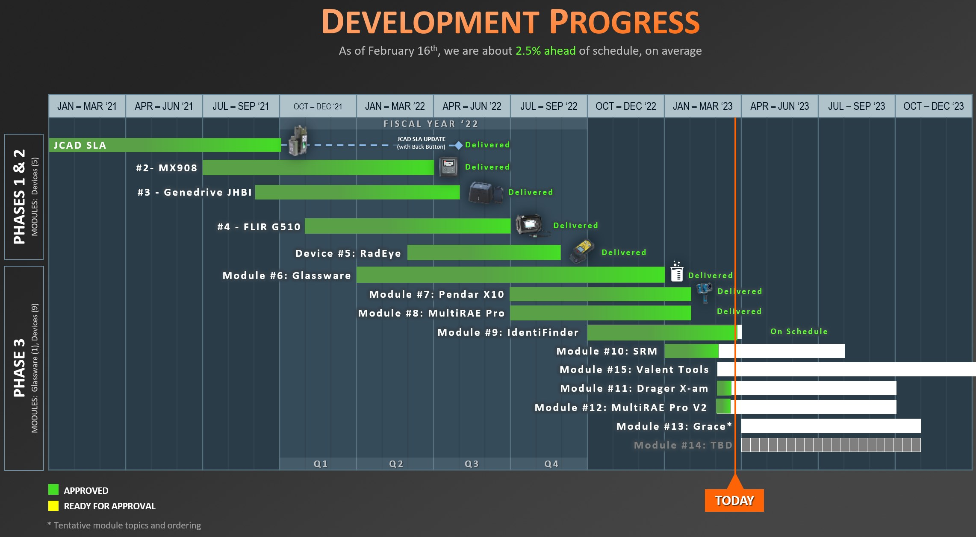
Project Example: Schedule Management
[PROJECT]
HoloTrainer Schedule Management
One of the most critical factors in the development of custom software is the ability to deliver the final product on time. ForgeFX project managers have extensive experience in the systematic planning, monitoring, and control of project activities to ensure timely completion. ForgeFX anticipates the development of your simulator to be a multi-phased effort, requiring optimized resource allocation over an extended period.
Leveraging both Gantt and milestone charts, ForgeFX provides Stakeholders with a project timeline at project kickoff. As the project progresses, actual performance is continually measured against the planned schedule. The ForgeFX project manager will address any variances, ensuring that potential delays or accelerations are appropriately communicated to Stakeholders.
An example of ForgeFX’s successful management of a multi-phased software development project is the HoloTrainer XR Training Simulator for the Department of Defense. This program required the development of full training simulators for fifteen different devices, each built by a different manufacturer. The overall program was divided into three development phases, with the total period of performance of 3 years. The Gantt chart below provides an example of how the ForgeFX team monitors the real-time status of the overall project time for this multi-phased project consisting of nearly 3000 individual and interactive training steps.

Slide 17
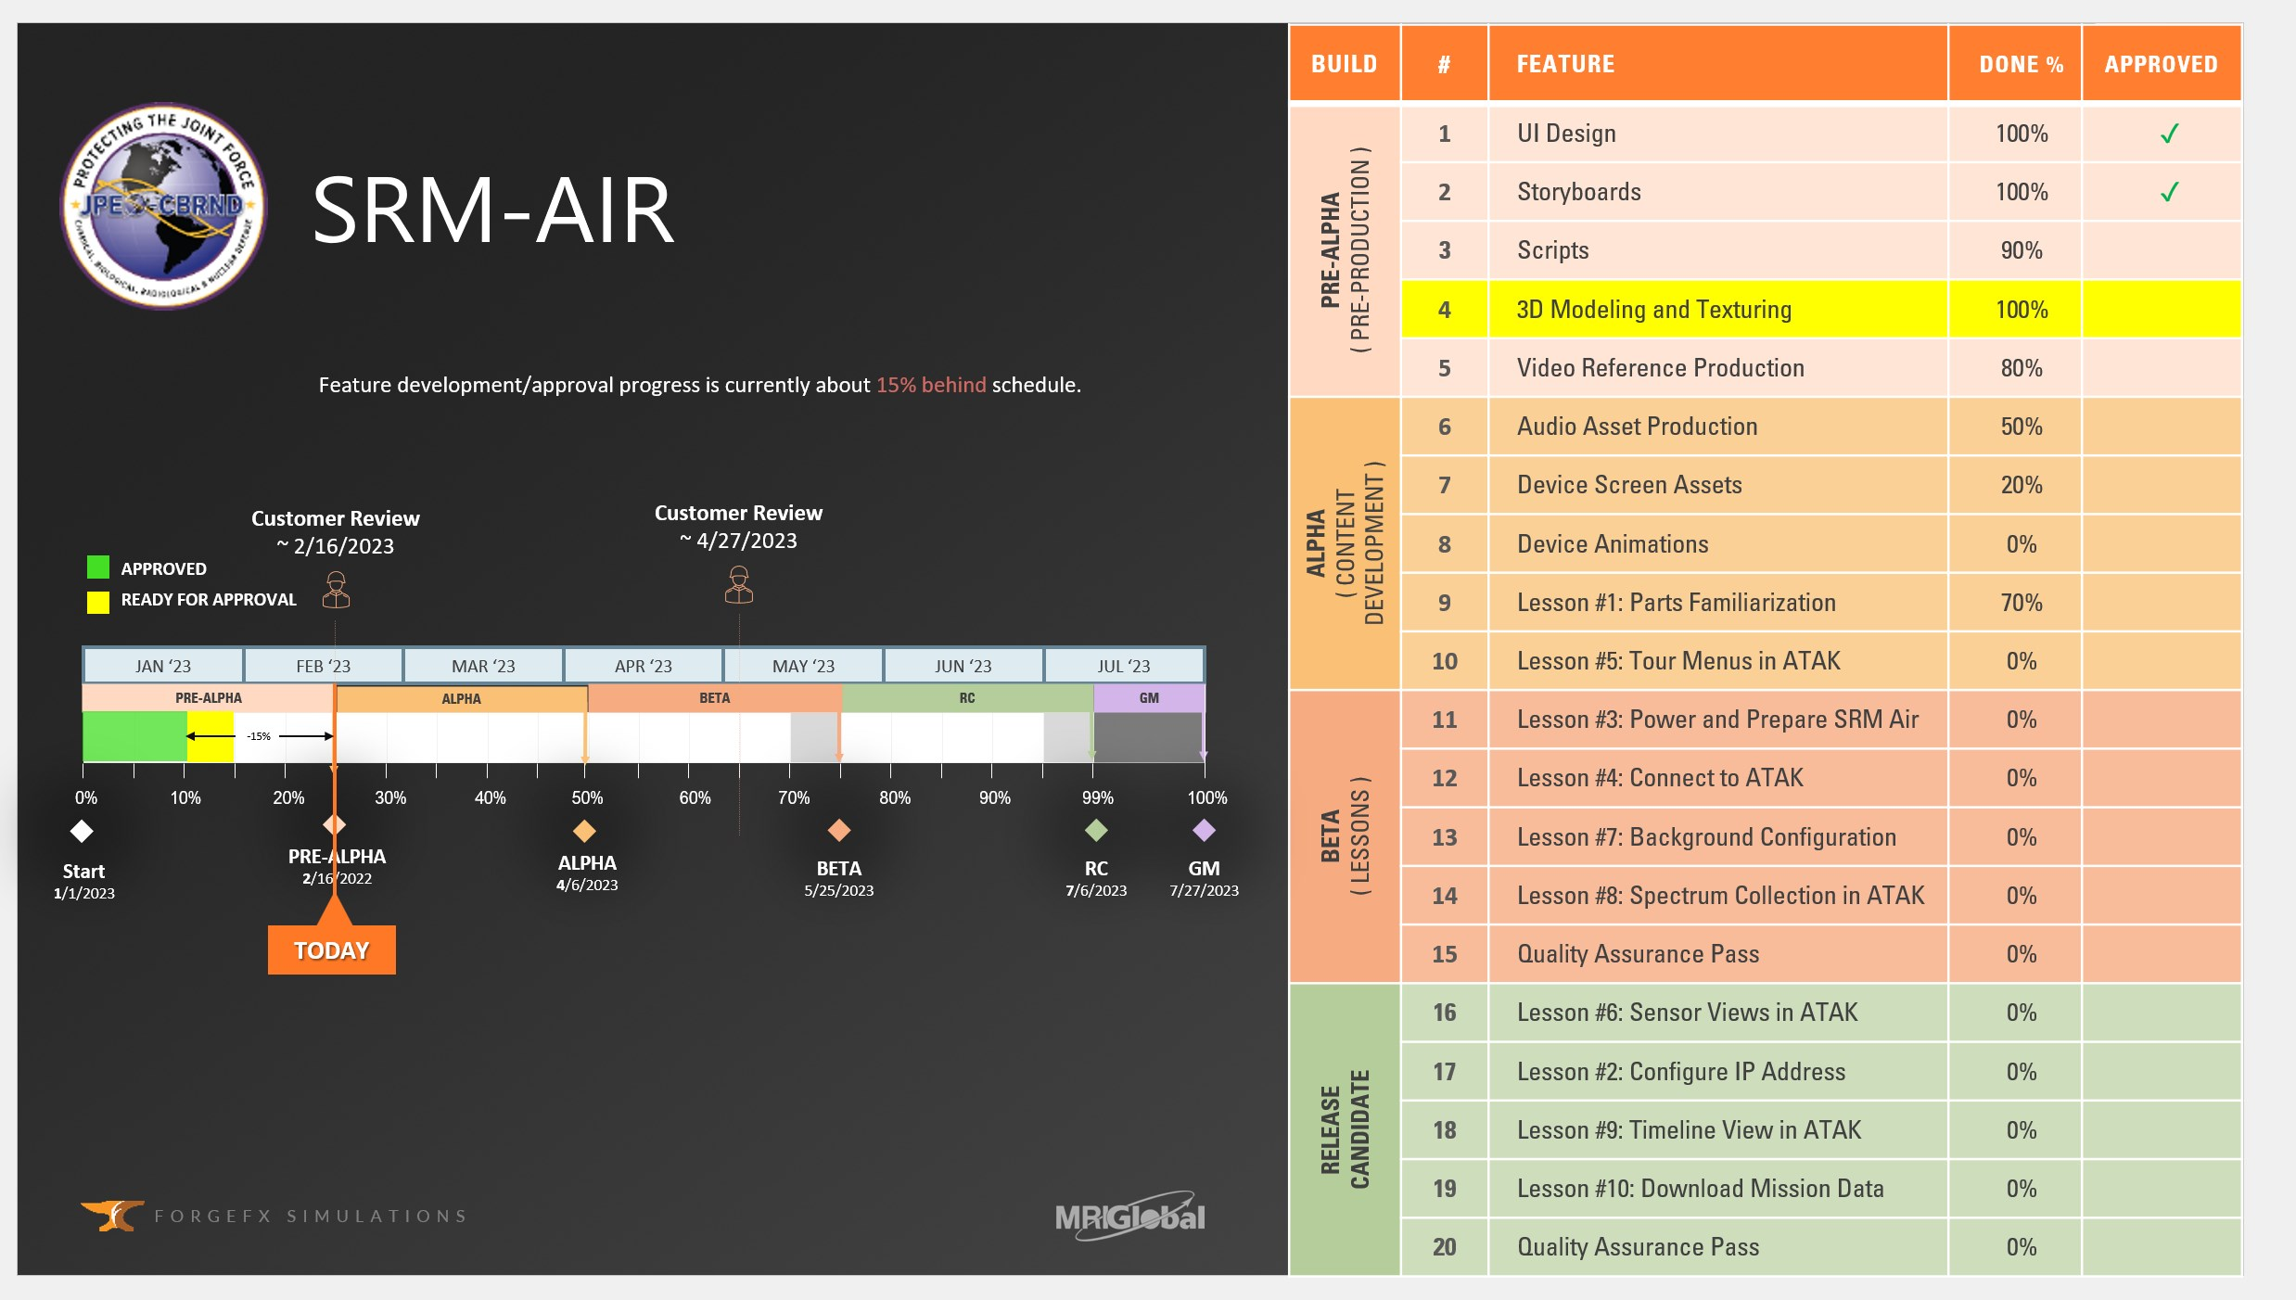
Project Example: Milestone Tracking
[PROJECT]
HoloTrainer Milestone Tracking
In addition to expertise in overall schedule management, ForgeFX has demonstrated the ability to track progress at the milestone and application feature level.
Shown below is an actual milestone status chart used during a bi-weekly HoloTrainer client meeting. For this specific training module, the chart tracks the development status from kick-off through each milestone deliverable (Alpha, Beta, etc.). It also identifies whether the team is ahead or behind schedule and provides a metric to quantify this schedule status.
Moreover, ForgeFX Simulations also maintains detailed records of requirements and progress on a feature-by-feature basis within each module, as identified in the table. Each feature’s percent progress is monitored, as well as the client-approval status for each specific feature.
This granular approach allows for precise monitoring and control over every aspect of development and provides additional benefits including early identification and resolution of potential issues and facilitates accurate forecasting and planning.
ForgeFX’s approach to schedule management, with its focus on low-level per module tracking, ensures that every aspect of your simulator’s development process will be carefully monitored and controlled to guarantee on-time delivery of a high-quality training solution.

Slide 18
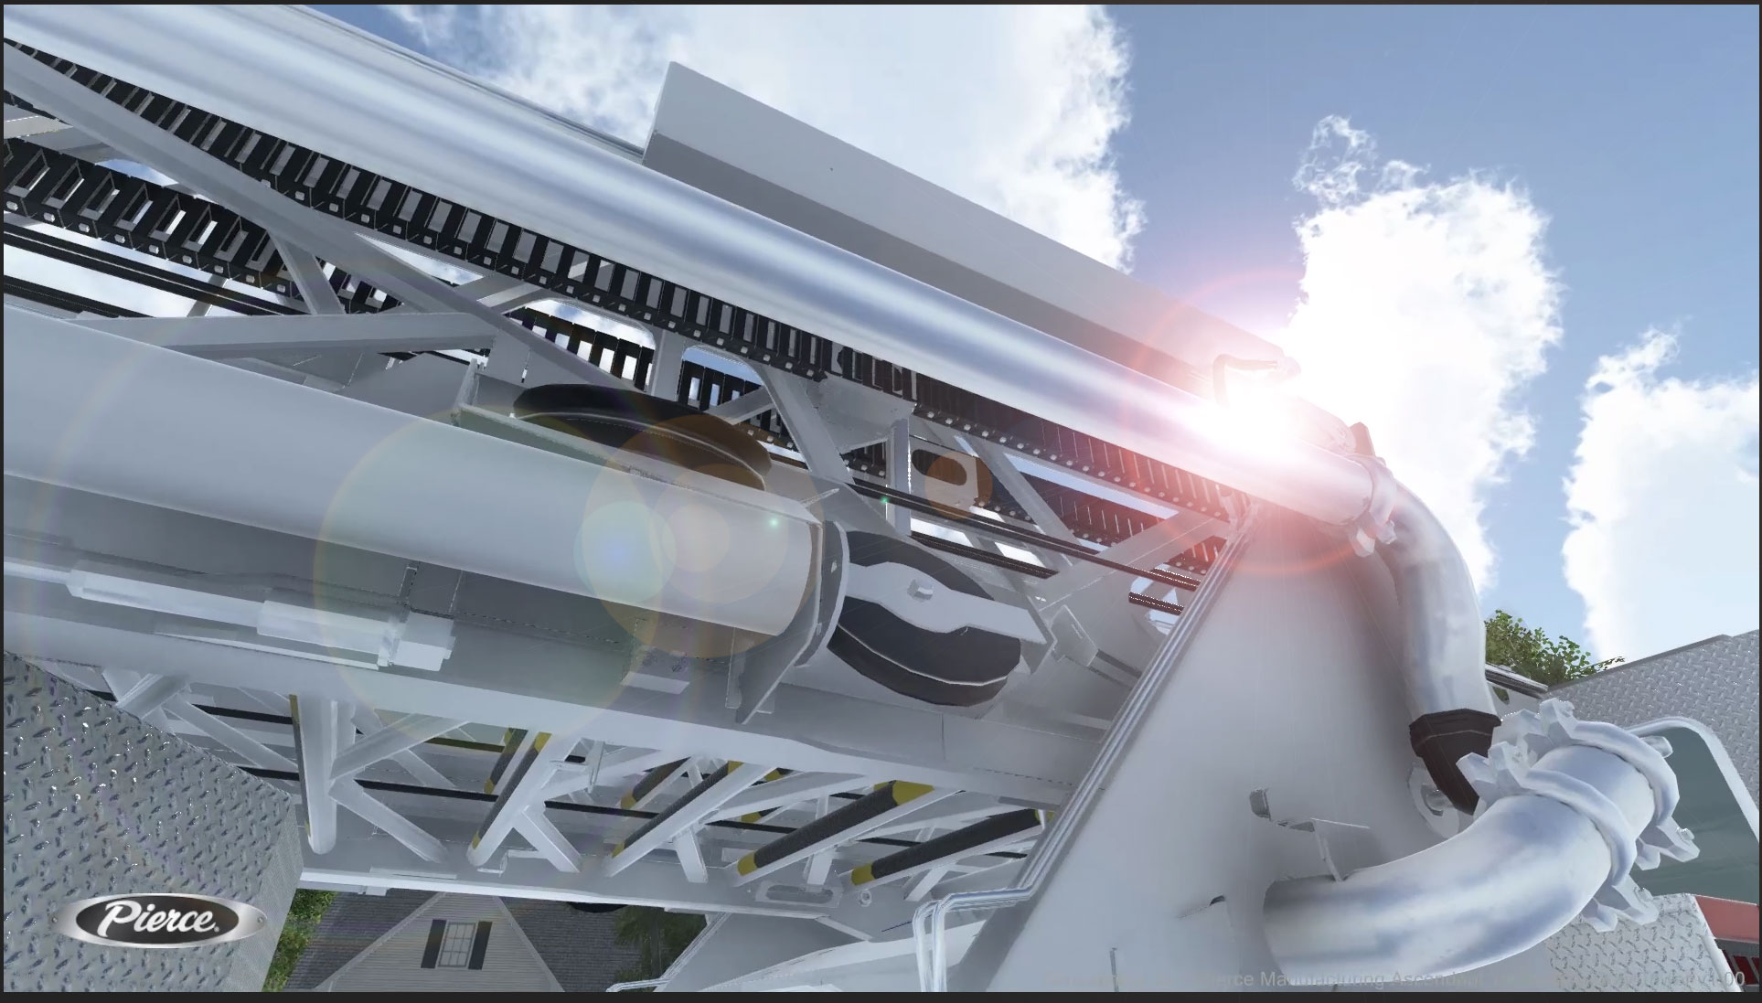
ForgeSIM™ FRAMEWORK
Essential
building blocks
of the training simulator
ForgeFX’s many years of simulator development has given us a tried-and-true methodology which is the framework on which we build our projects. This established methodology ensures that each simulator we create is not only reliable but also tailored to meet the specific needs of our clients. By incorporating real-world operational data and feedback into our design process, ForgeFX delivers simulators that provide practical training value and a high degree of realism, ultimately enhancing the learning outcomes and operational efficiency for our customers. Here are the elements of the framework:
A Culture of Continuous Improvement
We follow an agile development process: this is built around a process of delivering fully functioning application builds every 2 weeks for review. At that point, we will meet virtually via conference call and shared desktop to review the progress made over the preceding month, review the current prioritized feature list, and discuss requirement details for the features to be developed over the course of the next 2 weeks. In the agile process each one-month block of development, called a sprint, looks like this:
ForgeSIM™ CORE: Our core re-useable application framework enabling rapid development of fundamental application flows, based on a rock-solid foundation.
ForgeSIM™ CONNECT: Proprietary process and approach to bridge the gap between static machine and equipment CAD files to their interactive counterparts, matching real-world behaviors.
ForgeSIM™ CONTROL: Pre-built system to connect real-world equipment controls to ForgeSIM-based applications. Protocol support includes both custom and standard CAN-BUS systems.
ForgeSIM™ TRACK: Sophisticated system which granularly tracks both raw user actions as well as client-specified higher-level performance assessment and reporting criteria.
ForgeSIM™ GATHER: Time-tested multiplayer framework designed specifically for the team-based practice and instructor/student modalities required for simulation-based training.

Slide 19
Agile Methodology
A Culture of Continuous Improvement
We follow an agile development process: a practice of delivering fully functioning application builds every two weeks for review. At each review we meet virtually via conference call and shared desktop to assess the progress made over the preceding month, discuss the current prioritized feature list, and determine requirement details for the features to be developed over the course of the next two weeks.
The Sprint Cycle: One Month of Development
Sprint Planning: Review the prioritized feature list, possibly reprioritizing features, and/or adding removing features based on what we learn as development progresses and clients give their feedback.
Sprint: The development team works for 2 weeks developing the discussed features.
Sprint Delivery: At the end of each 2-week period, we upload the latest build for download and review.
Sprint Review Meeting: Review of progress from the prior 2 weeks and feedback collection. Revisions based on this feedback will be candidates for completion in the following sprint.
Sprint Planning
Sprint
(2 weeks)
Sprint
Delivery
Sprint Review Meeting

Slide 20
Game Engine Technology
Leveraging
a Winning
Strategy
The game engine is a software framework designed for the creation and development of video games. Video game developers use them to create games for video game consoles, mobile devices and personal computers. Simulations have many vital elements in common with games and their development processes:
  Interactive 3D Environments
  Task-Based Scenarios
  Scoring Mechanisms
  User Performance Monitoring
  Distribution Methods
For this reason, ForgeFX uses Unity, the dominant global game development software. More games are made with Unity than with any other game technology. We use game engine technology to produce our 3D simulations and visualizations because they are an incredibly efficient development environment with which to produce high-quality, enterprise-grade interactive 3D applications.
A Culture of Continuous Improvement
We follow an agile development process: this is built around a process of delivering fully functioning application builds every 2 weeks for review. At that point, we will meet virtually via conference call and shared desktop to review the progress made over the preceding month, review the current prioritized feature list, and discuss requirement details for the features to be developed over the course of the next 2 weeks. In the agile process each one-month block of development, called a sprint, looks like this:
Case Study: Caterpillar
ForgeFX developers enjoy injecting a simulated environment with all the little details that bring it to life and increase the feeling of immersion. Subtle effects such as trees swaying, birds flitting overhead, and cows mooing help the user feel as if they are in a real-world situation.

Slide 21

Quality Assurance Testing
Key to
a Superior
User Experience
To develop a robust application which is both reliable and supportable we follow a series of best practices that we have developed over the years.
The first piece of this puzzle, which occurs during development of the application, is automated unit testing. With each incremental change that is made to the application, we automatically run a suite of comprehensive tests which ensure that new features have not negatively impacted existing features.
The second piece that facilitates application support, after deployment to users, is our automated error reporting. The application, with end-user permission, sends us performance and issue telemetry which allows for detection and correction of issues in the deployed application.
Finally, we include the capability for both trainers and trainees to manually submit feedback from within the application, including a screenshot of the relevant item. This closes the loop for end-to-end reliability and support systems.
Usability testing is a type of testing we perform to evaluate our products, essentially testing how usable the application by users. Throughout the course of the development of the product, we will have people who have never seen the application use the software, to determine how user-friendly the program is. This type of testing gives us direct input on how users will be able to navigate and use the system.
These testing protocols are paramount to the to the success of our simulators, as we often uncover simple course corrections that we can perform to make the application more useable, and thus more successful.

Slide 22
END

Slide 23
Scope & Cost Options
[PROJECT]
To closely match [COMPANY’s] requirements, here are four degrees of scope for the initial release of the [PROJECT]. Please feel free to suggest an option we haven’t proposed, and we will update our proposal and quote to match your requirements.
Capability Area | Option 1: Spray Skills | Option 2: Enhanced Spray | Option 3: Core Simulator | Option 4: Operational Simulator | Option 5: Enterprise Platform
Primary Purpose | Basic spray skills and equipment familiarity | Spray fundamentals with contamination and visibility | Complete single-truck Type I workflow | Operational deicing procedures | Scalable enterprise training platform
Truck / Equipment | TEMPEST i | TEMPEST i | TEMPEST i | TEMPEST i | TEMPEST I with expanded operational workflows
Aircraft | Boeing 757 | Boeing 757 | Boeing 757 | Boeing 757 | Boeing 757, 767-200, 767-300
Environment | Fixed environment | Frost, snow, low visibility, day/night | Same as Option 2 | Expanded operational scenarios | Configurable weather, contamination, visibility, and lighting
Spray Simulation | Type I | Type I | Type I | Type I and Type IV | Type I, Type IV, fluid injection, future expansion
Vehicle Movement | Snap-to-position | AI-assisted movement | AI-assisted movement | AI-controlled CargoJet drive paths | AI-controlled CargoJet drive paths
Workflows | Spray skills only | Spray skills under varied conditions | Single-truck, engine-off Type I | Single-truck and advanced Type I/Type IV workflows | Single- and two-truck operations, ERD, fluid injection, expanded workflows
Guided Modules | 1 | 3 | 4 | 8 | 13
Assessments | 1 | 2 | 1 comprehensive | 3 | 7
Sandbox Practice | Not included | Not included | Boeing 757 Type I practice | Boeing 757 operational practice | Configurable sandbox across 757, 767-200, 767-300
Instructor Tools | Not included | Not included | Basic instructor interface | Basic instructor interface | Full instructor console
Reporting | Basic pass/fail | Enhanced pass/fail | Coverage, time, pass/fail | Coverage, contamination removal, compliance, time | Detailed analytics, violations, fluid usage, instructor comments
LMS Integration | Not included | Not included | Not included | Not included | Included
Multi-User Training | Not included | Not included | Not included | Not included | Included
Duration | 5 months | 5 months | 9 months | 11 months | 14 months
Cost | $656,000 | $940,000 | $1,340,000 | $1,770,000 | $2,254,000

Slide 24
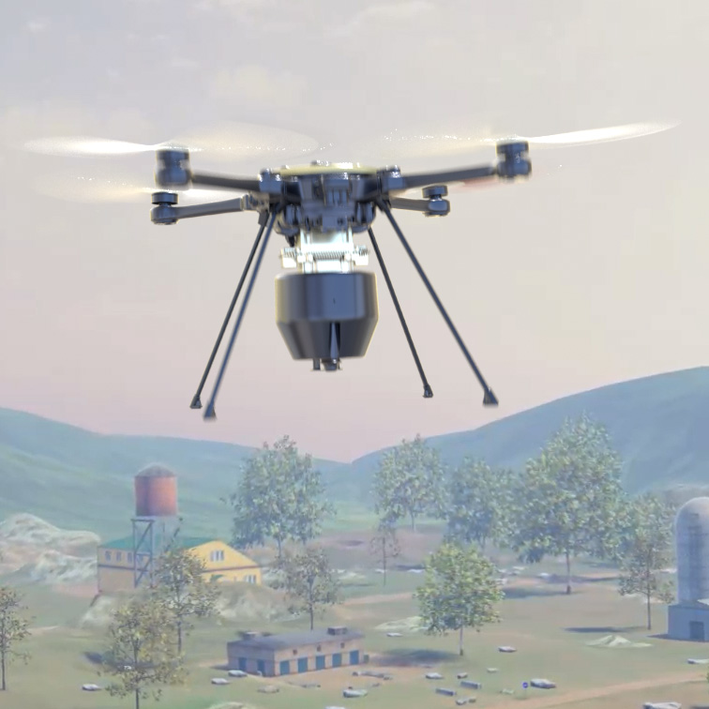
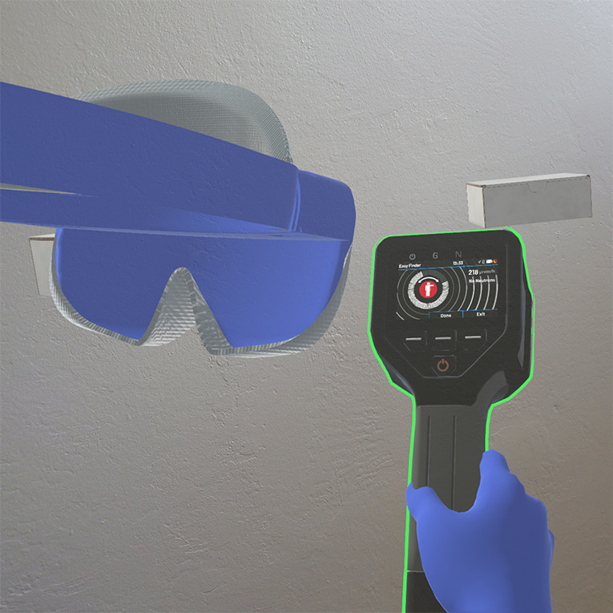
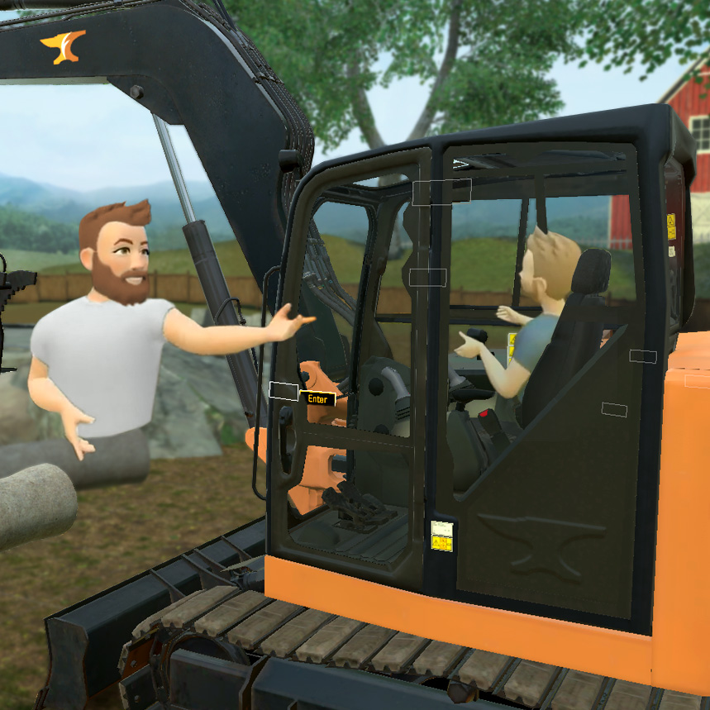
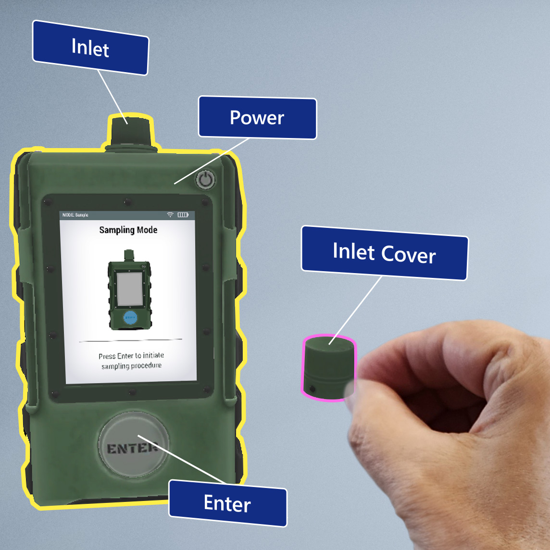
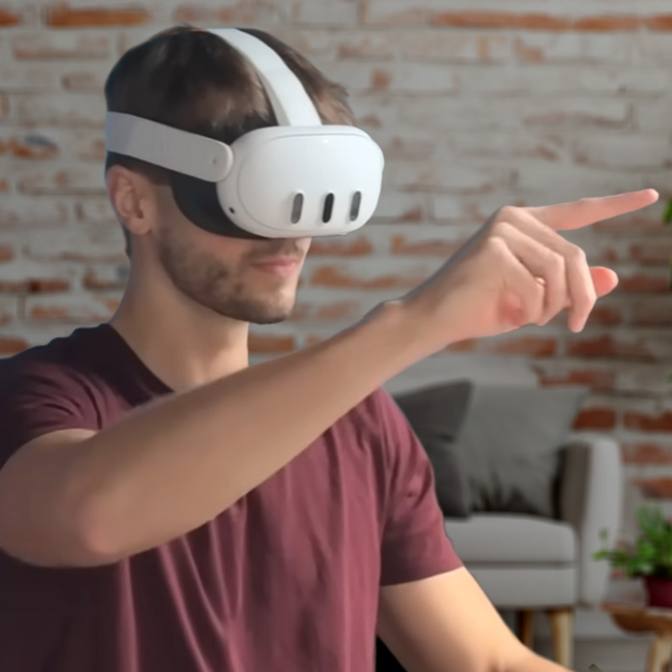
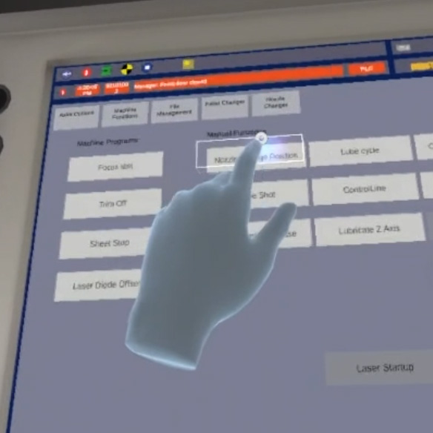
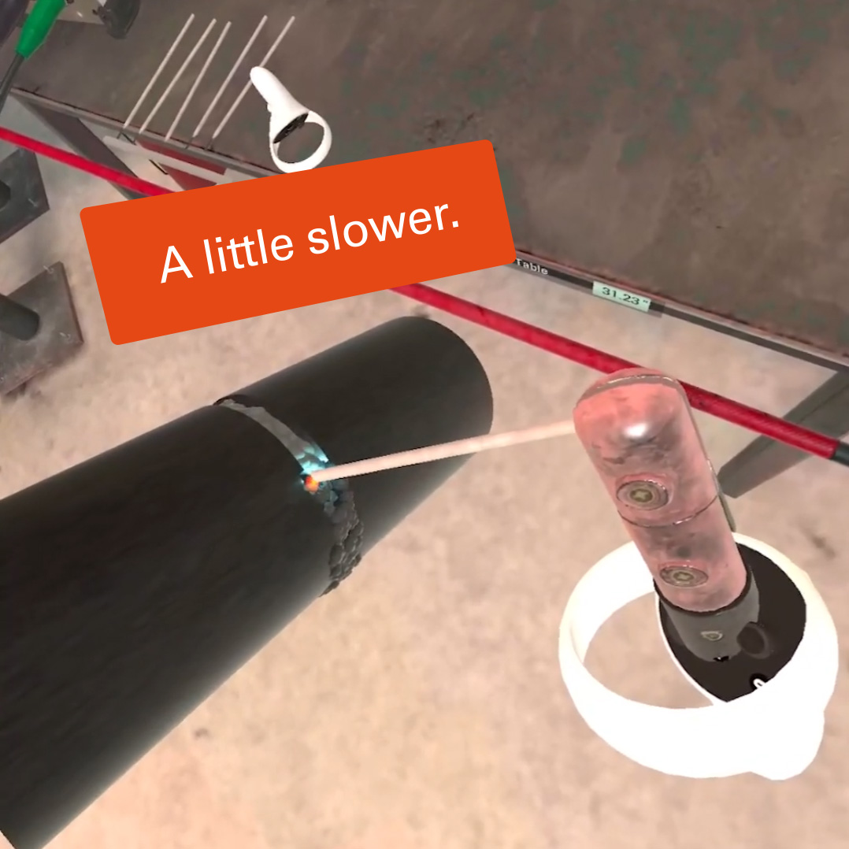
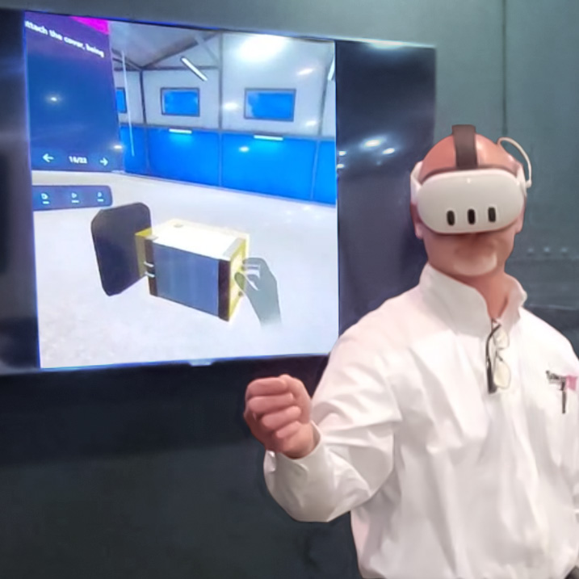
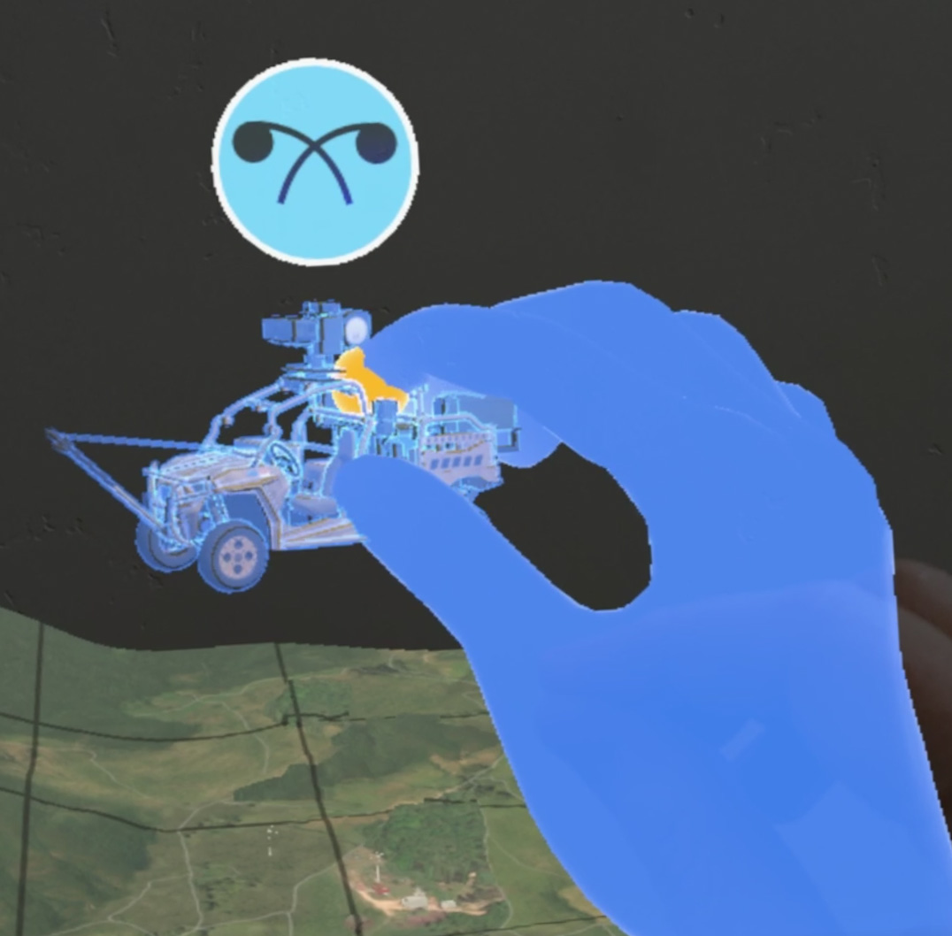
Contents
New! Invisible links are on top of the item names and page numbers. If you need to turn them off to edit the text, don’t forget to turn them on again. Thanks!
Project Overview
Why ForgeFX
Project Features
Lesson Content
Price Options
Development Process
In Conclusion
Appendix A: About ForgeFX
Appendix B: Recent Projects
3
5
7
39
45
52
61
65
71
EDIT

Slide 25
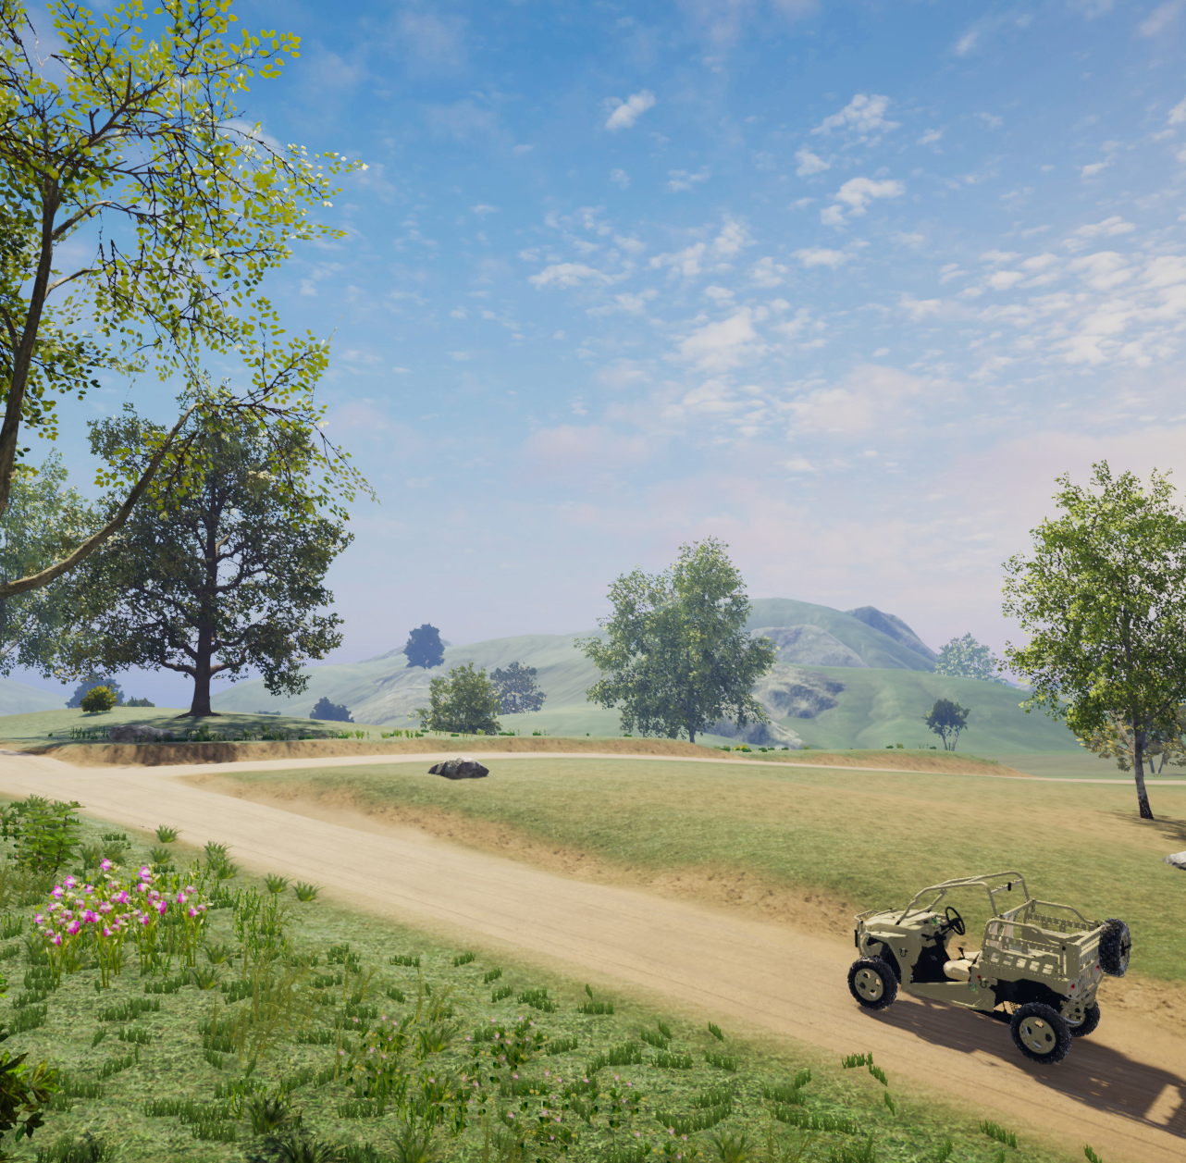
PROJECT OVERVIEW
Phase 1 will include one primary deicing training environment, three aircraft models, and one functionally accurate Tempest I deicing truck simulation. The trainee operates the sprayer/bucket controls in VR while an AI/NPC driver controls truck movement. The simulator will support one- and two-truck operations from the trainee’s active sprayer perspective, with three- and four-truck procedures represented through AI/scripted or visual-only supporting trucks where required by the selected procedure. The environment will be configurable across CargoJet’s required weather, contamination, visibility, wind, and engine-running conditions.
[COMPANY] seeks to enhance their current training methods for _____. The goal is to address operational errors, safety risks, and inefficiencies in the existing training process. They envision a solution that leverages advanced technology to provide immersive and realistic training experiences for operators of their _____.
Realistic
ForgeFX Simulations proposes to develop and deliver a custom-built ____ training solution. The simulator will faithfully replicate ____. By_____, ForgeFX aims to provide an immersive and realistic training experience that enhances operator efficiency, productivity, and safety.

Slide 26
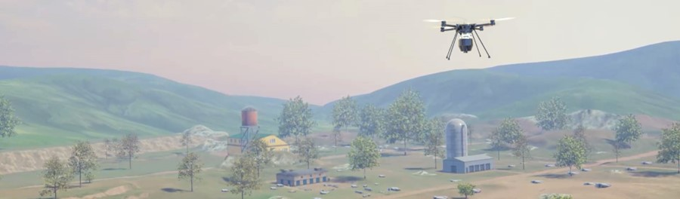
Project Overview
Expertise and attention
to detail
ForgeFX Simulations is excited to propose the development of the (company name Operator and Maintenance) Training Simulator. This simulator will transform MVTA’s approach to workforce development by providing a safe, scalable, and engaging training solution that supports recruitment and long-term skill growth.
Application Feature Highlights
Immersive simulation of (equipment) operation and servicing within lifelike VR environments, delivering engaging hands-on interaction, intuitive controls, and enhanced spatial awareness.
Scenario-based learning experiences that reflect specific job requirements, paired with built-in performance tracking to provide meaningful feedback and measurable progress.
Optional support for real-world control hardware and wireless headset-only deployments to suit different use cases.
Scalable content architecture, enabling future growth through new scenarios, diagnostics modules, and lesson authoring tools.
Implementation and Results
ForgeFX will collaborate closely with (Company) to define key training objectives and identify the most relevant tasks for their operator and maintenance personnel. Built upon our trusted ForgeSIM™ framework and established development process, we will deliver a targeted prototype that supports (Company) ‘s training goals.
The result will be a flexible, future-oriented platform that strengthens (company) training infrastructure, improves safety, enhances workforce readiness, and lays a strong foundation for sustained operational excellence.

Slide 27
Why
ForgeFX
ForgeSIM™ Framework
Extensive Experience
Industry Reputation
Realistic

Slide 28
Why ForgeFX
A Legacy of Excellence
ForgeFX Simulations offers a uniquely qualified and strategically advantageous solution for simulation-based training development. Their proprietary technology, proven track record, and industry partnerships distinguish them from competitors and justify a sole-source procurement.
  ForgeSIM™ Framework – Proven, Proprietary Technology
  ForgeFX has developed a proprietary simulation framework, ForgeSIM™, over the past 20 years. Built atop the Unity game engine, this robust code library enables the rapid development of high-quality, custom simulation applications—offering clients a lower-risk, cost-effective solution with reduced development timelines and enhanced technical stability.
  Unity Game Engine Experts
  ForgeFX’s development team brings deep technical expertise in Unity, the most widely adopted engine for immersive content development. Their mastery ensures optimal performance, seamless hardware integration, and compelling user experiences across VR, AR, and MR platforms.
  Meta Technology Partner
  As an official Meta Technology Partner, ForgeFX is uniquely positioned to access early platform innovations, tools, and support from Meta. This relationship ensures ForgeFX delivers cutting-edge solutions that are future-ready and aligned with the evolving capabilities of mixed reality hardware.
  Trusted by Industry Leaders
  ForgeFX has delivered successful training simulations for many Fortune 500 companies—including FedEx, Caterpillar, and GE Healthcare—addressing critical workforce challenges across logistics, heavy equipment, and medical industries. Their work is validated by repeat business, cross-industry referrals, and sustained client relationships.
  Pioneers in Virtual Reality Training
  With roots in traditional desktop-based simulation, ForgeFX was an early adopter of VR and has been delivering immersive training solutions since the inception of modern VR hardware. Their experience spans the full evolution of XR technologies, giving them unmatched insight into best practices for effective learning in virtual environments.
  ForgeFX is well-equipped to develop the [PROJECT]. Our experience, methodology, framework, and commitment to client success make us the ideal partner for this project. We look forward to the opportunity of partnering with [COMPANY] to create the envisioned training platform.

Slide 29
REDEFINING REALITY
Change to holotrainer
Safe
Engaging
Economical
Realistic

Slide 30
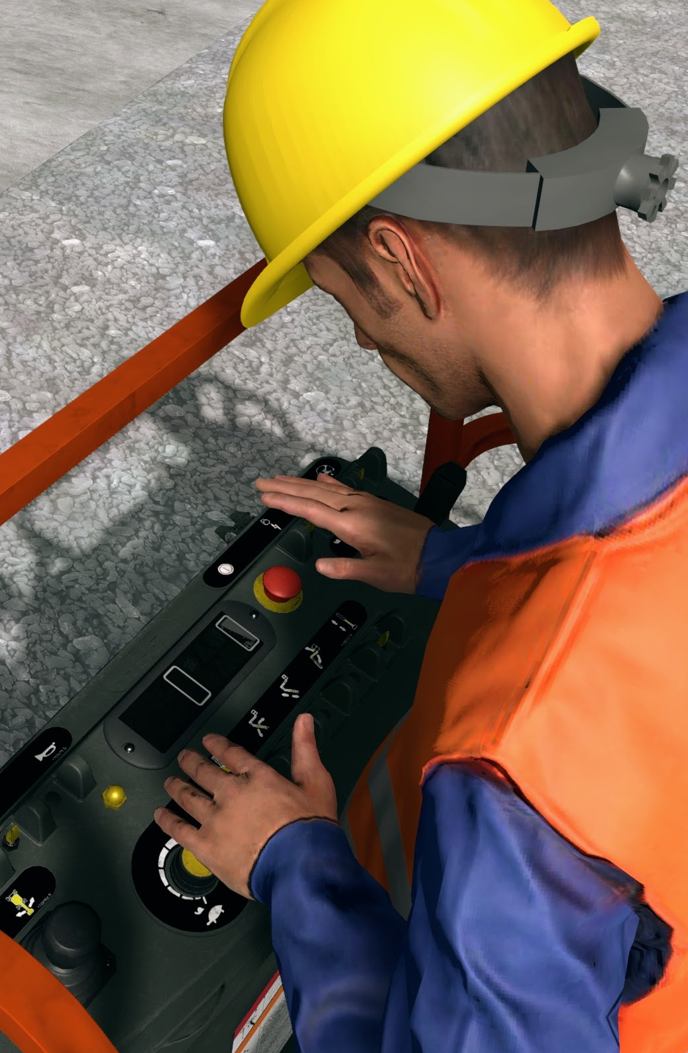
Redefining reality
Risk-Free Skill Building for Real World Mastery.
ForgeFX stands at the cutting edge of simulation technology, blurring the lines between real-world operations and virtual training environments. As rapid advancements make these tools increasingly accessible, organizations are transforming their training aspirations into strategic investments. Modern simulation technology has transcended traditional virtual reality, becoming an integral extension of our physical world. ForgeFX excels in navigating the intricate interplay between simulated and physical realities. We partner with your company to identify the most effective simulated features, tailoring solutions that propel your training capabilities into a future rich with possibilities.
Virtual Reality (VR) is an immersive simulation experience that places users in a computer-generated environment. It is used for training, gaming, and virtual tours, such as pilots simulating flights, soldiers training in virtual combat, and medical professionals practicing surgeries.
Mixed Reality (MR) is a hybrid environment where physical and digital objects coexist and interact in real-time. It is ideal for scenarios requiring seamless interaction between real and virtual elements, such as engineers manipulating virtual prototypes and educators creating interactive learning experiences.
Augmented Reality (AR) overlays digital information onto the real world, enhancing the user's perception. It is often used in medical training with anatomical overlays and industrial settings where assembly instructions are displayed on machinery.
Extended Reality (XR) is an umbrella term for VR, AR, and MR, representing technologies that extend the user’s experience of reality. It encompasses comprehensive training programs and simulation solutions for all.
Where what is possible, becomes what is next

Slide 31
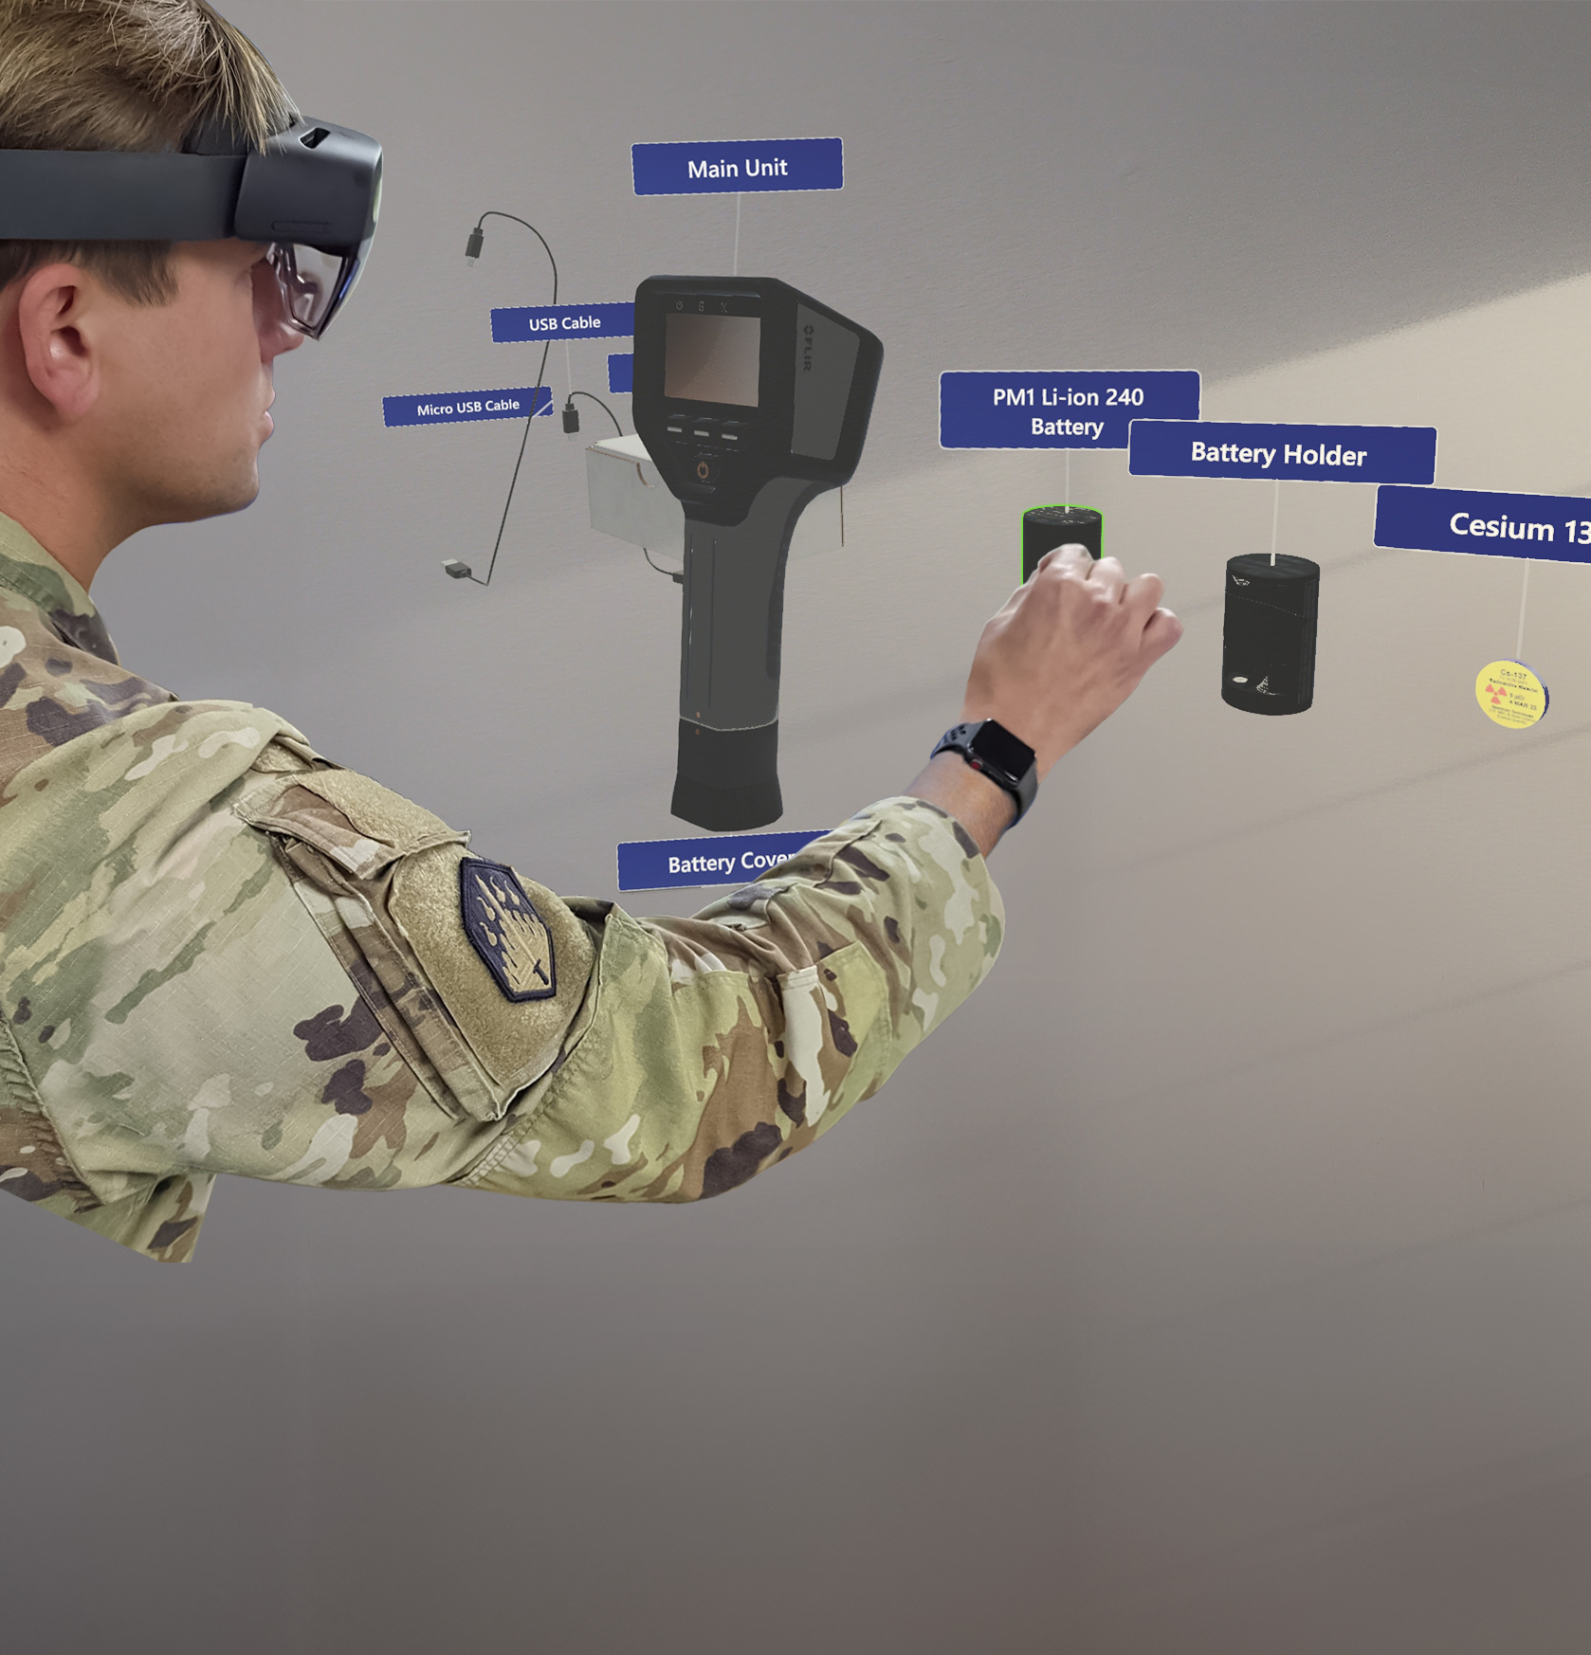
Project Features
EDIt
The following pages detail the many aspects of the training simulator that ForgeFX will develop to meet your trainees’ needs.
edit

Slide 32


SIMULATOR Foundation
[PROJECT]
EDIT
These components are integral to a robust, compelling simulator. The following pages describe in more detail how these features work to achieve a rewarding educational experience.
ForgeSIM™ Framework
A solid, tested code library ensures that the simulator is built efficiently and will support future expansion.
Hand Tracking
Controller-free technology allows for more natural, hands-on learning.
User Interface
Utilizing modern best practices in user interaction design ensures an easy and intuitive application.
Additional boxes and a template for new boxes is in the Alternates section.
- G
Audio Narration
Spoken instructions provide non-visual cues and audio learner support.
Instruction Modes
Two levels of guidance allow trainees to learn, practice, achieve mastery, and be tested on their knowledge.
Familiarization Tutorial
A brief introduction to the application interface promotes speedy proficiency.
PERFORMANCE TRACKING
The trainees’ actions in each session will be tracked, and the results will be displayed in a performance report screen.
Mixed Reality Training
Pass-through video capability augmented with multimedia information.
LMS Integration
Simulator data can be uploaded to your LMS, providing an easily accessible record of trainees’ progress.

Slide 33

FORGESIM™ FRAMEWORK
Rapid Development
Real-World Integration
Performance Tracking
Realistic

Slide 34
ForgeSIM™ Framework
Essential
Building Blocks
of the Training Simulator
ForgeFX's commitment to innovation and quality is embedded in every layer of our ForgeSIM™ suite. It embodies the best practices and technological advancements we've acquired over numerous successful deployments. Each component is designed to integrate seamlessly, providing clients with a cohesive development experience from concept to execution.
Here are the elements of the framework:
ForgeSIM™ CORE: Our core re-useable application framework enabling rapid development of fundamental application flows, based on a rock-solid foundation.
ForgeSIM™ CONNECT: Proprietary process and approach to bridge the gap between static machine and equipment CAD files to their interactive counterparts, matching real-world behaviors.
ForgeSIM™ CONTROL: Pre-built system to connect real-world equipment controls to ForgeSIM-based applications. Protocol support includes both custom and standard CAN-BUS systems.
ForgeSIM™ TRACK: Sophisticated system which granularly tracks both raw user actions as well as client-specified higher-level performance assessment and reporting criteria.
ForgeSIM™ GATHER: Time-tested multiplayer framework designed specifically for the team-based practice and instructor/student modalities required for simulation-based training.

Slide 35
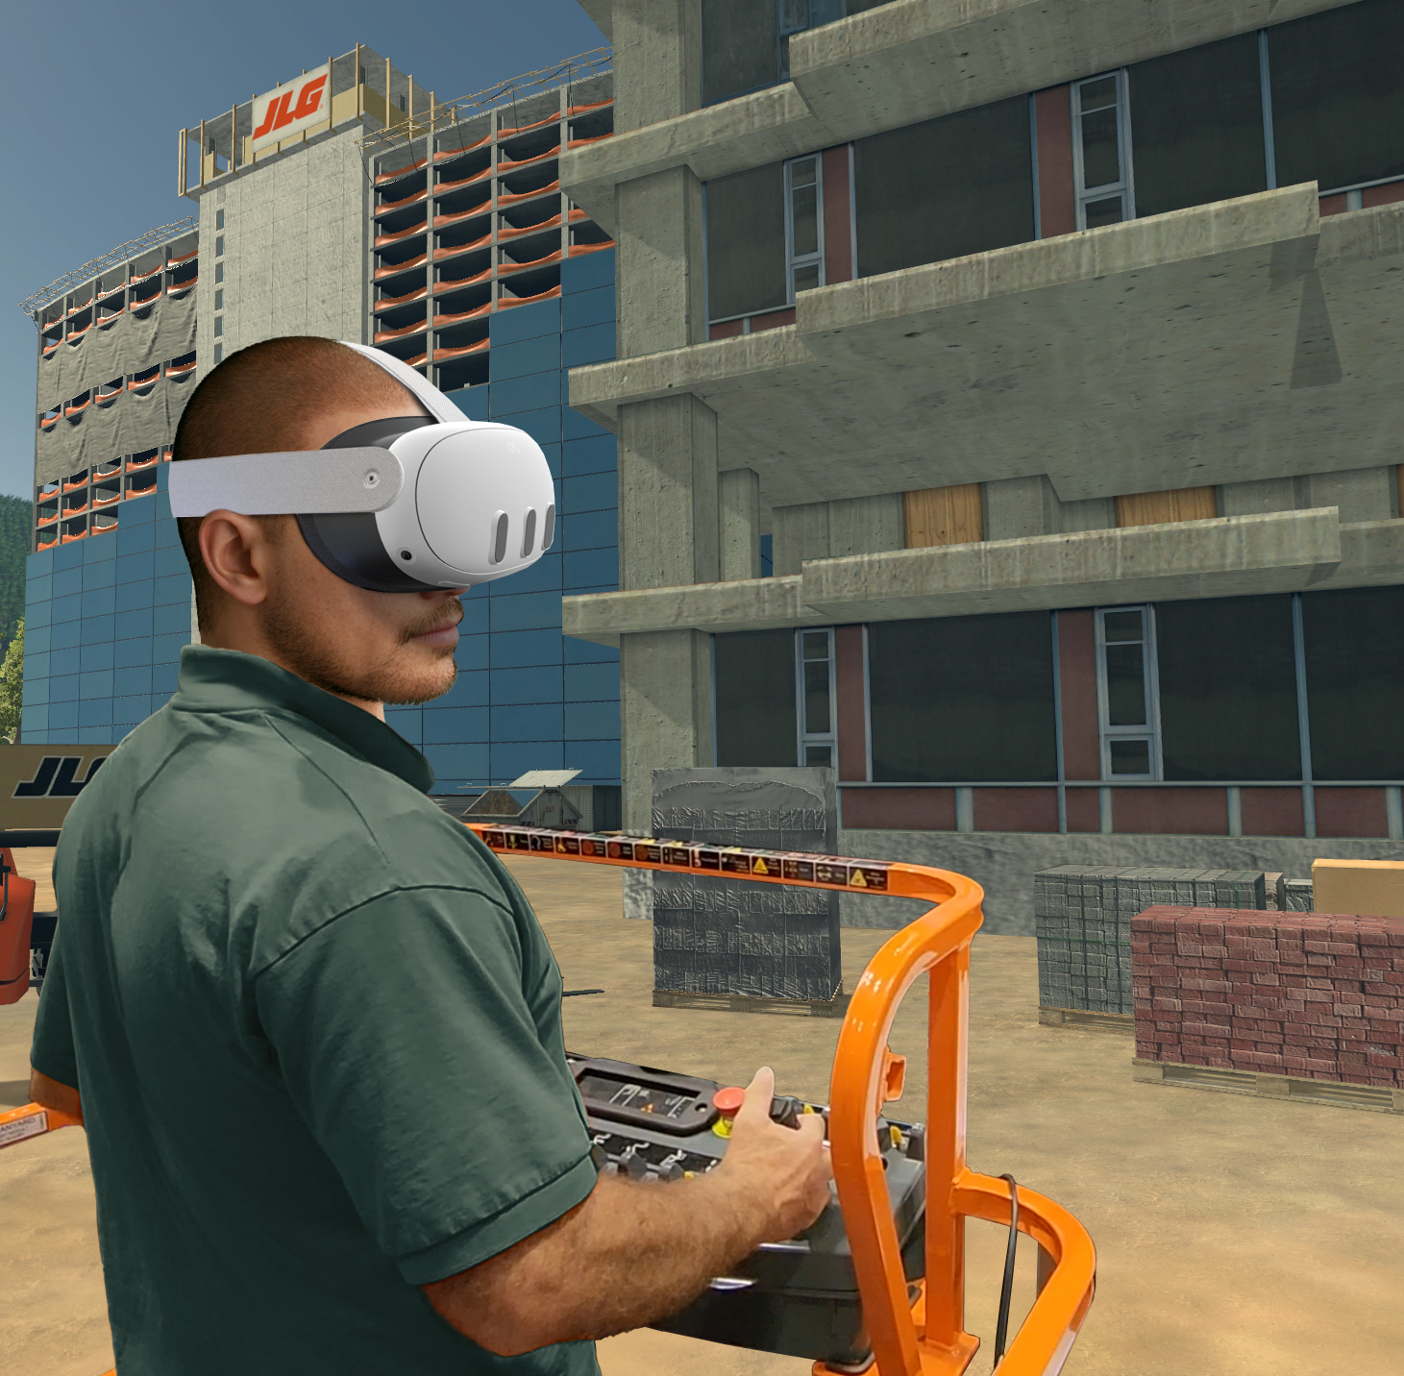
Virtual Reality Training
Change to holotrainer
Safe
Engaging
Economical
Realistic

Slide 36
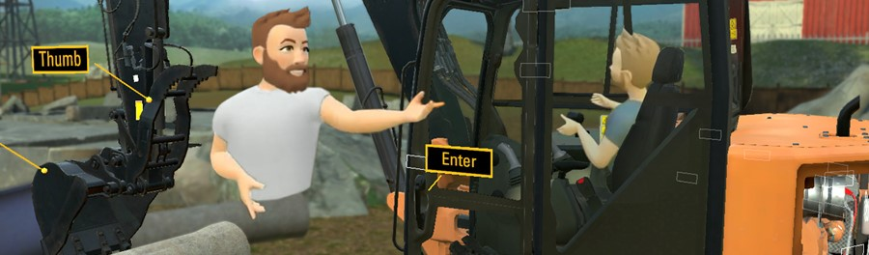
Virtual Reality Training
Risk-Free Skill Building for Real World Mastery.
Virtual Reality (VR) is a revolutionary technology that has transformed operator training. VR offers an immersive experience that makes it an excellent choice for training across a wide range of industries. Here are some of many compelling reasons why:
Realistic Simulation: VR creates highly realistic and immersive environments that replicate real-world scenarios. This allows trainees to experience situations as if they were physically present, enhancing the effectiveness of the training.
Safe Environment: Virtual reality provides a safe space for trainees to make mistakes and learn from them without real-world consequences. This benefit is particularly valuable in high-risk industries.
Cost-Effective: While traditional training methods often involve expensive equipment, materials, and facilities, VR training eliminates the need for physical props and allows for the reuse of virtual assets.
Accessibility: VR training can be conducted remotely, making it accessible to a wider audience. Trainees can participate from different locations, reducing the need for travel and associated expenses.
Engagement: The immersive nature of VR captivates trainees, increasing their engagement and motivation to learn. Leveraging positional tracking allows users to feel a greater sense of presence in the simulated environment, which leads to better retention of information and skills.
Repeatability: VR simulations can be repeated as many times as needed without wear and tear on physical equipment. Trainees can practice until they achieve proficiency.
Risk-Free
Skill Building
for Real World Mastery

Slide 37
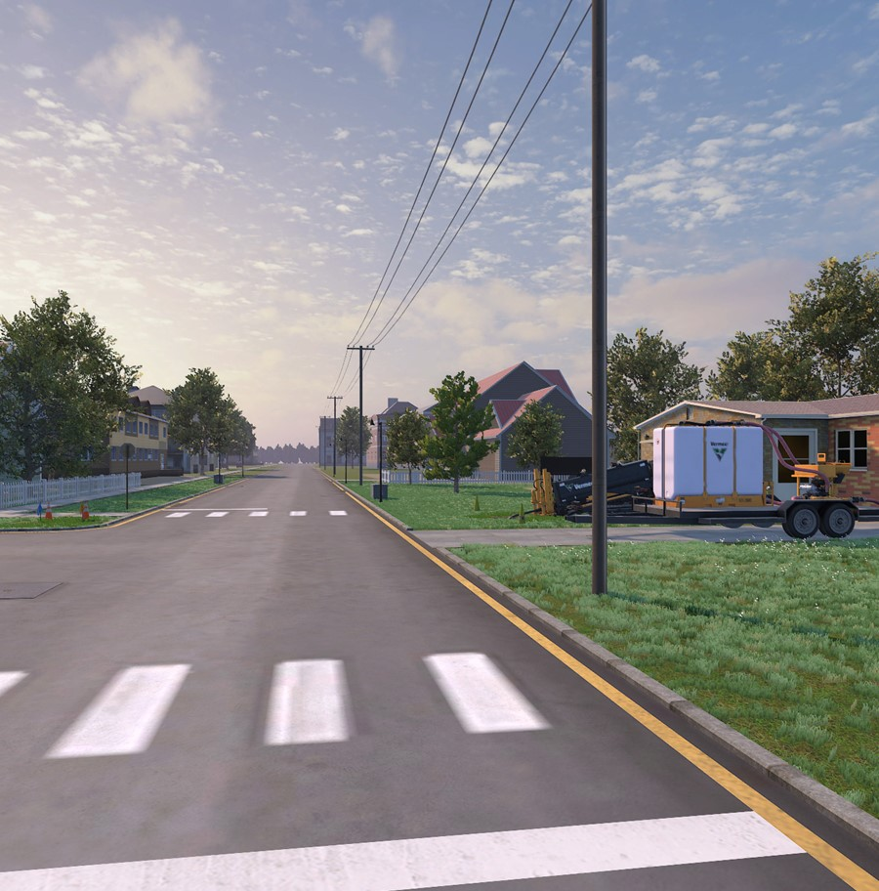
Virtual Environment
Scope Item | Count
Primary deicing truck models | 1
Aircraft models | 3
Human trainee roles | 1
AI/NPC driver role | 1
Truck-count procedure configurations | 4
Interactive truck operations | 2 configurations: one-truck and two-truck
Represented supporting truck procedures | 2 configurations: three-truck and four-truck
Primary physical environments | 1
Weather / contamination conditions | 8 listed conditions
Engine-condition modes | 2
Indoor environment is in the Alternates section.
- G
Structures
Objects
Terrain
Realistic

Slide 38
Virtual Environment
The Warehouse and workspace
The simulator will immerse users in a visually rich, fully rendered 3D warehouse environment that mirrors the everyday spaces where forklift operations occur. Every structure, surface, and object will be purposefully modeled to heighten realism and create a sense of presence that supports meaningful, task-based learning.
  Authentic Warehouse Layout: From pallet zones to staging areas and industrial structures, the environment will reflect the flow and scale of (company’s) facilities, providing a practical layout that reinforces spatial logic and operational flow.
  Visual and Spatial Immersion: Proportions, lighting, and texture details will enhance depth perception and spatial awareness, helping users orient themselves naturally while remaining focused on the task at hand.
In collaboration with (Company’s) training team, we’ll ensure the environment includes key features and visual markers that reflect real-world training conditions, reinforcing safety, awareness, and operational readiness from day one.
Case Study: Caterpillar
The All-Access Pass Experience Simulator that ForgeFX developed for Caterpillar includes both North America and Mexico terrains, allowing the user to train with different environmental conditions, visibility factors, and construction material.

Slide 39

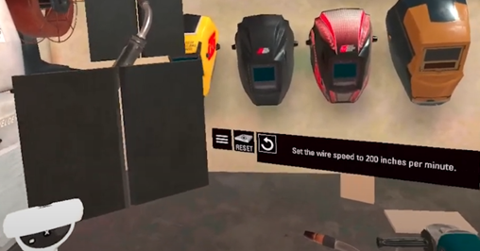
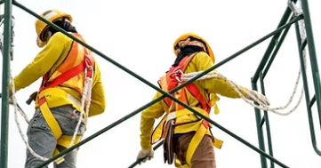
Virtual Environment
The Job Site and Training Context
Once inside the headset, learners are placed in a realistic, immersive 3D environment that mirrors the look and feel of the real-world jobsite. Carefully crafted lighting, textures, and spatial details provide the visual grounding for the simulated training, while layout and architectural cues ensure the environment feels instantly relatable.
Example virtual environments include:
Warehouse Safety Fault Finding
A broad, industrial-scale environment designed to evoke the busy visual texture of a working warehouse, open bays, stacked inventory, overhead piping, and ambient worksite clutter. Sightlines are intentionally layered, with nooks, overhead structures, and varied surface materials that create a rich, spatially complex environment for visual orientation and environmental realism.
  PPE & Welfare Station
  A thoughtfully staged interior space that mirrors the comfort and utility of on-site welfare areas. This room may feature rows of lockers, benches, mounted PPE stations, and day-to-day details such as signage or posted instructions, subtle touches that make the space feel immediately familiar to trainees upon entry.
  Working Safely At Height
  A dramatic vertical training setting that recreates the height, exposure, and structural geometry of a multi-level scaffold system. With open skies above, guardrails at the edge, and distant site vistas on the horizon, this setting reinforces the psychological sensation of elevation and spatial awareness—key elements for trainees preparing for work at height.
multi enviro
  ForgeFX is well-equipped to develop the [PROJECT]. Our experience, methodology, framework, and commitment to client success make us the ideal partner for this project. We look forward to the opportunity of partnering with [COMPANY] to create the envisioned training platform.

Slide 40
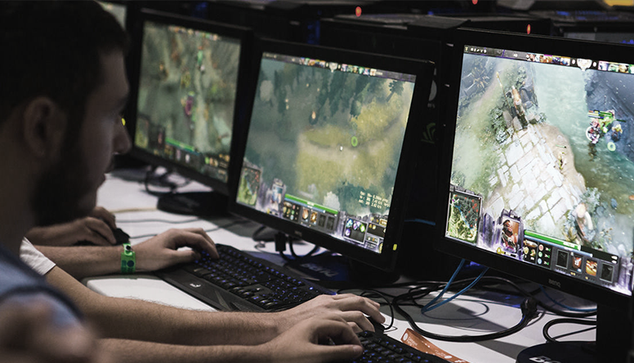

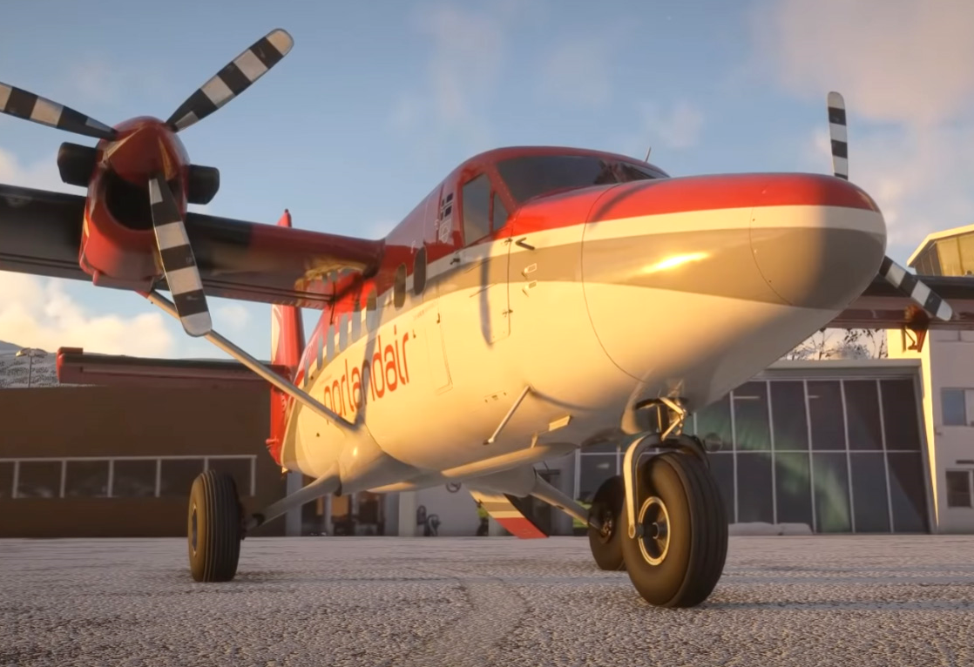


ALIGNMENT
WEATHER
CONDITIONS
EDIt
Rain or Shine
The Phase I Simulator will include two weather types, fair and rain. There are different ways in which to include the weather alternatives in the simulation. One way is to make it randomized, so there is perhaps a 25% chance of rain. It can be a choice that the instructor makes while setting up a multi-user session. It can also be an option the user selects upon entering the simulation.
The position-based environment audio will emit different sounds depending on the surface being pelted by raindrops, including metal, glass, and tarmac.
The goal is to replicate as closely as possible the atmospheric conditions that a pilot could encounter in the real world. If there is a hazard associated with the rain’s impact on equipment, the simulator can include it.
Future weather conditions can include various intensities of snow, sleet, and night.
Airport environment for Global Ground Support Deicing Simulator
Replica environment of JLG proving grounds in Pennsylvania

Slide 41
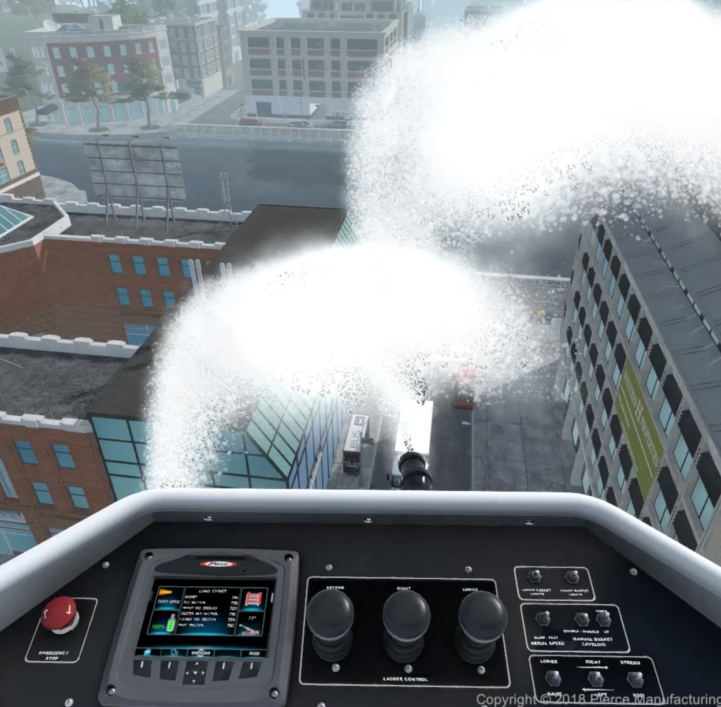
Virtual Equipment
Detailed
Interactive
Dynamic
Realistic

Slide 42

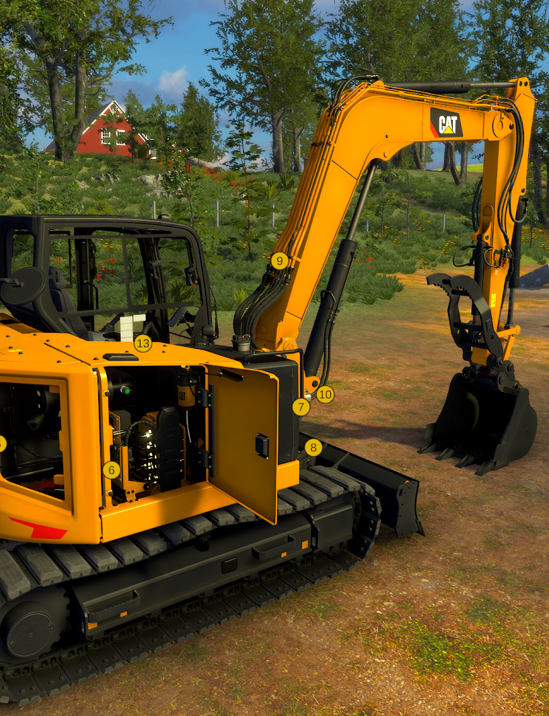
Virtual Equipment
Virtual machine
The proposed simulator’s centerpiece will be a fully interactive 3D (equipment/ machine). This digital replica will be developed to industry-standard scale and functionality using CAD references, photo documentation, and walkthroughs. While not modeled after a single OEM, the simulator will maintain broad realism and operator familiarity, supporting a wide range of internal training use cases.
True-to-Scale Layout and Visibility
Built at full scale, the (machine) model will reflect the spatial relationships between operator seating, controls, and surrounding zones, supporting natural posture and environmental awareness inside VR.
Accurate to the Detail
To reinforce real-world recognition, the (machine) will be modeled to emphasize structural accuracy, with clearly defined parts, surface details, and texturing.
Operationally Responsive Features
All primary control elements (machine components) will be rigged for animation and interaction, allowing users to interact directly with the machine to support inspection routines, basic maneuvering, and safety-related actions.
Networked Training for Collaborative Learning
EDIT
CASE STUDY: CATERPILLAR
ForgeFX’s experience and expertise is highlighted in a previous project with Caterpillar. The excavator operator training simulator improves safety and efficiency by providing an engaging learning platform, offering hands-on experience with machine controls and operations.
REVIEW

Slide 43

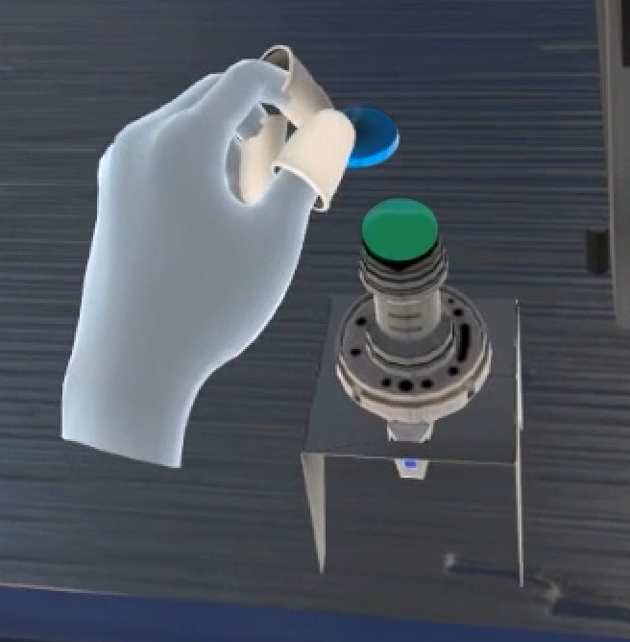
Virtual Equipment
Engagement Redefined:
Hands-On Experience
Our simulator transforms (process) into a memorable, muscle‑memory moment by surrounding trainees with realistically crafted, interactive assets. Whether clipping a safety harness, stabilizing a scaffold plank, or powering up a handheld tool, each item appears at true scale with lifelike textures and intuitive responses. Learners grip, lift, latch, and operate equipment exactly as they would on‑site, only inside a risk‑free, data‑rich virtual environment, building real‑world confidence long before they step onto the job.
Natural Interaction: Harness Safety Routine (VR Scaffold): Using natural hand‑tracking, learners clip a virtual carabiner to a scaffold anchor, watch the lanyard tighten, and step forward only when the system confirms full tie‑off, building instinctive compliance at height.
Realistic Environment: Smart Lift Challenge (VR Warehouse): Trainees scan a box’s weight tag and proceed to follow the instructions to safely lift the selected box or choose an approved virtual tool to assist with moving the box correctly.
Enhanced Engagement: Power‑Tool Safety Check (VR Tool Bay): Learners pick up the virtual electric drill, inspect the cord, secure the workpiece in a virtual clamp, and are prompted with the same precautions as one would using the physical drill.
By focusing on tactile components and replicating the natural physical interactions, the simulator ensures that skills learned virtually translate directly to on‑the‑job performance, accelerating competency while driving incident rates toward zero.
multi machine/process
Case Study:
TRUMPF TruLaser 2030
In the training simulator ForgeFX developed for the TRUMPF Group, hand tracking plays a crucial role by allowing the trainee to employ precise hand movements to manipulate small machine components.

Slide 44
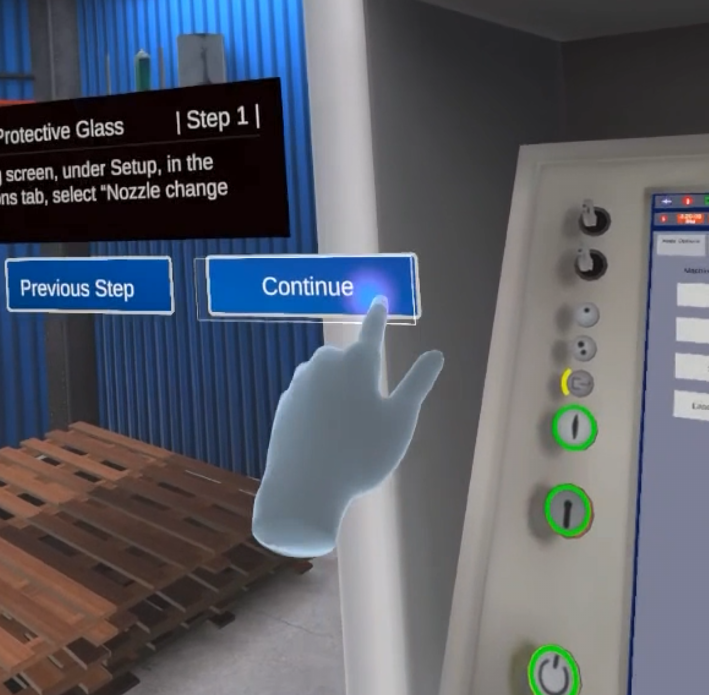
User Interface
Intuitive
Relevant
Accessible
Realistic

Slide 45

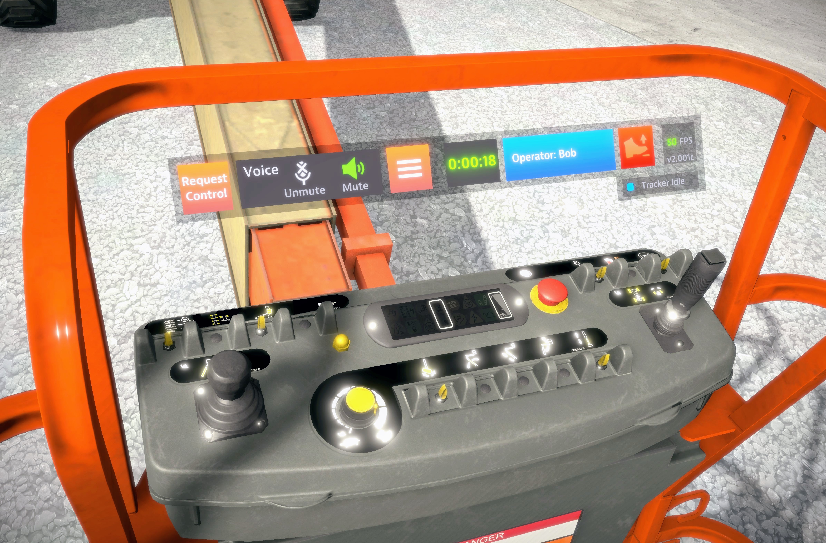
User Interface
Enhancing Engagement
The ways in which people interact with various computing devices have evolved a great deal, and ForgeFX stays current with the best practices of user experience (UX) design. Our goal is to craft intuitive interfaces that allow users to focus on the content of simulator lessons. Venturing into UX for a MR environment is a pioneering endeavor, one which ForgeFX has consistently been at the forefront to driving innovation as we advance the use of mixed reality training simulators.
An intuitive interface and experience not only boosts engagement but ensures that learners stay motivated, navigating seamlessly through the virtual curriculum. The user interface is crucial in MR training as it dictates how trainees interact with lessons. Ultimately, an exceptional interface fosters a rewarding user experience, enhancing learners‘ enjoyment and information retention.
edit
Case Study: JLG
In the several training simulators developed for JLG Industries, the virtual controls were conveniently placed in an otherwise unused space, scaled to be easily reached in MR, and designed to coordinate with the machines‘ real controls.

Slide 46
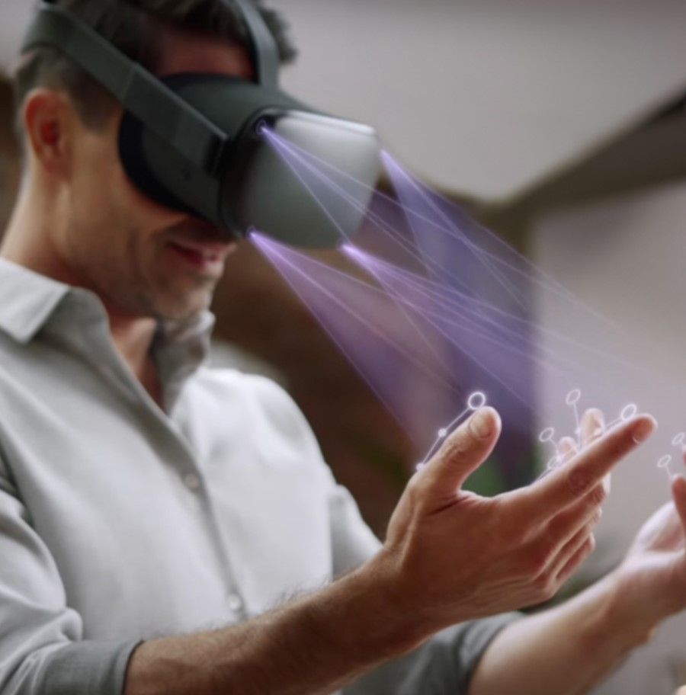
Hand Tracking
Easy
Natural
Effective
Realistic

Slide 47
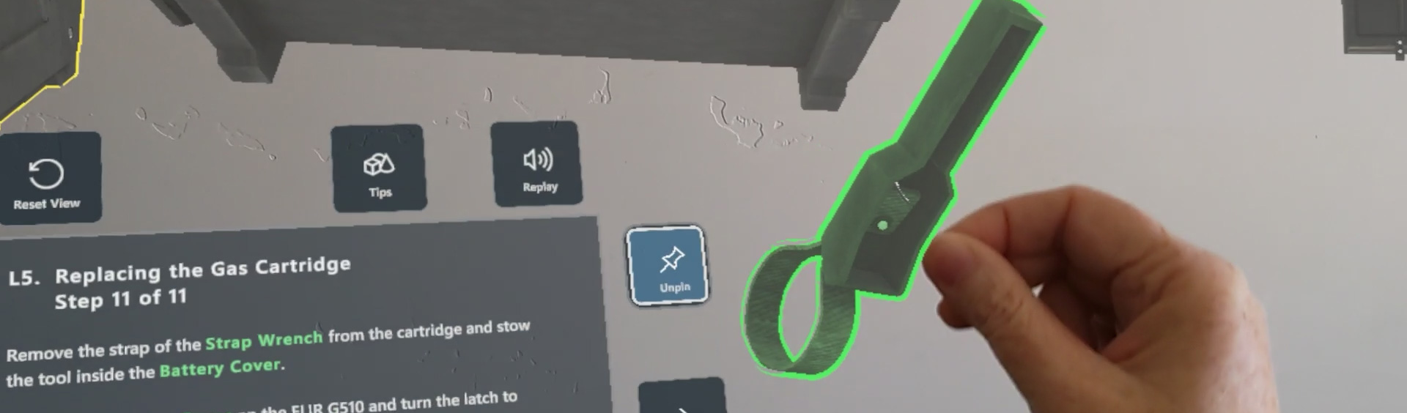
Hand Tracking
Engagement Redefined:
Hands-On Experience
Hand tracking is the detection of user hand movements in the virtual reality (VR) environment. Included with all modern mixed reality devices, this technology allows for direct and natural manipulation of virtual objects, as opposed to clicking on them with a controller device, thereby providing an immersive and realistic training experience.
In the proposed simulator, hand tracking will play a pivotal role in enhancing trainee engagement and knowledge retention. The following are key benefits of this feature:
Natural Interaction: The ability for trainees to use their hands to move and manipulate virtual objects just as they would in real life enhances immersion, stimulates muscle memory, and makes the training more intuitive.
Realistic Environment: By enabling trainees to interact directly with virtual products, hand tracking creates a training environment that closely mirrors real-world scenarios.
Enhanced Engagement: The ability to interact naturally with the VR environment increases trainee engagement, giving them a great sense of presence and agency in the virtual world.
Finally, hand tracking technology also unlocks unique options for performance analysis. For example, to track fine-grained trainee interactions during the session, providing valuable insights into their understanding and proficiency.
Case Study:
TRUMPF TruLaser 2030
In the training simulator ForgeFX developed for the TRUMPF Group, hand tracking plays a crucial role by allowing the trainee to employ precise hand movements to manipulate small machine components.

Slide 48
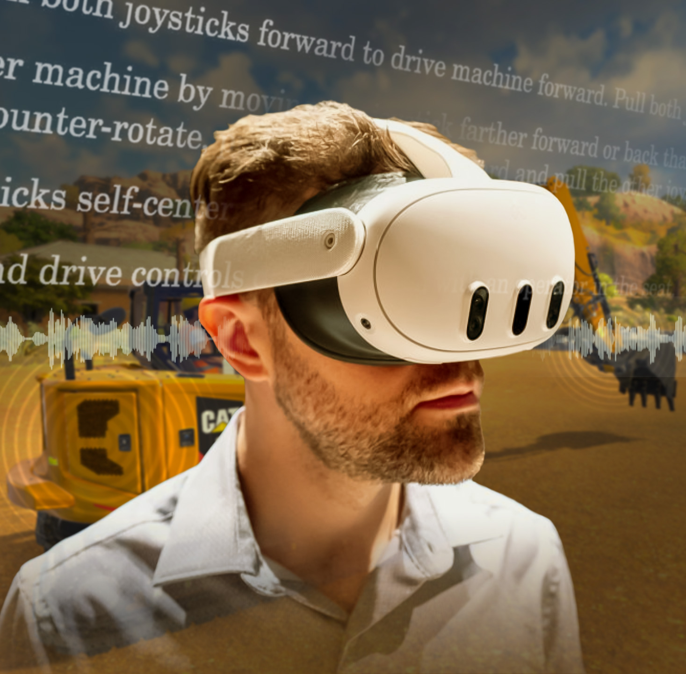
Audio Narration
Enhances
Realism
Accommodates Learners
Focused Instruction
Realistic

Slide 49
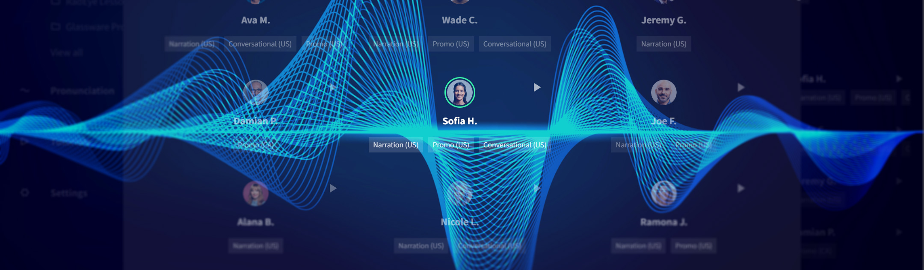
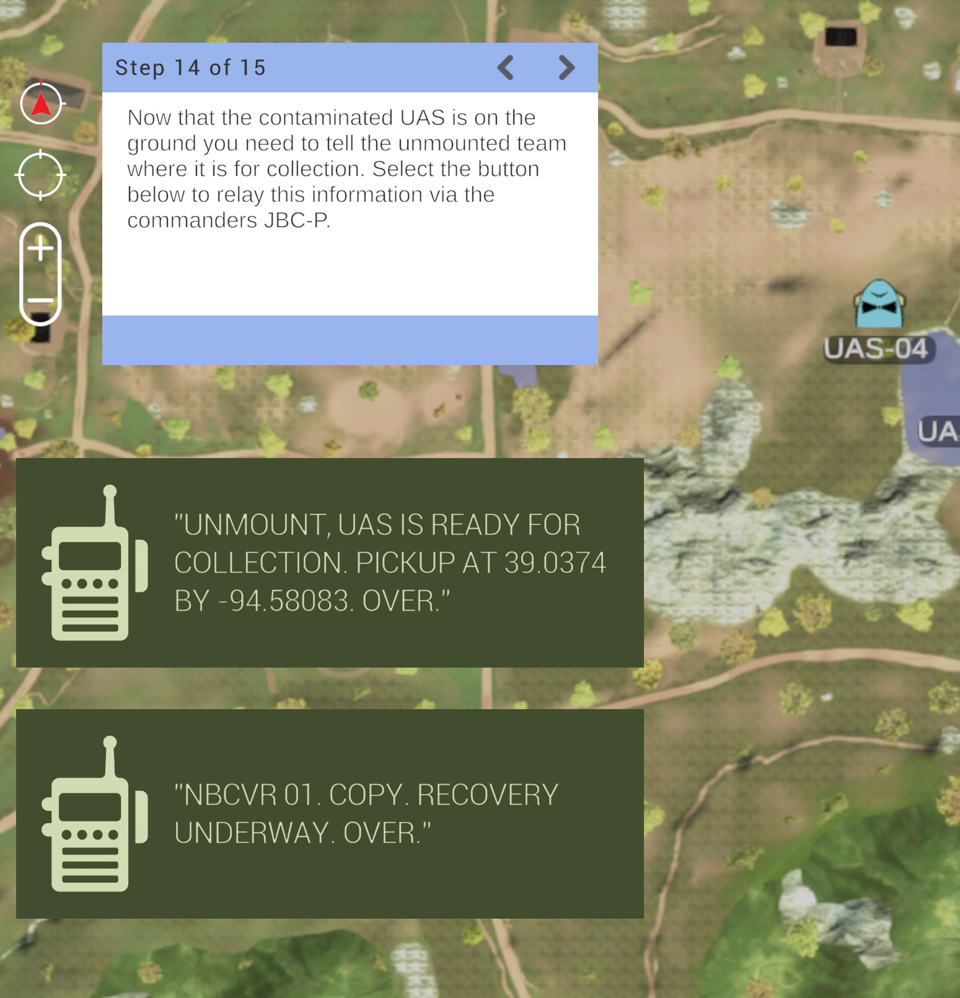
Audio Narration
Boosting
the Gain of Training
Recent advances in realistic AI-generated voices have made audio narration of lesson content affordable and easy to produce. ForgeFX frequently turns to the services of WellSaidLabs to create custom narration of our clients’ lessons. Clients can choose from a range of genders, ages, and narrative styles for spoken content. When a script is uploaded, the audio narration is generated within seconds, which makes it easy to revise and update lesson content.
Providing optional audio narration to trainees can greatly boost engagement and knowledge retention. Many people can find learning challenging when content is delivered via written text but have no problem understanding it in audio form. In addition, audio reinforcement can overcome reading difficulties such as dyslexia or language unfamiliarity.
Another use of audio feedback is to provide over-the-shoulder coaching to the trainee while they’re engaged in a task. Prompts such as “that’s too fast” lets them focus on what they’re doing without having to look away to read text.
When delivering critical information that can affect expensive equipment or even lives, it’s important to accommodate different learning styles and provide several types of information to teach as effectively as possible.
Case Study:
Tele-Op Simulator
In this UAS training simulator for the JPEO, ForgeFX not only provided a choice of male or female narration options, but also emulated real-world radio communications between squad members to provide context and verisimilitude for the lesson.

Slide 50
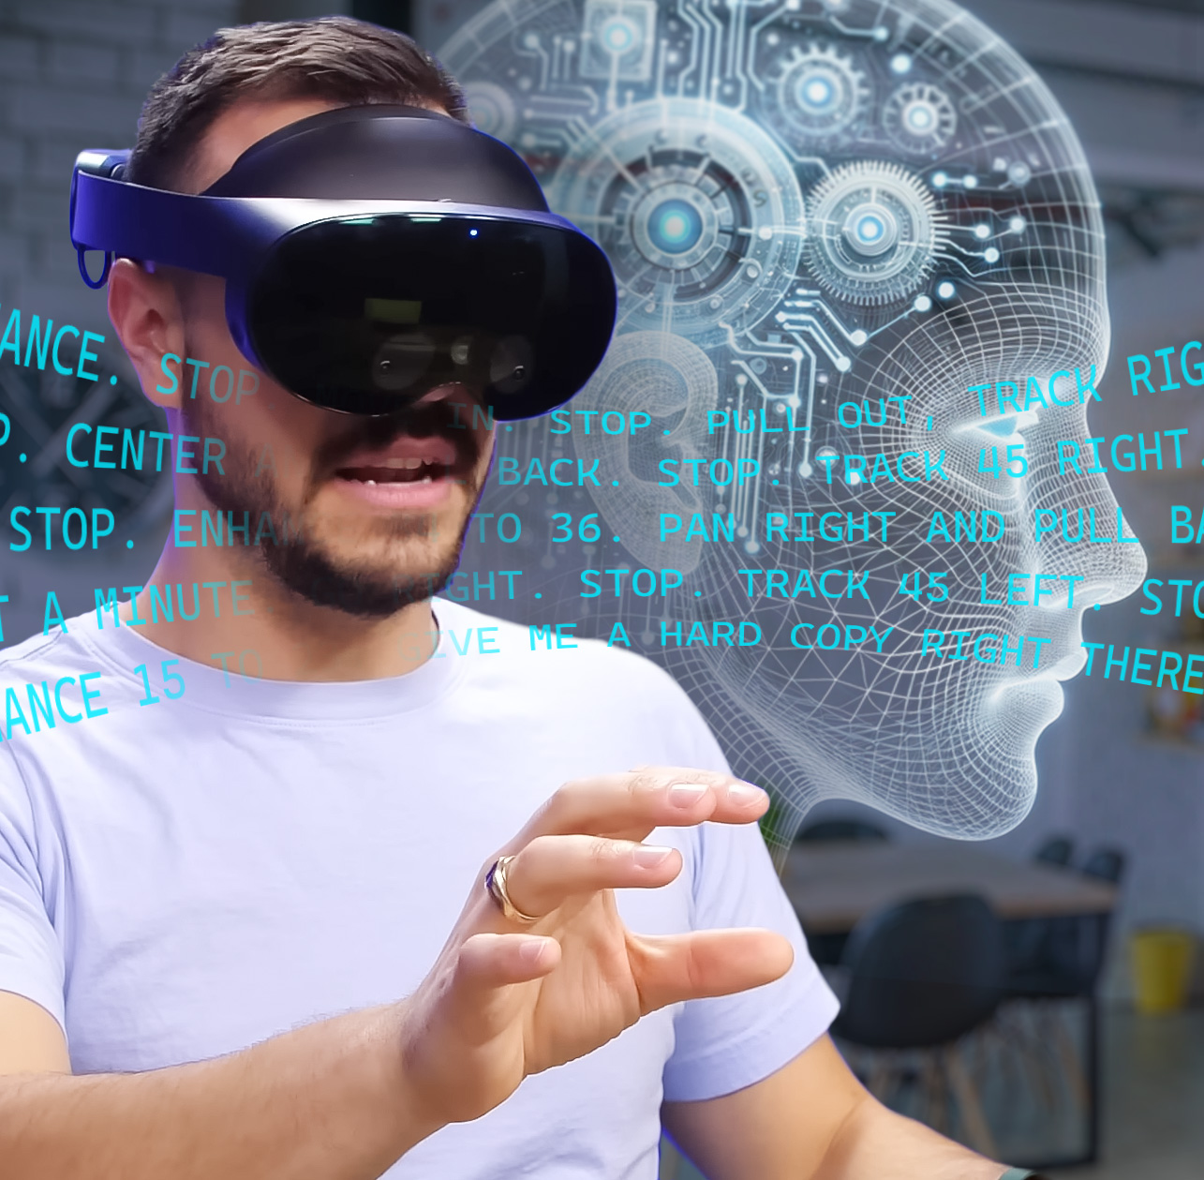
VOICE COMMANDS
Natural Language Processing
Contextual Understanding
Hands-Free Operation
Realistic

Slide 51
VOICE COMMANDS
NATURAL
LANGUAGE
PROCESSING
As a complement to the applications traditional user interface, the proposed simulator will feature an innovative voice command system driven by a state-of-the-art large language model (LLM). LLMs are practical artificial intelligence systems that can understand and respond to human language with remarkable accuracy. This feature will enable trainees to control the simulator with their voice using natural language, allowing them to focus on the learning experience.
Key features of this capability include:
Natural Language Processing: The simulator will understand and respond to an array of verbal commands related to navigation, module selection, and lesson control, even if they are imprecisely expressed. For example, trainees can use commands like "Start the engine," "Open the maintenance module," or "Pause the lesson" to control the training application.
Context and Intent Understanding: This is the ability to consider context to help infer intent, allowing the simulator to accurately interpret and execute trainee commands.
Hands-Free Operation: By utilizing voice commands, trainees can focus on the simulator's visuals and controls without the need to manually navigate menus.
The incorporation of an LLM-driven voice command system lays a solid groundwork for the future evolution and refinement of the simulator and unlocks up a range of exciting possibilities, such as broadening the scope of voice commands, tailoring learning experiences to individual needs, and integrating virtual expert guidance within the application.
x
Case Study:
Tele-Op Simulator
In this UAS training simulator for the JPEO, ForgeFX not only provided a choice of male or female narration options, but also emulated real-world radio communications between squad members to provide context and verisimilitude for the lesson.

Slide 52
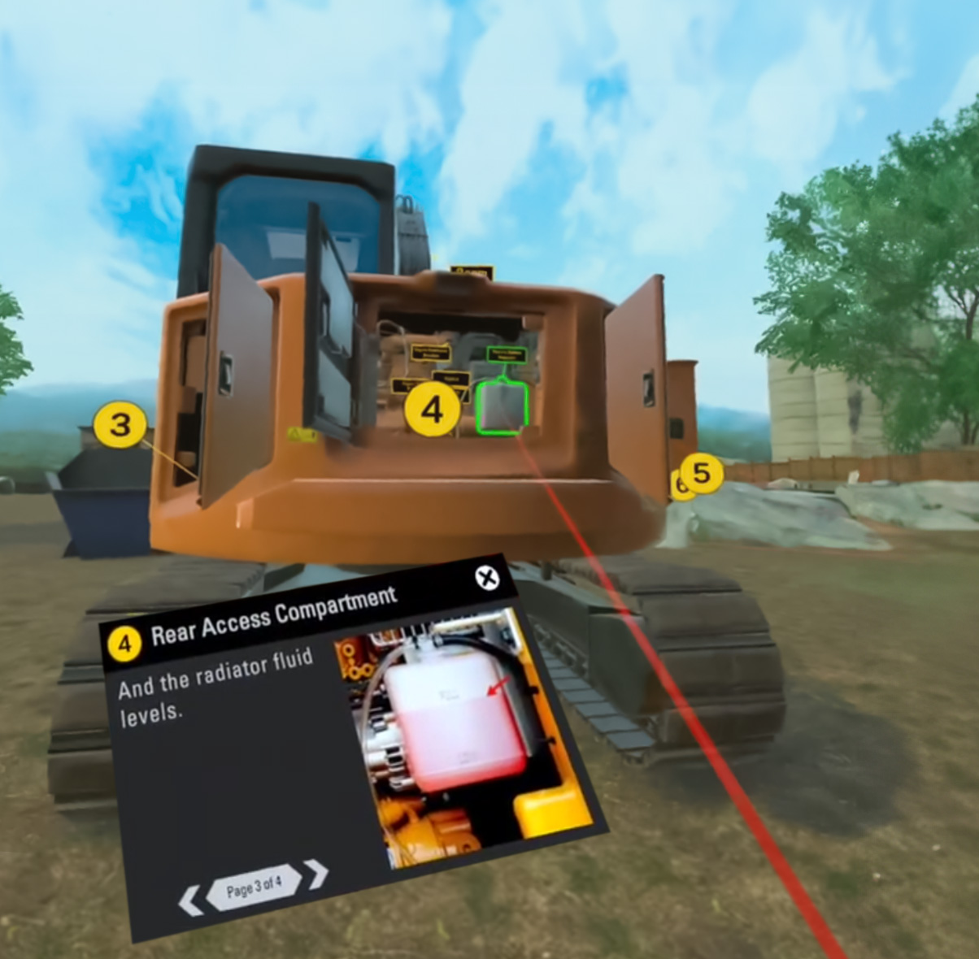
Instruction Modes
Guided
Unguided
Realistic

Slide 53
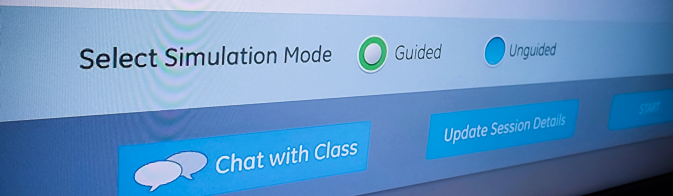
Instruction Modes
Guided and Unguided
Training
Modalities
The simulator will feature two distinct instructional modes: “Guided” and “Unguided.” These modes are designed to provide a comprehensive learning experience, catering to different stages of the training process.
Guided Mode
This mode is intended for initial learning phases, where trainees are still familiarizing themselves with basic operations. In this mode, students will be provided with step-by-step instructions and hints to help them navigate through various tasks. The guided mode will:
  Provide real-time feedback and support to ensure correct understanding and application of procedures.
  Enable trainees to practice in a low-pressure environment while they gain confidence.
Unguided Mode
Once trainees have gained sufficient knowledge and confidence from the guided mode, they can transition to the unguided mode. This mode serves as an assessment tool where students apply their learned skills without any assistance. This mode will:
  Challenge trainees to perform tasks independently, reinforcing their understanding of operations.
  Generate after-session performance reports that highlight areas of strength and those requiring improvement.
Incorporating both modes into the simulator ensures a comprehensive training approach that caters to varying levels of expertise among operators. It allows beginners to learn at their own pace in a supportive environment, while more experienced operators can test their skills and knowledge in realistic scenarios.

Slide 54
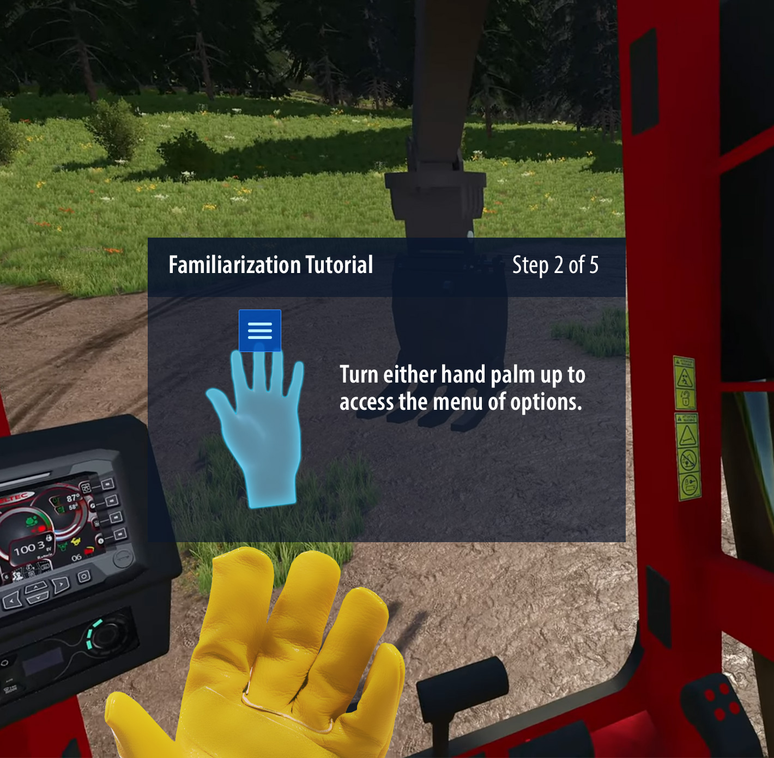
Familiarization Tutorial
EDIT
Boosts Confidence
Practical Experience
Ensures Proficiency
Realistic

Slide 55
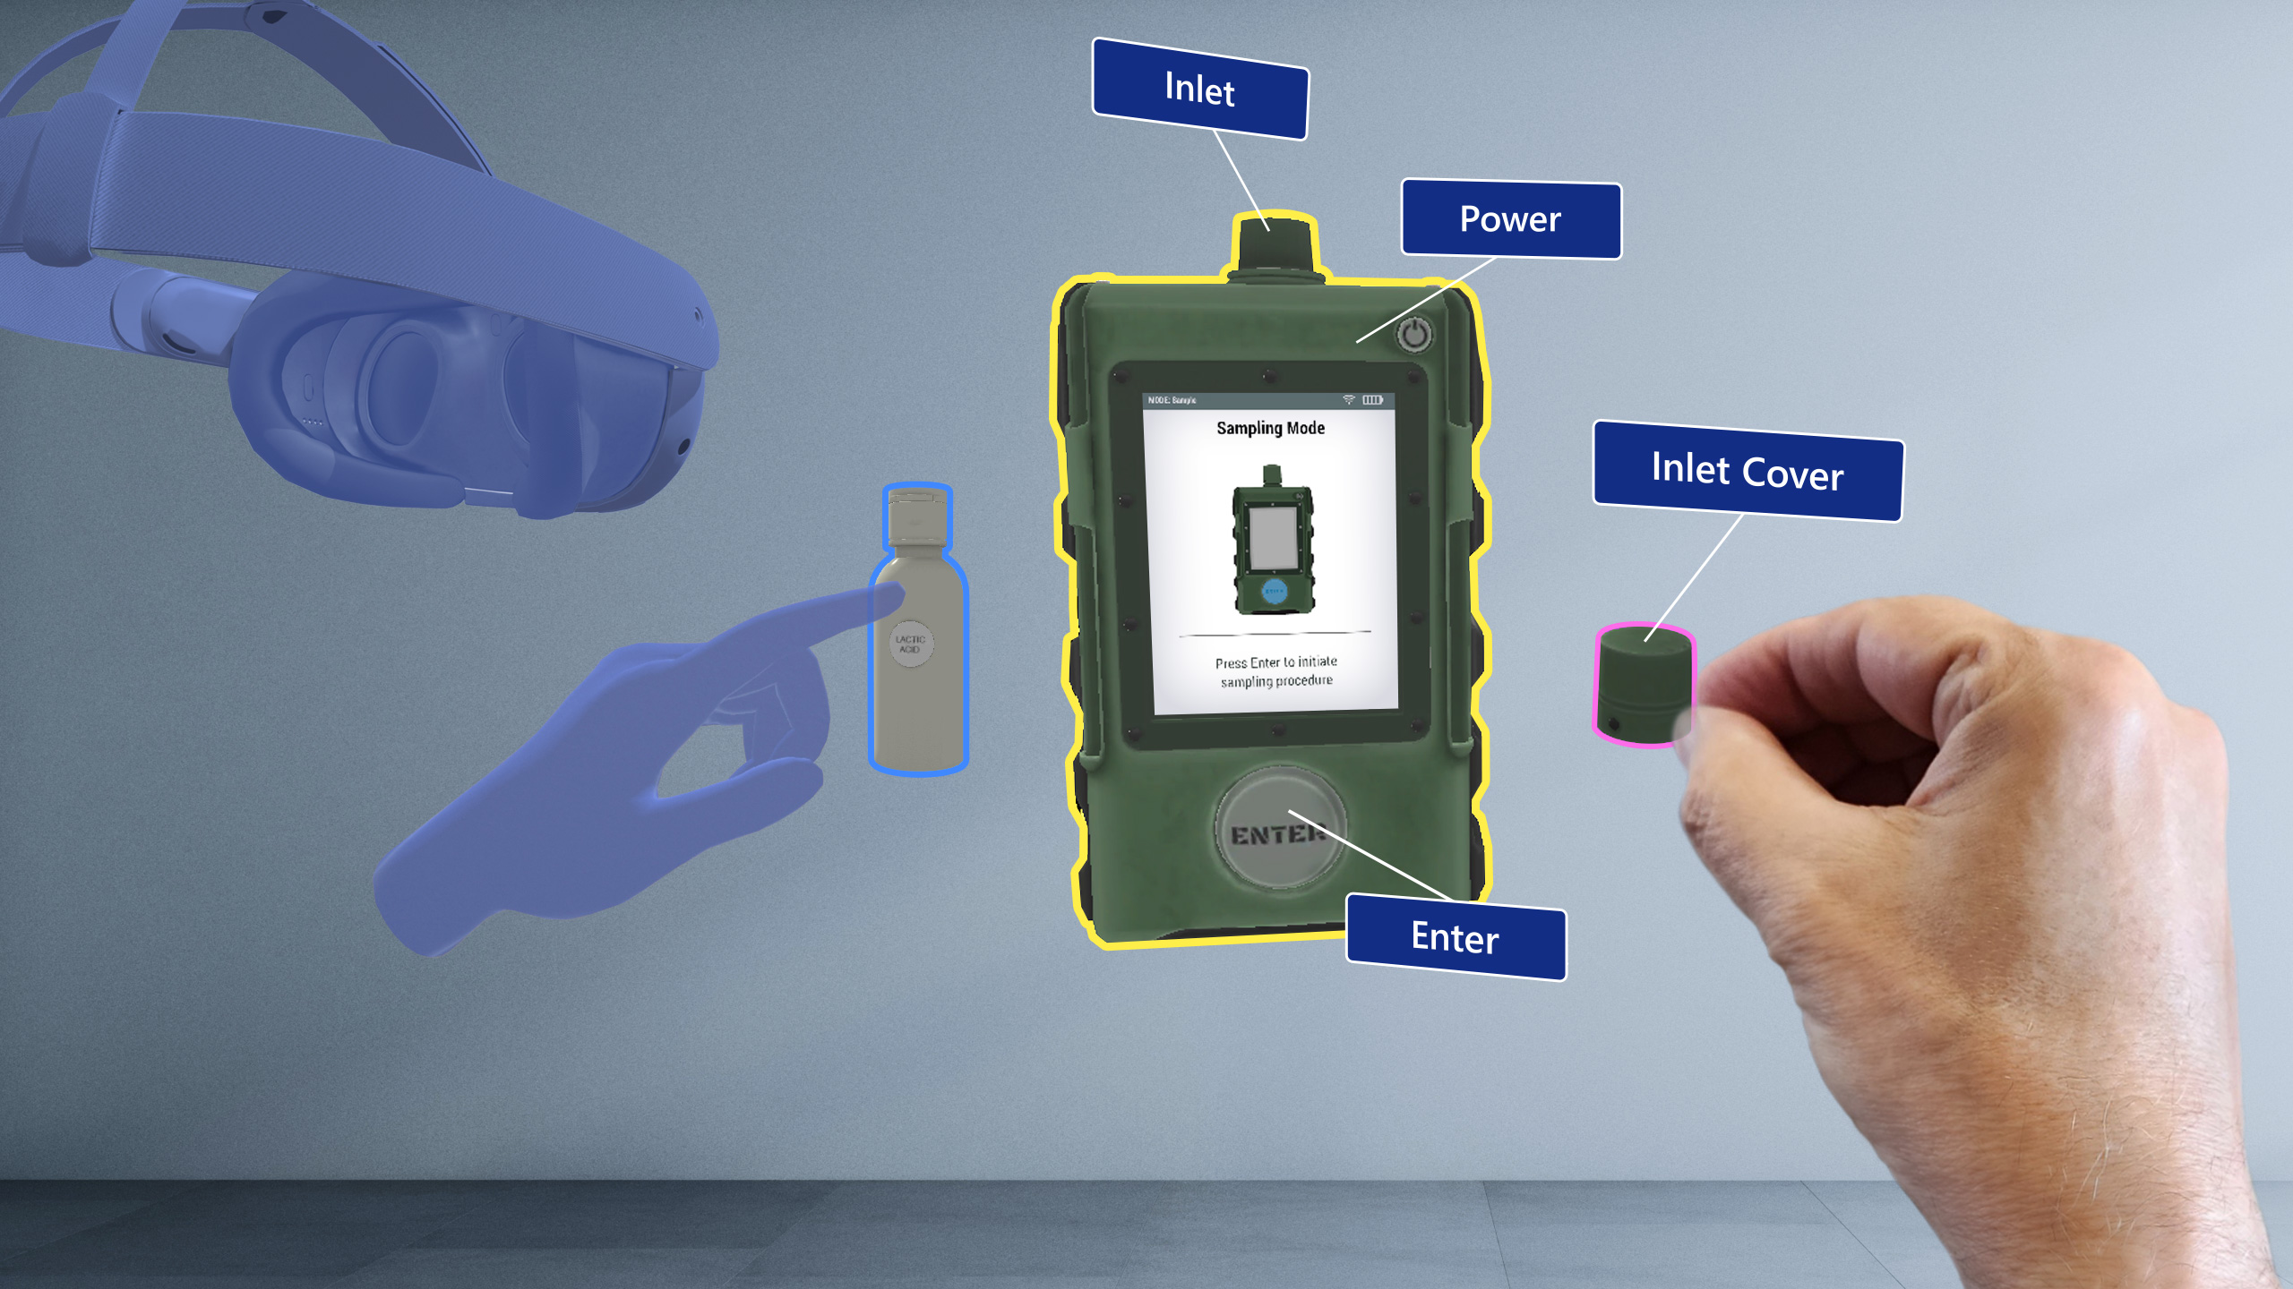
Familiarization Tutorial
Quickly
Mastering
the Virtual Interface
Our training simulators include a Familiarization Tutorial which is designed to ensure users quickly adapt to and excel in a virtual environment. Here’s what it includes:
  Intuitive User Interface Navigation: Our tutorial begins with an in-depth guide on navigating the user interface. This feature is crucial for empowering users to move seamlessly within the virtual world, boosting their confidence and efficiency from the start. The intuitive design reduces the learning curve, enabling users to focus on training objectives rather than mechanics.
  Practical Experience with an Example Model: We introduce an example model for hands-on practice. This model is representative of real-world scenarios, providing users with a safe and controlled environment to apply their skills. This practical approach not only reinforces learning but also enhances the users’ ability to handle complex tasks in real situations, bridging the gap between simulation and actual application.
  Training in Hand or Control Interaction: The tutorial trains users in interacting with virtual models using their hands or provided controls. This training is vital for developing fine motor skills and precision in a virtual setting. Users gain the ability to perform intricate tasks with accuracy, greatly enhancing their operational competence in real-world applications.
Our Familiarization Tutorial is designed not just to acquaint users with the VR system, but to equip them with the skills and confidence needed for proficient operation in their respective fields, ensuring a smooth transition from virtual to real-world applications.

Slide 56

Performance Tracking
Individualize Learning
Monitor
Progress
Customize
Goals
Realistic

Slide 57

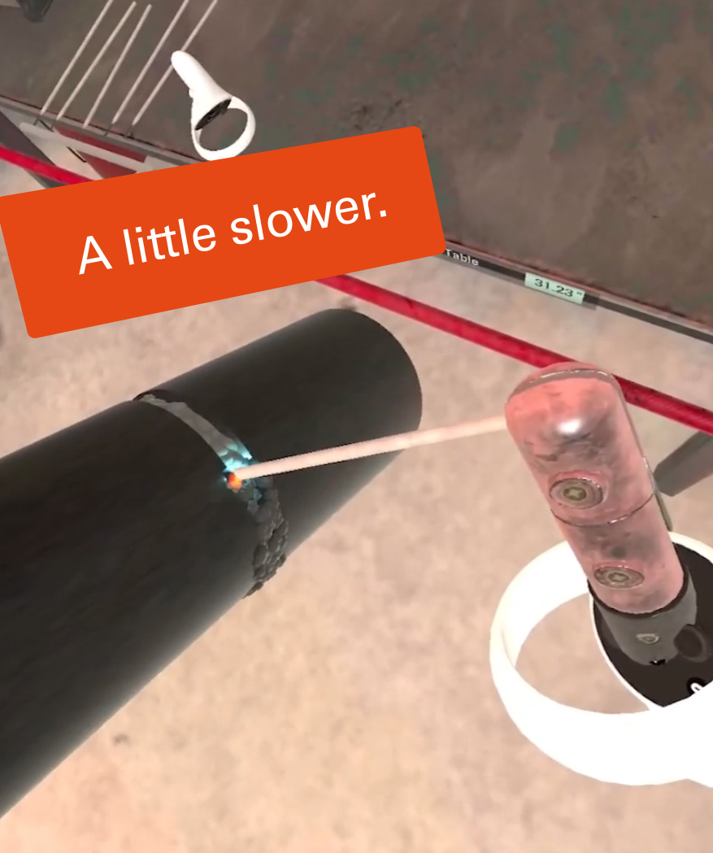
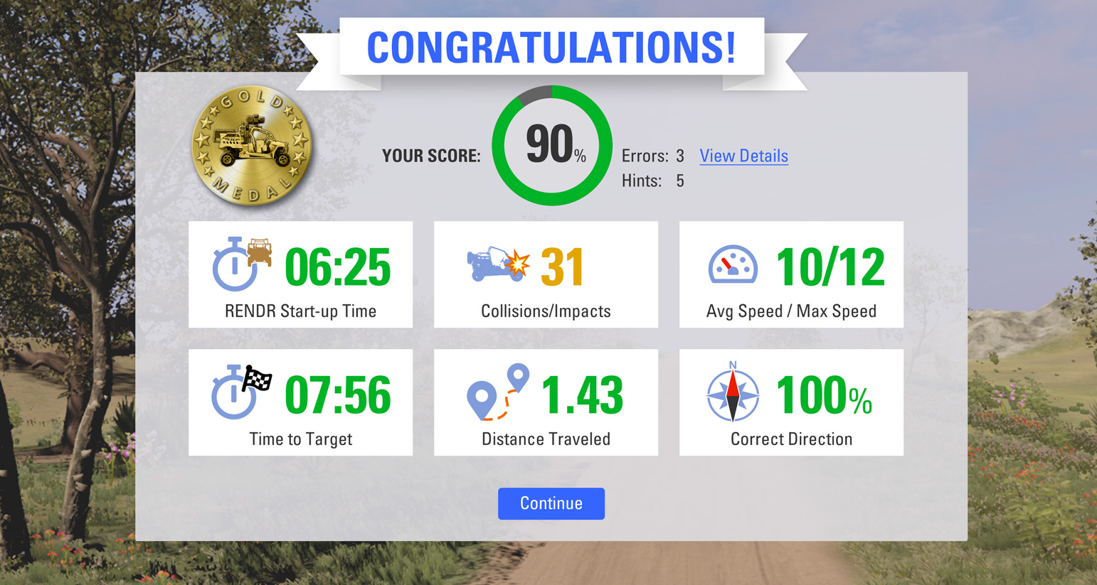
Performance Tracking
Monitoring
Trainee
Proficiency
The proposed simulator will incorporate a robust system for tracking trainee performance. This feature is designed to provide valuable insights into the progress of each trainee, enabling trainers to identify areas of strength and improvement.
  Performance Tracking: The simulator will track actions taken by the trainees during their training sessions, time spent on each task, and correct and incorrect actions taken.
  Data Analysis: The collected data will be analyzed in real-time to provide immediate feedback to the trainees. This instant feedback mechanism is designed to reinforce correct actions and rectify mistakes promptly, enhancing the learning process.
  Reporting: At the end of each training session, a performance analysis report will be generated. Available as a downloadable text document, this report could potentially integrate with an existing Learning Management System (LMS) for tracking and analysis across multiple training modules.
Trainers will be enabled to monitor trainee progress, provide timely feedback, and make data-driven decisions to enhance the effectiveness of their training programs overall.
edit
Case Study: Rendr Tele-Op
In the RENDR Tele-Op Simulator developed for the JPEO-CBRND, ForgeFX displayed trainees’ performance data in a graphic, gamified style to increase readability and engagement while reporting precise real-world-based measurements.

Slide 58
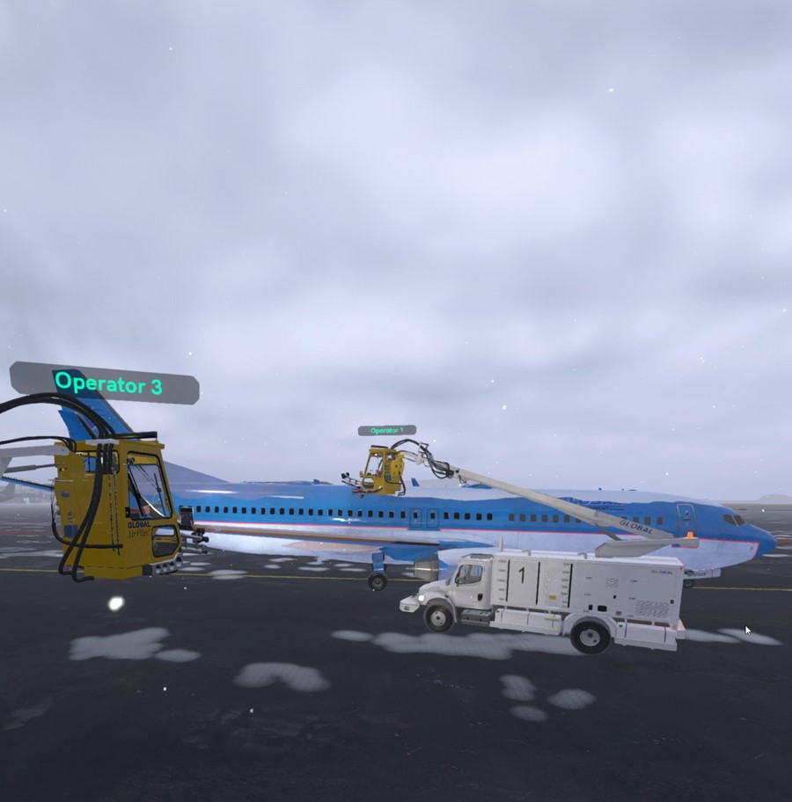

Multi-User Training
Realtime Communication
Collaborative Learning
Shared Environment
Realistic

Slide 59
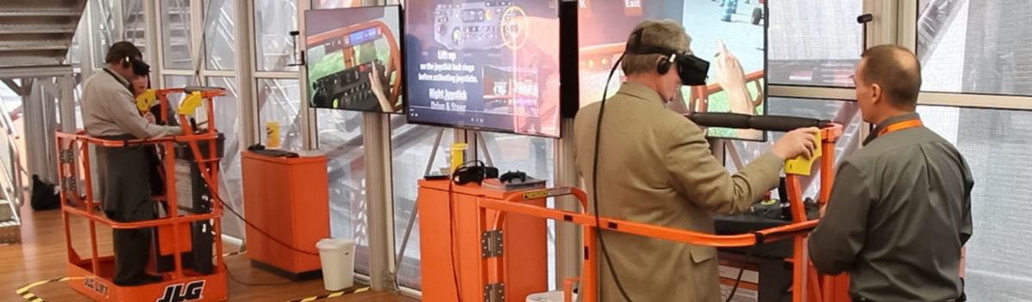
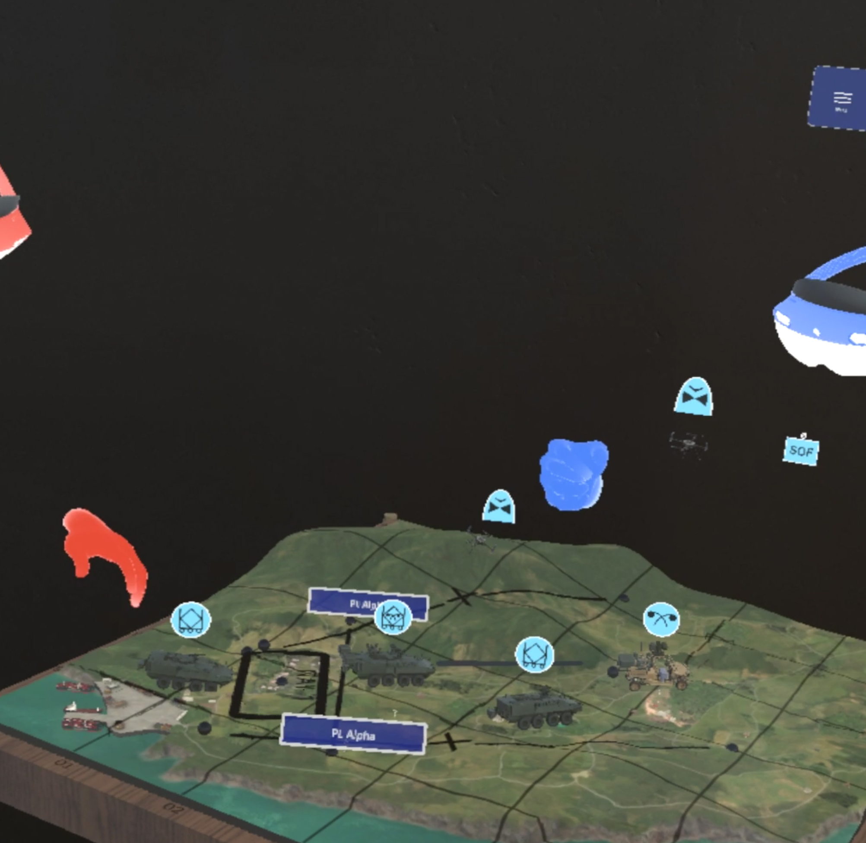
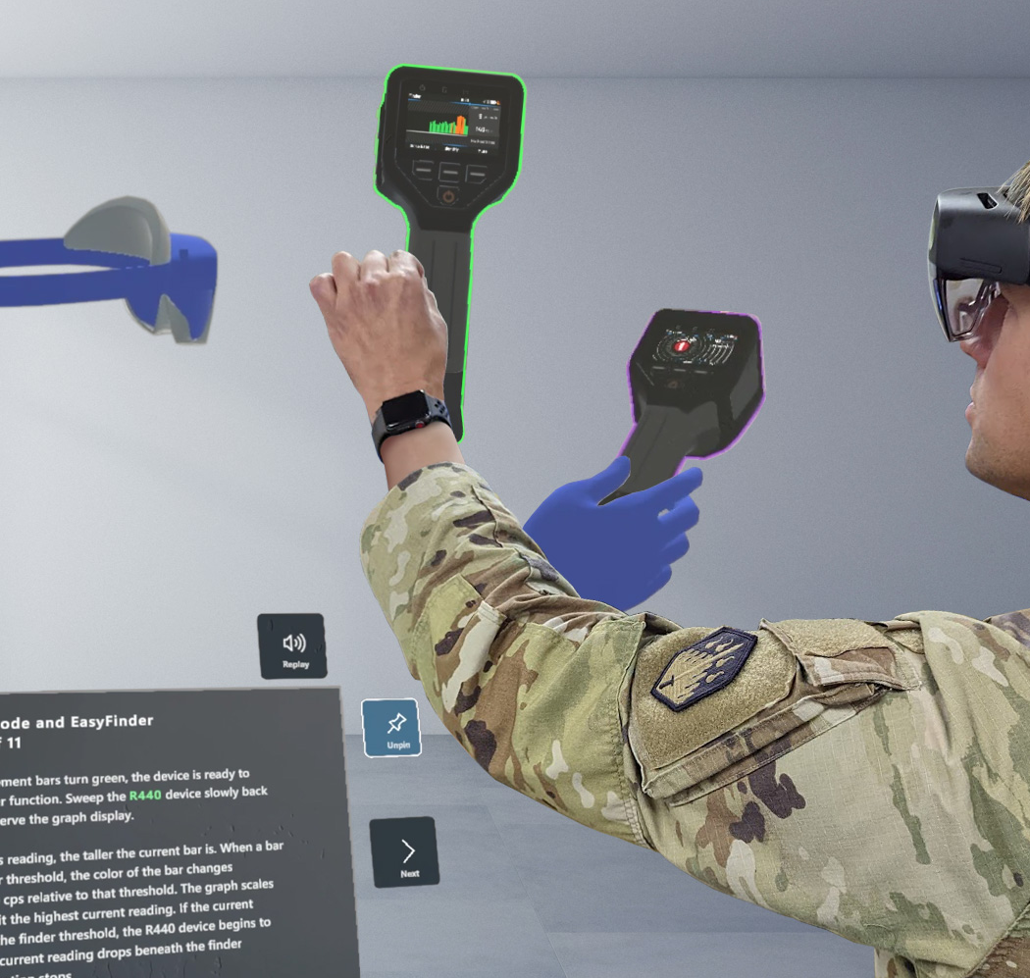
Multi-User Training
Networked Training for Collaborative Learning
The simulator will succeed in the goal to revolutionize the way training is conducted by providing a networked multi-user training system. This enables simultaneous training of multiple users in a shared virtual environment, fostering collaboration and real-time interaction among both students and trainers. This system is designed to support various types of training structures:
One-On-One Training: Direct interaction between a single trainee and trainer, allowing for personalized instruction and immediate feedback.
One-To-Many Training: Instructors can guide multiple trainees simultaneously, promoting an efficient use of resources.
Key features of the system include:
Real-Time Interaction: Trainees can interact with each other and their instructors in real-time within the virtual environment. This fosters teamwork and enhances development of problem-solving skills.
Shared Virtual Environment: Allows for both collaboration on tasks or observing others’ actions.
VoIP Communication: Voice over Internet Protocol (VoIP) technology for natural verbal communication among users.
Leveraging ForgeFX’s extensive experience in developing multi-user VR simulations, the simulator will offer an immersive, interactive platform that enhances engagement and knowledge retention.
CASE STUDY:
CBRND Holotrainer
Past projects such as the HoloTrainer for JPEO-CBRND, which includes multiuser telepresence functionality, ensure that ForgeFX is well-equipped to deliver on this aspect of the project.
Note: Multi-user functionality will require a yearly support subscription. Please see the Scope & Cost Options page for details.

Slide 60

LmS Integration
Familiar
Efficient
Motivating
Realistic

Slide 61

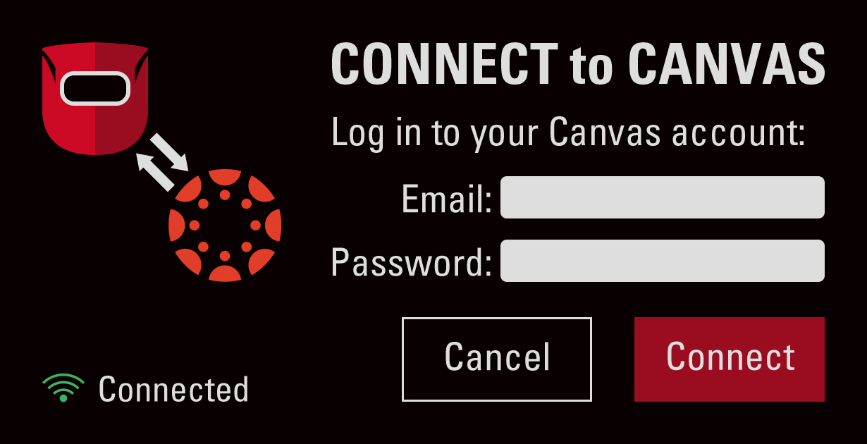
Learning Management System Integration
Using Data
to shape
the perfect curriculum
ForgeFX recognizes the importance of integrating our training applications with Learning Management Systems (LMS) for our clients.
  Web-based performance monitoring offers trainers a user-friendly, and familiar, web-based portal to monitor trainees’ performance and progress.
  Efficient learning management: LMS integration facilitates the management of training activities, reducing the administrative burden of manual tracking and reporting.
  Increased engagement and motivation: Progress-over-time tracking introduces an element of gamification, enhancing engagement and motivation levels.
Key features of this potential integration will include:
  User Authentication: The simulator will utilize either the LMS’s user authentication system or an independent authentication system to ensure secure access to training sessions. This flexible approach allows for a tailored solution that aligns with specific requirements and preferences.
  Training Session Records: Upon completion of each training session, a detailed performance analysis report will be generated by the simulator. This report can then be uploaded to the LMS, providing an easily accessible record of each trainees’ progress over time.
  Progress Tracking: The integrated system will allow trainers to monitor trainee progress over time, identifying areas of strength and areas needing improvement. This data-driven approach can inform future training strategies and contribute to continuous improvement in training outcomes.
CASE STUDY:
CANVAS FOR OCUWELD
ForgeFX has proven expertise in developing simulators that integrate effectively with existing systems, as exemplified by StrataTech’s OcuWeld project which allows trainees to login to their Canvas LMS account.
CASE STUDY:
CANVAS FOR OCUWELD
ForgeFX has proven expertise in developing simulators that integrate effectively with existing systems, as exemplified by StrataTech’s OcuWeld project which allows trainees to login to their Canvas LMS account.

Slide 62
Multi-Language Support
Inclusive
Collaborative
Immersive
Realistic

Slide 63

Multi-Language Support
Global Reach
with a
Local Touch
Supporting multiple languages in a virtual reality (VR) training simulator offers a range of benefits that enhance the learning experience and accessibility for users globally.
  Inclusivity: Users from different linguistic backgrounds can engage with the training content in their native language, which significantly improves comprehension and retention. This is particularly important in complex or technical training scenarios, where understanding nuances is crucial.
  Global collaboration: Trainees from various parts of the world can participate in the same training sessions, promoting a more integrated and diverse learning environment. This aspect is especially beneficial for multinational corporations and organizations that operate across different countries, as it ensures consistent training standards and experiences for all employees.
  Scalability: Organizations may deploy the same training content across multiple regions without the need for customization. This not only saves time and resources but also ensures that the quality and consistency of the training content are maintained across different languages.
  Cognitive engagement and immersion: When users interact with the simulator in their native language, they are more likely to be fully engaged and immersed in the training scenario. This heightened level of engagement enhances the effectiveness of the training, as users are more focused and motivated to learn.
Edit
CASE STUDY: CATERPILLAR
Though the feature was not implemented in the final release application, the Caterpillar simulator was originally designed to include both English and
Spanish text.

Slide 64
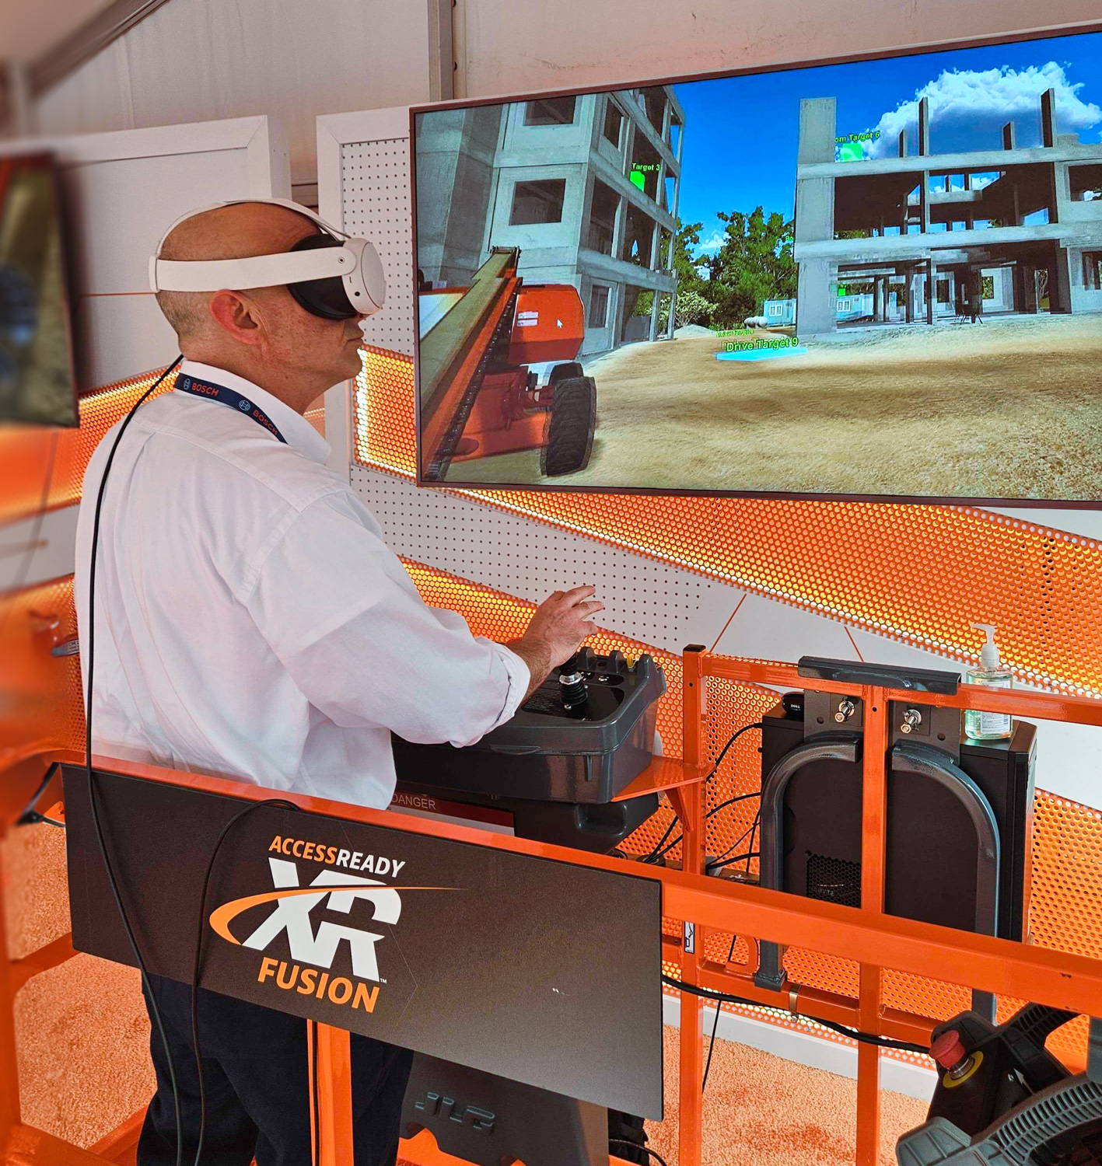
Real-World Controls Integration
edit
Realistic

Slide 65
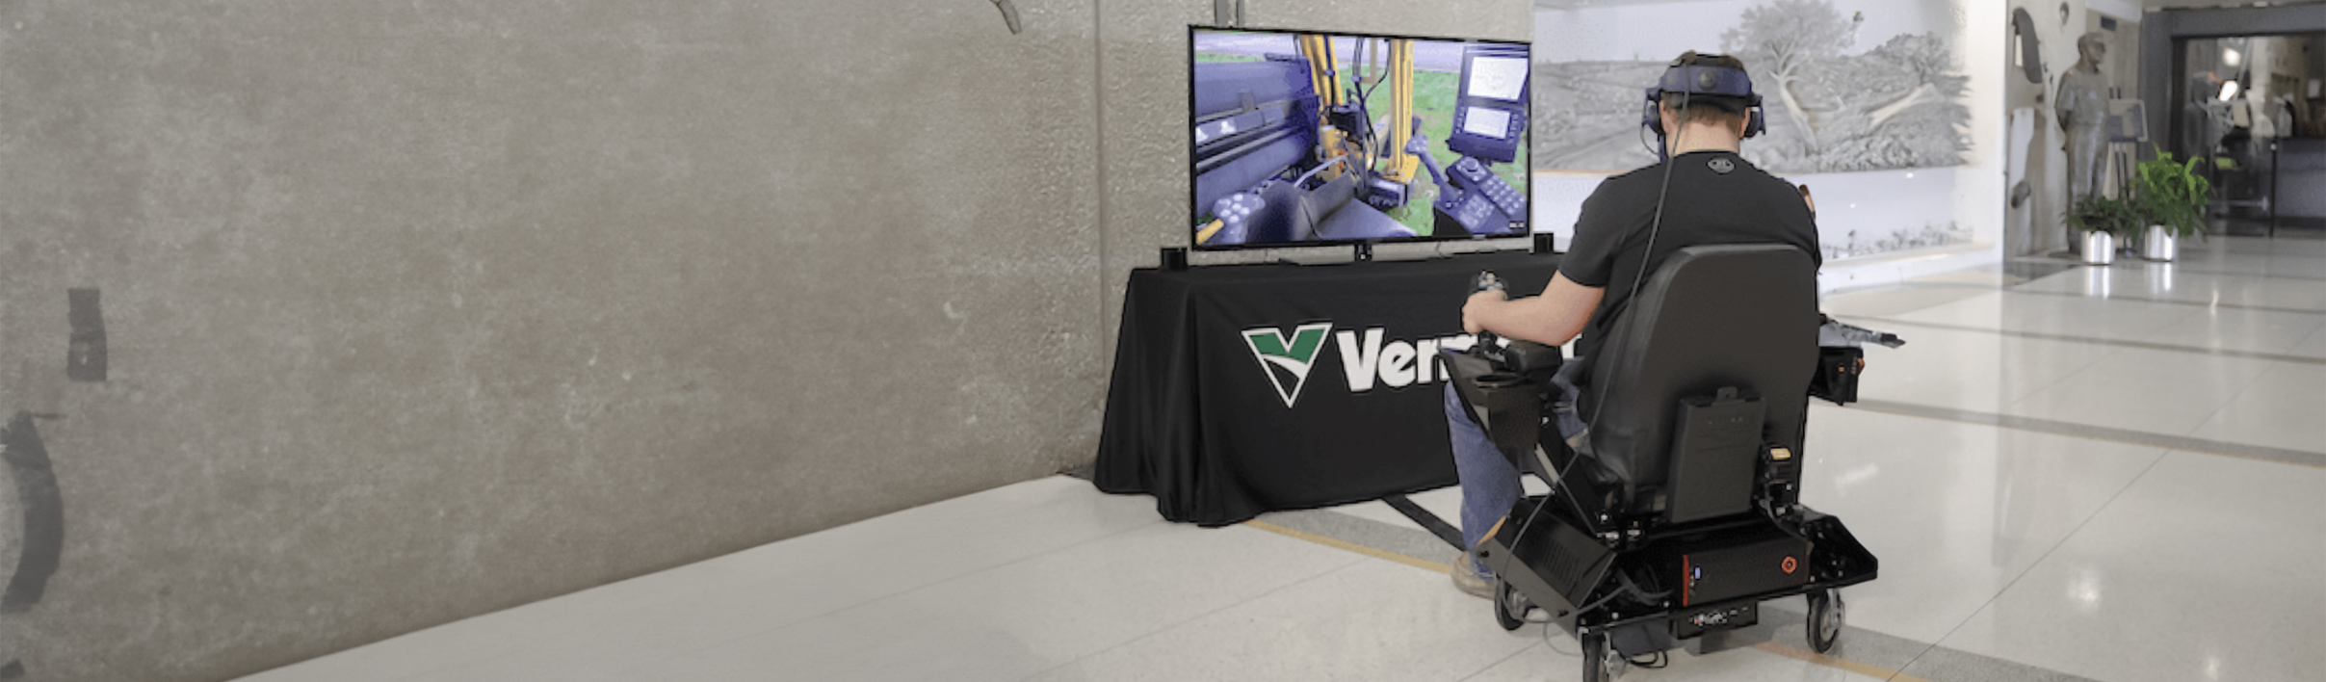
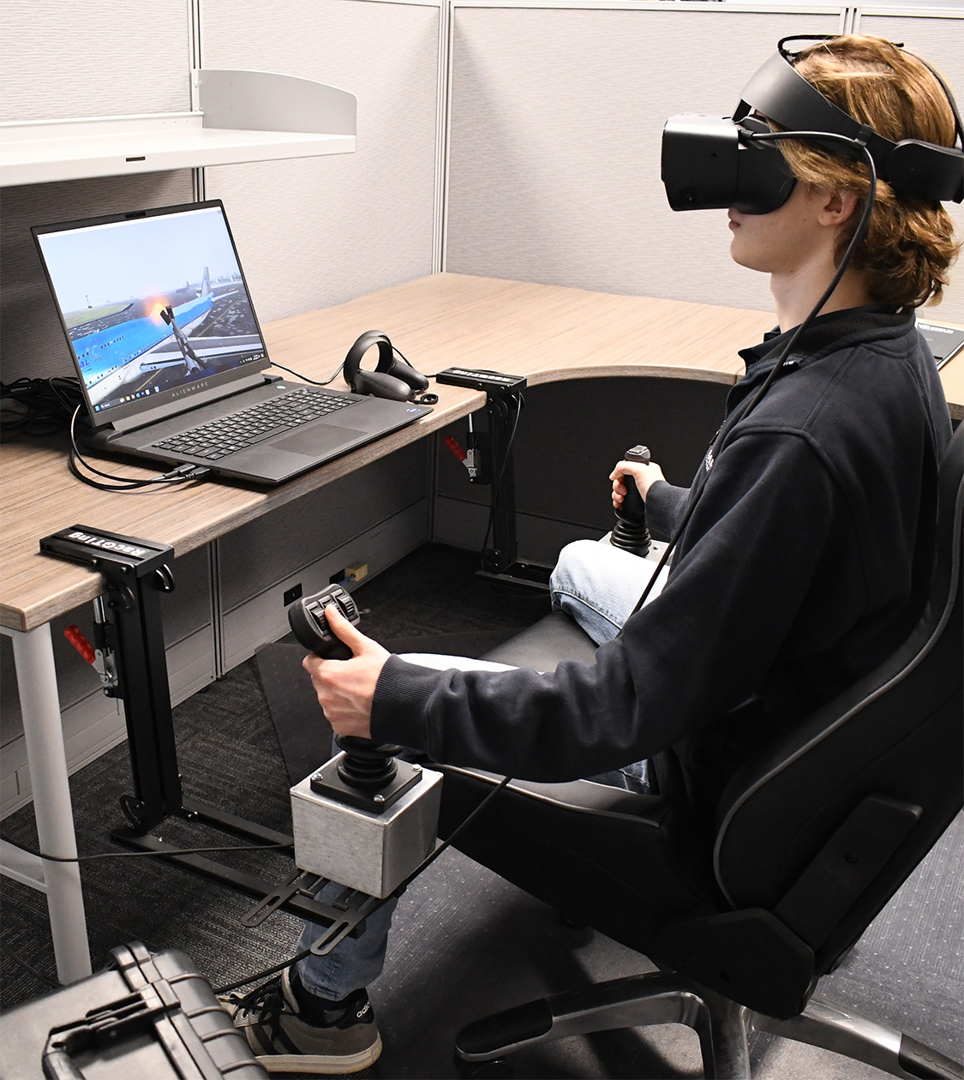
Real-World Controls Integration
Real controls,
Real skills
The simulator will be designed with the option to integrate with real-world physical cab controls. This option is a significant aspect of the simulator's design, with benefits including:
  Enhanced Realism: In addition to the robust virtual control setup, the supplementary physical controls feature further enhances the realism of the training experience. Integrating these controls using a CANBUS to USB system supports the seamless blend between virtual and physical elements in the simulator.
  Seamless Transition and Practical Skills: Whether trainees practice with virtual controls or physical controls, the focus remains on ensuring a smooth transition to real-world operations. Virtual controls provide a solid foundation, while the physical controls build upon this base to familiarize trainees with the feel of the physical equipment they will use in the field.
  Adaptable and Comprehensive Training Solution: The simulator will provide a comprehensive and adaptable training solution. The virtual controls serve as the core of the training experience, versatile enough to be effective in various training contexts. The optional physical controls are an enhancement, offering an additional layer of realism for those who seek a more hands-on approach.
CASE STUDY: Global Ground Support
The joystick controllers integrated with our training simulator for GGS play a crucial role in building deicing skills, helping the trainee build muscle memory that translated directly to real-world equipment.

Slide 66
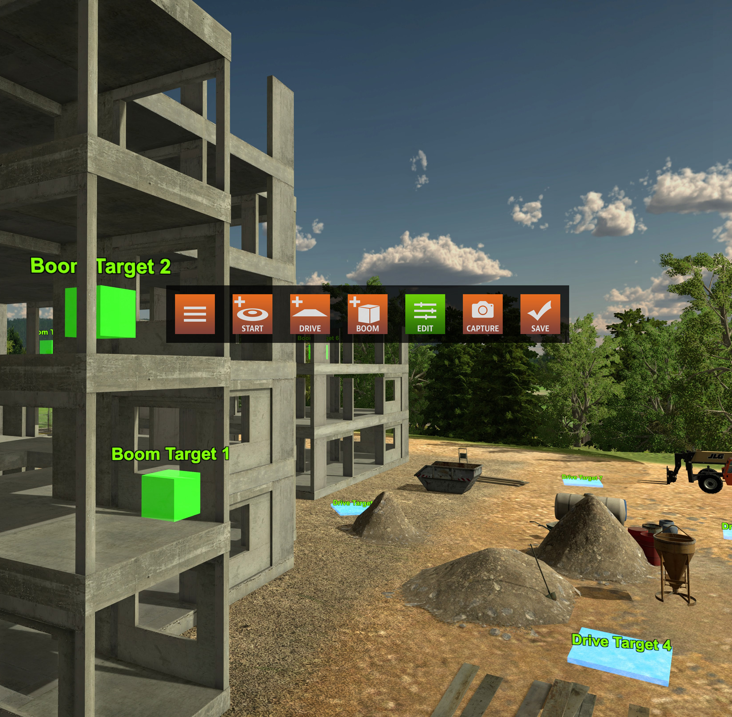
Lesson
Builder
Guided
Unguided
Realistic

Slide 67
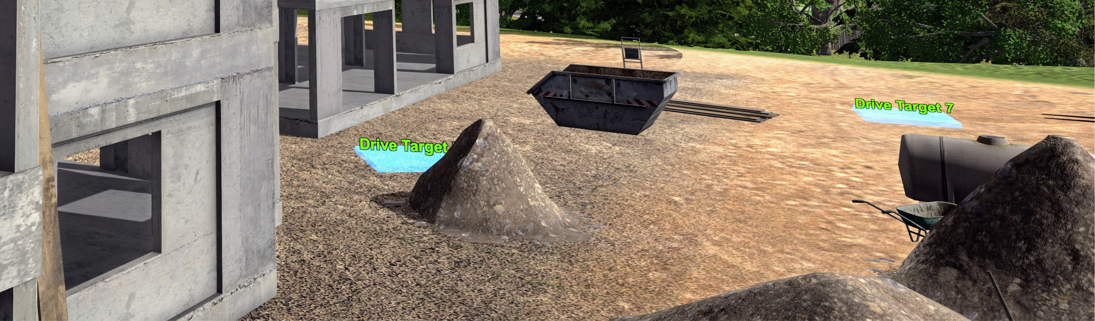
Lesson Builder
Buildable lessons, infinite possibilities
The Lesson Builder is a no-code authoring tool that enables trainers and instructors to create custom training lessons using predefined assets, environments, and interactive elements—all within the simulator’s framework. Users can configure objectives, define step-by-step instructions, and set pass/fail conditions through a user-friendly interface without requiring programming skills. Lessons can be saved locally or shared via an online library, allowing users to browse, download, and integrate community-developed modules. This fosters knowledge sharing and continuous improvement, giving organizations access to a growing repository of ready-to-use training content without extensive development effort. Here's how it works.
  No-Code Lesson Creation: Users can build custom training scenarios using an intuitive drag-and-drop interface without requiring programming skills.
  Predefined Assets & Environments: Leverage built-in simulator assets, environments, and interactive elements to construct realistic training scenarios.
  Step-by-Step Instructions: Define structured workflows, including instructional prompts, tool usage steps, and decision points.
  Pass/Fail Conditions: Set performance criteria, such as time limits, accuracy requirements, or task completion metrics.
  Assessment & Feedback: Integrate automatic performance tracking with real-time feedback and post-lesson evaluation.
  Scenario Testing & Preview: Run and test lessons within the simulator before saving and publishing.
  Online Lesson Library: Browse, download, and utilize lessons created by other users, fostering knowledge exchange and best practices.
  Multi Edit Access: Enable training team members to access, use, and edit created lessons, facilitating collaboration and refinement.
  Version Control & Updates: Allow lesson creators to update and improve their lessons over time, with version tracking for transparency
Notes:
The Lesson Builder empowers trainers to craft complex, adaptive scenarios with 10-15 distinct steps. Instructors can create branching narratives, customize environmental conditions, and define specific proficiency criteria for each step. The system's real-time data collection facilitates performance analysis and scenario refinement. This level of customization and insight makes the Lesson Builder ideal for industries where hands-on training is crucial but logistically challenging, such as manufacturing, construction, and high-risk

Slide 68

Avatar
Virtual Presence
Impactful
Relatable
Interactive
Realistic

Slide 69

Avatar Virtual Presence
Customized
avatars
revolutionized impact
The xxxxx Simulator’s Avatar or team of Avatars will be invaluable for teaching soft skills to hard workers. ForgeFX will custom-create an avatar that virtually embodies the xxxxxxx standards, from its appearance to its language.
Key features of this capability include:
Customizable Realism: The simulator’s avatars can range from stylized to photographic realism, allowing the avatars’ appearances to be most relatable to teams and enhancing the overall immersive experience.
Advanced AI Integration: xxxxxxx Simulator’s avatars will utilize the latest advancements in character design software and AI-generated human features, enabling realistic human appearances and behaviors.
Standardized Interaction Programming: The ability to program avatars to interact and respond based on xxxxx standardized communication expectations ensures that the training scenarios are relevant and impactful.
ForgeFX offers expert guidance to ensure the selected avatar features align perfectly with training objectives, maximizing the effectiveness of the simulation. By working closely with xxxxxxxx ForgeFX will create avatars that are visually realistic and capable of delivering the training interactions desired.
Case Study:
Tele-Op Simulator
In this UAS training simulator for the JPEO, ForgeFX not only provided a choice of male or female narration options, but also emulated real-world radio communications between squad members to provide context and verisimilitude for the lesson.

Slide 70

LESSON CONTENT
EDIt
This section describes in more detail the structure and type of lessons that will be included in the proposed simulator.

Slide 71

Lesson Definition
Risk-Free Skill Building for Real World Mastery.
The simulator training lessons are tailored to meet your initiative’s training requirements. The lesson framework supports selecting and including content based on specific training needs and offers the flexibility to expand and integrate additional lessons as the program progresses.
Objective, Overview, and Learning Outcomes: The simulator lesson will outline what the learner will achieve by the end of the lesson, summarizing the key content, skills, and knowledge areas covered. It will provide a clear statement of the intended learning goals and the specific, measurable outcomes that will indicate the learner’s competence.
Immersive Instructional Content and Lesson Flow: A typical lesson comprises 10-15 steps, and learners will be guided through these steps using virtual prompts, ensuring a smooth and coherent flow throughout the lesson. The instructional content includes interactive exercises and real-time feedback, all within the simulated environment.
Assessment and Feedback: In the virtual training lesson, assessment and feedback are seamlessly integrated throughout the experience. As learners progress through each step, the simulation automatically provides real-time assessment, offering feedback on their performance where required. At the end of the lesson, a performance summary report will provide a comprehensive overview of the learner's progress.
Defining
Simulator-based lessons

Slide 72
Lesson Types
Risk-Free Skill Building for Real World Mastery.
To support the training goals, the simulator will feature a variety of lesson types tailored to different stages of skill development. From low-pressure equipment familiarization to high-impact operational tasks and fault diagnosis, each lesson type is designed to reinforce safe habits, build confidence, and prepare trainees for real-world performance. These formats ensure training is both scalable and adaptive, meeting students where they are in their learning journey.
Familiarization Lessons: These introductory lessons let trainees explore equipment layouts and UI elements through interactive hotspots, giving them contextual information in a low-pressure environment. They prepare users for hands-on tasks by visually demonstrating controls and system interfaces, eliminating the need for procedural actions.
Operational and Procedural Lessons: Training begins with a guided, step-by-step simulation that walks the trainee through equipment operation or process-based tasks, reinforcing correct techniques in real time. Once the guided phase is complete, the trainee advances to the unguided version, performing the same task independently without prompts. Ultimately, they receive an automated scorecard with assessment and feedback.
Guided Troubleshooting Lessons: These guided lessons introduce preset faults or failures into an otherwise standard workflow, requiring users to diagnose and resolve issues as part of the procedure. Learners follow structured steps to identify symptoms, isolate root causes, and apply corrective actions within a controlled scenario.
Pre-Programmed Fault Simulations: In these unguided lesson scenarios, fault conditions are embedded into the virtual procedure, requiring users to detect and resolve issues without external prompts. The system evaluates their real-time actions, tracking safety, efficiency, and accuracy.
Tailoring
Training to Maximize
Learning
  (

Slide 73
(xxxxxx)
Lesson Types
TECHNOLOGY
ROADMAP
This section outlines the core lesson types available within the simulation, each designed to adapt to your specific training requirements. A complete virtual reality training solution typically includes a combination of lesson types.
Lesson builder…?
5
Fault Simulation
In these unguided lesson scenarios, fault conditions are embedded into the virtual procedure, requiring users to detect and resolve issues without prompts. The system evaluates their real-time actions, tracking safety, efficiency, and accuracy.
4
Troubleshooting
These guided lessons introduce preset faults or failures into an otherwise standard workflow, requiring users to diagnose and resolve issues as part of the procedure. Learners follow structured steps to identify symptoms, isolate root causes, and apply corrective actions within a controlled scenario.
3
Operational and Procedural
Training begins with a guided, step-by-step simulation that walks the trainee through equipment operation or process-based tasks, reinforcing correct techniques in real time. Once the guided phase is complete, the trainee advances to the unguided version, performing the same task independently without prompts. At the end, they receive an automated scorecard with assessment and feedback.
2
Familiarization
These introductory modules let trainees explore equipment layouts and UI elements through interactive hotspots, giving them contextual information in a low-pressure environment. They prepare users for hands-on tasks by visually demonstrating controls and system interfaces without requiring procedural actions.
1
Model Viewer
Sets the stage with a tappable 3D model experience—letting visitors explore components, layouts, and features in context.

Slide 74

LESSON LIST
the Content with immersive quality
The (xxxxx)training simulator curriculum will be designed to capture the critical details and nuanced features of the (xxxxxxxx) machine. Based on the training goals shared by the (Company) training team, here is a revisable, partial list of potential lessons:
  Lesson One: This lesson comprehensively overviews the main components and their functions within the (Model/ process).
  Lesson Two: This lesson guides trainees through the various features and controls of the machine's control panel and interface.
  Lesson Three: This lesson helps trainees identify and understand the different tooling parts used in the machine and their specific functions.
  Lesson Four: This lesson outlines essential safety procedures and best practices for handling and maintaining tooling to ensure the safe operation and longevity of the equipment.
  Lesson Five: This lesson teaches how to ensure the machine is ready for the next job.
Generic example to Prompt GPT
  Note: This is a broad-strokes lesson description. Final training content will be developed working closely with your subject matter experts.

Slide 75


Lesson Example
Generic Operational/ procedural example
This VR training lesson introduces new (machine) operators to one of the most fundamental procedures, safely picking up and staging an unloaded pallet. Designed to simulate the full physicality and presence of real-world (machine) work, the lesson immerses the trainee inside a life-sized virtual warehouse, where they practice using an interactive virtual (machine) in a realistic, mistake-tolerant environment.
This simulator will offer lessons tailored to Hensel Phelps’ safety training requirements. Below is a basic example of a VR training lesson, which will be refined with input from Hensel Phelps subject matter experts to ensure the inclusion of essential training details.
Safety Procedures for Installing Delineation Posts
  Initiate the Training: The trainee dons the Meta Quest 3 VR headset, instantly immersing in a realistic virtual construction site. Ambient sounds of machinery and distant conversations enhance the sense of presence. From the main menu, the trainee uses hand gestures to select the “Hand Safety for Post Delineation” module. As the selection is made, the environment transitions smoothly, and a user interface appears providing a brief overview of the training objectives and what to expect in the module.
  Review Safety Protocols: In this step, the trainee is guided through a detailed review of safety protocols for installing delineation posts. The simulator identifies critical safety points, and interactive elements highlight specific areas of the environment where hazards might be present. The trainee can watch short animated scenarios demonstrating both correct and incorrect practices and visual indicators (e.g., flashing warnings) ensure the trainee is fully aware of potential dangers and the importance of safety measures.
  Select Proper PPE: In this step, the trainee is presented with a virtual locker containing various types of personal protective equipment (PPE). They must choose the appropriate PPE from a 3D multiple-choice selection, including gloves, goggles, and other necessary items. Each item can be examined closely, and selecting an item prompts a brief explanation of its specific protective benefits. Incorrect choices trigger informative feedback, guiding the trainee towards the correct selection. The trainee can see themselves in a virtual mirror, ensuring proper fit and coverage before proceeding.
  Tool Selection: The simulator displays a multiple-choice selection of tools that could be found on the job site.
  Choosing the Correct Tool: The trainee selects the tool that best suits the task, which could include virtual guidance explaining the best choices for specific scenarios.
  Beginning Installation: With the correct PPE and tool, the trainee starts the post installation process, while the simulator provides real-time feedback on their technique to ensure safety and efficiency.
Lesson 3 – Module 1: operational/procedural lesson
  Initiate the Training: The trainee begins by putting on the VR headset and selecting the “BASIC Operational” lesson from the floating menu. Once selected, the simulation transitions smoothly into a full-scale warehouse environment. The forklift appears in front of them, accurately modeled and ready for interaction. A brief orientation begins, delivered through voiceover and subtle visual cues, introducing the trainee to the task, available controls, and key safety reminders. The interface highlights the pallet’s location, designated placement zone, and the path they’ll follow, creating a clear and intuitive entry point into the lesson.
  Preparation and Step-by-Step Execution: Each lesson is presented in a natural step sequence with strategic hints and intuitive flow. The trainee will engage in the lesson learning at their own pace, with the ability to repeat steps as needed.
  Lesson Steps:
      Approach the Pallet.
        Identify the pallet’s position.
        Line up forks while maintaining appropriate speed and spacing.
      Fork Adjustment and Insertion.
        Level and raise forks to proper height.
        Insert forks fully beneath the pallet without shifting it.
Generic example to Prompt GPT
REVIEW

Slide 76

Lesson Example (continued)
  Preparation and Step-by-Step Execution: Continued
      Lift and Check.
        Raise the pallet slightly for transport.
        Pause to verify stability and fork position.
      Transport to Designated Area.
        Navigate the pallet to the designated area using smooth, controlled movement.
        Maintain awareness of aisle boundaries and visibility limitations.
      Placement and Withdrawal.
        Lower pallet to ground markers in the designated zone.
        Back out the forks carefully and confirm correct alignment.
  Lesson Completion: Once the lesson is complete, the trainee’s tracked lesson completion performance and real-time progress feedback data will be generated into a comprehensive report. The report's insight will allow the training team to review the trainee's success and identify areas that may need additional attention.
      Note: This is a broad-strokes lesson description. Final training content will be developed working closely with your subject matter experts.
REVIEW

Slide 77

Lesson Example
Detail
Lesson example
The (Simulator) will offer scalable lessons that enhance the familiarization and operations process of (company) machine. Below is a basic example of a VR training lesson.
This simulator will offer lessons tailored to Hensel Phelps’ safety training requirements. Below is a basic example of a VR training lesson, which will be refined with input from Hensel Phelps subject matter experts to ensure the inclusion of essential training details.
Safety Procedures for Installing Delineation Posts
  Initiate the Training: The trainee dons the Meta Quest 3 VR headset, instantly immersing in a realistic virtual construction site. Ambient sounds of machinery and distant conversations enhance the sense of presence. From the main menu, the trainee uses hand gestures to select the “Hand Safety for Post Delineation” module. As the selection is made, the environment transitions smoothly, and a user interface appears providing a brief overview of the training objectives and what to expect in the module.
  Review Safety Protocols: In this step, the trainee is guided through a detailed review of safety protocols for installing delineation posts. The simulator identifies critical safety points, and interactive elements highlight specific areas of the environment where hazards might be present. The trainee can watch short animated scenarios demonstrating both correct and incorrect practices and visual indicators (e.g., flashing warnings) ensure the trainee is fully aware of potential dangers and the importance of safety measures.
  Select Proper PPE: In this step, the trainee is presented with a virtual locker containing various types of personal protective equipment (PPE). They must choose the appropriate PPE from a 3D multiple-choice selection, including gloves, goggles, and other necessary items. Each item can be examined closely, and selecting an item prompts a brief explanation of its specific protective benefits. Incorrect choices trigger informative feedback, guiding the trainee towards the correct selection. The trainee can see themselves in a virtual mirror, ensuring proper fit and coverage before proceeding.
  Tool Selection: The simulator displays a multiple-choice selection of tools that could be found on the job site.
  Choosing the Correct Tool: The trainee selects the tool that best suits the task, which could include virtual guidance explaining the best choices for specific scenarios.
  Beginning Installation: With the correct PPE and tool, the trainee starts the post installation process, while the simulator provides real-time feedback on their technique to ensure safety and efficiency.
Detail Lesson Example
  Initiate the Training: The trainee dons the Meta Quest 3 VR headset, instantly immersing them in a realistic virtual warehouse. Ambient sounds of machinery and distant conversations enhance the sense of presence. From the main menu, the trainee will use hand gestures to select the “Unsetting the Wrapper” module. As the selection is made, the environment transitions smoothly, and a user interface appears, providing a brief overview of the training objectives and what to expect in the module.
  Preparation and Set Up: In this step, the trainee is guided through a detailed review of the tools, molds, and forms that will be manipulated while “unsetting” the machine. The simulator identifies critical tool requirements and the impacting variables, while interactive elements highlight the specific areas where these adjustments on the machine will be made. The trainee can watch short animated scenarios demonstrating the implications and applications of the form and mold elements installation, including visual indicators (e.g., flashing warnings), increasing trainee observation and orientation toward accuracy.
  Removing (steps to be created): In this set of steps, the trainee is set to engage with the Virtual machine. They will be guided through the detailed step-by-step process of removing the top form. During the initial orientation of the process, the simulator may feel like a guided tour, with visual highlights of each step as it could be performed. The steps will be articulated in as simple or explicit detail as required. Following is an example of how the steps for this task could appear.
  (continued on next page)
Detail example to Prompt GPt
REVIEW

Slide 78
Lesson Example (continued)
Detail Lesson Example (continued)
      Identify the wrapper form and spotter form.
      Identify the wind block generally covered with Teflon.
      Loosen the clips mounted to the top side of the form.
      Move the loosened form clips up out of the way.
      Loosen the form bolts that hold the form tight to the machine.
      Using the Control Panel, select the “Manual Tab” to enable the form/mold.
      Ensure the machine is in the proper position to start movement.
      Verify or Re-Select the “mold” option on the control panel.
      Use the hand wheel attached to the control panel to slowly spin the form downwards, allowing access to the form’s bolt and spring clip.
      Depress the plate on the backside of the yoke to allow the form to release.
      Check the control panel screen to ensure the mold is still enabled.
      Reverse direction to move the form to an accessible position.
      Gently remove the form. (lesson complete)
      Lesson Completion
      Once the lesson is complete, the trainee’s tracked lesson completion performance and real-time progress feedback data will be generated into a comprehensive report. The insight provided by the report will allow the training team to review the success of the trainee and the areas that may need additional attention.
      Note: This is a broad-strokes lesson description. Final training content will be developed working closely with your subject matter experts.
Detail example to Prompt GPt
REVIEW

Slide 79

Fig. 1: Lesson Mockup
[PROJECT]
Scope & Cost Options
MOCKUP
NEEDED
A
B
C
D
E
Once a trainee puts on a VR headset and enters the training application, they will be in a 360° simulated environment. The following elements are anticipated to be included in your project:
As with the mechanical controls, the cab computer will be realistically interactive. Inputting instructions on the touchscreen will cause the expected results on the machine.
The user will be able to see representations of their arms and hands as they operate the real-world controls. The hand-tracking capability of the VR unit ensures accurate replication of finger motions.
Lesson step instructions are visible on a panel within the trainee’s reach. The panel can be repositionable by the user to a location that is convenient to them.
In Guided Mode or when a hint is needed, animated graphic prompts appear superimposed over the levers, pedals, and other control surfaces.
The environment, equipment, trees, and logs will be full scale models that move and sound like their real-world counterparts.
REVIEW

Slide 80
Fig. 1: Lesson Mockup
[PROJECT]
Scope & Cost Options
MOCKUP
NEEDED
8
7
3
6
2
5
9
4
Digging Bucket
Optimum wrapper angle and no sharp corners promote superior bucket fill and reduce material packing.
1
4
Click & hold to rotate
Add options in playground
A
B
C
D
E
Once a trainee puts on a VR headset and enters the training application, they will be in a 360° simulated environment. The following elements are anticipated to be included in your project:
As with the mechanical controls, the cab computer will be realistically interactive. Inputting instructions on the touchscreen will cause the expected results on the machine.
The user will be able to see representations of their arms and hands as they operate the real-world controls. The hand-tracking capability of the VR unit ensures accurate replication of finger motions.
Lesson step instructions are visible on a panel within the trainee’s reach. The panel can be repositionable by the user to a location that is convenient to them.
In Guided Mode or when a hint is needed, animated graphic prompts appear superimposed over the levers, pedals, and other control surfaces.
The environment, equipment, trees, and logs will be full scale models that move and sound like their real-world counterparts.
REVIEW

Slide 81

PRICE OPTIONS
Our proposal offers a range of scope sizes and pricing options, a comprehensive product ownership model, and a clear focus on delivering a compelling return on investment.
BOILER
PLATE

Slide 82
[PROJECT]
ALIGNMENT
ROI
Benefits
These components are integral to a robust, compelling simulator. The following pages describe in more detail how these features work to achieve a rewarding educational experience.
System requirements
Reduced Wear and Tear
Reduced Use of Consumables
Increased Operator Familiarity
Training on simulators minimizes wear and tear on real equipment by reducing the number of training hours conducted on physical machines. It extends the lifespan of expensive equipment, reducing repair and replacement costs.
Simulators eliminate the need for consumables like fuel, oil, and other materials required in real-world training. Lowers operational expenses by eliminating recurring costs for training sessions.
Reduces the learning curve, minimizes operational risks, and improves operator performance before hands-on use.
Reduced Training Cost
Sales and Marketing
Increased Training Productivity
Simulators streamline the training process, reducing time spent waiting for access to real equipment and eliminating the need for travel to specific locations.
Creates a powerful sales tool that enables potential customers to "try before they buy," increasing engagement and sales opportunities.
Maximize the number of trained operators without requiring additional physical resources, increasing training capacity.
Future proof development
No licensing costs
Full Asset Ownership
Long-term flexibility, ensuring that the simulation can grow and adapt with future needs and technologies without incurring additional costs.
Unlike other services, ForgeFX doesn’t charge recurring licensing fees for developed assets, which are fully transferred to the client.
Clients retain full ownership of all developed assets, ensuring complete control and the freedom to modify, update, or expand projects without restrictions.

Slide 83
Baker Hughes VR SWA training simulator
SCOPE OPTIONS
& ROM PRICING
Below are three potential scope options, each designed to address different aspects of your requirements. However, we greatly value your feedback and welcome any suggestions or adjustments. If you'd like to explore other possibilities, we would be happy to collaborate on creating an alternative solution that more closely aligns with your vision and specific needs.
 | Scope Package Features
Option 1 | Virtual 3D Art Components (Qty ) Critical Component Theoretical Operation Simulations (Qty) Familiarization Lesson (Qty ) Guided Operational Lesson (Qty ) Network, Multi-User Support Framework 10 Meta Quest Headsets | Duration | mo
 |  | ROM Cost
 |  | Loyalty Discount | %
 |  | Final ROM Cost
Option 2 | Virtual 3D Art Components (Qty ) Critical Component Theoretical Operation Simulations (Qty) Familiarization Lesson (Qty ) Guided Operational Lesson (Qty ) Guided Troubleshooting Lesson (Qty ) Unguided Operational Scenario Lesson (Qty ) Network, Multi-User Support Framework Multi-Language (English + 1 additional Language) Expanded Scoring, Assessment, & Gamification 10 Meta Quest Headsets
 |  | Duration | mo
 |  | ROM Cost
 |  | Loyalty Discount | %
 |  | Final ROM Cost
Option 3 | Virtual 3D Art Components (Qty ) Critical Component Theoretical Operation Simulations (Qty) Familiarization Lesson (Qty) Guided Operational Lesson (Qty) Guided Troubleshooting Lesson (Qty ) Unguided Operational Scenario Lesson (Qty ) Network, Multi-User Support Framework Multi-Language (English + 1 additional Language) Expanded Scoring, Assessment, & Gamification Marketing Video 10 Meta Quest Headsets
 |  | Duration | mo
 |  | ROM Cost
 |  | Loyalty Discount | %
 |  | Final ROM Cost

Slide 84
SCOPE OPTIONS
We've prepared three scope options to meet your requirements. Each option builds upon the previous tier, offering increasing levels of sophistication and automation. This proposal provides flexible starting points—we welcome your feedback and are happy to collaborate on customizing any aspect to align with your vision. .

Slide 85
Scope & Cost Options
[PROJECT]
To closely match [COMPANY’s] requirements, here are four degrees of scope for the initial release of the [PROJECT]. Please feel free to suggest an option we haven’t proposed, and we will update our proposal and quote to match your requirements.
# | FEATURE | OPTIONS | 6 |  | 7
 |  | POC | PILOT | CORE | PRO
1 | Simulation Framework Core architecture for the trainer. ForgeSIM™ Framework Requirements Verification User Interface Audio Effects & Voiceover Narration Performance Tracking Parts Familiarization Essential AI Voice Commands (e.g., “Start lesson #1”) | ✓ | ✓ | ✓ | ✓
2 | Virtual Equipment The machinery being replicated. | 1 | 1 | 1 | 2
3 | Virtual Environment This is the custom virtual world in which the user will interact. This environment will be tailored to your specifications. | ✓ | ✓ | ✓ | ✓
4 | Extended Reality (XR) Includes support for the virtual equipment and environment to be interacted with in a Stereoscopic mixed reality 3D experience. Qty 1 Meta Quest 3 Headset | ✓ | ✓ | ✓ | ✓
5 | Instruction Modes: Guided and Unguided Support for both a structured step-by-step guided mode as well as unguided mode that allows users to advance through the training without assistance. | ✓ | ✓ | ✓ | ✓
7 | Real-world Controls Integration Physical controls integrated with virtual experience.
8 | Voice Commands Support for a voice command system driven by a state-of-the-art large language model (LLM). | ✓ | ✓ | ✓ | ✓
9 | Languages Translation of the simulation software and training content into one additional language other than English.
10 | LMS Integration Usage tracking within learning management system. |  | ✓ | ✓ | ✓
11 | Networked Multi-user Training Collaborative environment for instructors and students. Includes/requires $199/mo. ongoing support service. |  |  | ✓ | ✓
12 | Training Lessons scenarios Step-by-step interactive training curriculum & content. | 2 | 5 | 10 | 20
Development Time (Months) |  | 4 | 6 | 10 | 15
Cost per Lesson |  | $148k | $110k | $82k | $55k
Economies of Scale |  | N/A | 25% | 44% | 63%
Total Cost |  | $295k | $550k | $822K | $1.10M

Slide 86
scope & Cost Glossary
[PROJECT]
Simulation Core Architecture
ForgeSIM™ Framework – Core simulation engine managing system logic and performance.
User Interface (UI) – In-sim navigation and interaction system.
Audio Effects & Voiceover Narration – Immersive sound and instructional guidance.
Hand Tracking – Gesture-based interaction enabled through VR hardware.
Guided & Unguided Instruction Mode – Supports both step-by-step and freeform learning.
Training Content
Familiarization Lesson – Intro to equipment layout and controls (15-step max).
Guided Maintenance Lesson – Step-based maintenance walkthrough (15-step max).
Guided Troubleshooting Lesson – Structured fault diagnosis (15-step max).
Unguided Operational Scenario – Independent assessment under realistic conditions.
Pre-Programmed Fault Simulations – Auto-generated system errors for response testing.
Virtual Assets
Virtual 3D Art Components – ~85 interactable parts modeled in 3D.
Virtual Environment – Custom immersive training space.
Virtual Model Viewer (Sketchfab) – External 3D viewer for pre-training orientation.
Collaboration & Support
Network, Multi-User Support – Synchronous multi-user training capability.
Additional Language Support – Dual-language content delivery (e.g., English +1).
On-Site Training Visit – 3-day, 3-person team training session on location.
Deployment & Delivery
Meta Quest-based Executable Application – Self-contained VR app for deployment.
Performance Tracking – Logs user progress, completion, and assessment data.

Slide 87
IN CONCLUSION
Some final thoughts about this project and our hope for a successful cooperative venture with your organization.
BOILER
PLATE

Slide 88
Looking Forward
A future
Beneficial Partnership
We hope that this document has demonstrated our commitment to providing the very best quality training for trainees across various industries who often face hazardous situations. We strongly feel that virtual reality simulators such as the ones we develop are a highly effective method for conducting comprehensive and impactful training. This immersive technology is key in enhancing safety protocols and reducing the incidence of expensive mishaps.
ForgeFX has a long track record of developing and delivering high-quality training simulations for our clients. We follow an agile development process which allows for both flexibility and predictability. Through maximizing efficiency and minimizing development costs which do not directly contribute to the quality of the end-product, we are able to deliver a remarkable level of affordability. We leverage and build upon the constant advances in video game development tools technology for the benefit of our clients. Our leadership team is tight-knit, passionate, and works directly with each of our clients.
All of this taken together makes ForgeFX uniquely qualified to develop simulation-based training for your organization, and we look forward to your response to our proposal and hopefully to working with you to produce your simulator.
Thank you for your interest in our development services, and please contact Greg Meyers if you have any questions and to discuss next steps.

Slide 89

Appendix A: About ForgeFX
From the time Greg, Adam, and David founded ForgeFX in 2002, the company has produced innovative educational and job-training simulations. The three founders actively oversee every project that ForgeFX develops, leading dozens of projects from concept to completion and delivery.

Slide 90

Company Structure
Core Values of Efficiency and Enthusiasm
We hope that this proposal has demonstrated our commitment to providing the very best quality training for the individuals who will put their lives on the line in service to the safety of others. We strongly feel that virtual reality simulators such as the ones we develop are a highly effective solution for training first responders thoroughly and meaningfully while preserving their own safety and avoiding costly accidents.
ForgeFX has a long track record of developing and delivering high-quality training simulations for our clients. We follow an agile development process which allows for both flexibility and predictability. Through maximizing efficiency and minimizing development costs which do not directly contribute to the quality of the end-product, we are able to deliver a remarkable level of affordability. We leverage and build upon the constant advances in video game development tools technology for the benefit of our clients. Our leadership team is tight-knit, passionate, and works directly with each of our clients.
All of this taken together makes ForgeFX uniquely qualified to develop simulation-based training for your organization, and we look forward to your response to our proposal and hopefully to working with you to produce your simulator.
Thank you for your interest in our development services, and please contact Greg Meyers if you have any questions and to discuss next steps.

Slide 91



Company Leadership
Executive Team
GREG MEYERS | CEO & Co-Founder
As Executive Producer for projects, Greg establishes and manages client relationships and develops and negotiates project scope and contracts. Prior to founding ForgeFX, Greg was a front-line participant in the landmark dot-com era, working at digital content development agencies; these included Sapient’s Rich Media Group and the ad agency Red Sky Interactive––one of the world’s most-awarded agencies at the time.
ADAM KANE | CTO & Co-Founder
As the CTO and a Co-Founder of ForgeFX, Adam brings to the table a unique blend of technical expertise and strategic insight that serves both ForgeFX and our clients. Continually scanning the horizon for key trends, he shapes the technology roadmap for us and our clients. His commitment to pioneering immersive experiences has steered both ForgeFX and our clients from the realm of VR, through the landscape of AR, and now into the transformative world of AI.
DAVID VAILLANCOURT | COO & Co-Founder
David manages the art production staff which includes user interface designers and 3D modeling and texturing artists. Prior to founding ForgeFX, David worked with both Greg and Adam in Sapient’s Rich Media Group. Before that, he was at the video game company Presage, working on cutting-edge real-time interactive 3D web graphics, as this was first becoming possible in the late 1990s.

Slide 92



Project Team Leads
ForgeFX Development Team Leaders
SCOTT LAFORGE | Chief Product Officer
Scott provides architectural solutions and designs, assessments, strategies, and road maps. He defines product ideas, iterates on those product ideas, and formulates a vision. He defines functional requirements for software products to fulfill the envisioned ideas and interacts with other cross-functional teams to architect, design, develop, test, and release features and final products.
Mary Pierce | Executive Director of Enterprise Partnerships
Mary spearheads strategic collaborations with organizations across a wide range of industries. Her primary objective is to address critical training, operational, and educational requirements within these industries by leveraging ForgeFX's expertise in developing custom, immersive, and interactive simulators. Mary has nearly 20 years of experience managing complex portfolios, leading cross-functional teams, and establishing and maintaining customer partnerships to meet strategic business objectives.
GENEVIEVE MOORE | Chief Creative Officer
Genevieve is an award-winning interactive designer who oversees the user interface design of our products. Bringing over 20 years’ worth of design experience for multiple platforms, she ensures that our simulators reflect the branding and positioning of our clients, while keeping them intuitive and easy for their customers as well.

Slide 93



Project Team Leads
ForgeFX Development Team Leaders
RIVER COX | Technical Program Manager
As the technical program manager at ForgeFX, River orchestrates the implementation of products across multiple disciplines. River is responsible for ensuring the timely and stable execution of product requirements and deliverables. He works closely with individual contributors to ensure the team is well prepared, trained, and coordinated to meet the unique requirements and challenges of each delivery.
DEVIN WEIDINGER | Senior Software Architect
A virtual reality enthusiast and passionate developer for Mobile VR, Devin enjoys rapid prototyping and proving theories one demo at a time. When he’s not working, he’s still working—breaking new ground for the future of virtual reality. His interests are new technologies, drawing, programming, virtual reality, software development and competitive gaming.
RACHEL CALGARO | QA Manager
Rachel oversees the quality assurance process at ForgeFX. As QA manager, Rachel and the QA team works closely with the development team throughout the production of each simulator we create, testing the application as it gets built to ensure a bug-free delivery. Rachel’s attention to detail and methodical testing and reporting methods guarantee that upon release, your software will work as expected, without issue.

Slide 94







Project Specialists
Development Team
ForgeFX has taken the care to develop a team of professionals across a wide set of talents, who collectively follow the creative thought process of interactive 3D simulation and visualization development from inception all the way through to deployment.
3D Graphics Specialists
Our modelers excel at re-creating practically anything under the sun, from sweeping landscapes to the smallest internal parts of medical imaging equipment. The backbone of our realistic simulators is the verisimilitude that our modelers deliver, scrupulously replicating both the physical features and the kinetic properties of our clients’ products.
Game Engine Specialists
To bring our 3D models to life, we rely on our code developers to duplicate the physical functions and interactive details in response to the users’ actions. They program the responsiveness of hydraulics to the actions of the joystick; the particle physics of fluids, gases, soil, and metal; create the soundscape generated by engines and environments; and clone the interface functionality of clients’ software.
Development Tools Experts
Behind the scenes but essential to our development process are the specialists who maintain the superstructure that interconnects the various departments. Our experts maintain our schedules, administrate our Kanban task boards, perform quality assurance testing, and expand our internal ForgeSIM™ Framework capabilities.

Slide 95
Appendix B: Recent Projects
Since 2002, ForgeFX Simulations has focused on the development of highly interactive 3D training simulations for clients across a wide spectrum of industries. The simulation-based training that ForgeFX has developed for our clients has set them apart as innovators in their industries. This section includes a collection of some of ForgeFX’s latest development efforts for our clients.

Slide 96







Selected Clients
A collection of our our clients and the work we’ve done for them.
Commercial training simulator for the 308 Mini Hydraulic Excavator.
AR, VR, PC, tablet & real-world operator training simulators for access equipment.
OcuWeld welding instruction simulator for the Meta Quest 2 platform.
Horizontal Directional Drill training simulator for both VR and flat-screen modes.
Virtual reality aircraft de-icing operator training simulators for PC and real-world controls.
Unmanned vehicle tele-operation training simulator.
Simulation-based training application for employee safety training.
Simulation and AR-based training applications for MR,
CT and XV machines.
Underground and surface mining equipment operator training simulators.

Slide 97




Somero Enterprises
CASE STUDY: SOMERO S-22EZ LASER SCREED
Concrete Screeding Trainer for Meta Quest
ForgeFX is excited to announce our recent development of the Meta Quest-based S-22EZ Laser Screed Simulator for Somero Enterprises, Inc. The simulator provides a detailed and accurate digital replica of the S-22EZ Laser Screed cockpit with simulated physical controls, buttons, and mechanical and visual feedback solutions. The Meta Quest’s superior hand-tracking capabilities allows for a fully immersive experience without the need for physical hardware controls. The simulator incorporates a robust system for tracking trainee performance and presents them with a score card at the end of their session. This feature provides valuable insights into the progress of each trainee, enabling trainers to identify areas of strength and improvement.
EDIT
Read more

Slide 98

StrataTech Education Group
CASE STUDY: TRUMPF TRULASER 2030
EDIT
Meta Quest-Powered Training
ForgeFX recently joined with Trumpf to develop TruLaser 2030, a VR simulator that educates students in how to replace the protective glass of the TruLaser 2030 fiber machine.
ForgeFX chose the Meta Quest headset because it meets important criteria such as a comfortable design for long use, a wide field of view, adjustable PPD, good battery life, modest cost, comfortable fit, and ease of use. Specific features that the application includes are the ability for a group to observe what’s going on in the headset, by wirelessly casting a live feed to any external display; and the ability to record, save, and share training session .mp4 videos.
Read more

Slide 99
Mixed Reality Trainer
CASE STUDY: MIXED REALITY TRAINER
Demonstrating AR Expertise
This application is a demonstration of a typical familiarization tutorial in an Augmented Reality training simulation. Wearing a Meta Quest, users can follow tutorial steps that teach the components and use of a material sampling and analysis device. Similar to the ForgeFX Showcase, the Mixed Reality Trainer is a multi-user virtual environment in which participants can speak to and interact with each other and with the virtual objects. This is another example in which ForgeFX both demonstrates our proficiency with various Mixed Reality platforms and exemplifies the advantages of collaborative training.
Read more

Slide 100


StrataTech Education Group
CASE STUDY: STRATATECH EDUCATION GROUP
OcuWeld Welding Trainer for Meta Quest
ForgeFX recently worked with Tulsa Welding School and The Refrigeration School, Inc, to develop OcuWeld™, a virtual reality welding education simulator that teaches students how to prep, grind and join materials in a virtual environment that removes the safety and cost concerns.
Students are assigned a Meta Quest set on which OcuWeld is installed. Via OcuWeld, they log in to their Canvas learning management system accounts. ForgeFX worked closely with StrataTech to accurately reproduce the effects of welding with various types of torches and materials, mimicking as closely as possible the hands-on feel and physical effects of real-world tools.
Read more

Slide 101



JPEO-CBRND: HoloTrainer
EDIt
CASE STUDY: JPEO-CBRND
CBRND HoloTrainer
ForgeFX collaborated with MRIGlobal to develop the CBRND HoloTrainer, an augmented reality device training simulator built for the Microsoft HoloLens 2. The CBRND HoloTrainer instructs trainees in the familiarization, operation, and maintenance of chemical, biological, radiological, and nuclear detection devices by providing holographically-projected interactive 3D virtual versions of the equipment they need to learn to use. Trainees follow interactive narrated tutorial steps that teach the components and use of the devices and can learn collaboratively in a shared multi-user environment.
Read more

Slide 102


Vermeer Corporation
CASE STUDY: VERMEER CORPORATION
HDD Fundamentals
With infrastructure development and underground utility installations rising around the world, the need for skilled horizontal directional drill (HDD) operators is skyrocketing. To meet this growing demand, market leader Vermeer Corporation partnered with ForgeFX Simulations to develop the HDD Fundamentals training tool for real-world simulators combined with virtual reality via the HTC Vive platform.
The simulator features tutorials in many aspects of drill preparation including checking underground utilities, lessons in soil types and bits, and operation of the mixing machine; and substantive interactive walk-throughs of bore planning, pipe feeding, and drill operation.
Read more

Slide 103



JLG Industries
CASE STUDY: JLG INDUSTRIES
A Long-Standing Partnership
Since 2014, ForgeFX has developed several simulator solutions for JLG Industries, the world’s leading manufacturer of aerial work platforms, telehandlers, and other access equipment. Not only has ForgeFX developed simulators that provide training on various types of equipment; we also designed a Scenario Builder for JLG in which trainers can create and edit their own custom training scenarios.
JLG training simulators run on multiple platforms including iPad, laptop, and VR-enabled real-world simulators. Recently ForgeFX upgraded the VR simulators from the HTC Vive to the Meta Quest platform, which provided enormous benefits in the form of non-tethered hand tracking and improved responsiveness between the operator and the equipment.
EDIt
10 Year
Partnership
Read more

Slide 104


ForgeFX Showcase
CASE STUDY: FORGEFX SHOWCASE
Leveraging Meta Quest Development Tools
ForgeFX made ample use of the Meta Quest Developer Hub and other support offered by Meta to create this VR showcase application. Because the demonstration is most effective as a multi-user experience, ForgeFX used the Meta Avatars SDK to allow users to easily project their presence into the simulation.
This application melds technology and education to deliver an immersive experience that transcends conventional sales methods. Inside the application, users take command of an excavator and perform pre-inspection steps and place pipes into a dumpster. This multi-user VR environment provides a real-time virtual meeting space where ForgeFX not only shows off our expertise but also demonstrates the benefits of multi-user training for both education and sales opportunities.
Read more

Slide 105





Pierce Manufacturing
CASE STUDY: PIERCE MANUFACTURING
Heavy-Duty Sales Tool
ForgeFX Simulations is honored to be a simulation development partner for Pierce Manufacturing, one of the largest fire apparatus producers in the world. ForgeFX worked with Pierce to develop the Pierce Ascendant® 100 Heavy Duty Aerial Tower Fire Truck Simulator for real-world simulators combined with virtual reality via the HTC Vive platform. Pierce is an Appleton, Wisconsin-based manufacturer of custom fire and rescue apparatus and a wholly owned subsidiary of Oshkosh Corporation. ForgeFX is proud to be a simulation development partner with Oshkosh for more than five years, currently supporting their Pierce Manufacturing and JLG Industry brands, by providing simulation development services for a wide array of equipment and trucks across industry sectors.
Read more

Slide 106




FedEx
CASE STUDY: FEDEX
Airport Ramp Safety Training
For FedEx, ForgeFX developed a productivity- and safety-focused simulator geared towards training freight handlers. There are various scenarios in which the trainee must indicate the safest procedure in a particular situation. After the trainee has made their choice, they watch an animated cut scene which illustrates the results. Proper choices result in efficient, effective, safe, and successful completion of the operation. A visceral demonstration of unsafe practices is the result of incorrect choices.
DESIGN
Read more

Slide 107



Caterpillar
CASE STUDY: CATERPILLAR
Excavator Operation and Maintenance Training
The CAT All Access Pass Experience simulator is a robust training and sales tool for the 308 model Mini Excavator. It is intended to be used by both showroom sales teams and the end consumer who wants to practice operation of the machine. Inside either American or Mexican environments, the user can choose from a wide menu of activities including control familiarization, hammer and basket tutorials, and even a game of skill in the arena.
More importantly, the simulator includes both machine inspection and maintenance walk-throughs. The user is guided step-by-step through these crucial and complicated tasks on a highly detailed virtual model of the excavator to ensure comprehension of the many elements required.
DESIGN
Read more

Slide 108




JPEO-CBRND: RENDR Tele-Op
CASE STUDY: JPEO-CBRND
RENDR Tele-Op Simulator
This unmanned vehicle teleoperation training simulator was developed by ForgeFX Simulations and MRIGlobal for the Joint Program Executive Office for Chemical, Biological, Radiological and Nuclear Defense (JPEO-CBRND). The JPEO-CBRND is responsible for the development, acquisition, fielding and life-cycle support of chemical, biological, radiological and nuclear defense equipment and medical countermeasures. The training simulator allows soldiers to learn how to operate the unmanned vehicle, along with the suite of sensors it contains.
Read more

Slide 109




GE Healthcare
CASE STUDY: GE HEALTHCARE
AR-Based Training
ForgeFX developed several virtual training simulators products for GE HealthCare, including applications for MR, CT and Vascular services field engineers. These training simulators allow GE Healthcare technicians to train for the technical maintenance of diagnostic imaging apparatus on a standard computer, without the need for access to the real-world equipment. Trainees use the simulator to learn how to conduct the corrective and planned maintenance procedures and practice these tasks associated with each piece of equipment.
DESIGN
Read more

Slide 110





Global Ground Support
CASE STUDY: GLOBAL GROUND SUPPORT
VR-Based Training
Recently upgraded from the Oculus Rift to the Meta Quest platform, Global Ground Support’s VR Deicer Simulator is available to customers worldwide. This networked multiplayer VR training simulator allows for safe, effective and cost-cutting training. Trainers have the ability to generate more than a million different situations for their trainees, choosing aircraft model and detailed environmental conditions: temperature, wind speed and direction, precipitation level and type. The simulation teaches equipment operators year-round to use GGS deicers quickly, with more flexibility and at a lower cost than traditional training. No real-world equipment is taken off the line and no expensive consumables, such as fuel, oil and deicing fluids, are required.
DESIGN
Read more

Slide 111



Komatsu
CASE STUDY: KOMATSU
Mining Equipment Simulations
ForgeFX is a proud partner of P&H Mining Equipment, a subsidiary of Komatsu. P&H Mining builds and supports a line of drilling and material-handling machinery for surface mining operations worldwide.
By providing a range of training simulators for underground longwall systems, surface mining equipment, and heavy earth movers, ForgeFX has established expertise in the creation of virtual training environments for complex machinery. Each of these custom simulators run on both desktop computers and real-world physical control stations.
Read more

Slide 112
END

