Slide 1

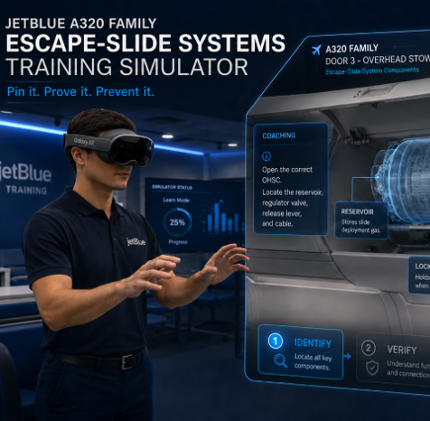
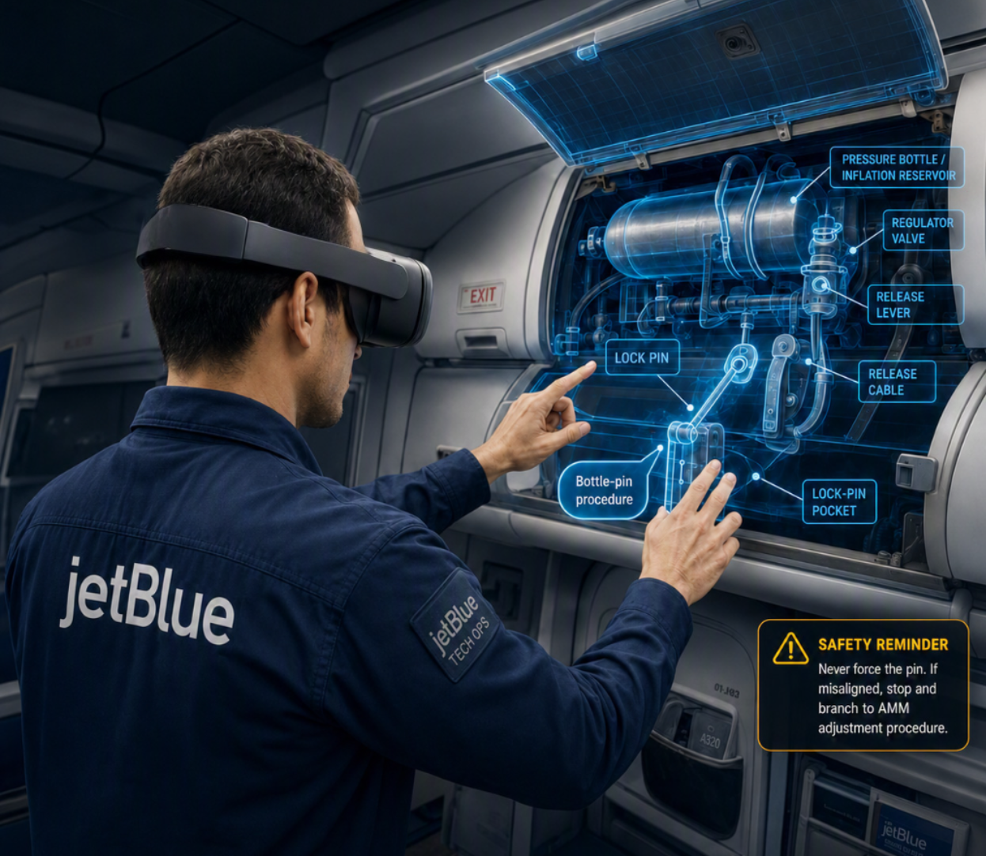

Escape-Slide System training SIMULATOR
EDIT
Immersive procedural training for the Airbus A320-family
escape-slide bottle lock-pin installation procedure

Slide 2
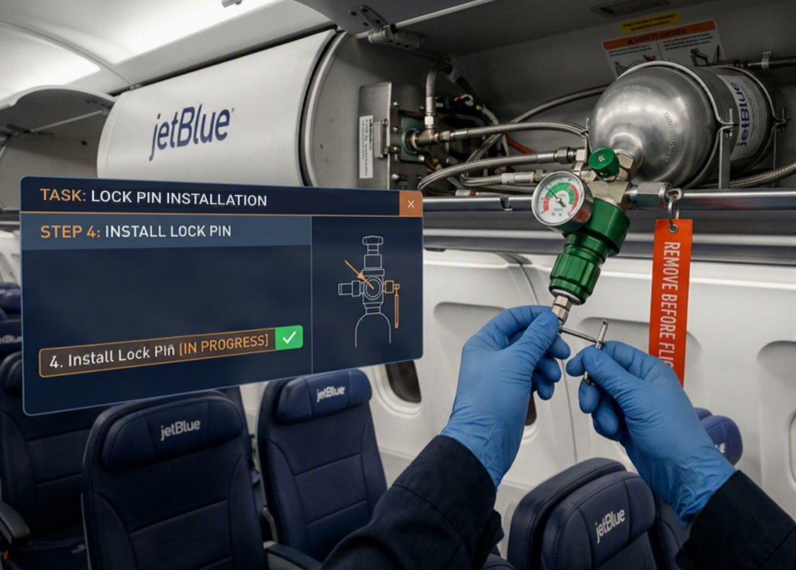
Executive Summary
JetBlue is seeking an immersive, measurable training solution that enables technicians to safely build proficiency in one of the aircraft’s most safety-critical maintenance procedures: installation of the escape-slide bottle lock pin prior to performing maintenance on the A320-family escape-slide system. Rather than relying solely on classroom instruction or limited hands-on exposure, the proposed simulator will provide a realistic environment where technicians can repeatedly practice component identification, system access, procedural sequencing, and safety-critical decision-making without risk to personnel or equipment.
ForgeFX Simulations proposes the development of a simulator focused on the Airbus A320-family Door 3 bottle lock-pin procedure. The simulator will recreate the aircraft work area and guide trainees through the complete process of locating the correct access point, opening the appropriate overhead stowage compartment, exposing the inflation reservoir, verifying release lever and cable position, aligning the regulator valve assembly, installing the correct lock pin, and confirming the final safe state in accordance with approved maintenance procedures.
Designed for deployment on both VR headsets and desktop computers, the application will combine guided instruction, interactive hands-on practice, and objective assessment while capturing trainee performance throughout the exercise. This implementation establishes the foundation for future expansion to additional door stations and related maintenance procedures while delivering an immediately deployable training solution for JetBlue technicians.

Slide 3
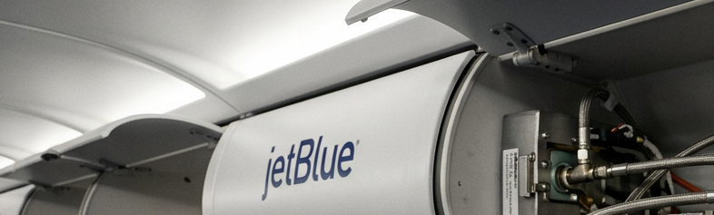
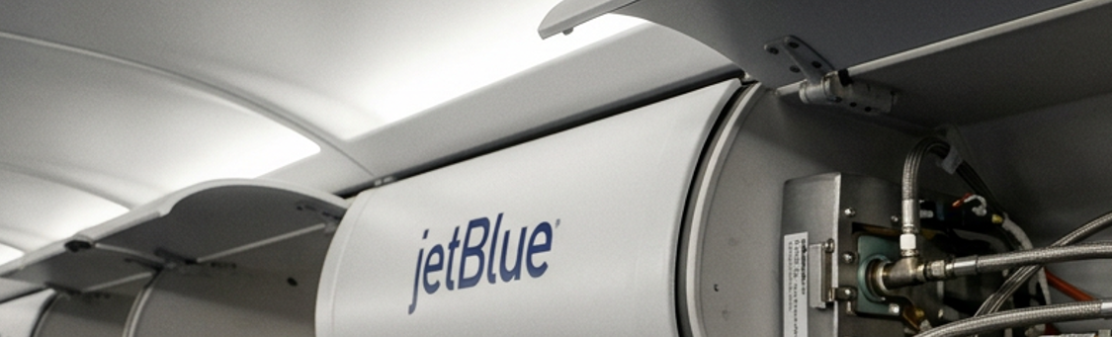
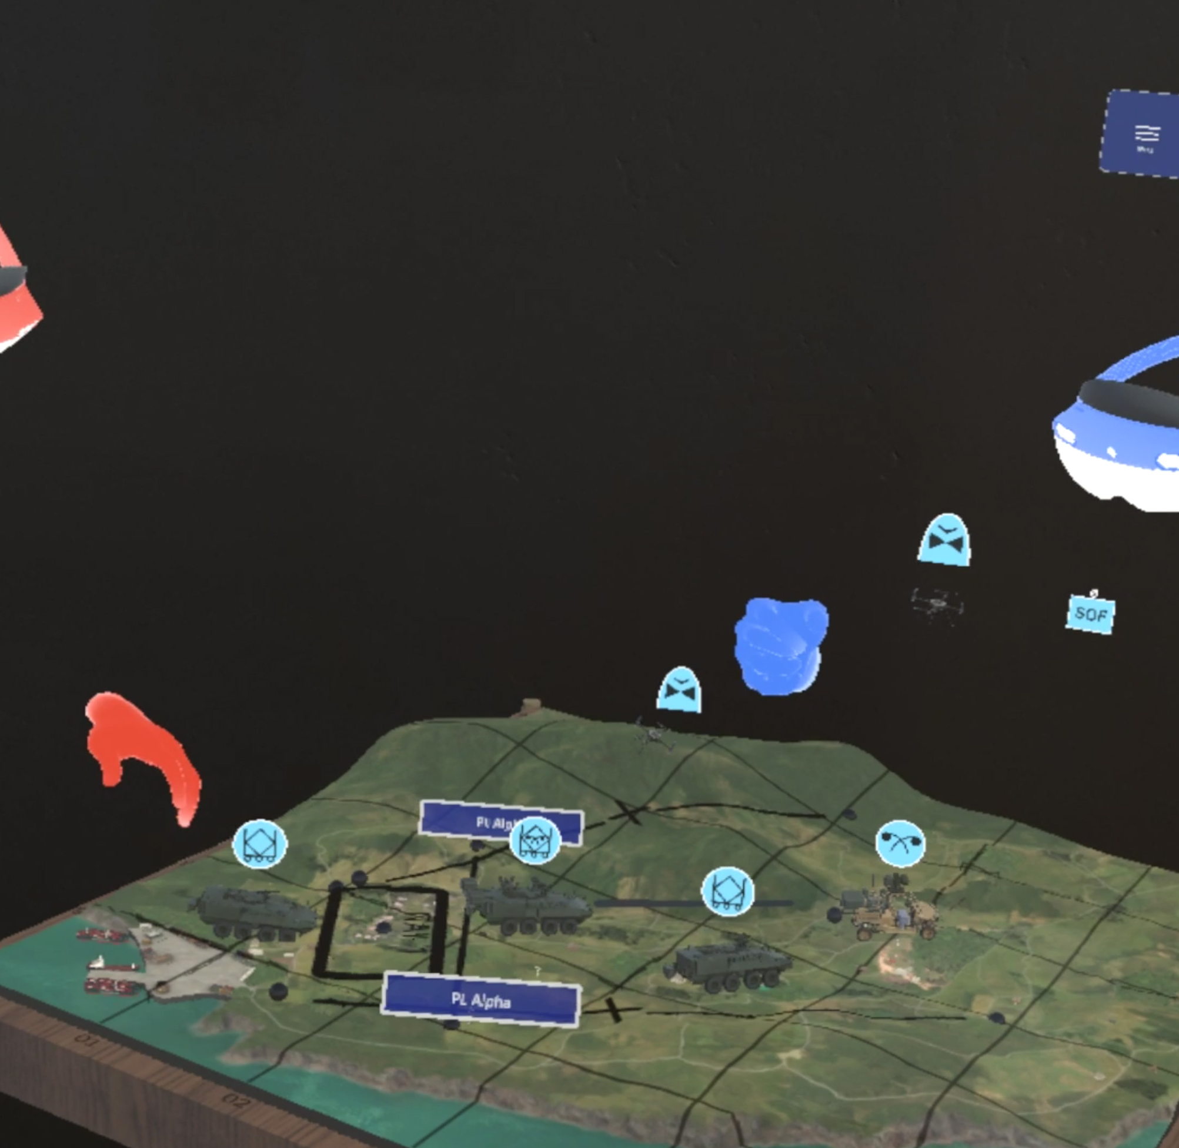
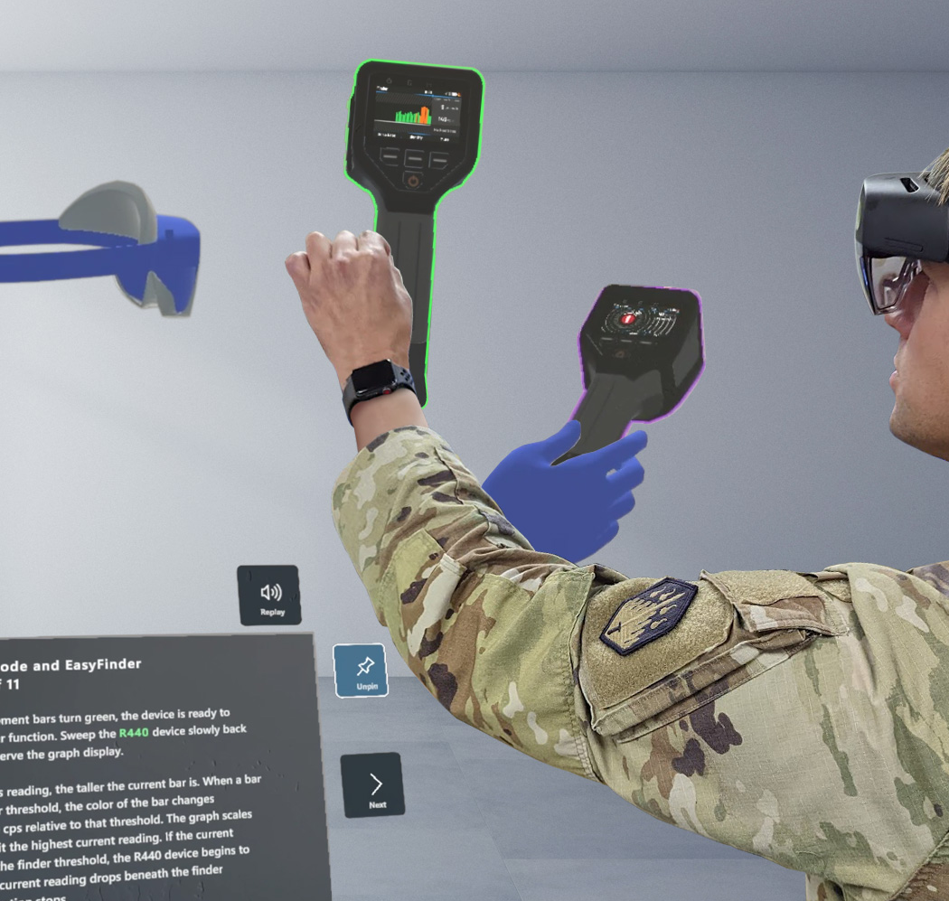
One small pin. Zero Room for error.
Training High-Consequence Procedures Safely
Before performing maintenance on the Airbus A320-family escape-slide system, technicians must install the lock pin into the regulator valve assembly of the high-pressure inflation reservoir. This critical step helps keep the system safe during maintenance and prevents unintended activation. Because the procedure involves safety-critical components and limited opportunities for live-aircraft practice, it is well suited for immersive simulation-based training.
FROM LIMITED PRACTICE TO VERIFIED READINESS
WHAT’S AT RISK
WHY IT’S HARD TO TRAIN
HOW VR SOLVES IT
Accidental bottle discharge
Limited opportunities to perform the task on live aircraft
Unlimited hands-on repetition in a risk-free environment
CASE STUDY:
CBRND Holotrainer
Past projects such as the HoloTrainer for JPEO-CBRND, which includes multiuser telepresence functionality, ensure that ForgeFX is well-equipped to deliver on this aspect of the project.
Unintended escape-slide deployment
Safety-critical equipment cannot be repeatedly manipulated for training
Interactive practice with realistic component manipulation
Personnel injury
Multiple components must be correctly identified and verified
Guided instruction reinforces correct procedures and decision making
Aircraft damage and operational disruption
Rare procedures are difficult to retain through classroom instruction alone
Objective assessment validates competency before technicians perform the task on an aircraft
Note: Multi-user functionality will require a yearly support subscription. Please see the Scope & Cost Options page for details.

Slide 4
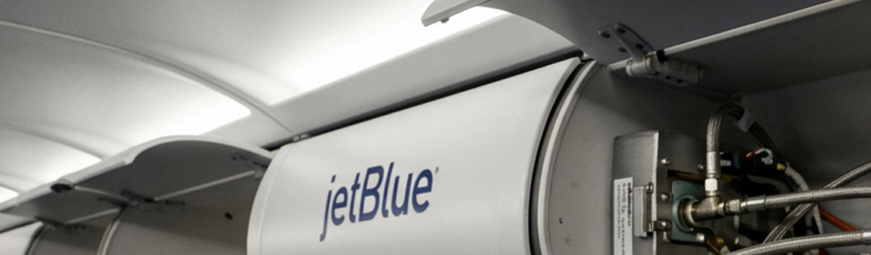
Simulator CAPABILITIES
From Prompts to Performance
The ForgeFX Escape-Slide System Training Simulator combines immersive visualization, realistic equipment interaction, guided instruction, and objective performance assessment into a comprehensive procedural training solution. Depending on the selected implementation option, the simulator may include the following capabilities, with additional functionality introduced as the solution expands.
Virtual Aircraft Environment
The simulator recreates the aircraft work area required to perform the escape-slide bottle lock-pin procedure within a realistic three-dimensional environment. For option 2, the virtual environment is intentionally limited to the Door 3 work area and includes only the aircraft geometry necessary to support the lesson, such as the surrounding cabin structure, overhead stowage compartment (OHSC), access panels, and technician workspace. This focused approach minimizes development effort while providing the visual context and spatial awareness required for effective procedural training.
Interactive Aircraft Components
Technicians interact directly with the aircraft components required to complete the maintenance procedure. Interactive objects may include the overhead stowage compartment, access covers, quick-release fasteners, escape-slide bottle assembly, regulator valve assembly, release lever, release cable, bottle lock pin, lock pin storage pocket, and other supporting hardware. Each component responds appropriately to user interaction, allowing trainees to perform the procedure using realistic manipulation and sequencing while reinforcing equipment familiarization and procedural compliance.
Guided Learning & Assessment
The simulator can support both guided instruction and independent assessment. During Guided Learning Mode, visual prompts, instructional messaging, and immediate feedback help technicians learn the approved maintenance procedure. When included, Assessment Mode removes instructional guidance and objectively evaluates the trainee’s ability to successfully complete the procedure independently.

Slide 5
Simulator CAPABILITIES
Risk-Free Skill Building for Real World Mastery.
Core Simulator Capabilities Continued
Performance Evaluation & Reporting
The simulator may record trainee performance throughout the lesson, including procedural completion, sequencing, safety-critical actions, completion time, and overall pass/fail results. Performance summaries provide instructors with objective insight into technician readiness while supporting standardized training, qualification, and performance evaluation.
Modular Training Framework
The simulator is developed using ForgeFX’s modular ForgeSIM™ architecture, allowing new door station variants, escape-slide maintenance procedures, and additional training content to be incorporated over time. This scalable approach enables JetBlue to expand the simulator as training requirements evolve while leveraging previously developed software, digital assets, and lesson content to reduce future implementation effort.

Slide 6
scope Options
A Scalable Training Solution That Grows with JetBlue’s Needs
ForgeFX has developed three implementation options that allow JetBlue to balance budget, fidelity, and training scope. Each option builds on the ForgeSIM™ framework and can serve as a foundation for future enhancements, allowing JetBlue to begin with a low-cost proof of concept and expand the simulator as training needs evolve.
Option 1 – VR Proof of Concept
The VR Proof of Concept is the lowest-cost option and is designed to validate the core training concept without recreating the aircraft cabin environment. This option focuses on the essential escape-slide bottle lock pin, simplified instructional interface, guided text-based instruction, and single-device VR deployment. It demonstrates whether technicians can learn and perform the Door 3 bottle lock-pin procedure through an interactive VR training experience before investing in a more detailed aircraft environment.
Option 2 – Core VR Proof of Concept
The Core VR Proof of Concept builds on Option 1 by adding a simplified Door 3 aircraft work area and additional environmental context, such as the overhead compartment, nearby seats, window, aisle, floor, and related cabin references. This option also expands the virtual equipment model, adds audio-guided instruction, and provides a more realistic training setting while maintaining the same focused Door 3 bottle lock-pin procedure.
Option 3 – Comprehensive Escape-Slide Systems Training Module
The Comprehensive Escape-Slide System Training Module expands the simulator beyond the initial Door 3 proof of concept by adding an expanded virtual environment scope, expanded equipment configurations, additional Door 2 and Door 3 bottle-pin procedure variants, the lock-pin adjustment procedure, additional maintenance workflows identified during requirements review, Practice Mode, and enhanced assessment with configurable scoring. The following implementation matrix summarizes the capabilities included in each option and illustrates how the solution can scale as JetBlue’s training requirements evolve.

Slide 7
Scope & Cost Options
JetBlue escape slide system training simulator
OPTION 1
VR POC
$85k
3 months
OPTION 2
CORE VR POC
$175k
3 months
OPTION 3
Comprehensive Escape-Slide System Training Module
$265k
4 months
INCLUDES
✓ ForgeSIM Framework
✓ Virtual Equipment Model: Escape-slide bottle assembly and lock pin with required components.
✓ Simplified User Interface
Main menu with instructional prompts.
✓ Interactive Training Lesson
1 bottle-pin procedure, approximately 10 primary trainee interactions based on AMM TASK 25-62-00-481-001-A; excludes lock-pin adjustment procedure.
✓ Guided Learning Mode with Text-based Instructions
Step-by-step text-based instruction
✓ VR Application
Single device deployment (Quest, Pico, Galaxy XR etc.)
Future Features
Interior Aircraft 3D model
Audio Narration
Performance Tracking & Scoring
Assessment Mode
Instructor Dashboard
Desktop Companion Application
Learning Management System (LMS) integration
Multi-User Training
INCLUDES
✓ ForgeSIM Framework
✓ Simplified Virtual Environment
Simplified Door 3 work area only, with minimal aircraft geometry such as the overhead compartments, about 3–5 rows of seats, windows, aisle, roof, floor, etc.
✓ Virtual Equipment Models
Escape-slide bottle assembly, regulator valve, lock pin, lock pin pocket, release lever, release cable, OHSC cover, and related components.
✓ Advanced User Interface
Main menu, lesson selection, instructional prompts, progress indicators, and completion screens.
✓ Interactive Training Lesson
1 bottle-pin procedure, approximately 10 primary trainee interactions based on AMM TASK 25-62-00-481-001-A; excludes lock-pin adjustment procedure.
✓ Guided Learning Mode with Audio Narration
Step-by-step instruction that includes audio narration and instructional prompts.
✓ Assessment Mode with Performance Tracking & Scoring: Basic completion tracking and pass/fail assessment.
✓ VR Application
Single-device deployment (Quest, Pico, Galaxy XR, etc.)
Future Features
Instructor Dashboard
Desktop Companion Application
Learning Management System (LMS) integration
Multi-User Training
INCLUDES
EVERYTHING FROM OPTION 2, PLUS:
✓ Advanced Virtual Environment:
Expanded support for Door 2 LH, Door 2 RH, Door 3 LH, and Door 3 RH work areas and expanded aircraft geometries.
✓ Expanded Virtual Equipment Models: Additional door-specific equipment configurations as required.
✓ Interactive Training Lesson(s) Expanded curriculum to support all Door 2 LH/RH and Door 3 LH/RH bottle-pin procedures plus the lock-pin adjustment procedure and other maintenance workflows excluded from the POC, approximately 55–60 primary interactive actions total.
✓ Enhanced Assessment Mode with Performance Tracking & Scoring: Enhanced analytics and configurable scoring
✓ Practice Mode
Future Features
Desktop Companion Application
Learning Management System (LMS) integration
Multi-User Training

Slide 8
project Approach
A COLLABORATIVE
AND ITERATIVE
DEVELOPMENT
PROCESS
ForgeFX follows a structured, milestone-driven development process that keeps JetBlue engaged throughout the project. Regular design reviews, working sessions, and software demonstrations provide opportunities to validate functionality, refine training content, and ensure the simulator accurately reflects JetBlue’s maintenance procedures and instructional objectives. This collaborative approach reduces implementation risk while allowing feedback to be incorporated throughout development rather than only at final delivery.
Requirements & Design
ForgeFX will collaborate with JetBlue subject matter experts to review maintenance documentation, confirm training objectives, define lesson requirements, and validate the virtual environment, user interface, and interaction workflow before development begins.
Simulator Development
The development team will create the virtual aircraft environment, implement interactive aircraft components, develop the procedural lesson logic, and integrate guided instruction, assessment, and performance tracking capabilities. Throughout development, interim demonstrations will allow JetBlue to review progress and provide feedback.
Validation & Refinement
The completed simulator will undergo functional testing and customer review to verify that the training experience accurately reflects the approved maintenance procedure. Feedback received during validation will be incorporated prior to final delivery to ensure the simulator meets JetBlue’s operational and training expectations.
Final Delivery & Knowledge Transfer
Upon successful acceptance, ForgeFX will deliver the completed VR application based on the selected implementation option, along with installation guidance, user documentation, and administrator orientation to support deployment within JetBlue’s training program.

Slide 9
simulator Roi
Simulation-based training delivers value by reducing dependence on live equipment, minimizing recurring training costs, and providing teams with a repeatable way to build technician readiness before real-world use.
Lower Cost. Faster Readiness. Long-Term Value.
Risk-Free Skill Building for Real World Mastery.
1
Reduce Training Cost
2
Improve Training Readiness
3
Extend Business Value
Simulation reduces dependency on live equipment, consumables, travel, and repeated access to physical training assets.
Technicians can build familiarity before hands-on use, practice procedures repeatedly, and train without waiting for equipment, trainers, or ideal operating conditions.
Simulator assets can support demonstrations, stakeholder engagement, future expansion, and long-term training program growth.
ROI DRIVERS
Reduced wear and tear on physical equipment
Reduced use of consumables
Reduced training time and expenses
ROI DRIVERS
Increased technician familiarity
Increased throughput
More consistent access to repeatable training
ROI DRIVERS
Sales and marketing opportunities
Future-proof development
Asset ownership / reusable content
BOTTOM-LINE IMPACT
Fewer recurring costs tied to equipment access, materials, travel, and real-world training logistics.
BOTTOM-LINE IMPACT
More trainees can practice more often, with fewer barriers to skill development and readiness validation.
BOTTOM-LINE IMPACT
The simulator becomes a reusable business asset that can support future modules, demonstrations, and program expansion.

Slide 10



Let’s Get Started!
Mary Pierce
Executive Director of
Enterprise Partnerships
Mary consults with our clients, studies their business, and generates creative solutions for their training needs.
ForgeFX Simulations looks forward to working with you to design and develop your training simulator. If our proposal aligns with your requirements, please contact Mary Pierce to discuss development options. Mary can coordinate next steps and provide a project agreement for review.
(415) 788-5725, ext. 703
mary.pierce@forgefx.com
ForgeFX Simulations
1160 Battery Street East, Suite 100
San Francisco, CA 94111
(415) 788-5725 www.forgefx.com
BOILER
PLATE

