Slide 1
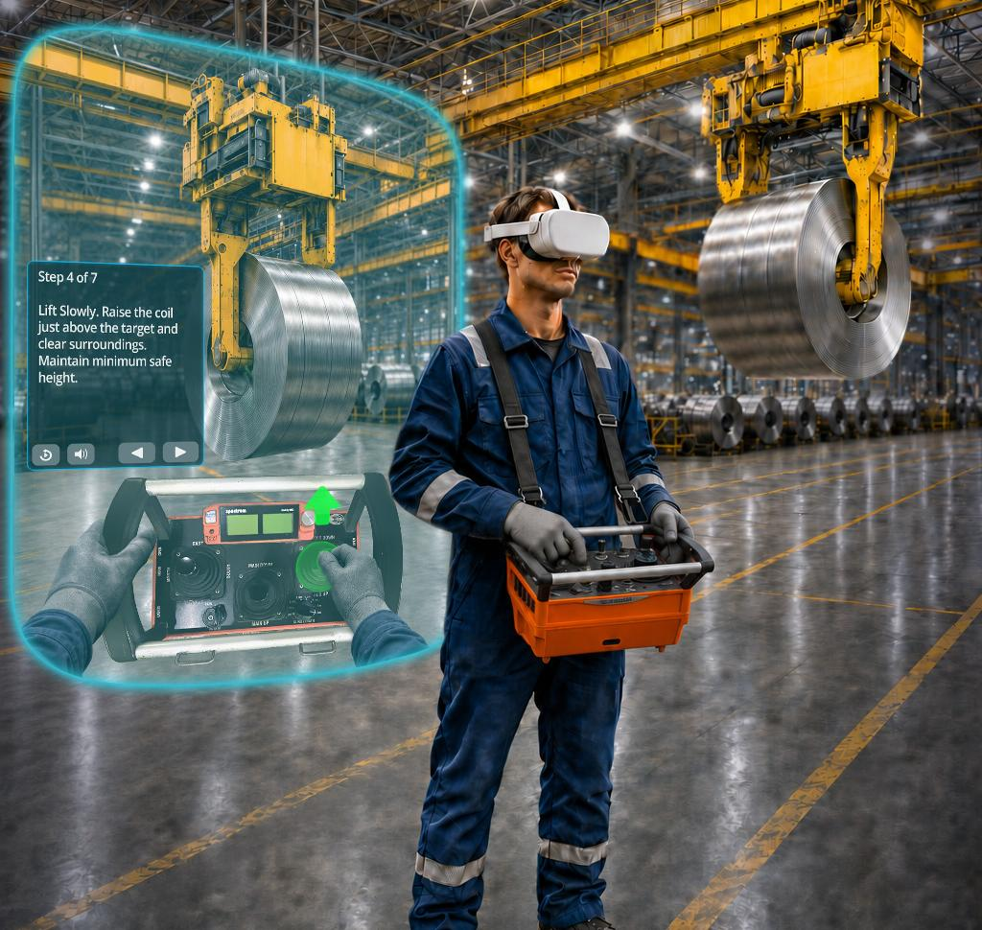


Crane Operator
Training SIMULATOR
A Virtual Reality Crane Operations Trainer
EDIT

Slide 2

Introduction
01
The Training Challenge:
Consistent Readiness Takes More Than Classroom Instruction
Outokumpu’s crane training challenge is not a lack of procedures, experienced trainers, or operator commitment. The challenge is giving new and cross-training operators enough safe, consistent, hands-on practice before they begin working with live equipment, suspended loads, production activity, and changing floor conditions.
Overhead crane operation requires trainees to connect several skills at once: belly box control, load movement, body position, line of sight, travel-path awareness, communication, hazard recognition, and stop-condition judgment. These skills are difficult to build through classroom instruction alone and difficult to repeat consistently during live-floor training.
Live equipment training is valuable, but it cannot easily be paused, reset, repeated, or standardized. Trainers cannot deliberately create pedestrian conflicts, visibility issues, improper coil engagement, excessive load swing, or other unsafe conditions just to see how a trainee will respond. As a result, some of the most important readiness behaviors are learned under real production pressure.
During periods of rapid hiring or cross-training, the challenge becomes even greater. Trainers must prepare more employees while maintaining the same level of training quality across people, shifts, departments, and locations. Without sufficient structured repetition, trainees may reach the floor with uneven control habits and a lack of confidence due to limited exposure to the situations they are expected to manage safely.
The core training gap is repeatable practice at scale: giving every operator enough consistent, realistic training time before the first live lift.
CONTENTS
Project Overview
Executive Summary
Simulator Features
Training Modes and Performance Progression
Experiencing the Pilot
Options Overview
Cost Table
Conclusion

Slide 3
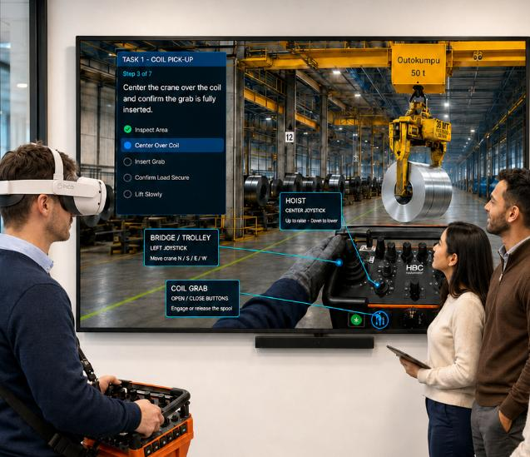
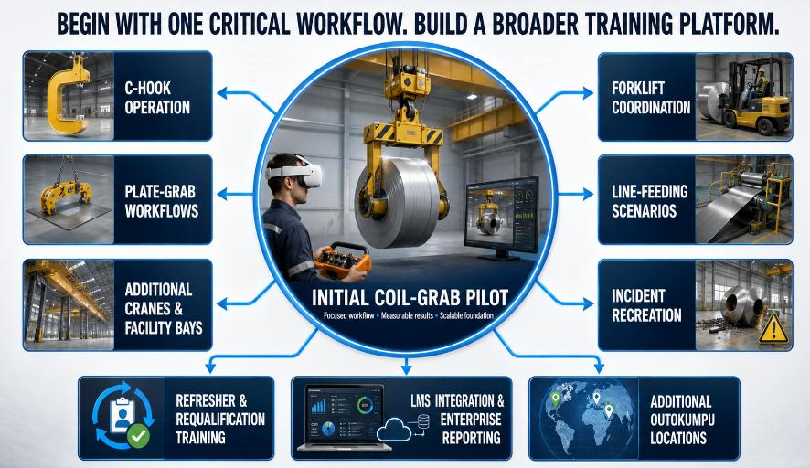
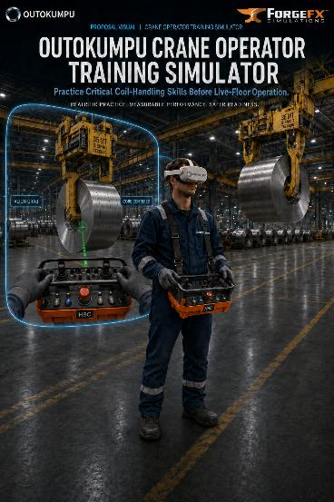
1.
Project Overview
Building Crane-Operator Readiness Before Live-Floor Exposure
Outokumpu’s overhead crane operators work in an active steel-production environment where safe coil movement depends on more than basic equipment control. Operators must understand the production floor, anticipate surrounding activity, manage suspended loads, and make disciplined decisions while working around people, equipment, restricted areas, and ongoing line-side operations.
Current training relies on classroom instruction, trainer-led observation, and supervised experience with live equipment. That progression remains essential, but it offers limited opportunity for new or cross-training operators to repeat difficult procedures, experience changing conditions, or build confidence before entering a live production setting.
ForgeFX proposes a Crane Operator Training Simulator that gives Outokumpu a realistic, repeatable bridge between classroom learning and live-floor operation. Under the recommended Option 2 Pilot, the simulator will use a standalone VR headset and an HBC Spectrum B belly box controller. The simulator allows trainees to practice representative crane and coil-handling tasks with guided instruction, without placing personnel, equipment, or production material at risk.
The initial pilot is designed to help Outokumpu evaluate whether simulation can improve operator readiness, reinforce consistent training expectations, and provide trainers with clearer insight into performance before trainees advance to supervised live-equipment instruction.
ForgeFX proposes a Crane Operator Training Simulator that gives Outokumpu a realistic, repeatable bridge between classroom learning and live-floor operation. Using an XR headset, an HBC radiomatic-style belly box controller, and a mirrored display for trainer review, the simulator allows trainees to practice representative crane and coil-handling tasks with coaching and performance feedback, without placing personnel, equipment, or production material at risk.
The initial pilot is designed to help Outokumpu evaluate whether simulation can improve operator readiness, reinforce consistent training expectations, and provide trainers with clearer insight into performance before trainees advance to supervised live-equipment instruction.

Slide 4
2.
Executive Summary
ForgeFX Simulations proposes a phased approach to developing the Outokumpu Crane Operator Training Simulator, allowing Outokumpu to select the level of investment, training depth, and long-term scalability that best align with its current goals.
Each option builds from the same core training priority: helping operators practice crane-control decisions, coil-handling behaviors, and safety-critical actions in a repeatable virtual environment before progressing to live-floor operation. The proposed options range from a focused proof-of-concept application to a broader crane and material-handling training platform.
ForgeFX recommends the Pilot Option as the strongest balance of training value, demonstration impact, and practical scope for the first release. It provides a more complete operator readiness experience than the Proof of Concept while remaining focused enough to support efficient development, stakeholder evaluation, and future expansion.
This approach gives Outokumpu a credible first release for safety, management, and trainer review, while preserving a clear path toward a broader crane and material-handling training program.
Option 1: Proof of Concept
Focused Crane-Control and Coil-Movement
A compact web-based experience designed to demonstrate the core potential of simulation-based crane training through one representative coil pickup, transport, and placement exercise.
Option 2: Pilot
Complete Coil-Handling VR Training — Recommended
A production-quality VR-enabled pilot that expands the training experience with a more complete virtual environment, structured instruction modes, integrated hazards, performance review, and stronger stakeholder demonstration value.
Option 3:
Core
Crane Operator Training Simulator
Builds on the complete Pilot with six additional lessons, expanding the curriculum to ten total lessons with configurable scenarios, incident recreation, and broader material-handling workflows.
Option 4:
Pro
Crane and Material-Handling Training Platform
Builds on the complete Core package with LMS or internal reporting integration and networked training for up to eight simultaneous participants.

Slide 5
3.
Simulator Features
Immersive Audio and Guided Instruction
The Option 2 Pilot will include immersive audio and guided instruction to help trainees understand the virtual worksite, recognize equipment response, and follow the coil-handling exercise with clear support. The simulator will combine ambient facility audio, equipment-specific cues, and synchronized on-screen guidance so operators receive feedback through both what they see and what they hear. Professional voiceover narration is available with Option 3.
IMMERSIVE ENVIRONMENT AUDIO
Immersive environment audio will help recreate the atmosphere of an active steel-production setting. Ambient sounds may include ventilation, machinery, warning signals, distant facility activity, and nearby equipment movement. These sounds reinforce the scale and activity of the workspace while making the virtual environment feel more operationally credible.
EQUIPMENT-SPECIFIC AUDIO FEEDBACK
Equipment-specific audio feedback will respond to the trainee’s actions throughout the exercise. Operators will hear bridge and trolley movement, hoist operation, brake response, coil grab engagement, and load-handling feedback as they lift, transport, and place the coil. These cues support realism while helping trainees recognize equipment states, confirm successful actions, and notice conditions that may require attention.
AUDIO-GUIDED INSTRUCTION
Audio-guided instruction will work alongside the visual interface to support each stage of the exercise. Professional narration can introduce the training objective, explain the HBC Spectrum B belly box controls, direct attention to the correct joysticks and buttons, and reinforce key actions such as inspecting the work area, positioning the crane, engaging the coil through its center core, lifting smoothly, transporting the load, and setting it down safely.
Narration will explain not only what action to perform, but why that action matters. When helpful, context-sensitive guidance can acknowledge correct actions, provide direction when the trainee hesitates, or intervene when an unsafe or incorrect action is attempted. Synchronized on-screen text can reinforce the spoken guidance so trainees receive consistent instruction through both audio and visual cues.
Together, immersive facility sound, equipment feedback, and audio-guided instruction make the simulator more intuitive, realistic, and effective as a training tool. As the program expands with Option 3, these capabilities also support a clear training progression, allowing operators to begin with guided support and move toward more independent practice and assessment as their confidence improves.

Slide 6
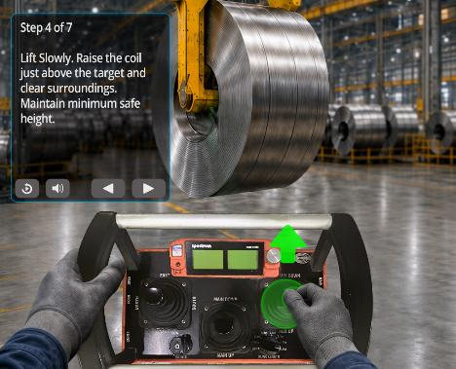
3.
Simulator Features
Training Modes and Performance Progression
The simulator will support a structured training progression that helps operators move from guided instruction to independent practice and then to performance assessment. The Option 2 Pilot delivers Guided Training Mode; Practice and Assessment modes are added with Option 3. This approach allows new and cross-training operators to learn the process, repeat the workflow, and demonstrate readiness in a controlled environment before advancing to supervised live-floor training.
Guided Training Mode
Guided Training Mode provides step-by-step support while the operator learns the coil-handling workflow. The simulator can combine narration, visual prompts, control callouts, highlighted task areas, and corrective feedback to help the trainee understand what action is required and why it matters.
Guided instruction may walk the operator through key steps such as inspecting the work area, confirming the travel path, positioning the crane and coil grab, engaging the coil through its center core, lifting smoothly, transporting the suspended load, avoiding obstacles or unsafe movements, and safely placing the coil at the target location.
Unguided Practice Mode
Unguided Practice Mode allows the operator to repeat the same workflow with reduced assistance. Instead of receiving step-by-step direction, the trainee can practice control use, sequencing, hazard awareness, and placement accuracy with limited prompts available only when needed.
This mode helps operators build procedural fluency and confidence while still working in a safe, repeatable training environment. It also gives trainers a clearer view of how the trainee performs when they are not being led through every step.
Concept Image: In Guided Training mode, tutorial instructions are viewed via a control panel that also contains playback, audio, and navigational options. Graphic overlays superimposed on the relevant belly box controls prompt the user in the correct actions to take.

Slide 7
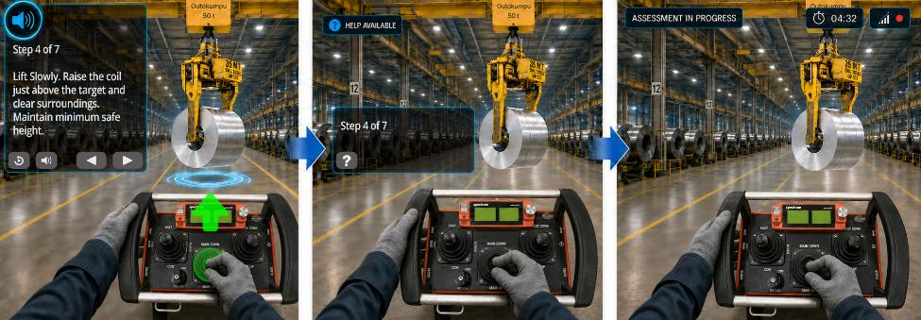
4.
Training Modes and Performance Progression
Performance Assessment Mode
Performance Assessment Mode removes instructional support and records how the operator performs independently. The simulator can evaluate accuracy, sequencing, control use, visual checks, load stability, swing prevention, placement accuracy, response to hazards, and other safety-related behaviors.
After the assessment, trainers can review a performance summary that identifies completed steps, missed actions, unsafe behaviors, and repeated issues, thereby supporting trainer coaching priorities. This gives Outokumpu a more objective way to support readiness decisions before trainees move into live crane operation.
A Structured Path from Familiarization to Readiness
GUIDED TRAINING
Narration · Highlighted Path ·
Step-by-step Instructions
INDEPENDENT PRACTICE
Fewer Prompts · Optional Assistance ·
Limited Corrective Feedback
PERFORMANCE ASSESSMENT
No Assistance · Independent Workflow ·
Performance Recorded
LEARN
PRACTICE
PROVE READINESS
Together, Guided Training, Unguided Practice, and Performance Assessment create a clear path from instruction to repetition to evaluation. This gives operators a safer way to build confidence and gives trainers a more consistent way to measure readiness, reinforce expectations, and identify where additional coaching is needed.

Slide 8
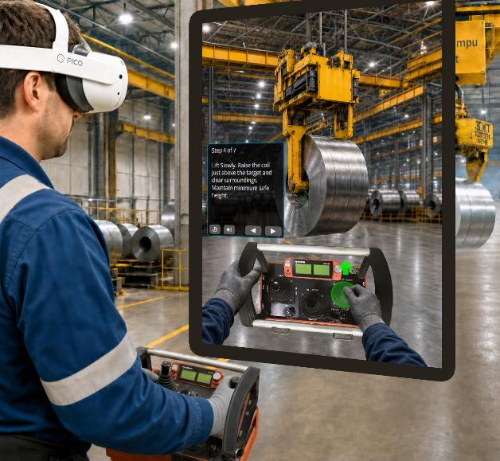
5.
Experiencing the Pilot
The pilot puts the trainee directly into the training moment. Wearing the VR headset and holding the HBC Spectrum B belly box controller, the operator stands inside a simulated finishing-area environment where the crane, coil, floor markings, travel path, and nearby activity are visible around them.
As the exercise begins, the trainee receives a task prompt and control guidance within the virtual interface. They hear ambient facility sounds, equipment movement, and instructional cues while practicing the sequence of work: orienting themselves, reading the floor, positioning the crane, engaging the coil through its center core, lifting with control, and moving the load toward the placement target.
The experience is interactive and responsive. The trainee sees the crane move overhead, hears equipment feedback as controls are used, watches the suspended load react to movement, and must adjust to drift, swing, visibility, and surrounding worksite conditions. They are not simply reviewing the process. They are practicing the rhythm, timing, and decision-making of crane operation in a safe virtual setting.
The result is a more realistic readiness experience before live-floor exposure, helping operators build confidence in control, situational awareness, and safer coil-handling habits while giving trainers a clearer view of where coaching is needed.
Concept Image: A trainee uses VR and the HBC Spectrum B belly box controller to practice crane control, coil engagement, transport awareness, and precision placement within the recommended coil-handling training pilot.

Slide 9
6.
Options Overview
Option 1: Proof of Concept
Focused Web-Based Crane-Control and Coil-Movement Validation
Option 1 will establish the foundation for Outokumpu’s Crane Operator Training Simulator through a focused proof-of-concept experience. The POC will allow Outokumpu stakeholders to conveniently verify essential crane and load behavior and one representative coil-handling workflow before expanding into a broader training program.
Option 1 Focus
Deploy the Interactive 3D Web Experience
Allow Outokumpu stakeholders to evaluate the proposed crane-control and coil-movement experience before expanding the training program and extending it into a full VR-based application.
Validate the Essential Operation
Demonstrate how the representative finishing-area environment, crane, coil grab, and load interact to support a focused operator-training workflow.
Complete a Representative Coil Move
Allow users to perform one coil pickup, transport, and placement exercise incorporating selected pre-operation checks, control familiarization, through-core grab engagement, smooth lifting, defined-route transport, and controlled placement.
A Focused First Step with Room to Grow
Option 1 will give Outokumpu a practical, cost-controlled way to verify the training concept and evaluate its potential. The POC will validate the simulator’s essential equipment, environment, and coil-handling workflow while establishing a scalable technical foundation for the expanded lessons, physical controls, instructional modes, performance reporting, and enterprise capabilities available in future phases.
 | Option 1 POC
✓ | Simulation Logic A web-based training foundation with scalable architecture and ready to migrate to full VR-enabled ForgeSIM framework.
✓ | Essential Virtual Equipment and Environment One overhead crane, one inside-diameter coil grab, one steel coil, one saddle or placement target, and representative finishing-area environment with defined pickup and placement zones.
✓ | 1 Coil-Handling Lesson One coil pickup, transport, and placement exercise incorporating selected pre-operation checks, control familiarization, through-core grab engagement, smooth lifting, defined-route transport, and controlled placement.

Slide 10
6.
Options Overview
Option 2: Pilot
Coil-Handling VR Training Pilot
Option 2 will deliver a practical VR training pilot for novice and cross-training operators. The Pilot will combine the essential virtual equipment and environment, the complete coil-handling lesson, virtual reality support, and Real-World Controls Integration.
Option 2 Focus
Deliver the Coil-Handling Lesson
Rebuild the workflow previewed in Option 1 as a complete interactive VR lesson covering pickup, transport, and placement, giving novice and cross-training operators repeatable practice in the essential coil-handling workflow. Additional lessons are available with Option 3.
Establish Operational Realism
Deliver the essential equipment and operating environment, including the overhead crane, inside-diameter coil grab, steel coil, saddle target, and defined pickup and placement zones within a representative finishing-area setting. Extended attachments, crane configurations, and expanded environments are available with Option 3.
Train in Full Virtual Reality
Guided lesson instruction in virtual reality lets operators practice the approved sequence hands-on before live-floor exposure. Practice and Assessment modes, corrective coaching, and performance reporting are available with Option 3.
Real-World Controls and Flexible Deployment
Connect the HBC Spectrum B controller to principal crane functions and support training through standalone VR and desktop access. This combination will provide realistic control practice with flexible options for trainees and instructors.

Slide 11
6.
Options Overview
Option 2: Pilot Continued
A Practical Pilot for Operator Readiness
Option 2 is ForgeFX’s recommended option because it offers the strongest balance of practical training value, operational realism, and scalability. It rebuilds the Option 1 coil-handling content as a full VR simulator, combining the simulation framework, essential virtual equipment and environment, the complete coil-handling lesson, and Real-World Controls Integration.
 | Option 2 Pilot Rebuilds the Option 1 coil-handling content as a full VR simulator. The Option 1 POC is priced separately.
✓ | 1 Coil-Handling Lesson: A complete lesson covering inspection, belly box familiarization, alignment, secure engagement, lifting, transport, hazard awareness, swing prevention, and precision placement.
✓ | Essential Virtual Equipment: An overhead crane, inside-diameter coil grab, steel coil, saddle target, and a virtual representation of the HBC Spectrum B controls module.
✓ | Essential Virtual Environment: A representative finishing-area bay with floor markings, coil-storage locations, saddles, production destinations, and defined pickup and placement zones.
✓ | Guided Lesson Instruction: Step-by-step guidance through the approved coil-handling sequence, supporting onboarding, cross-training, and refresher practice.
✓ | Extended Reality / VR Deployment: Provides standalone VR headset access, desktop access, HBC Spectrum B controller integration, and centralized deployment support.
✓ | Real-World Controls Integration: Maps roughly 12–15 essential HBC Spectrum B functions, including bridge, trolley, hoist, horn, grab, and principal production-floor controls, with smooth input, drift, swing, and stopping-distance training.
+ | Available with Option 3: Nine additional lessons, extended equipment and environments, Practice and Assessment modes, performance summary and instructor review, and voiceover narration with corrective coaching.

Slide 12
6.
Options Overview
Option 3: Core
Expanded Crane Operator Training Curriculum
Option 3 will include the complete Option 2 Pilot and add nine newly developed lessons, expanding the curriculum from one to ten total lessons. The Core package will extend the virtual equipment and environments, and add instruction modes, corrective coaching, and performance reporting alongside the established Real-World Controls Integration, applying these capabilities across the expanded curriculum.
With ten lessons, operators will have more opportunities to reinforce essential crane-control and coil-handling skills while encountering a broader range of operating conditions, equipment applications, and material-handling workflows. This added variety will help move training beyond repeated practice of a limited number of sequences and create a more durable foundation for operator development.
Option 3 Focus
Expand from One to Ten Lessons
Nine additional lessons will extend the training program with new content addressing pre-operation checks, control familiarization, configurable scenarios, incident recreation, additional attachments and coil types, production-bay and line-feeding workflows, coordinated forklift activity, and wider material-handling practice.
Increase Scenario Variety
Configurable scenarios and incident recreation will introduce varied conditions and decision points, requiring operators to recognize the situation at hand and respond appropriately rather than relying on a memorized sequence.
Broaden Material-Handling Practice
Additional attachments, coil types, production workflows, and coordinated forklift activity will extend training beyond the Pilot’s initial coil-handling curriculum, exposing operators to a wider range of material-handling applications.

Slide 13
6.
Options Overview
Option 3: Core Continued
Expanded Crane Operator Training Curriculum
The ten-lesson Core curriculum will continue to reinforce the foundational skills introduced in the Pilot, including inspection, belly box familiarization, crane and grab alignment, secure engagement, lifting, transport, hazard awareness, swing prevention, and precision placement.
Nine new lessons will extend that foundation into a broader range of scenarios, equipment applications, and material-handling workflows. Operators will have more opportunities to practice interpreting conditions, selecting appropriate responses, and applying established skills across varied training situations.
 | Option 3 Scope Includes the complete Option 2 Pilot
✓ | 6 Additional Lessons: Expands the curriculum from four to ten total lessons, creating a broader and more repeatable crane operator training program.
✓ | Configurable Scenarios: Introduces varied training conditions and decision points that require operators to evaluate the situation presented rather than repeat one fixed sequence.
✓ | Incident Recreation: Provides controlled opportunities to incorporate relevant incident conditions into training for recognition, response, and post-incident remediation.
✓ | Additional Attachments and Coil Types: Broadens lesson content to address more equipment applications, load conditions, and coil-handling considerations.
✓ | Production-Bay and Line-Feeding Workflows: Extends training into additional material-movement activities associated with production destinations and line-feeding operations.
✓ | Coordinated Forklift Activity: Adds forklift coordination to the curriculum, increasing the situational-awareness and decision-making demands placed on the crane operator.
✓ | Wider Material-Handling Practice: Expands the range of workflows operators can experience using the established simulator equipment, controls, instructional modes, and reporting foundation.

Slide 14
6.
Options Overview
Option 4: Pro
Connected, Multi-User Training Platform
Option 4 will include the complete Option 3 Core package and extend it with LMS / Reporting Integration and Networked Multi-User Training. The Pro package will connect training results to Outokumpu’s designated reporting workflow and support an approved multi-user configuration for up to eight simultaneous participants.
Option 4 Focus
Connect Training Results
LMS or internal-system integration will connect training records, readiness analytics, and centralized reporting to Outokumpu’s designated organizational reporting workflow.
Enable Multi-User Training
Networked Multi-User Training will support up to eight simultaneous participants, creating opportunities for coordinated training and broader program delivery.
Expand Instructor Oversight
Mirrored instructor views and deployment support will help trainers observe participant activity, oversee connected sessions, and manage training across the approved multi-user configuration.
From Core Simulator to Connected Training Platform
Option 4 will transform the Core Simulator into a connected training platform built for wider adoption. By adding centralized reporting and multi-user participation, the Pro package will give Outokumpu the strongest foundation for managing training records, monitoring readiness, and expanding crane operator training across its organization.
 | Option 4 Scope
✓ | Includes the complete Option 3 Core Package
✓ | LMS / Reporting Integration: Connects training records, readiness analytics, and centralized reporting to the designated organizational workflow and supports transfer of approved simulator results.
✓ | Networked Multi-User Training Supports up to eight simultaneous participants and includes participant capacity, instructor-view functionality, and the deployment support required for the approved configuration.

Slide 15
7.
Cost Table
ID | Feature Title | Feature Description | INITIAL RELEASE OPTIONS
 |  |  | P.O.C. Option 1 | Pilot Option 2 | Core Options 2-3 | Pro Options 2-4
F-00 | Interactive 3D Web-based Coil Handling Lesson | Web previsualization of the Coil Handling Lesson with overhead crane, inside-diameter coil grab, steel coil, saddle target, and a representative finishing-area environment. | $88,322 | N/A | N/A | N/A
F-01 | Simulation Framework | The reusable ForgeSIM simulation framework carrying equipment interaction, physics, lesson flow, user guidance, and the build that ships each release. | N/A | $101,083 | $101,083 | $101,083
F-02 | Essential Virtual Equipment and Environment | Essential POC package: 3D models of overhead crane and inside-diameter coil grab, plus steel coil, saddle target, and defined pickup and placement zones. | N/A | $148,098 | $148,098 | $148,098
F-03 | Coil Handling Lesson | Coil-handling lesson covering pickup, transport, and placement. (Assumes roughly 8-12 steps for this lesson). | N/A | $58,769 | $58,769 | $58,769
F-04 | Additional Lessons (3) | Additional lessons (3) covering pre-operation checks, control familiarization, and expanded coil-handling operations. (Assumes an average of about 10 steps per lesson). | N/A | N/A | $176,307 | $176,307
F-05 | Additional Lessons (6) | Additional lessons (6) covering added attachments and coil types, coordinated forklift activity, advanced operations, site-specific workflows, and obstacle management. (Roughly 10 steps per lesson). | N/A | N/A | $352,614 | $352,614
F-06 | Extended Virtual Equipment | Adds C-hook, cab-operated crane, and virtual HBC Spectrum B belly box controls module beyond the essential POC equipment. | N/A | N/A | $50,541 | $50,541
F-07 | Extended Virtual Environment | Adds up to 1,000 sq ft of additional modeled area with floor markings, coil storage, saddles, restricted zones, and obstacles, plus (5) medium props, (10) small props, and pedestrian pathing. | N/A | N/A | $78,620 | $78,620
F-08 | Instruction Modes | Instruction modes (3): Guided Training with narration and interface assistance, Practice Mode with a single objective and limited instruction, and unguided Assessment Mode for evaluation. | N/A | N/A | $78,620 | $78,620
F-09 | VR Support | Virtual reality training support including tracked hand interaction and spatial presence, and the physical HBC Spectrum B controller shown in position for the operator to reach and grip. | No | Yes | Yes | Yes
F-10 | Performance Summary / Instructor Review | Performance reporting tracks (8-12) key metrics across step completion, inspection, safety, and coil-handling quality, reviewable by an instructor. | N/A | N/A | $77,836 | $77,836
F-11 | Real-World Controls Integration | Connects the client-provided HBC Spectrum B belly box to the simulator via assumed existing CAN signals, mapping (roughly 12-15) essential controls. Excludes custom hardware or enclosure fabrication. | N/A | $134,777 | $134,777 | $134,777
F-12 | Voiceover Narration | A narrator's voice carries the on-screen guidance, letting the trainee stay hands-on and heads-up while the lesson talks them through it. | N/A | N/A | $22,463 | $22,463
F-13 | LMS / Reporting Integration | Learning management integration for launch, completion, and score data, with centralized reporting on trainee activity and proficiency. | N/A | N/A | N/A | $67,389
F-14 | Networked Training | Networked training for up to eight (8) simultaneous individual operator sessions, with an instructor view that observes any seat from a single station and follows the exercise as it runs, mirroring what that trainee sees. | N/A | N/A | N/A | $202,166
MONTHS |  |  | 3 | 6 | 9 | 12
TOTALS |  |  | $88,322 | $442,727 | $1,279,728 | $1,549,283
Notes:
200 chars

Slide 16
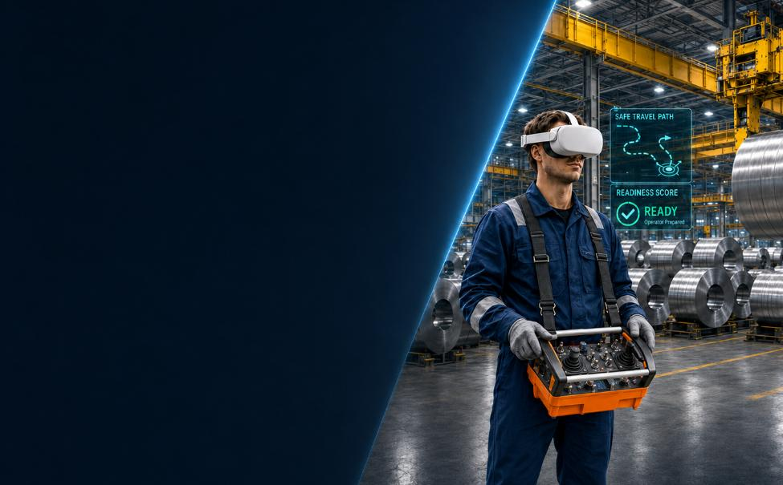

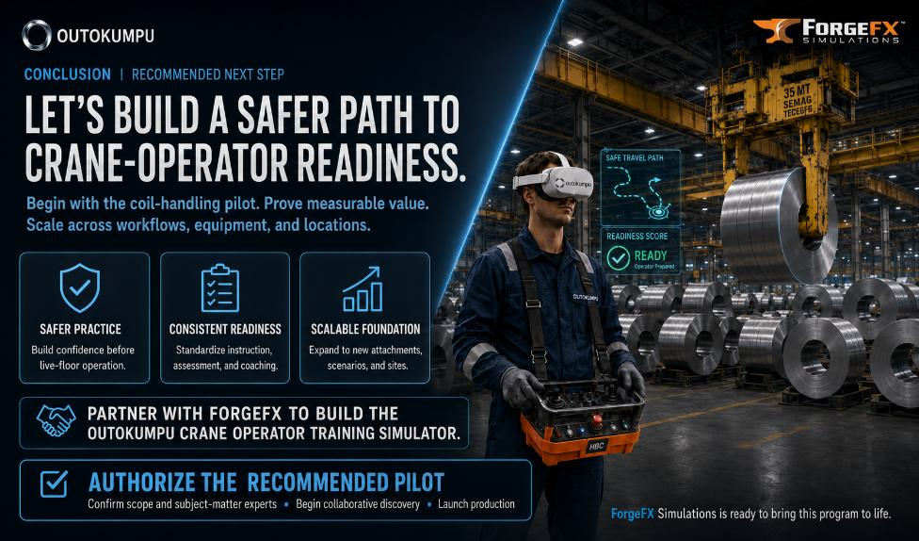


8.
Conclusion
The recommended Option 2 Pilot gives Outokumpu a focused, practical path to improve crane-operator readiness before live-floor exposure. Its coil-handling lesson combines realistic control interaction, guided instruction, and repeatable practice in full virtual reality, giving trainers a credible basis for evaluating operator consistency and coaching needs.
ForgeFX is ready to help Outokumpu turn this opportunity into a production-quality training tool that supports safer preparation, stronger operator confidence, and a scalable foundation for future crane and material-handling training.
Begin with one critical workflow. Prove the value. Build the foundation.
Conclusion | Recommended next step
Begin with the coil-handling pilot to prove measurable value.
Scale across workflows, equipment, and locations.
Safer
Practice
Consistent Readiness
Scalable Foundation
Partner with ForgeFX to build the Outokumpu Crane Operator Training Simulator.
Authorize the recommended pilot
is ready to bring this program to life

Slide 17



Let’s Get Started!
Mary Pierce
Executive Director of
Enterprise Partnerships
Mary consults with our clients, studies their business, and generates creative solutions for their training needs.
ForgeFX Simulations looks forward to helping Outokumpu advance the recommended Pilot. To confirm the scope, align subject-matter experts, and begin project planning, please contact Mary Pierce. ForgeFX will then prepare the project agreement for review.
(415) 788-5725, ext. 703
mary.pierce@forgefx.com
ForgeFX Simulations
2109 N Street, Suite N
Sacramento, CA 95816
(415) 788-5725 www.forgefx.com
BOILER
PLATE

Slide 18

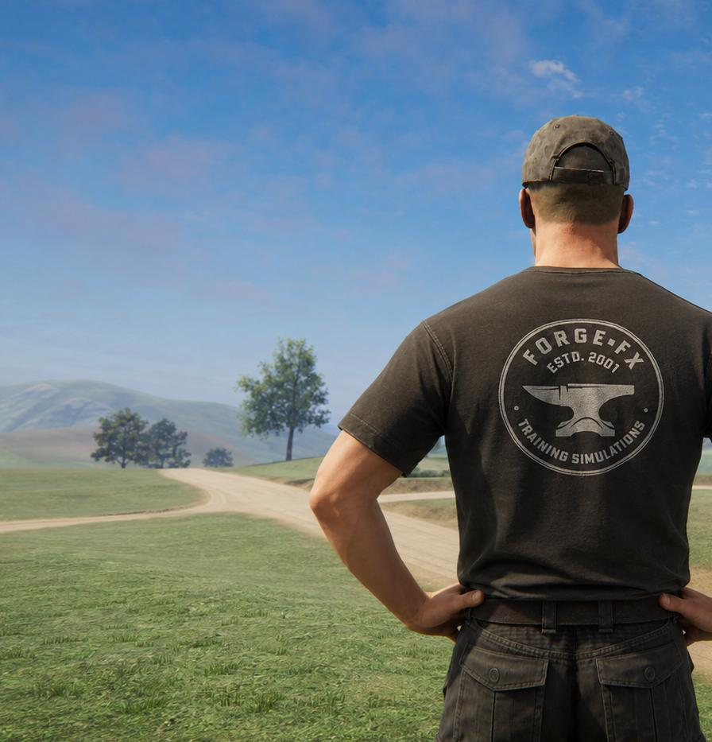

Appendix A: About ForgeFX
From the time Greg, Adam, and David founded ForgeFX in 2001, the company has produced innovative educational and job-training simulations. The three founders actively oversee every project that ForgeFX develops, leading dozens of projects from concept to completion and delivery.

Slide 19
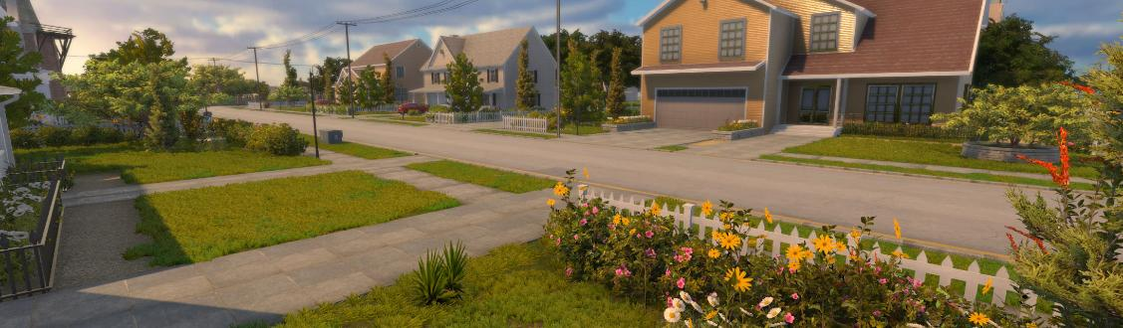
Company Structure
Core Values of Efficiency and Enthusiasm
We hope this proposal has demonstrated ForgeFX’s commitment to delivering high-quality, effective training solutions for the people who operate complex machinery in demanding real-world environments. We believe immersive simulation training provides a safer, more efficient, and more engaging way to build operational confidence, reinforce procedures, and reduce the risk of costly mistakes before trainees ever step into the field.
ForgeFX has a long track record of developing and delivering high-fidelity training simulations for clients across a wide range of industries. Our agile development process balances flexibility with predictability, allowing us to collaborate closely with clients while maintaining efficient production schedules and clear project visibility. By focusing resources where they create the greatest impact, we maximize development efficiency without compromising the quality, realism, or effectiveness of the final product.
We continually leverage advancements in real-time graphics, game engine technology, and immersive hardware to provide modern, scalable training solutions that evolve alongside industry needs. Just as importantly, our team brings genuine enthusiasm and passion to every project. ForgeFX leadership works directly with clients throughout development, creating a collaborative environment built on responsiveness, innovation, and shared commitment to success.
Taken together, these core values of efficiency, innovation, and enthusiasm make ForgeFX uniquely qualified to develop simulation-based training solutions for your organization. We appreciate the opportunity to present this proposal and look forward to the possibility of working together to bring your simulator project to life.
Thank you for your interest in our development services, and please contact Mary Pierce if you have any questions or would like to discuss next steps.

Slide 20
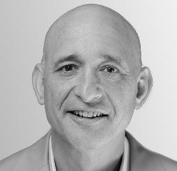

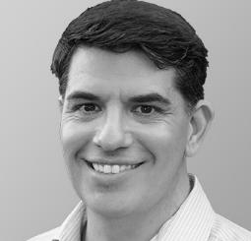
Company Leadership
Executive Team
GREG MEYERS | CEO & Co-Founder
As Executive Producer for projects, Greg establishes and manages client relationships and develops and negotiates project scope and contracts. Prior to founding ForgeFX, Greg was a front-line participant in the landmark dot-com era, working at digital content development agencies; including Sapient’s Rich Media Group and Red Sky Interactive––one of the world’s most-awarded agencies at the time.
ADAM KANE | CTO & Co-Founder
As ForgeFX’s CTO and co-founder, Adam brings to the table a unique blend of technical expertise and strategic insight that serves both ForgeFX and our clients. Continually scanning the horizon for key trends, he shapes the technology roadmap for us and our clients. His commitment to pioneering immersive experiences has steered both ForgeFX and our clients from the realm of VR, through the landscape of AR, and now into the transformative world of AI.
DAVID VAILLANCOURT | COO & Co-Founder
David manages the art production staff, which includes user interface designers and 3D modeling and texturing artists. Prior to founding ForgeFX, David worked with both Greg and Adam in Sapient’s Rich Media Group. Before that, he was at the video game company Presage, working on cutting-edge real-time interactive 3D web graphics, as this was first becoming possible in the late 1990s.

Slide 21


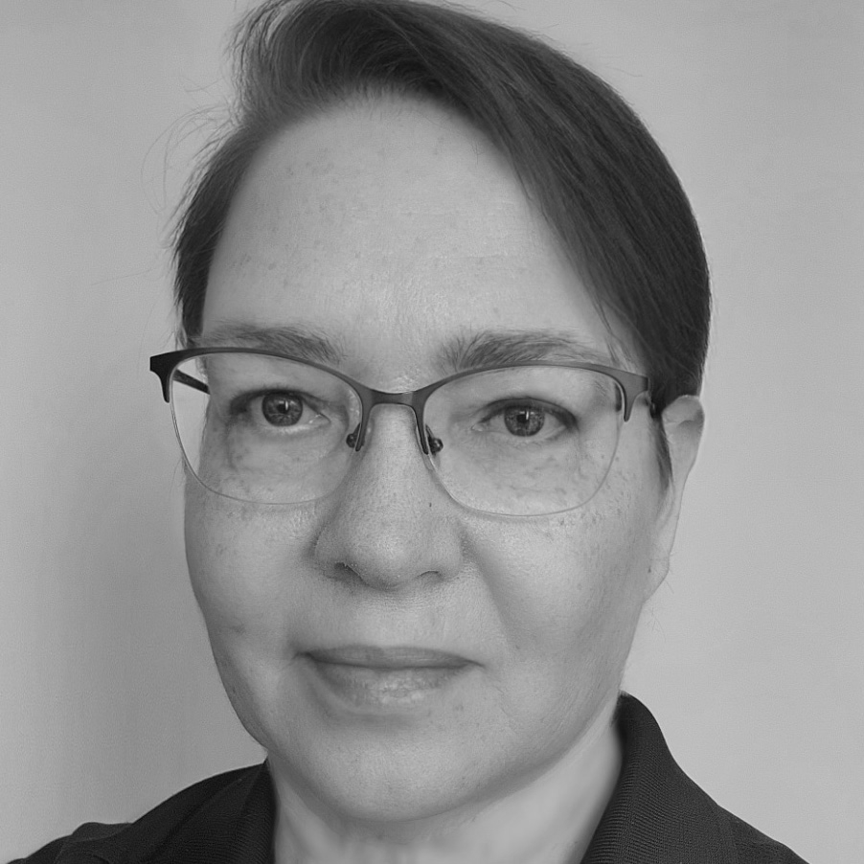

Project Team Leads
ForgeFX Development Team Leaders
Mary Pierce | Executive Director of Enterprise Partnerships
Mary spearheads strategic collaborations with organizations across a wide range of industries. Her primary objective is to address critical training, operational, and educational requirements within these industries by leveraging ForgeFX's expertise in developing custom, immersive, and interactive simulators. Mary has nearly 20 years of experience managing complex portfolios, leading cross-functional teams, and establishing and maintaining customer partnerships to meet strategic business objectives.
GENEVIEVE MOORE | Chief Creative Officer
Genevieve is an award-winning interactive designer who oversees the user interface design of our products. Bringing over 20 years’ worth of design experience for multiple platforms, she ensures that our simulators reflect the branding and positioning of our clients, while keeping them intuitive and easy for their customers as well.
RIVER COX | Production Director
River oversees multiple product development teams across disciplines, ensuring smooth and efficient collaboration between product teams. He works closely with clients, project managers, and individual contributors to align on the requirements of each project. Beyond strategizing and streamlining processes, River actively engages in hands-on development, creating custom features and tools to push the boundaries of what simulations can offer.

Slide 22



Project Team Leads
ForgeFX Development Team Leaders
JONATHAN COX | Project Manager
With over a decade of experience spanning video game development, digital marketing, and entertainment technology, Jonathan has led the successful delivery of hundreds of projects for globally recognized brands in entertainment and technology such as Disney, Amazon, and Meta. Jonathan’s expertise lies in forging strong partnerships and navigating complex initiatives with adaptability and strategic insight.
DEVIN CALAHAN | Project Manager
Devin bridges the gap between clients and his project development team. With over 10 years of management experience, he ensures that client needs align seamlessly with project goals. Devin takes an idea-driven and enthusiastic approach to development, fostering innovation and exploring what’s possible to deliver the most effective simulation-based training solutions.
RACHEL CALGARO | QA Manager
Rachel oversees the quality assurance process at ForgeFX. As QA manager, Rachel and the QA team work closely with the development team throughout the production of each simulator we create, testing the application as it gets built to ensure a bug-free delivery. Rachel’s attention to detail and methodical testing and reporting methods guarantee that upon release, your software will work as expected, without issue.

Slide 23







Project Specialists
Development Team
ForgeFX has assembled a team of professionals across a wide set of talents, who collectively follow the creative thought process of interactive 3D simulation and visualization development from inception all the way through to deployment.
3D Graphics Specialists
Our modelers excel at re-creating practically anything under the sun, from sweeping landscapes to the smallest internal parts of medical imaging equipment. The backbone of our realistic simulators is the verisimilitude that our modelers deliver, scrupulously replicating both the physical features and the kinetic properties of our clients’ products.
Game Engine Specialists
To bring our 3D models to life, we rely on our code developers to duplicate the physical functions and interactive details in response to the users’ actions. They program hydraulics to respond to joystick actions, simulate the particle physics of fluids, gases, soil, and metal, create soundscapes generated by engines and environments, and replicate the functionality of clients’ software interfaces.
Development Tools Experts
Behind the scenes but essential to our development process are the specialists who maintain the superstructure that interconnects the various departments. Our experts maintain our schedules, administer our Kanban task boards, perform quality assurance testing, and expand our internal ForgeSIM™ Framework capabilities.

Slide 24
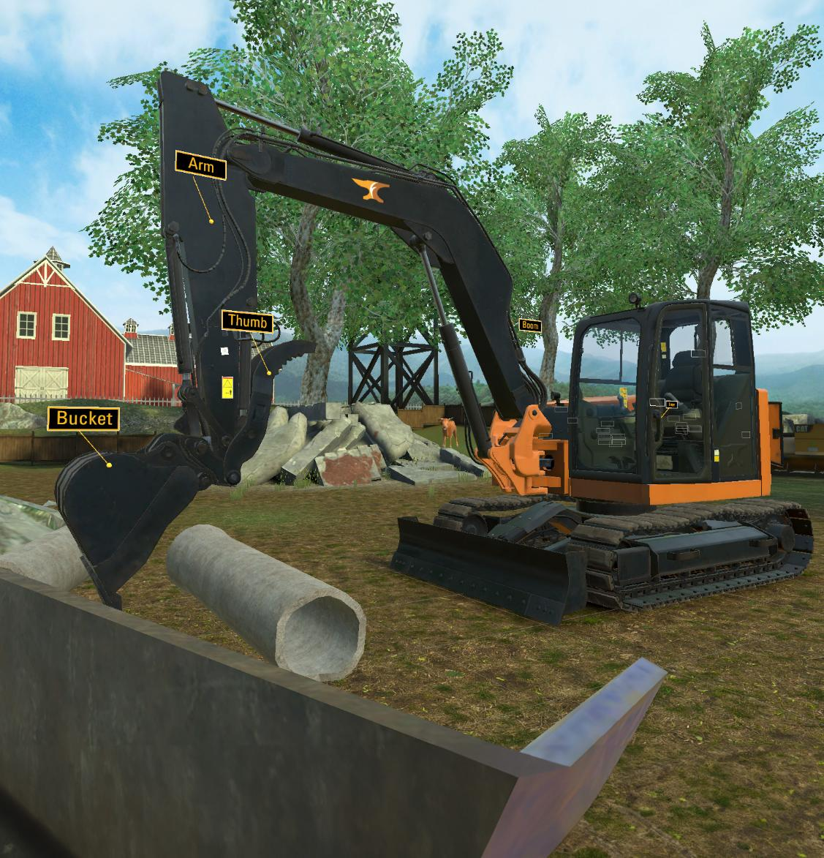
Appendix B: Recent Projects
Since 2002, ForgeFX Simulations has focused on the development of highly interactive 3D training simulations for clients across a wide spectrum of industries. The simulation-based training that ForgeFX has developed for our clients has set them apart as innovators in their industries. This section includes a collection of some of ForgeFX’s latest development efforts for our clients.

Slide 25







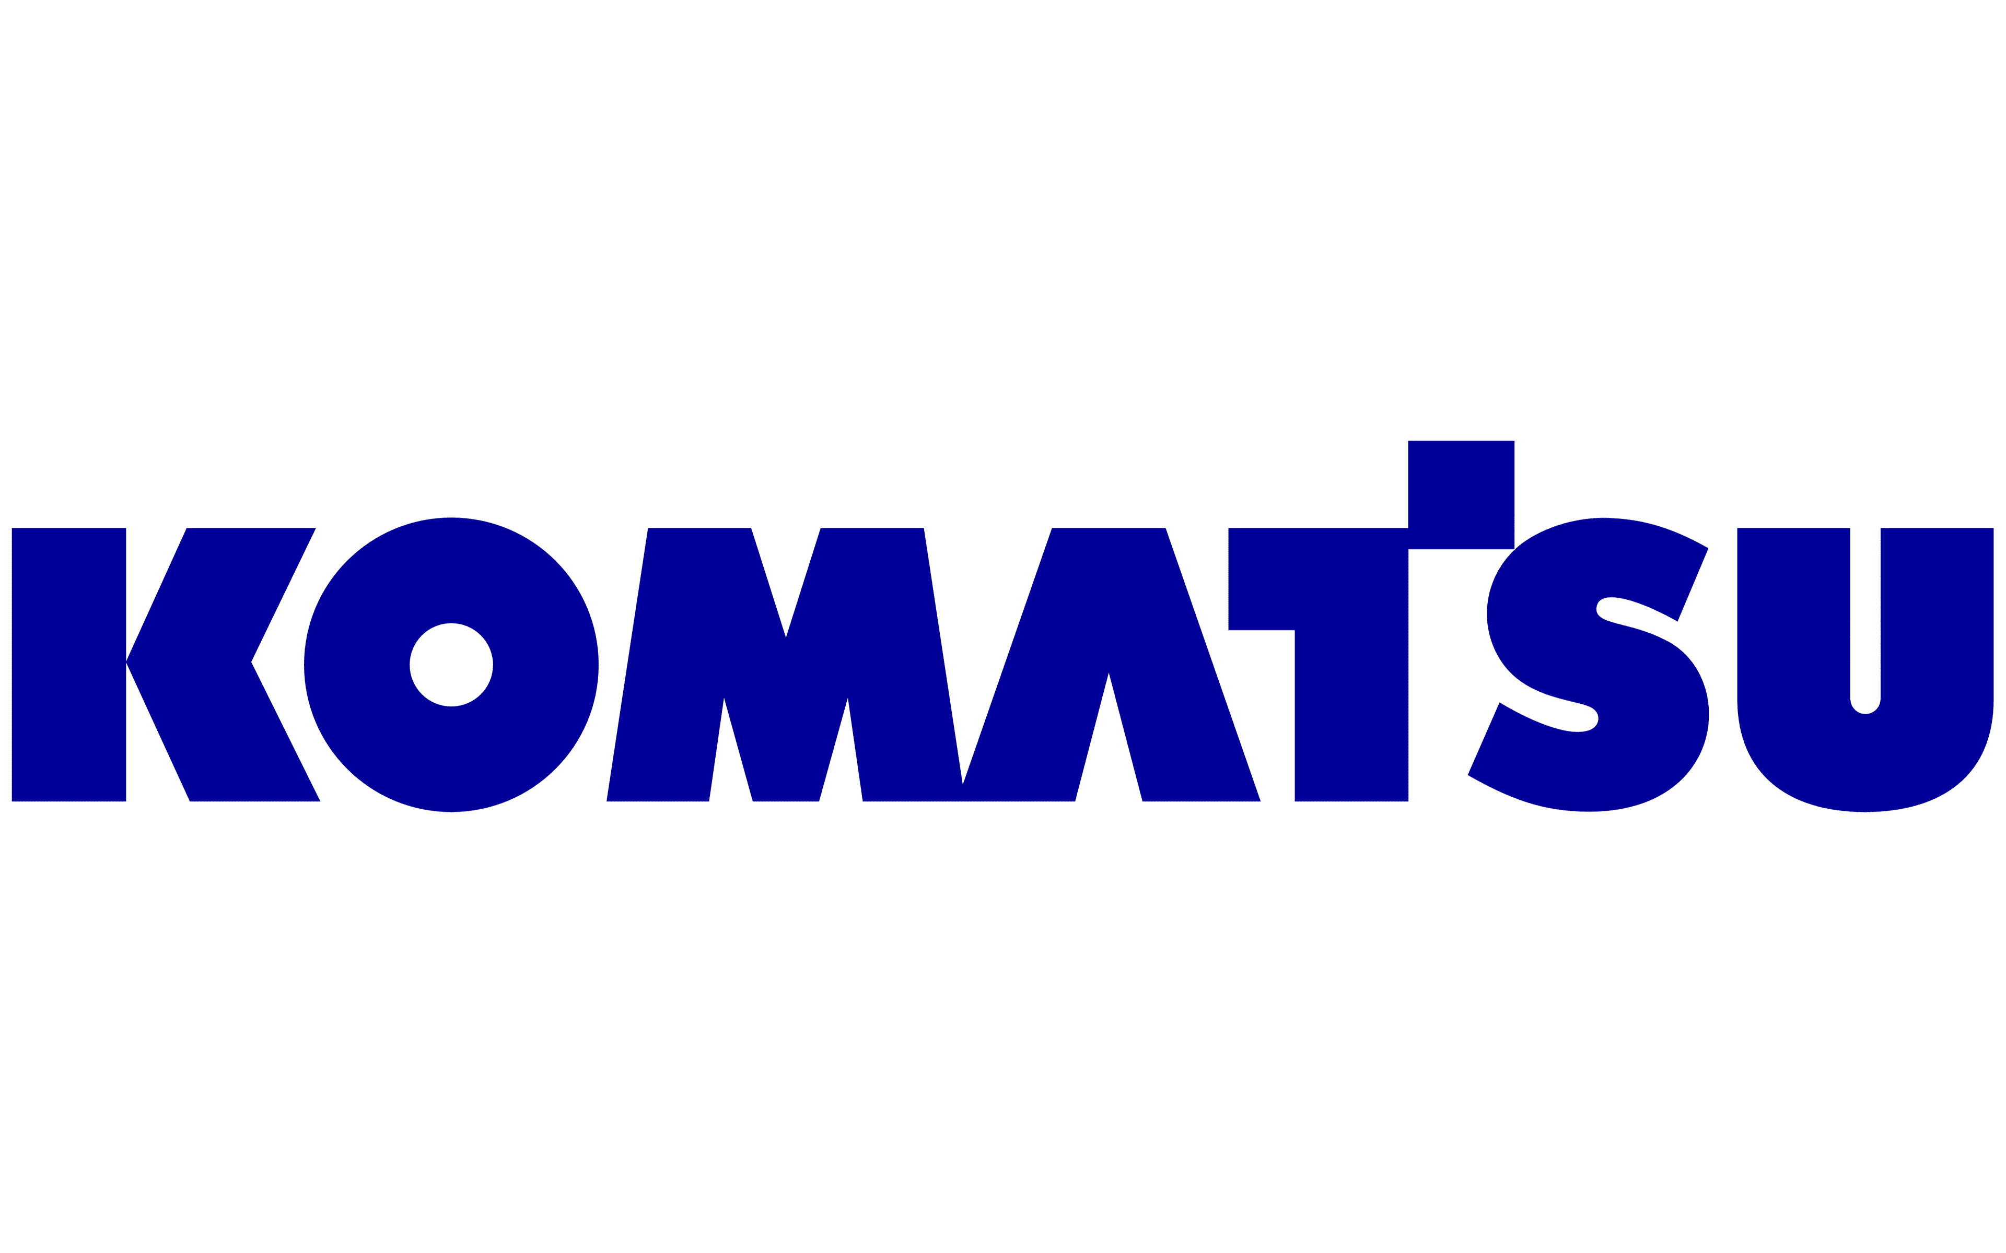


Selected Clients
A collection of our clients and the work we’ve done for them.
Operational instructions and testing for multiple construction machines.
Hydraulic workover station instruction simulator for the Meta Quest 3 platform.
Commercial training simulator for the 308 Mini Hydraulic Excavator.
OcuWeld welding instruction simulator for the Meta Quest 2 platform.
Unmanned vehicle tele-operation training simulator.
AR, VR, PC, tablet & real-world operator training simulators for access equipment.
Horizontal Directional Drill training simulator for both VR and flat-screen modes.
Virtual reality aircraft de-icing operator training simulators for PC and real-world controls.
Simulation-based training application for employee safety training.
Simulation and AR-based training applications for MR,
CT and XV machines.
Underground and surface mining equipment operator training simulators.

Slide 26
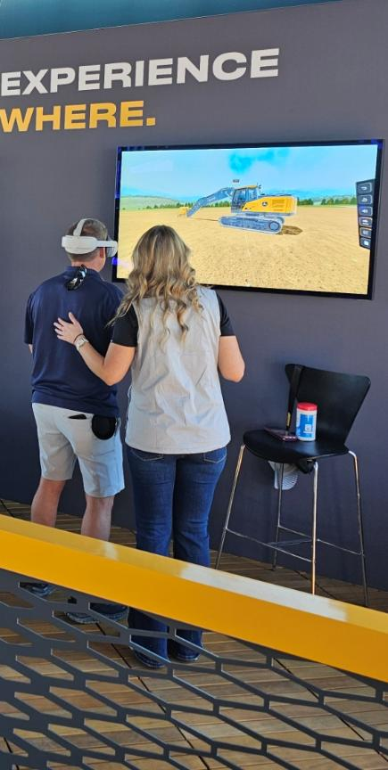
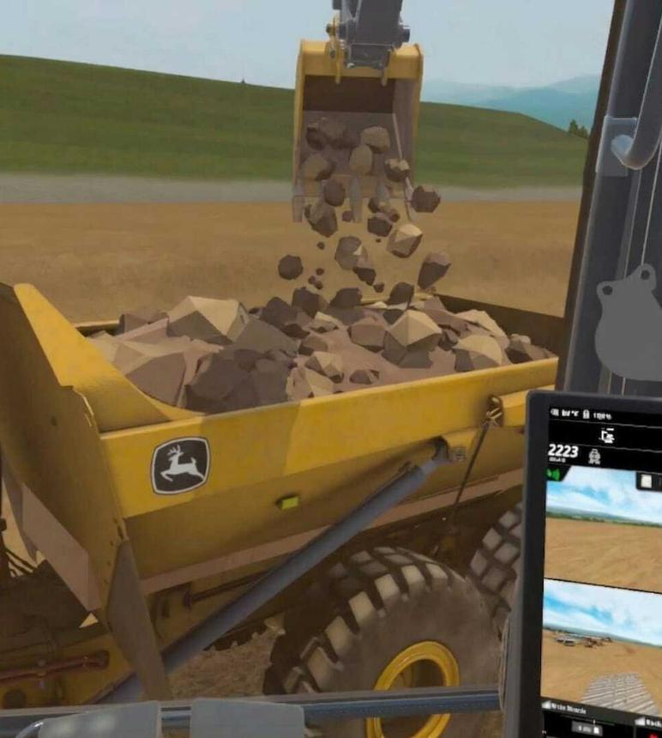
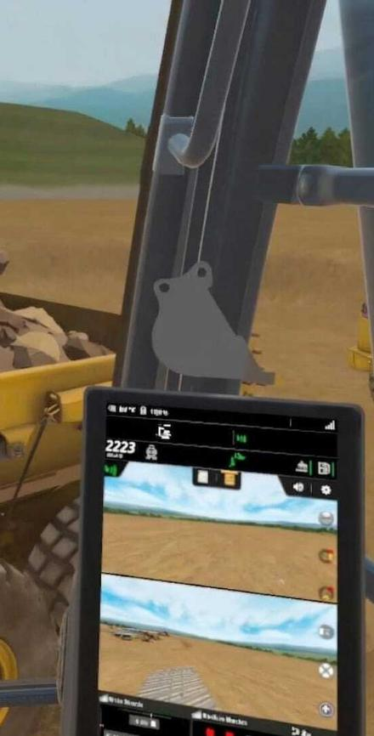


CASE STUDY: JOHN DEERE
Extended Reality Training System
ForgeFX recently partnered with John Deere to develop the Extended Reality Training System, designed to help operators, dealers, and customers learn construction machine operation, maintenance, and product features in a virtual environment. The system supports safer, more accessible training by allowing users to build skills and familiarity before working with physical equipment.
The XR Training System is delivered on portable Meta Quest 3 and Pico 4 Ultra Enterprise headsets and includes both virtual reality and augmented reality experiences. Users can complete guided lessons, perform hands-on maintenance tasks, explore machine systems, and participate in interactive challenges that reinforce learning through repetition and feedback.
DESIGN
Read more

Slide 27
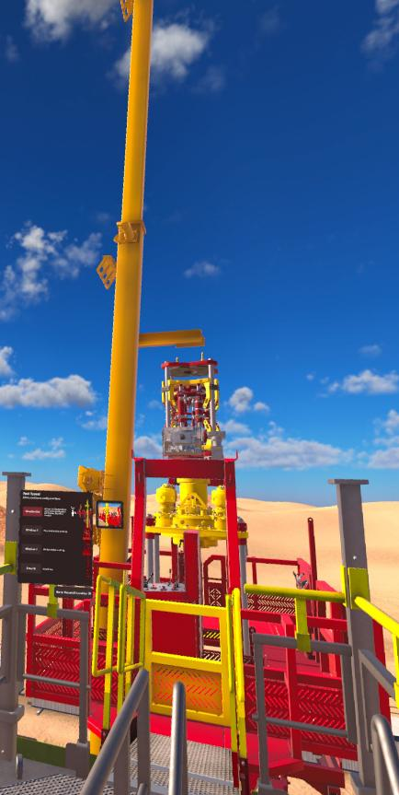
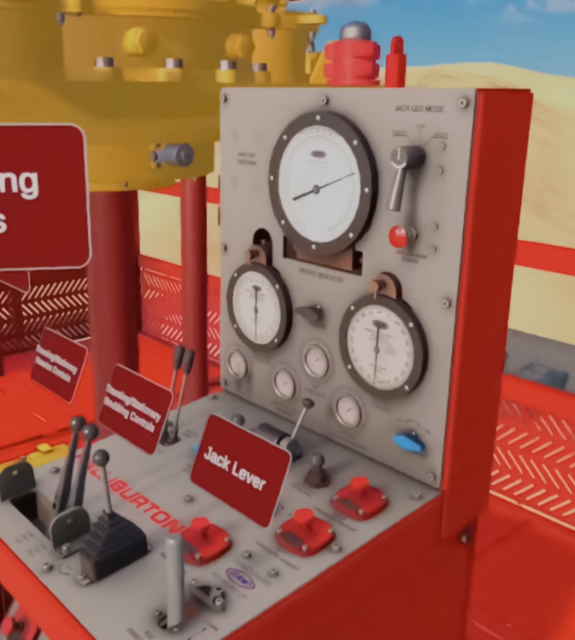
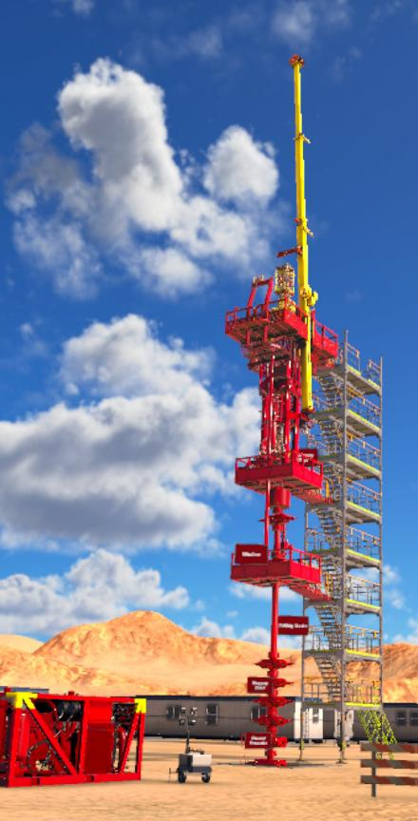
CASE STUDY: Halliburton
HWO Simulator
ForgeFX recently partnered with Halliburton to develop the HWO Simulator, an immersive virtual reality training solution built around a full-scale, interactive model of the 225K SafeGrip® Quick Rig Hydraulic Workover Unit. The simulator enables trainees to identify components, understand system layout, and practice equipment operation in a virtual environment that improves familiarity, reinforces learning, and reduces the risks associated with real-world training. Delivered on Meta Quest 3 headsets, the HWO Simulator combines guided instruction, interactive controls, and hand-tracked user interaction to create a highly realistic training experience. Trainees can navigate the rig, engage with control panels, and follow step-by-step tutorials supported by integrated instructional content.
DESIGN
Read more

Slide 28
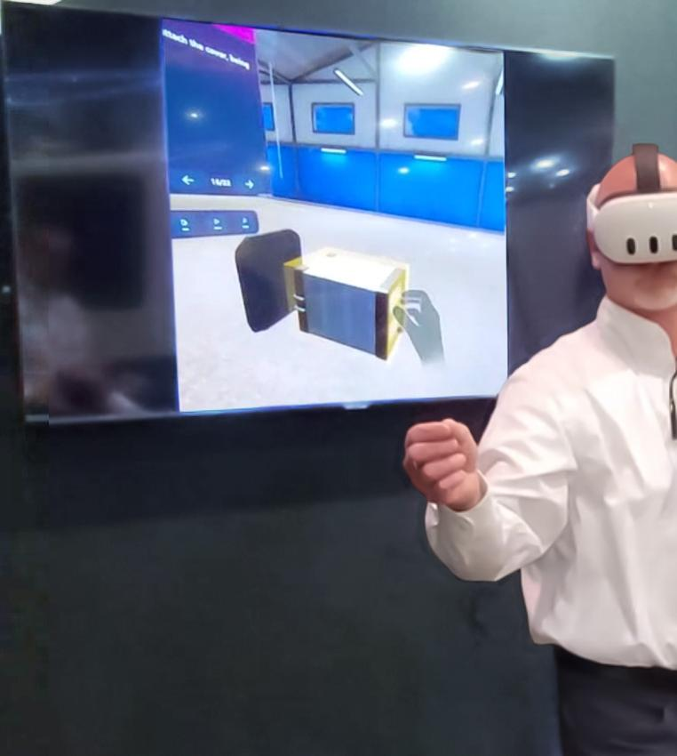

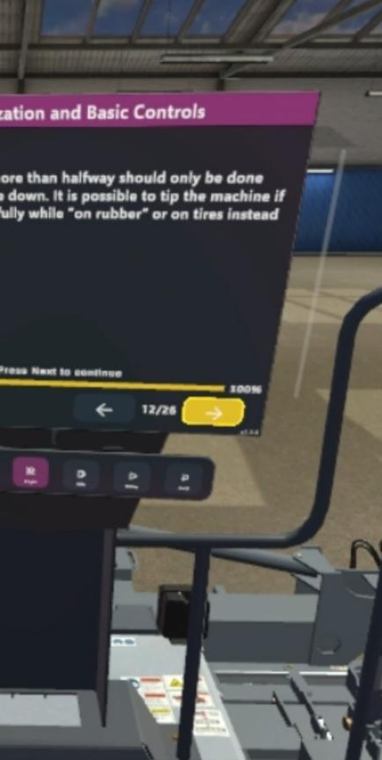
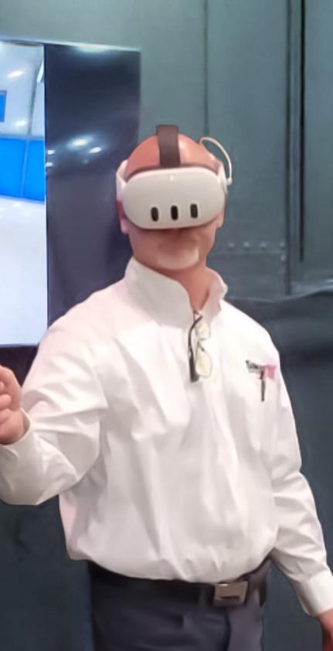


Somero Enterprises
CASE STUDY: SOMERO S-22EZ LASER SCREED
Concrete Screeding Trainer for Meta Quest
ForgeFX is excited to announce our recent development of the Meta Quest-based S-22EZ Laser Screed Simulator for Somero Enterprises, Inc. The simulator provides a detailed and accurate digital replica of the S-22EZ Laser Screed cockpit with simulated physical controls, buttons, and mechanical and visual feedback solutions. The Meta Quest’s superior hand-tracking capabilities allow for a fully immersive experience without the need for physical hardware controls. The simulator incorporates a robust system for tracking trainee performance and presents them with a scorecard at the end of their session. This feature provides valuable insights into the progress of each trainee, enabling trainers to identify areas of strength and areas for improvement.
EDIT
Read more

Slide 29
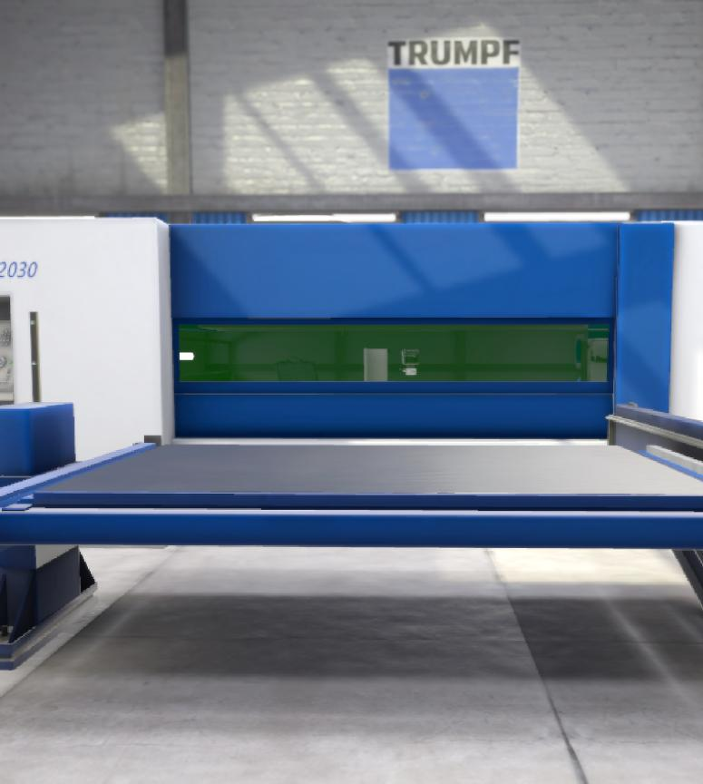
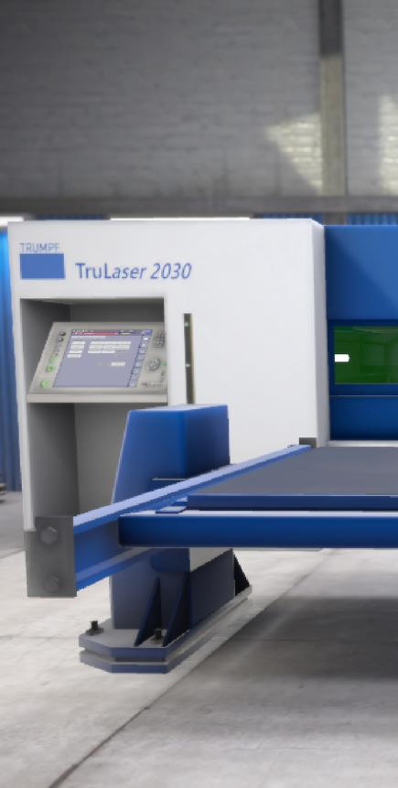
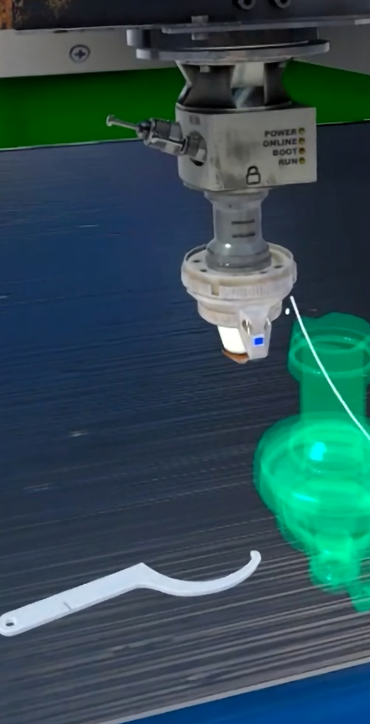

StrataTech Education Group
CASE STUDY: TRUMPF TRULASER 2030
EDIT
Meta Quest-Powered Training
ForgeFX recently joined with Trumpf to develop TruLaser 2030, a VR simulator that educates students in how to replace the protective glass of the TruLaser 2030 fiber machine.
ForgeFX chose the Meta Quest headset because it meets important criteria such as a comfortable design for long use, a wide field of view, adjustable PPD, good battery life, modest cost, comfortable fit, and ease of use. Specific features that the application includes are the ability for a group to observe what’s going on in the headset, by wirelessly casting a live feed to any external display; and the ability to record, save, and share training session videos in .mp4 format.
Read more

Slide 30
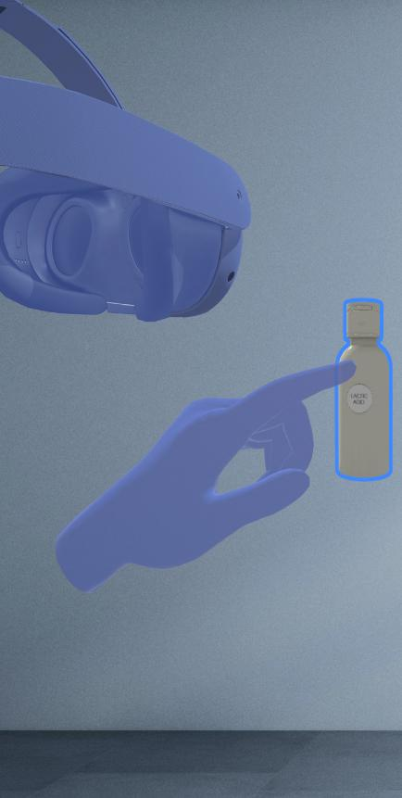
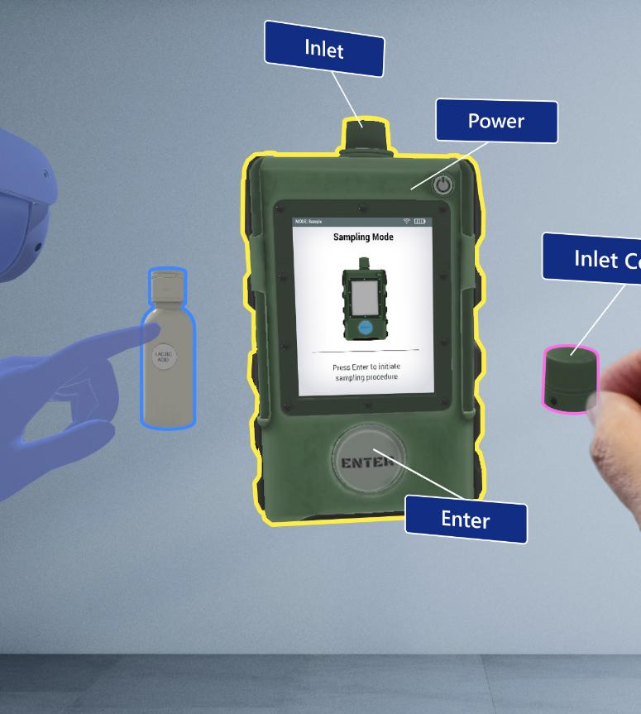
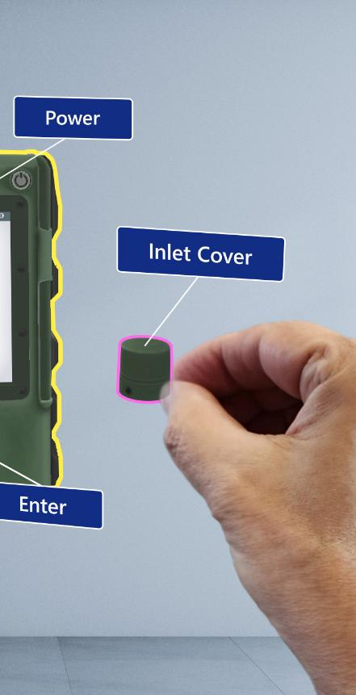
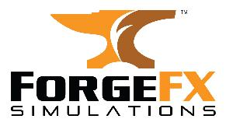
Mixed Reality Trainer
CASE STUDY: MIXED REALITY TRAINER
Demonstrating AR Expertise
This application is a demonstration of a typical familiarization tutorial in an Augmented Reality training simulation. Wearing a Meta Quest, users can follow tutorial steps that teach the components and use of a material sampling and analysis device. Similar to the ForgeFX Showcase, the Mixed Reality Trainer is a multi-user virtual environment in which participants can speak to and interact with each other and with the virtual objects. This is another example in which we both demonstrate our proficiency with various Mixed Reality platforms and exemplifies the advantages of collaborative training.
Read more

Slide 31
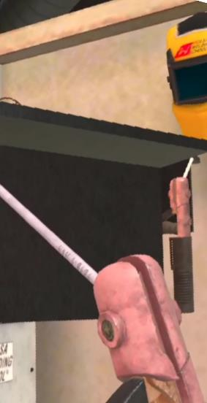
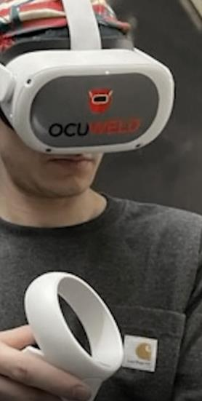
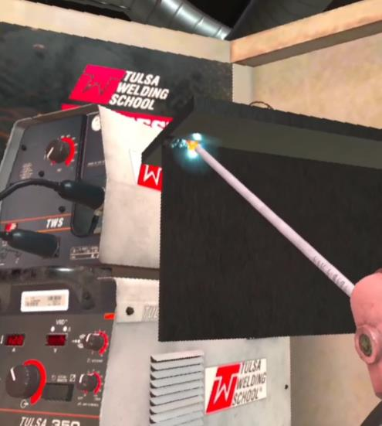

StrataTech Education Group
CASE STUDY: STRATATECH EDUCATION GROUP
OcuWeld Welding Trainer for Meta Quest
ForgeFX recently worked with Tulsa Welding School and The Refrigeration School, Inc., to develop OcuWeld™, a virtual reality welding education simulator that teaches students how to prepare, grind, and join materials in a virtual environment that removes the safety and cost concerns.
Students are assigned a Meta Quest headset on which OcuWeld is installed. Via OcuWeld, they log in to their Canvas learning management system accounts. ForgeFX worked closely with StrataTech to accurately reproduce the effects of welding with various types of torches and materials, mimicking as closely as possible the hands-on feel and physical effects of real-world tools.
Read more

Slide 32
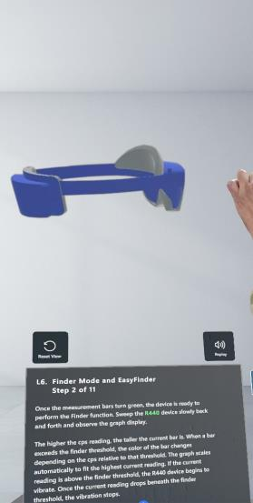
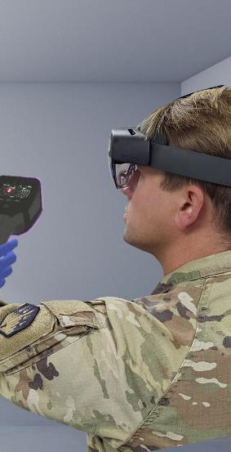
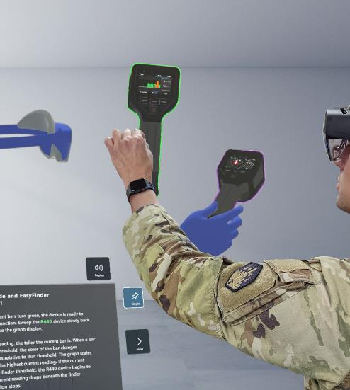

JPEO-CBRND: HoloTrainer
EDIt
CASE STUDY: JPEO-CBRND
CBRND HoloTrainer
ForgeFX collaborated with MRIGlobal to develop the CBRND HoloTrainer, an augmented reality device training simulator built for the Microsoft HoloLens 2. The CBRND HoloTrainer instructs trainees in the familiarization, operation, and maintenance of chemical, biological, radiological, and nuclear detection devices by providing holographically projected interactive 3D virtual versions of the equipment they need to learn to use. Trainees follow interactive narrated tutorial steps that teach the components and use of the devices and can learn collaboratively in a shared multi-user environment.
Read more

Slide 33
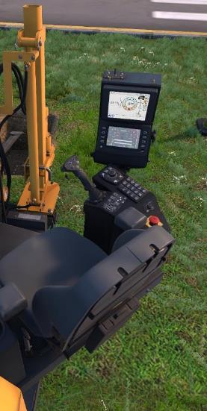
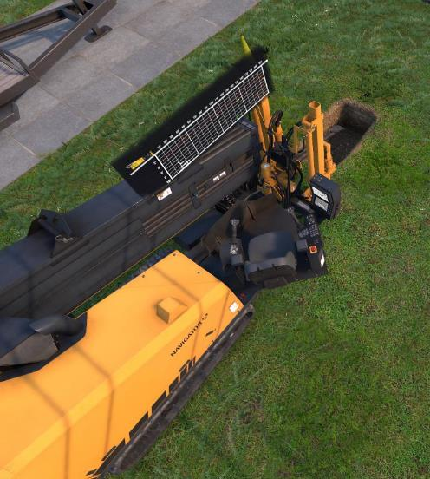
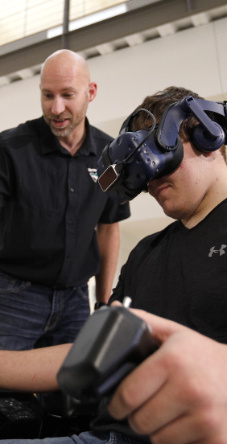

Vermeer Corporation
CASE STUDY: VERMEER CORPORATION
HDD Fundamentals
With infrastructure development and underground utility installations rising around the world, the need for skilled horizontal directional drill (HDD) operators is skyrocketing. To meet this growing demand, market leader Vermeer Corporation partnered with ForgeFX Simulations to develop the HDD Fundamentals training tool for real-world simulators combined with virtual reality via the HTC Vive platform.
The simulator features tutorials covering underground-utility checks, soil types, bit selection, mixing-machine operation, bore planning, pipe feeding, and drill operation.
Read more

Slide 34
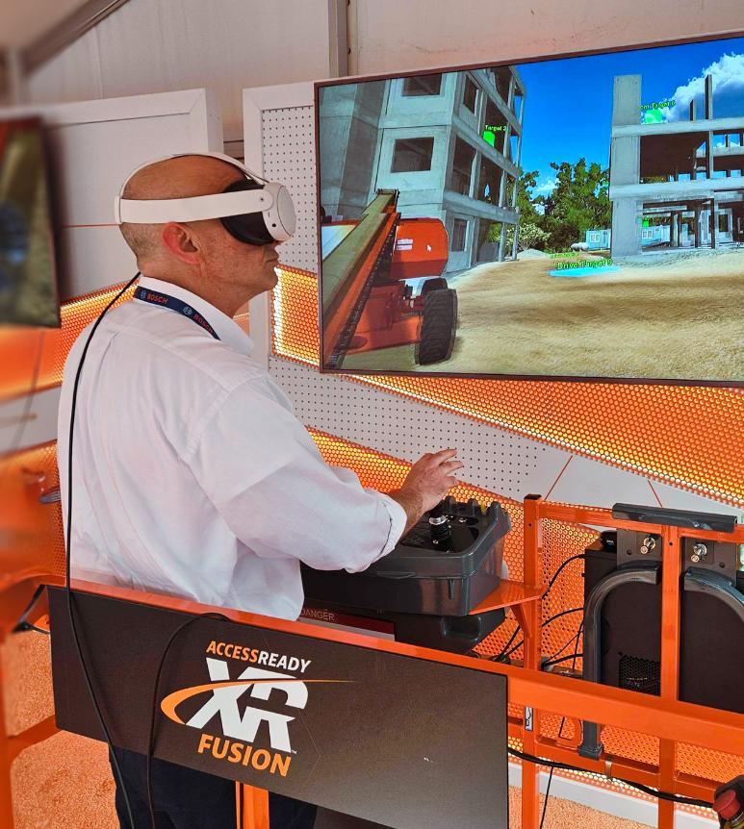
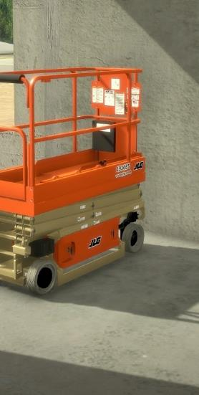

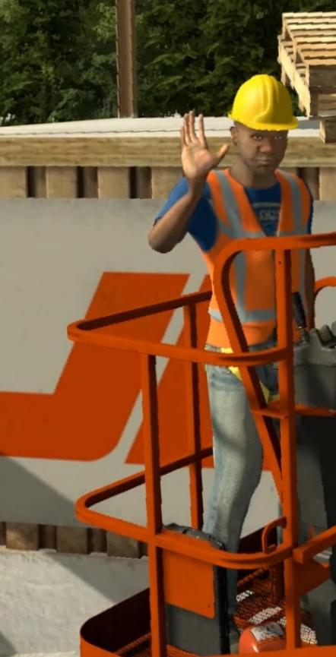

JLG Industries
CASE STUDY: JLG INDUSTRIES
A Long-Standing Partnership
Since 2014, ForgeFX has developed several simulator solutions for JLG Industries, the world’s leading manufacturer of aerial work platforms, telehandlers, and other access equipment. ForgeFX has not only developed simulators that provide training on various types of equipment but has also designed a Scenario Builder for JLG in which trainers can create and edit their own custom training scenarios.
JLG training simulators run on iPad, laptop, and VR-enabled equipment. ForgeFX recently upgraded the VR systems from HTC Vive to Meta Quest, adding the benefits of untethered hand tracking and more responsive equipment interaction.
EDIt
10-Year
Partnership
Read more

Slide 35
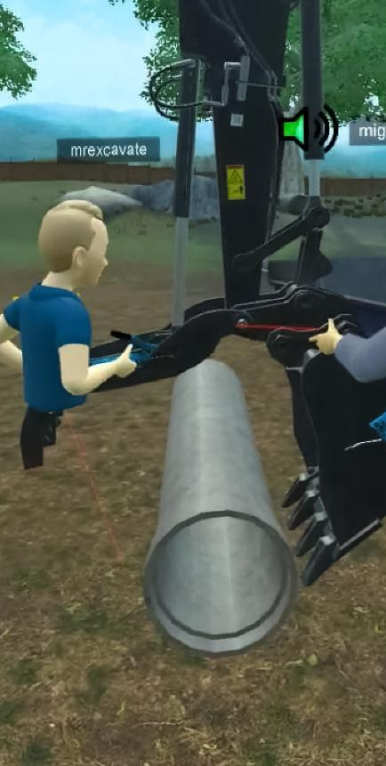
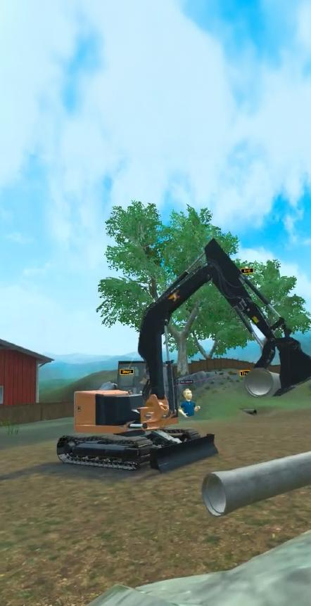
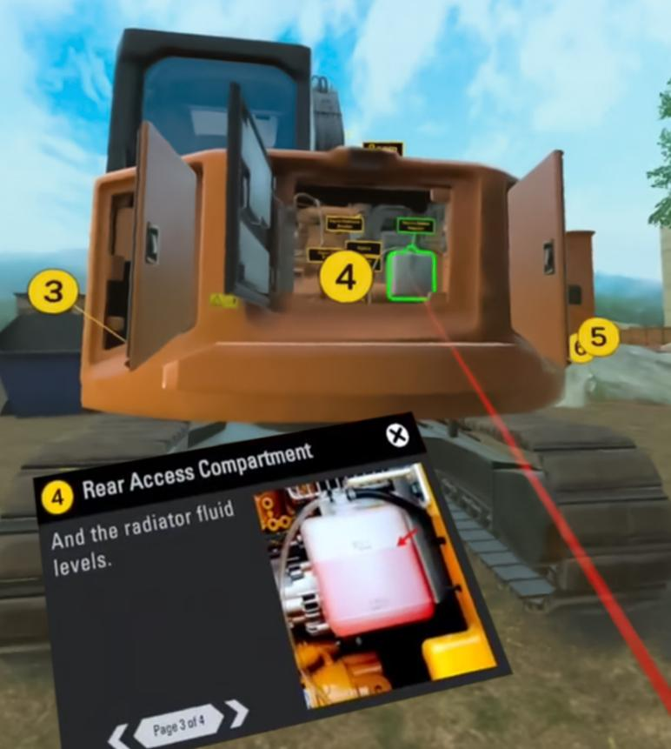
ForgeFX Showcase
CASE STUDY: FORGEFX SHOWCASE
Leveraging Meta Quest Development Tools
ForgeFX made ample use of the Meta Quest Developer Hub and other support offered by Meta to create this VR showcase application. Because the demonstration is most effective as a multi-user experience, ForgeFX used the Meta Avatars SDK to allow users to easily project their presence into the simulation.
This application melds technology and education to deliver an immersive experience that transcends conventional sales methods. Inside the application, users take command of an excavator and perform pre-inspection steps and place pipes into a dumpster. This multi-user VR environment provides a real-time virtual meeting space where we not only show off our expertise but also demonstrate the benefits of multi-user training for both education and sales opportunities.
Read more

Slide 36
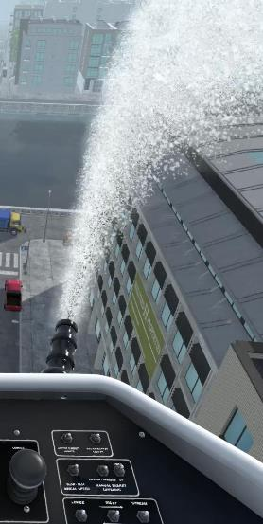
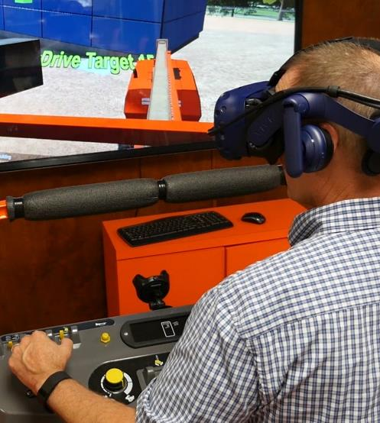
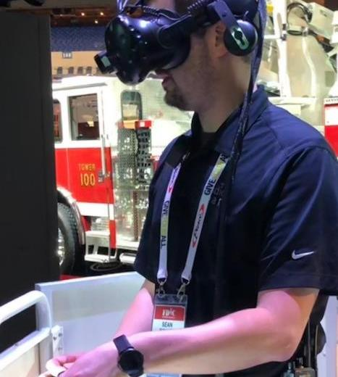


Pierce Manufacturing
CASE STUDY: PIERCE MANUFACTURING
Heavy-Duty Sales Tool
ForgeFX Simulations is honored to be a simulation development partner for Pierce Manufacturing, one of the largest fire apparatus producers in the world. ForgeFX worked with Pierce to develop the Pierce Ascendant® 100 Heavy Duty Aerial Tower Fire Truck Simulator for real-world simulators combined with virtual reality via the HTC Vive platform. Pierce is an Appleton, Wisconsin-based manufacturer of custom fire and rescue apparatus and a wholly owned subsidiary of Oshkosh Corporation. ForgeFX has been a simulation development partner with Oshkosh for more than five years and currently supports its Pierce Manufacturing and JLG Industries brand, by providing simulation development services for a wide array of equipment and trucks across industry sectors.
Read more

Slide 37




FedEx
CASE STUDY: FEDEX
Airport Ramp Safety Training
For FedEx, ForgeFX developed a productivity- and safety-focused simulator geared towards training freight handlers. There are various scenarios in which the trainee must indicate the safest procedure in a particular situation. After the trainee has made their choice, they watch an animated cut scene which illustrates the results. Proper choices result in efficient, effective, safe, and successful completion of the operation. A visceral demonstration of unsafe practices is the result of incorrect choices.
DESIGN
Read more

Slide 38



Caterpillar
CASE STUDY: CATERPILLAR
Excavator Operation and Maintenance Training
The CAT All Access Pass Experience simulator is a robust training and sales tool for the 308 model Mini Excavator. It is intended to be used by both showroom sales teams and end consumers who wants to practice operation of the machine. Inside either American or Mexican environments, the user can choose from a wide menu of activities including control familiarization, hammer and basket tutorials, and even a game of skill in the arena.
More importantly, the simulator includes both machine inspection and maintenance walk-throughs. The user is guided step-by-step through these crucial and complicated tasks on a highly detailed virtual model of the excavator to ensure comprehension of the many elements required.
DESIGN
Read more

Slide 39




JPEO-CBRND: RENDR Tele-Op
CASE STUDY: JPEO-CBRND
RENDR Tele-Op Simulator
This unmanned vehicle teleoperation training simulator was developed by ForgeFX Simulations and MRIGlobal for the Joint Program Executive Office for Chemical, Biological, Radiological and Nuclear Defense (JPEO-CBRND). The JPEO-CBRND is responsible for the development, acquisition, fielding and life-cycle support of chemical, biological, radiological and nuclear defense equipment and medical countermeasures. The training simulator allows soldiers to learn how to operate the unmanned vehicle, along with the suite of sensors it contains.
Read more

Slide 40





GE Healthcare
CASE STUDY: GE HEALTHCARE
AR-Based Training
ForgeFX developed several virtual training simulators for GE HealthCare, including applications for MR, CT, and Vascular services field engineers. These training simulators allow GE HealthCare technicians to train in the technical maintenance of diagnostic imaging apparatus on a standard computer, without the need for access to the real-world equipment. Trainees use the simulator to learn how to conduct the corrective and planned maintenance procedures and practice these tasks associated with each piece of equipment.
DESIGN
Read more

Slide 41





Global Ground Support
CASE STUDY: GLOBAL GROUND SUPPORT
VR-Based Training
Recently upgraded from the Oculus Rift to the Meta Quest platform, Global Ground Support’s VR Deicer Simulator is available to customers worldwide. This networked multiplayer VR training simulator allows for safe, effective and cost-cutting training. Trainers have the ability to generate more than a million different situations for their trainees, choosing aircraft model and detailed environmental conditions: temperature, wind speed and direction, precipitation level and type. The simulation provides year-round instruction in the use of GGS deicers, with greater flexibility and at a lower cost than traditional training. No real-world equipment is taken off the line and no expensive consumables, such as fuel, oil and deicing fluids, are required.
DESIGN
Read more

Slide 42



Komatsu
CASE STUDY: KOMATSU
Mining Equipment Simulations
ForgeFX is a proud partner of P&H Mining Equipment, a subsidiary of Komatsu. P&H Mining builds and supports a line of drilling and material-handling machinery for surface mining operations worldwide.
By providing a range of training simulators for underground longwall systems, surface mining equipment, and heavy earth movers, ForgeFX has established expertise in the creation of virtual training environments for complex machinery. Each of these custom simulators runs on both desktop computers and real-world physical control stations.
Read more

Slide 43
END

